Slide 1

INDUSTRIAL RELATIONS AND Labour Laws

Slide 2
INDUSTRIAL REVOLUTION
1760 : Industrial Revolution – Great Britain- spread to other countries
1830 :France ,Belgium , USA
1850 : Sweden and Japan
1870 -80 : Canada , USSR ,Japan , India

Slide 3
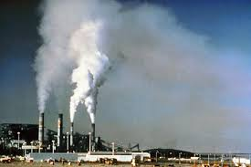
Agrarian , Artisans – use of machines in mass production (Industrialization)
Out-workers – people working at their homes with their own tools
REPLACED BY
Factory System –
Owners provided premises , machinery and means of production
Workers supplied their labor

Slide 4
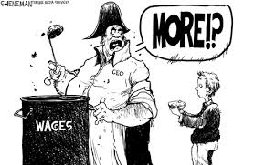
EMERGENCE OF TWO DISTINCT CLASSES
Capitalist Working
Class Class

Slide 5
Initial stages – industrialization – workers – uneducated , untrained and unorganized
Exploitation of labour – slaves , unhygienic working conditions , employment of children
Problems / Disagreements – Management / Workers
This led to both sides – studying the problems more closely – the need for IR – began
The size of modern companies – added to the dimensions of the relationship

Slide 6
Labour relations departments – added – to negotiate and administer – complex contracts – with union pressures
State – stepped in – exploitation of workers
Organized labour – began lobbying the government for favorable legislation to counter the management
Personnel departments – had to monitor compliance – with labour laws
Further on – Human Resource Departments were added

Slide 7
IR IS A TRI-PARTITE PROCESS
3 Tier system
MANAGEMENT
LABOUR
GOVERNMENT
(STATE)

Slide 8
INDUSTRIAL RELATIONS
All matters that arise in day-to-day association between employers , managers / supervisors and workers , and includes –
Relations between supervisors / managers and individual workers
Collective relations between employers and trade unions ; and
Role of government in regulation of these relationships.

Slide 9
COMPONENTS OF IR
Relations between manager / supervisor and individual workers
(Personnel Management)
(worker – absenting , chronic alcoholism, insubordination)
The collective relations between Employers and Trade Unions
(Collective Bargaining)
( revision of wages , profit-sharing , welfare measures for workers , improve working and living conditions)
The Role of Government in the regulation of these relationships
(Labour Legislation)

Slide 10
NATURE/ FEATURES OF IR
1) IR does not emerge in vacuum (emptiness) – born out of ‘employment relationship’.
Without – existence of two parties – labour and management – this relationship cannot exist
Industry – provides the environment- for IR
2) IR characterisized – both conflict and co-operation
(Focus of IR – study of relationships , practices and procedures developed by the parties to resolve or at least minimize conflicts)

Slide 11
3) The study of IR includes issues like – technology of the workplace , countries socio-economic environment , political environment , Nations labour policy, attitude of TU, employers and workers.
4 ) Both the groups (labor and management) develop different orientations and perceptions of their interests.
They generally , also develop negative images about each other.

Slide 12
5) IR involves the role of three players viz. Management , Labor and the State
6) The concept of IR , draws heavily from a variety of disciplines like social sciences , humanities , behavioral sciences , law , economics , sociology etc.
7) The levels covered by IR , range from, individual relations at the shopfloor to the regional , national and international bodies.

Slide 13
OBJECTIVES OF IR
To safeguard the interests -
labour and management
securing – highest level of - mutual understanding and goodwill among them.(TISCO)
To establish - growth of industrial democracy
labor partnership in – sharing of profits
& participative decision-making

Slide 14
To avoid - industrial conflict and strife.
To raise productivity to highest levels
To eliminate or minimize the number of strikes , lockouts and gheraos.
Vesting of a proprietary interest - workers in industries - in which they are employed.

Slide 15
Approaches
To
Industrial Relations

Slide 16
Approaches to Industrial Relations
Psychological Approach
Sociological Approach
Human Relations Approach
Gandhian Approach
System Approach
Human Resource Management Approach
2/20

Slide 17
Approaches to Industrial Relations (contd.)
The Oxford Approach
The Action Theory Approach
The Unitary Approach
The Pluralist Approach
The Marxist/Radical Approach
Weber’s Social Action Approach
Socio-Ethical Approach
3/20

Slide 18
Why So Many Approaches...?
The problems posed in the field of industrial relations cannot be solved within the limits of a single discipline, and hence it is bound to be inter-disciplinary in approach.
Any problem in industrial relations has to be approached on a multi-disciplinary basis, drawing from the contributions of a number of disciplines.
1/20

Slide 19

Psychological Approach
Problem of industrial relations lie in the perception and attitude of the participants.
Study by Mason Haire on the behaviour of two groups, namely, “Union leaders” and “Executives”.
4/20

Slide 20
Psychological Approach (contd.)
Results of Mason Study:
The general impression about a person is radically different when he is seen as a representative of management from that of a person as a representative of labour.
The management and labour see each other as less dependable.
The management and labour see each other as inadequate in thinking regarding emotional characteristics and inter-personal relations.
5/20

Slide 21

Sociological Approach
This approach includes various sociological factors like value system, customs, norms, symbols, attitude and preception of both labour and management.
As industrialisation gets momentum, a set of new industrial-cum-social patterns emerges. These influences shape the industrial relations.
Now a days industrial relations are determined by power.
6/20

Slide 22

Human Relations Approach
Human are not inanimate or passive.
Human are very complex to understand i.e. to manage.
Relationship during out of employment
situation.
7/20

Slide 23
What Influences Human To Work
Style of leadership
    Autocratic style
    Democratic style
Motivation (satisfy the dissatisfied needs)
    Physiological needs (food, water, clothing, shelter)
    Safety needs (physical, finance and job security)
    Social needs (belonging, affection)
    Egoistic needs (self-esteem and esteem from others)
8/20

Slide 24
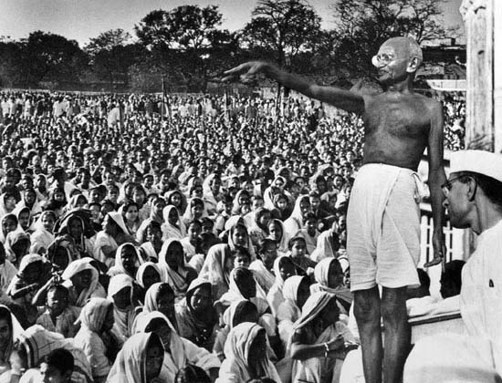
Gandhian Approach
Truth, Non-violence, Non-possession, Non-co-operation (Satyagraha), trusteeship...
Workers’ right to strike.
Concept of equality
9/20

Slide 25
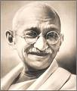
Gandhian Approach (contd.)
There is no room for conflict of interests between the capitalist and the laborers.
But what IF conflicts occur...?
  Should they go for strikes/lockouts...!
10/20

Slide 26
Gandhian Approach (contd.)
Two things that Gandhiji expect from workers
    Awakening
        Nurturing faith in their moral strength
        Awareness of its existence
    Unity
11/20

Slide 27
Gandhian Approach (contd.)
Gandhiji advocates
  Demands should be reasonable and through collective action.
  Avoid strikes as far as possible.
  Avoid formation of unions in philanthropic organizations.
  Strikes should be the last resort only.
  In case of organizing a strike, workers should remain peaceful and non-violent.
12/20

Slide 28
System Approach (by John Dunlop)
Focuses on
  Participants in the process
  Environmental forces
  Output
And their inter-relationship.
13/20

Slide 29
System Approach (contd.)
Environmental Forces
Participants
Outputs
Market or Budgetary Restraints
Technology
Distribution of Power in Society
Union – Management
Government
Rules of the Workplace
15/20

Slide 30
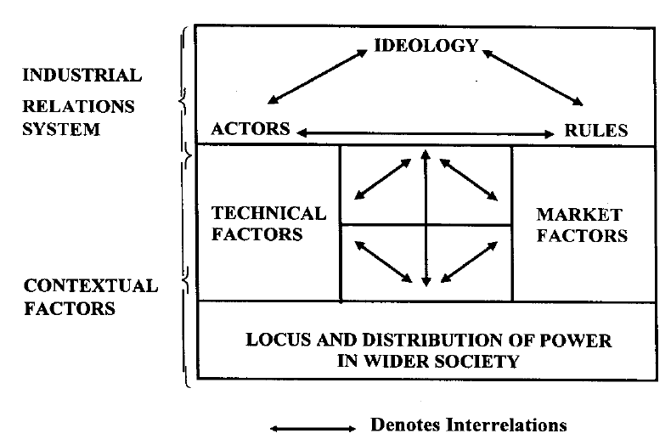
System Approach (contd.)
(Set of Ideas and Beliefs)
14/20

Slide 31
System Approach: Participants
The main participants are
  Workers and their organisations
  Management and their representatives
  Government agencies
16/20

Slide 32
System Approach : Environment
Three types of environments
Technological characteristics of workplace
(Technological sub-system)
The market or economic constraints
(Economic sub-system)
The ‘locus’ and ‘balance of power’ existing in society
(Political sub-system)
17/20

Slide 33
System Approach: Output
Output is the result of interaction of the parties/actors of the system which is manifested in the network of rules, country’s labour policy and labour agreements etc. that facilitate a fair deal to workers.
18/20

Slide 34
Human Resource Management Approach
The term, human resource management (HRM) has become increasingly used in the literature of personnel/industrial relations. The term has been applied to a diverse range of management strategies and, indeed, sometimes used simply as a more modern, and therefore more acceptable, term for personnel or industrial relations management.
19/20

Slide 35
HRM Approach (Contd.)
Some of the components of HRM are:
(i) human resource organisation
(ii) human resource planning
(iii) human resource systems
(iv) human resource development
(v) human resource relationships
(vi) human resource utilization
(vii) human resource accounting
(viii) human resource audit.
20/20

Slide 36
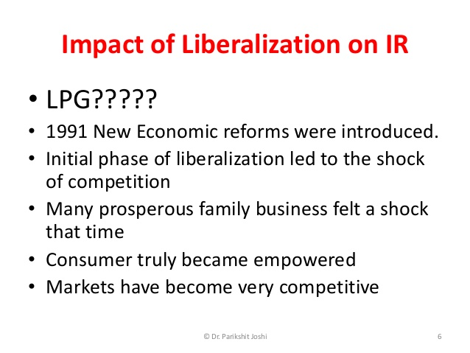

Slide 37
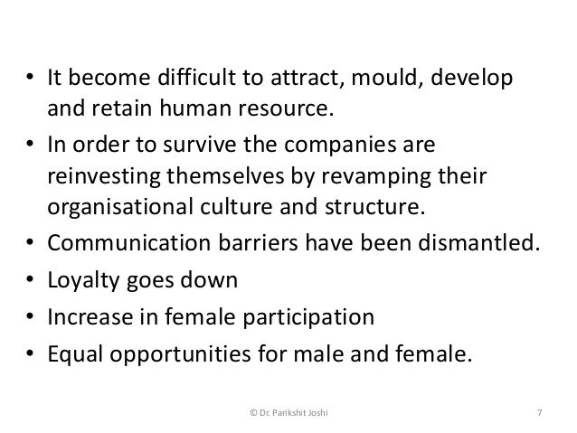

Slide 38
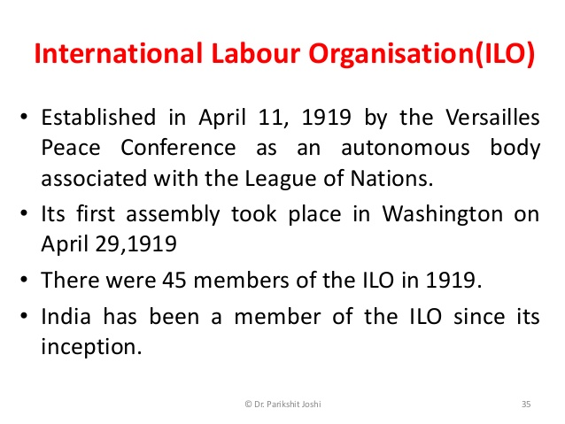

Slide 39
Only tripartite U.N. agency, the ILO brings together governments, employers and workers representatives of 187 member States , to set labour standards, develop policies and devise programs promoting decent work for all women and men.
the ILO's Decent Work agenda helps advance the economic and working conditions that give all workers, employers and governments a stake in lasting peace, prosperity and progress.

Slide 40
Three main bodies of ilo:
The International Labour Conference
It is an annual gathering of governments, workers, and employers from ILO member countries. The conference's goal is to discuss the organization's broad policies, establish and adopt international labour standards, and elect the governing body.
Governing Body
It is the ILO's executive body, responsible for policy decisions, setting the agenda for the International Labour Conference, adopting a budget, and electing the Director-General. It is made up of 56 titular members, of which 28 are held by governments and 14 by employers and workers, respectively. Ten of the titular government seats are non-elected, permanent seats held by states with the greatest industrial importance; India is one of these nations.
International Labour Office
It is the International Labour Organization's permanent secretariat, and it is in charge of the organization's administration as well as the implementation of technical cooperation activities, as well as programs for awareness, advocacy, and information sharing.

Slide 41
Impact of I.L.O’s Conventions on Labour Legislations in India
Factories and Mines Legislations with regards to aspects like hours of work, weekly rest, holiday with pay and wages a) Employment of children and young persons b) Employment of women at night c) Industrial health, safety and welfare.
Wage-legislations - India ratified Convention 26 on minimum wages fixing machinery in 1955 and amended Minimum Wages Act to constitute an advisory Committee to advise on this matter.

Slide 42
Social Security - A number of Conventions and Recommendations dealing with workmen compensation, sickness insurance, invalidity, old age and survivors' insurance, unemployment provisions, maternity protection and general aspects of social security have been adopted by the ILO. India has directly or indirectly adopted some of them in its laws.

Slide 43
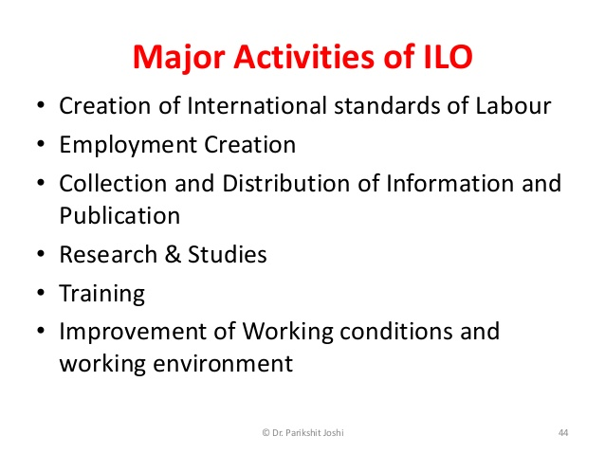

Slide 44
THANK YOU

