Slide 1
UNIT 3
Process of Organizing –
Span of Management,
Levels of Authority,
Delegation of Authority,
Decentralization of Authority,
Line and Staff Organization.

Slide 2
ORGANISING
Organizing- The process by which managers establish working relationships among employees to achieve goals.
According To Chester Barnard Organization Is Defined As
“A system of consciously co-ordinated activities or efforts of two or more persons”.
An Organization Defined
A deliberate arrangement of people to accomplish some specific purpose

Slide 3
Definition of Organizing
Activities:
Identification of activities
Grouping of Activities
Assignment of jobs to formal groups
Establishing a network of authority and responsibility
Providing framework for measurement, evaluation and control
Resources:
Determining the specific need of resources
Allocation of resources into specific groups
Evaluation and control of use of the resources

Slide 4
Organizing
Organizing is the process of arranging and allocating work, authority, and resources among an organization’s members so that they can achieve organizational goal.
Stoner, Freeman and Gilbert

Slide 5
Process of Organizing
Division of Work
Grouping of Work
Delegation of Authority
Coordination of Work

Slide 6
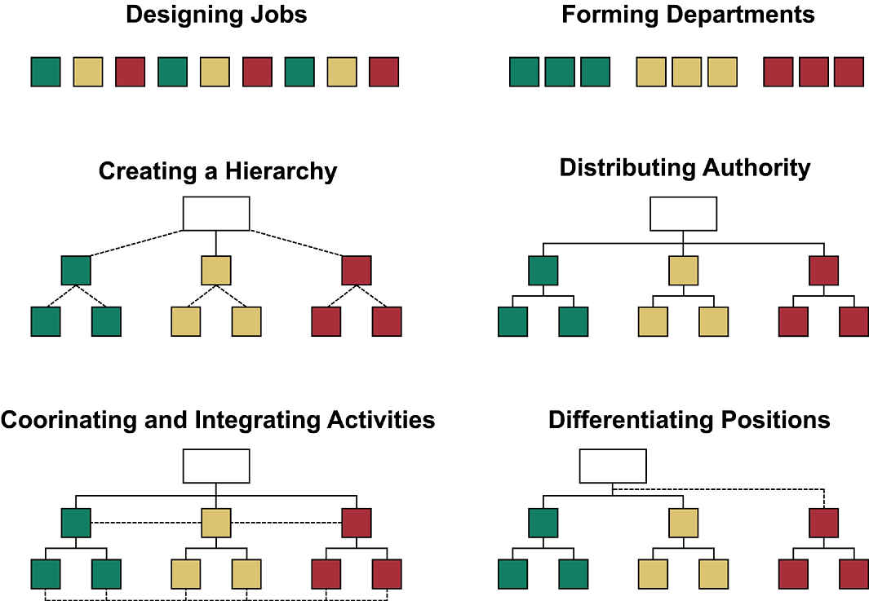
Process of Organizing simplified

Slide 7
Principles of Organizing
Exception
Efficiency
Balance
Homogeneity
Continuity
Simplicity
Unity of Objective
Specialization
Coordination
Authority and Responsibility
Unity of Command
Scalar Chain
Span of Control

Slide 8
Vertical differentiation
Tall versus Flat Structure
Horizontal differentiation
Functional Structure
Multidivisional Structure
Geographic Structure
Matrix Structure

Slide 9
Tall Versus Flat Organizations
Tall Organization
President
Flat Organization
President

Slide 10
Organizational architecture - Vertical integration
Tall Organization:
This type of organizational architecture has many layers and narrow span of control.
Flat organization:
This type of organizational architecture has few layers and wide span of control.

Slide 11
Establishing Reporting Relationships: Tall Versus Flat Organizations
Tall Organizations
Are more expensive because of the number of managers involved.
Foster more communication problems because of the number of people through whom information must pass.
Flat Organizations
Lead to higher levels of employee morale and productivity.
Create more administrative responsibility for the relatively few managers.
Create more supervisory responsibility for managers due to wider spans of control.

Slide 12
1. Functional structure:
Organizational Architecture – Horizontal Differentiation
General Manager
Production Dept
Finance Dept
Marketing Dept
HR Deprtment
Structure is created based on the various functions of an organization.

Slide 13
2. Multi-Division structure
Organizational Architecture – Horizontal Differentiation
General Manager
Division I
Division II
Division III
Multiple divisions are created in a related industry.

Slide 14
Organizational Architecture – Horizontal Differentiation
Divisional or M-form (Multidivisional) Design
An organizational arrangement based on multiple businesses in related areas operating within a larger organizational framework; following a strategy of related diversification.
Activities are decentralized down to the divisional level; others are centralized at the corporate level.
The largest advantages of the M-form design are the opportunities for coordination and sharing of resources.

Slide 15
3. Geographic structure:
Organizational Architecture – Horizontal Differentiation
General Manager
Eastern Region
Central Region
Western Region
Departments are created based on geographic regions.
All the activities in one geographic region is categorized into one unit.

Slide 16
4. Matrix Organization
Organizational Architecture – Horizontal Differentiation
CEO
Vice president,
Vice president,
Vice president,
Vice president,
engineering
production
finance
marketing
Employees
Project
manager A
Project
manager B
Project
manager C

Slide 18
Matrix Structure:
Advantages:
Enhances organizational flexibility.
Team members have the opportunity to learn new skills.
Provides an efficient way for the organization to use its human resources.
Team members serve as bridges to their departments for the team.
Disadvantages:
Employees are uncertain about reporting relationships.
The dynamics of group behavior may lead to slower decision making, one-person domination, compromise decisions, or a loss of focus.
More time may be required for coordinating task-related activities.

Slide 19
Responsibility
Meaning of Responsibility
Establishing Task and Reporting Relationships
Creating Accountability

Slide 20
Responsibility:
Responsibility is the
obligation to perform
or
duty to carryout certain activities

Slide 21
Establishing Task and reporting relationship:
Task Relationship:
How activities related to each other in an organization.
How the basic units of an organization are formed.
Establishment of job description and job specification
Job Specification: Prerequisites of job. Various skills and experiences needed to perform certain job.
Job Description: The activities that have to be carried out at certain position in a job. It describes the job.

Slide 22
Establishing Task and reporting relationship:
Establishing Reporting Relationship:
It is finding out
Chain of command
Span of control or span of management
1. Who reports to whom?
2. How many subordinates will a supervisor have?
(Relate it to tall vs flat organizational architecture.)

Slide 23
Creating accountability
Accountability:
Requirement to report

Slide 24
authority
Line and Staff Authority
Delegation of Authority

Slide 25
Authority:
Right to take decisions that arises due to position in organizational structure.
Authority is the right to perform or command. It allows its holder to act in certain designated ways and to directly influence the actions of others through orders.
Types of Authority:
Line Authority
Staff Authority

Slide 26
Line Authority
The chain of command in the organizational structure that flows major decision making power.
The officially sanctioned ability to issue orders to subordinate employees within an organization.

Slide 27
Staff authority
Staff authority consists of the right to advise or assist those who possess line authority as well as other staff personnel.
The Advisory or Counseling Role :
The Service Role
The Control Role

Slide 28
Delegation of authority
Assigning work to subordinates and giving them necessary authority to do the assigned work effectively.
Simple terms,
GRANTING AUTHORITY TO SUBORDINATES

Slide 29
FEATURES OF DELEGATION OF AUTHORITY:
No delegation of total authority
Delegation of only that authority a manager has
Representation of the superior
Delegation for organizational purpose
Restoration of delegated authority
Balance of authority and responsibility
No delegation of responsibility

Slide 30
Conflict between line – staff employees
Assume Line Authority
Do not give Sound Advice
Steal Credit for Success
Fail to Keep line personnel informed of their activities
Do not see the whole picture.

Slide 31
centralization and decentralization
Meaning : Centralization and Decentralization
Reasons: In which case which is needed
Advantages and Disadvantages: of both

