Slide 1
UNIT II PLANNING AND CONCEPT OF OBJECTIVES :
Nature and purpose of planning
The planning process
Principles of planning
Types of planning
Advantages and limitations of planning
Objectives (Nature and Types)
MBO (Process benefits and limitations)

Slide 2
MEANING OF PLANNING
“Planning is deciding in advance what to do, how to do it, when to do it and who to do it. It involves anticipating the future and conciously
Choosing the future course of action”.
“According to Haimann, Planning is the function that determines in advance what should be done.”

Slide 3
Nature of Planning
Planning is goal-oriented
Planning is a primary function
Planning is all-pervasive
Planning is a continuous process
Planning is forward-looking
Planning involves choice
Planning is directed toword efficiency

Slide 4
Importance of planning
Focuses attention on objectives and result
Reduces uncertainty and risk
Provides sense of direction
Encourages innovation and creativity
Helps in co-ordination
Guides decision-making
Provide efficiency in operation

Slide 5
PROCESS OF PLANNING
The main step in planning proccess are as follow:-
Step 1- Define the task-
Step 2- Identify resources-
Step 3- consider alternative-
Step 4- Create the planning-
Step 5- Work the plan
Step 6- Evaluate-

Slide 6
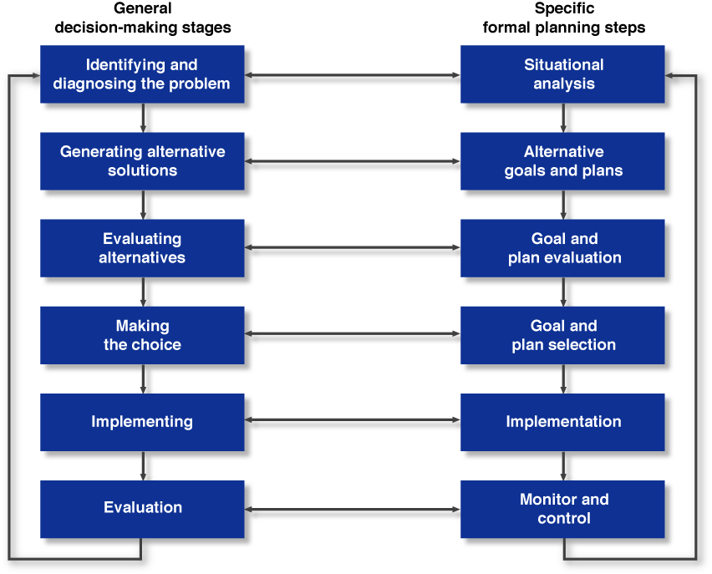
Decision Making Stages and Formal Planning Steps

Slide 7
Establishment of Mission, Vision, and Goals
Mission
An organization’s basic purpose and scope of operations

Slide 8
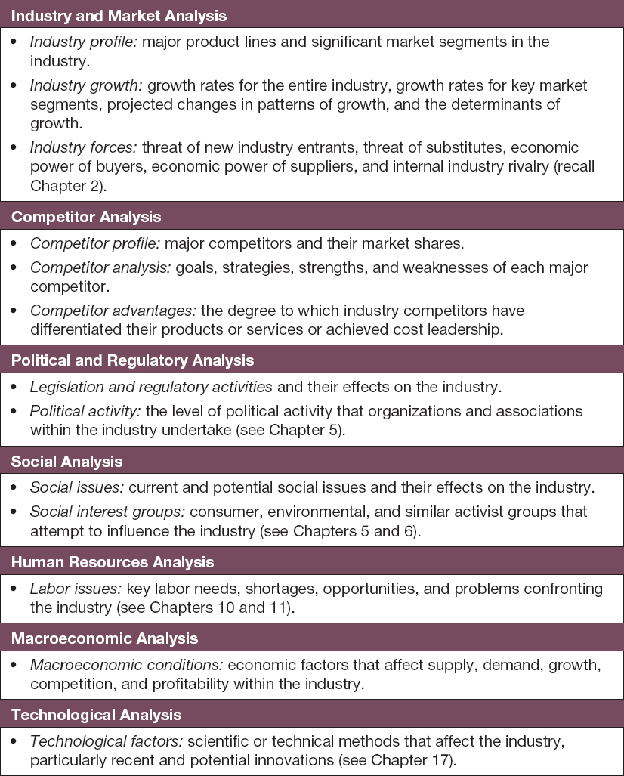
Environmental Analysis

Slide 9
Analysis of External Opportunities and Threats
Stakeholders
Groups and individuals who affect and are affected by the achievement of the organization’s mission, goals, and strategies

Slide 10
Analysis of Internal Strengths and Weaknesses
Resources
Inputs to a system that can enhance performance
Tangible, intangible assets

Slide 11
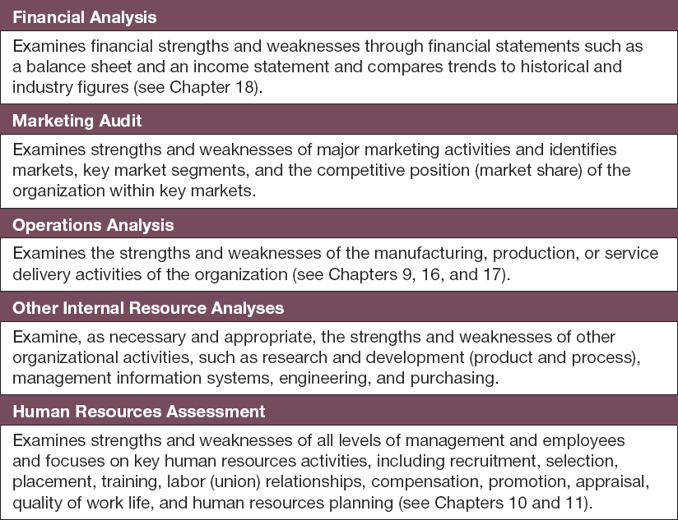
Internal Resource Analysis

Slide 12
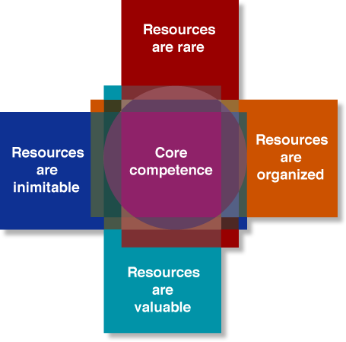
Resources and Core Competencies

Slide 13
SWOT Analysis and Strategy Formulation
SWOT analysis
A comparison of strengths, weaknesses, opportunities, and threats that helps executives formulate strategy.

Slide 14
Principles of planning
Principle of contribution to objectives
Principle of efficiency of plans
Principle of primary of planning
Principle of planning premises
Principle of policy framwork
Principle of timing
Principle of alternatives
Principle of limiting factor
Principle of commitment
Principle of flexibility
Principle of navigational change
Principle of competitive stategies

Slide 15
Types of planning
Corporate planning
Group planning
Divisional or functional planning

Slide 16
TYPES OF PLANNING
ACTITVITY
COVERED
PERIOD
APPROACH
FORMULATION
IMPORTANCE
Long
term
Short
term
FORMAL
INFORMAL
Corporate
PROACTIVE
REACTIVE
OPERATIONAL
STRATEGIC
Functional

Slide 17
Limitation of planning
Lack of accurate information
Time and cost
Resistance to change
Lock of ability to plans
False sense of security
Environmental constraints

Slide 18
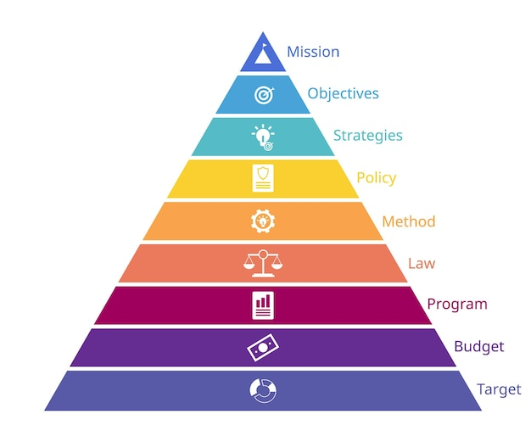
Hierarchy of plans

Slide 19
MANAGEMENT
BY
OBJECTIVES

Slide 20
OBJECTIVE SETTING
In an MBO, good goals are SMART goals:
S specific
M measurable
A achievable
R result oriented
T time-related
S
U
C
C
E
S
S
WORK
HAVE

Slide 21
WHAT IS MBO ?
Peter Drucker, (1954, “The Practice of Management”)
Is a systematic and organized approach that allows management to focus on achievable goals and attain the best possible results from available resources
Aims to increase individual and organizational effectiveness by aligning organizational goals and subordinate objectives
Clarifies and quantifies objectives to allow for monitoring, evaluation, and feedback throughout the hierarchy of objectives

Slide 22
IN SIMPLE WORDS, MBO IS…
MBO emphasises the importance of objectives as a tool to be used by managers in fulfilling their managerial roles (accomplish their tasks)
Divide problem into manageable, “bite-size” chunks

Slide 23
MBO; PLAN VIEW
Single-Use Plans
Operational Plans
Management by Objectives
Mission
Vision
Tactical Plans
Standing Plans

Slide 24
MBO; CROSS SECTION
Vision
Top
Managers
Mission
Middle
Managers
Tactical
Plans
Management
by
Objectives
Operational
Plans
Standing
Plans
Single-Use
Plans
First-Level
Managers

Slide 25
Single-use Plans are developed to achieve objectives that are not likely to be repeated in the future. Single-use plans include both programs and projects.
Standing Plans are used to provide guidance for tasks performed repeatedly within the organization. The primary standing plans are organizational policies, rules, and procedures.
Operational Plans are used to identifies specific results to be accomplished within a given short term time period. Contain detailed information used in the lower levels in an organization.

Slide 26
FEATURES OF MBO
Peter Drucker also stated that:
For the business to succeed, the managers and employees must work towards a common goal
Managers must identify and agree targets for achievement with subordinates
Managers must negotiate the support needed to achieve the targets with subordinates
Evaluate the objectives over time

Slide 27
MBO AIM
Short and long-term planning
Optymalization of organization structure
Better work and collaboration quality
Appraisal based on objective results
BONUSES

Slide 28
MBO PRINCIPLES
Cascading of organizational goals and objectives
Specific objectives for each team member
Participative decision making
Explicit time period
Performance evaluation & feedback

Slide 29
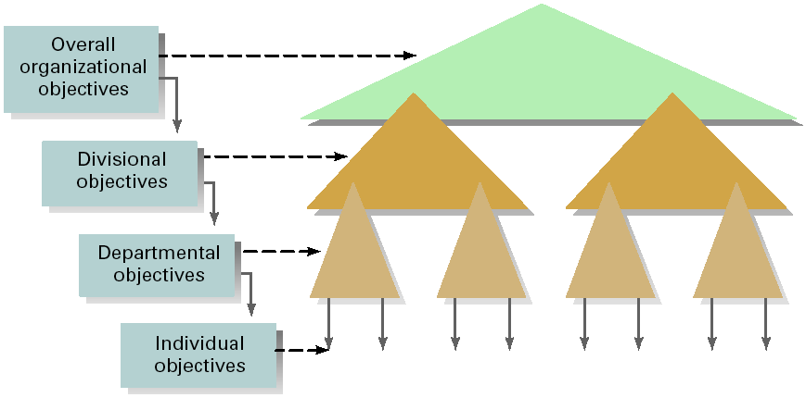
CASCADING OF OBJECTIVES

Slide 30
ADVANTAGES OF MBO
Improves employee motivation
Improves communication in the organisation
Flags up and highlights training needs required to achieve objectives
Improves overall performance and efficiency
Attainment of goals can lead to the satisfaction of Maslow’s higher order needs

Slide 31
MASLOW’S NEEDS THEORY
“We each have a hierarchy of needs that ranges from "lower" to "higher." As lower needs are fulfilled there is a tendency for other, higher needs to emerge.” Daniels, 2004
Maslow’s theory maintains that a person does not feel a higher need until the needs of the current level have been satisfied. Maslow's basic needs are as follows:

Slide 32




MASLOW’S NEEDS THEORY
Achieve full potential, Fulfillment
Self-Actualization
Self-Respect, Self-Esteem, Respected by Others
Esteem Needs
Affection, Acceptance, Inclusion
Social Needs (Love & Belonging)
Protection, Stability, Pain Avoidance, Routine/Order
Safety
Basic Human Needs (Physiological)
Food, Air, Water, Sex, Clothing

Slide 33
DISADVANTAGES OF MBO
May demotivate staff if targets are too high and unrealistic, also if imposed rather than agreed
Requires the cooperation of all employees to succeed
Can be bureaucratic and time consuming (meetings, feedback)
Can encourage short-term rather a more focused long-term growth
Objectives may go out of date and can restrict staff initiative and creativity
Setting targets for certain specialised employees may be difficult

Slide 34
IS MBO SUITABLE FOR EVERY BUSINESS?
MBO could be suitable for a medium to large business, using a democratic approach to management and operating in a stable market
The overriding issues therefore are size of the business, the leadership style it uses and the rate of change in the market it operates.

Slide 35
HOW MBO WORKS
Jointly identify common goals.
Define major areas of responsibility in terms of results expected.
Use measurements as guides for operating and assessing contributions of members.

Slide 36
UNDERLYING PURPOSES OF MBO
Clarify organization’s goals and plans at all levels.
Gain better motivation and participation from organization’s members.

Slide 37
MBO; FRAMEWORK CONCEPT
Supervisor
Jointly plan
Setting objectives
Setting standards
Choosing actions
Individually act
Performing tasks (subordinate)
Providing support (supervisor)
Jointly control
Reviewing results
Discussing implications
Renewing MBO cycle
and
Subordinate

Slide 38
PHASES OF MBO
Top management team studies system.
Team sets up methods of measuring performance.
Goal-setting sessions are held at all levels of organization.

Slide 39
STEPS FOR MBO
STEP 1: SET GOALS
STEP 2: DEVELOP PLANS
Corporate Strategic goals
Departmental goals
Individual goals
Action Plans
Review Progress & Take Corrective Action
Appraise Performance
STEP 3: REVIEW PROGRESS
STEP 4: APPRAISE OVERALL PERFORMANCE
Notes:
Set goals – not day to day but rather goals that answer at least a portion of the “where are we going” question and then are linked with other goals
Plans – Steps required
Review – make sure plan is working; Is corrective action necessary either in the plan or the execution?
CAUTION: Don’t get locked into PREDETERMINED behavior or sacrifice QUALITY to “MEET” goal

Slide 40
ESSENTIAL STEPS FOR MBO
Set Goals (The most difficult step)
What are we trying to accomplish?
Develop Action Plans
“What do we need to do to get there?”
Groups and individuals
Review Progress
“How are we doing?”
Periodically (How Often?)
Does plan need to be tweaked?
Appraise Performance
Rewards?
Notes:
Set goals – not day to day but rather goals that answer at least a portion of the “where are we going” question and then are linked with other goals
Plans – Steps required
Review – make sure plan is working; Is corrective action necessary either in the plan or the execution?
CAUTION: Don’t get locked into PREDETERMINED behavior or sacrifice QUALITY to “MEET” goal

Slide 41
e.g. HOW TO SET CORPORATE OBJECTIVES
Mission statement
Corporate objectives
Departmental objectives
Individuals and team targets
To become the leading supplier of computers in London
To increase sales in London by 10% in the next 5 years
e.g. (marketing department) to achieve a 10% share of the computer market in London within the next 5 years
e.g. to design questionnaires as part of market research

Slide 42
SOURCES OF MBO FAILURES
Lack of top management commitment and follow through on MBO.
Employees’ negative beliefs about management’s sincerity in its efforts to include them in the decision-making process.

