Slide 1







Chapter-1 Introduction
Computer System

Slide 2
Introduction to Computer
Computer is an advanced electronic device that takes raw data as input from the user and processes these data under the control of set of instructions (called program) and gives the result (output) and saves output for the future use.
A computer is a combination of hardware and software resources which integrate together and provides various functionalities to the user. Hardware are the physical components of a computer like the processor, memory devices, monitor, keyboard etc. while software is the set of programs or instructions that are required by the hardware resources to perform various operations as per the requirement of users.

Slide 3
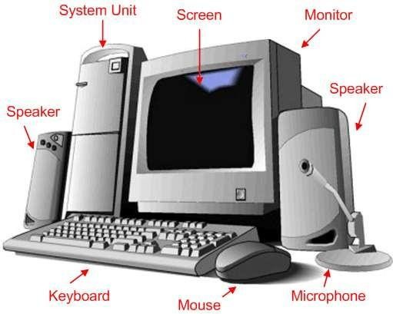
Introduction to Computer

Slide 4
EVOLUTION OF COMPUTING DEVICE
First Generation (1940-56):
The first generation computers used vacuum tubes & machine language was used for giving the instructions. These computers were large in size & their programming was difficult task. The electricity consumption was very high. Some computers of this generation are ENIAC, EDVAC, EDSAC & UNIVAC-1.
In this generation, mainly batch processing operating system was used. Punch cards, paper tape, and magnetic tape was used as input and output devices. The computers in this generation used machine code as the programming language.

Slide 5
Second Generation (1956-63):
In 2nd generation computers, vacuum tubes were replaced by transistors. They required only 1/10 of power required by tubes. This generation computers generated less heat & were reliable. The first operating system developed in this generation. IBM 1620, IBM 7094, CDC 1604 are the examples of this generations computers.
In 2nd generation, magnetic cores were used as the primary memory and magnetic tape and magnetic disks as secondary storage devices.
In this generation, assembly language and high-level programming languages like FORTRAN, COBOL were used. The computers used batch processing and multiprogramming operating system.

Slide 6
Third Generation (1964-71):
The 3rd generation computers replaced transistors with Integrated circuit known as chip. From Small scale integrated circuits which had 10 transistors per chip, technology developed to MSI circuits with 100 transistors per chip. These computers were smaller, faster & more reliable. High level languages invented in this generation.
The IC was invented by Jack Kilby. This development made computers smaller in size, reliable, and efficient. In this generation remote processing, time-sharing, multiprogramming operating system were used. High-level languages (FORTRAN-II TO IV, COBOL, PASCAL PL/1, BASIC,
ALGOL-68 etc.) were used during this generation. IBM-360 series, Honeywell-6000 are some examples of computers in 3rd
generation. .

Slide 7
Fourth Generation (1972- 1980):
LSI & VLSI were used in this generation. As a result microprocessors came into existence. The computers using this technology known to be Micro Computer. High capacity hard disk were invented. There is great development in data communication.
Fourth generation computers became more powerful, compact, reliable, and affordable. As a result, it gave rise to Personal Computer (PC) revolution. In this generation, time sharing, real time networks, distributed operating system were used. All the high-level languages like C, C++, DBASE etc., were used in this generation.

Slide 8
Fifth Generation (1980-Present & Beyond):
Fifth generation computing devices, based on artificial intelligence, are still in development, though there are some applications, such as voice recognition, that are being used today. The use of parallel processing and superconductors is helping to make artificial intelligence a reality. Quantum computation and molecular and nanotechnology will radically change the face of computers in years to come.
Some computer types of this generation are −
Desktop
Laptop Note Book Ultra Book

Slide 9
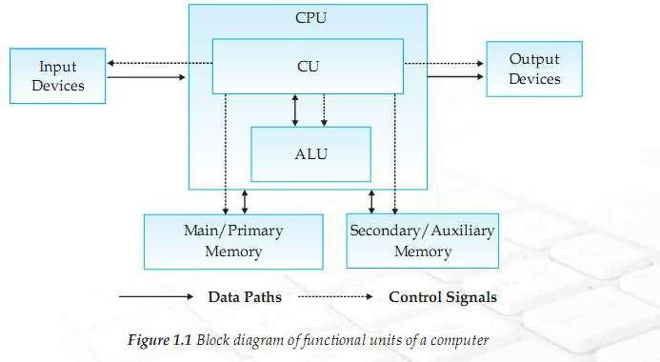
COMPONENT OF A COMPUTER SYSTEM

Slide 10
In the above diagram, both control (control unit or CU) and arithmetic & logic unit (ALU) combinely called as Central Processing Unit (CPU).
Let's describe about all the parts as included in the above
diagram one by one.
The Processor Unit (CPU)
It is the brain of the computer system. All major calculation and comparisons are made inside the CPU and it is also responsible for activation and controlling the operation of other unit.
This unit consists of two major components, that are arithmetic logic unit (ALU) and control unit (CU).

Slide 11
Arithmetic Logic Unit (ALU)
Arithmetic logic unit performs all arithmetic operations such as addition, subtraction, multiplication and division. It also uses logic operation for comparison like comparison or decision making (>, <, <=, >=, = etc.).
Control Unit (CU)
The control unit of a CPU controls the entire operation of the computer. It also controls all devices such as memory, input/output devices connected to the CPU.
CU fetches instructions from memory, decodes the instruction, interprets the instruction to know what the task are to be performed and sends suitable control signals to the other components to perform for the necessary steps to execute the instruction.

Slide 12
Input/Output Unit
The input/output unit consists of devices used to transmit information between the external world and computer memory.
The information fed through the input unit is stored in computer's memory for processing and the final result stored in memory can be recorded or display on the output medium.
Memory unit
It is an essential component of a digital computer. It is where all data intermediate and find results are stored. The data read from the main storage or an input unit are transferred to the computer's memory where they are available for processing. This memory unit is used to hold the instructions to be executed and data to be processes.

Slide 13
Primary Memory:
Primary memory has direct link with input unit and output
unit. It stores the input data, intermediate calculation, result.
Secondary Memory:
The primary storage is not able to store data permanently for future use. So some other types of storage technology is required to store the data permanently for long time, it is called secondary or auxiliary memory.

Slide 14




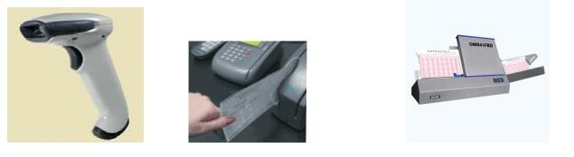
Input & Output Device
Input Device:
Input devices are those devices which help to enter data into computer system. E.g. Keyboad, Mouse, Touchscreen, Barcode Reader, Scanner, MICR, OMR etc.
Bar Code Reader MICR used in Bank OMR

Slide 15
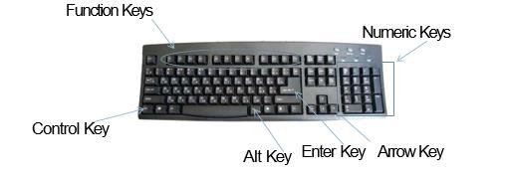
KEYBOARD: This is the most common input device which uses an arrangement of buttons or keys. In a keyboard each press of a key typically corresponds to a single written symbol. However some symbols require pressing and holding several keys simultaneously or in sequence. While most keyboard keys produce letters, numbers or characters, other keys or simultaneous key presses can produce actions or computer commands.

Slide 16
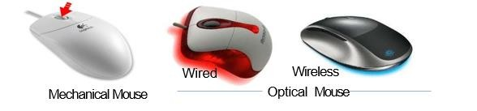
Mouse:
A computer mouse (plural mice or mouses) is a hand- held pointing device that detects two-dimensional motion relative to a surface. This motion is typically translated into the motion of a pointer on a display, which allows a smooth control of the graphical user interface of a computer.

Slide 17
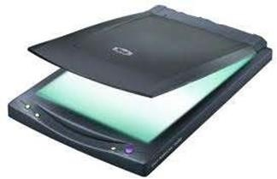
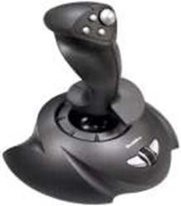
Scanner:
Scannerisa device that optically scans images, printed text, handwriting, or an object, and converts it to digital image.
JOYSTICK:
A joystick isan input device consistingof a stick that pivots ona base and reports its angle or direction to the device it is controlling.
Many people usejoysticks on computer games involving flight suchas
flight simulator.
Joysticks are often used to control video games, and usually have one or more push-buttons whosestate canalso be read by the computer

Slide 18
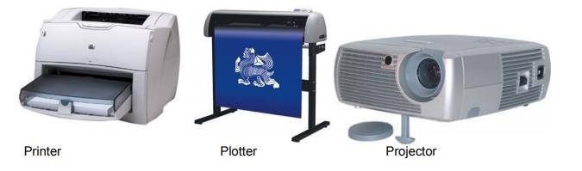
Output Device:
Output devices are those devices which help to display the processed information. Eg. Monitor, Printer, Plotter, Projector etc.

Slide 19
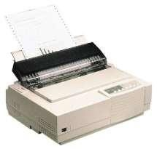
PRINTER:
Printer produces result on the paper.
There are various types of printers available in the market:
DOT MATRIX PRINTER:
Uses ribbon and hammer technology.
Its quality is not very good. It prints by making the object using
small dots.

Slide 20
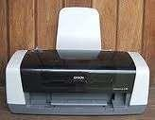

















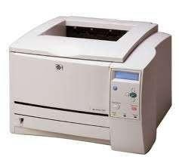
INKJET PRINTER:
It creates a digital image by propelling droplets of ink onto the paper.
LASERJET PRINTER:
They uses laser technology to print documents. It produce high quality printing at very high speed.

Slide 21
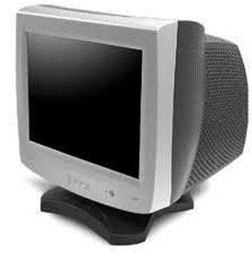
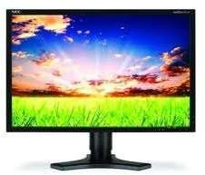
MONITOR
It is the primary output device where we
see the output. It looks like TV.
It is also known as VDU(Visual Display Unit).
Its display may be in the form of CRT
LED, LCD.
CRT(CATHODE RAY TUBE)
LCD(LIQUID CRYSTAL DISPLAY)
LED(LIGHT EMITTING DIODE)

Slide 22
MEMORY UNITS: Memory is used to store the data for later
reference. The smallest unit is bit, which mean either 0 or 1.
1 bit = 0 or 1
1 Byte = 8 bits
1 Nibble = 4 bits
1 Kilo Byte = 1024 Byte= 2¹⁰ Byte
1 Mega Byte = 1024 KB= 2¹⁰ KB
1 Giga Byte = 1024 MB= 2¹⁰ MB
1 Tera Byte = 1024 GB= 2¹⁰ GB
1 Peta Byte =1024 TB= 2¹⁰ TB
1 Exa Byte =1024 PB= 2¹⁰ PB

Slide 23
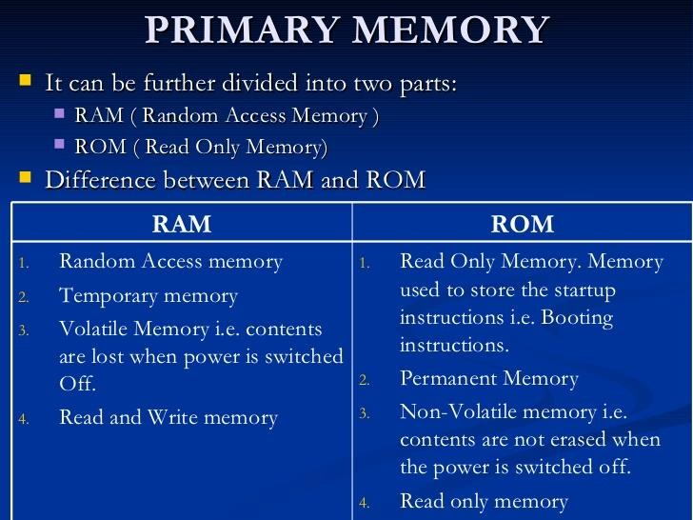
PRIMARY MEMORY

Slide 24
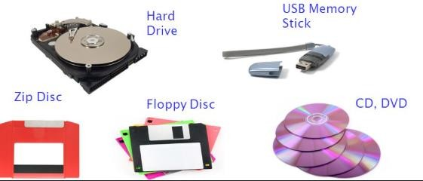
SECONDARY MEMORY
The primary storage is not able to store data permanently for future use. So some other types of storage technology is required to store the data permanently for long time, it is called secondary or auxiliary storage.
EXAMPLES OF SECONDARY STORAGE

Slide 25
DATA DELETION AND ITS RECOVERY ,
SECURITY CONCERN
You can conveniently delete personal data stored in computer system, survey responses, tickets, and contacts, no matter where the data originated.
Examples of reasons for deleting the data are:
Freeing the disk space
Removing duplicate or unnecessary data to avoid confusion
Making sensitive information unavailable to others
Removing an operating system or blanking a hard drive

Slide 26
DATA RECOVERY
in computing, data recovery is a process of salvaging (retrieving) inaccessible, lost, corrupted, damaged or formatted data from secondary storage and removable media or files, when the data stored in them cannot be accessed in a normal way.
The most common data recovery scenario involves an operating system failure, malfunction of a storage device, logical failure of storage devices, accidental damage or deletion, etc. (typically, on a single-drive, single-partition, single-OS system), in which case the ultimate goal is simply to copy all important files from the damaged media to another new drive.

Slide 27
COMPUTER SECURITY
It is also known as IT security, is the protection of information systems from theft or damage to the hardware, the software, and to the information on them.
It includes controlling physical access to the hardware, as well as protecting against harm that may come via network access, data and code injection, and due to malpractice by operators, whether intentional, accidental, or due to them being tricked into deviating from secure procedures.

Slide 28
CONCERNS OF COMPUTER SECURITY
Computer Security is concerned with four main areas:
Confidentiality:- Only authorized users can access the data resources and information.
Integrity:- Only authorized users should be able to modify the data
when needed.
Availability:- Data should be available to users when needed.
Authentication:- are you really communicating with whom you think
you are communicating with

Slide 29
SOFTWARE AND ITS TYPE
SOFTWARE: Software, simply are the computer programs. The instructions given to the computer in the form of a program is
called Software. Software is the set of programs, which are used for different purposes. All the programs used in computer to perform specific task is called Software.

Slide 30
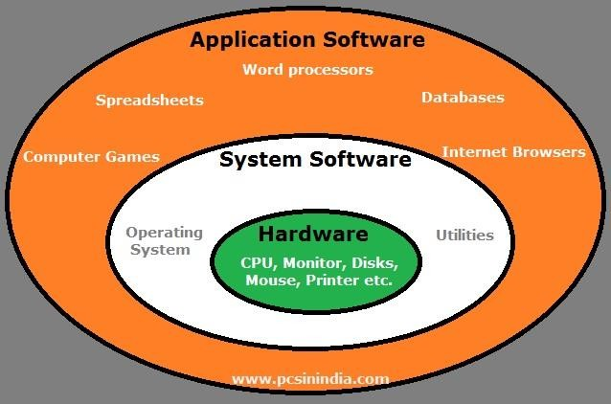
TYPES OF SOFTWARE

Slide 31
1. SYSTEM SOFTWARE
The system software is a collection of programs designed to operate, control, and extend the processing capabilities of the computer itself.These software products comprise of programs
written in low-level languages, which interact with the
hardware at a very basic level. System software serves as the interface between the hardware and the end users.Some examples of system software are Operating System, Compilers, Interpreter, Assemblers, etc.

Slide 32
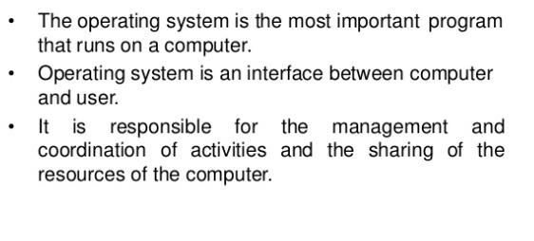
OPERATING SYSTEM

Slide 33
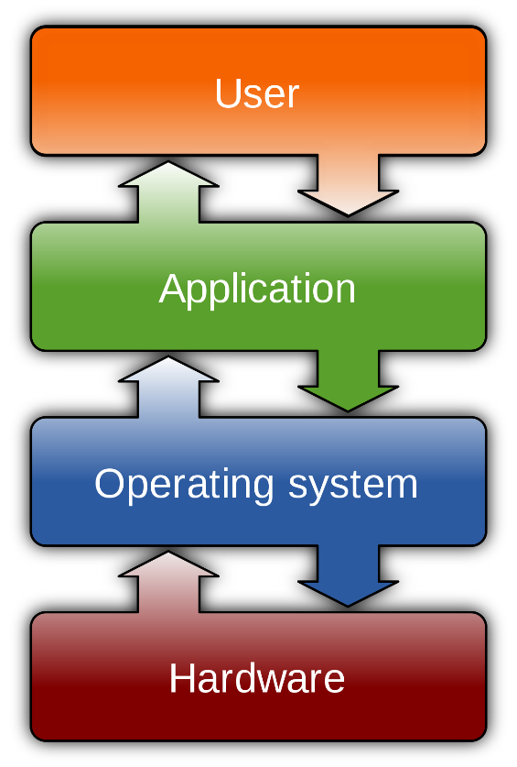
OPERATING SYSTEM ARCHITECTURE

Slide 34
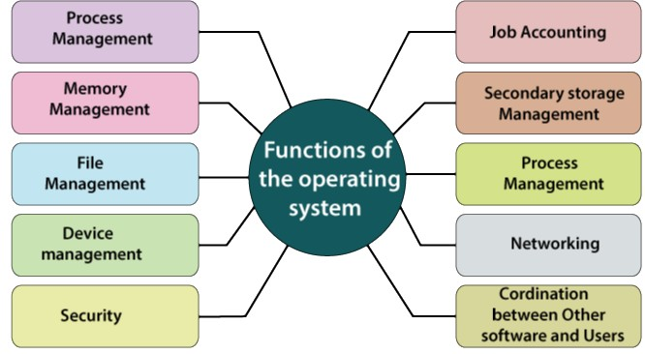
FUNCTIONS OF OPERATING SYSTEM

Slide 35
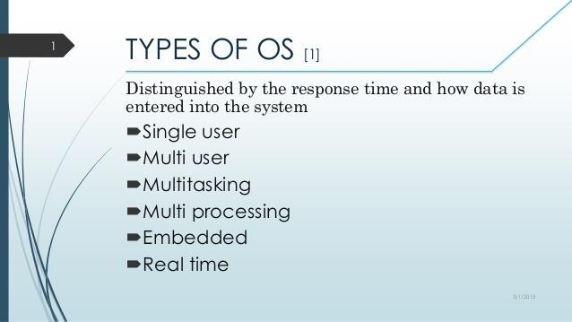
TYPES OF OPERATING SYSTEM

Slide 36
SINGLE USER OS: As the name implies, this operating system is designed to manage the computer so that one user can effectively do one thing at a time.
MULTI USER OS: A multi-user operating system (OS) is a computer system that allows multiple users that are on different computers to access a single system's OS resources simultaneously.
MULTI TASKING OS: Multitasking, is an operating system, that allows a user to perform more than one computer task (such as the multiple operation of an application program) at a time. The operating system is able to keep track of where you are in these tasks and go from one to the other without losing information.

Slide 37

MULTI PROCESSING OS: Multiprocessing is sometimes used to refer to the execution of multiple concurrent processes in a system. A program in execution is called process.
EMBEDDED OS: Embedded Operating System is an Embedded System’s Operating System. Embedded Systems are a specially designed computer system that essentially contains software and hardware for performing specific tasks. Mobile Phones, Laptops, Cameras, Washing Machines, ATMS, and Hair Straightener etc are examples of embedded operating sytem.

Slide 38
REAL TIME OS: It is used to control machinery, industrial systems, scientific instruments ,tasks where time deadlines may be forced to execute a task.

Slide 39
LANGUAGE PROCESSOR
We generally write a computer program using a high-level language. A high-level language is one that is understandable by us, humans. This is called source code.
However, a computer does not understand high-level language. It only understands the program written in 0's and 1's in binary, called the machine code.
To convert source code into machine code, we use either a compiler or an interpreter. Compiler, Interpreter are known as language processor. Both compilers and interpreters are used to convert a program written in a high-level language into machine code understood by computers. However, there are differences between how an interpreter and a compiler works.

Slide 40
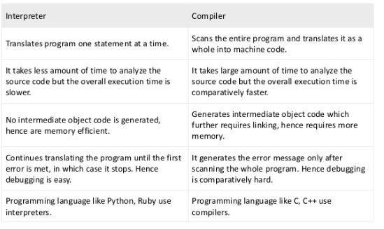
DIFFERENCE BETWEEN COMPILER AND INTERPRETER

Slide 41
APPLICATION SOFTWARE
Application software products are designed to satisfy a particular need of a particular environment. All software prepared in the computer lab may come under the category of Application software.
Examples of Application software are the following −
Payroll Software
Student Record Software
Inventory Management Software
Income Tax Software
Railways Reservation Software
Microsoft Office Suite Software
Microsoft Word, Microsoft Excel

Slide 42
Computer Networking
We are living in a connected world. Information is being produced, exchanged, and traced across the globe in real time. It's possible as almost everyone and everything in the digital world is interconnected through one way or the other.

Slide 43
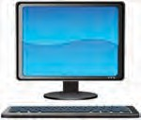

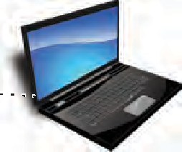

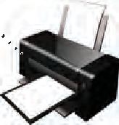

Introduction of computer network
A group of two or more similar things or people interconnected with each other is called network Some of the examples of network in our everyday life includes:
•Mobile network
•Network of computers
•Airlines, railway, banks, hospitals networks
Acomputer network (Figure 10.2) is an interconnection among two or more computers or computing devices. Such interconnection allows computers to share data and resources among each other. A basic network may connect a few computers placed in a room.
NetworkingDevice

Slide 44
Type of networks
There are various types of computer networks ranging from network of handheld devices (like mobile phones or tablets) connected through Wi-Fi or Bluetooth within a single room to the millions of computers spread across the globe. Some are connected wireless while others are connected through wires.
Based on the geographical area covered and data transfer rate, computer networks are broadly categorised as:
•PAN ( Personal Area Network)
•LAN (Local Area Network)
•MAN (Metropolitan Area Network)
•WAN (Wide Area Network)

Slide 45
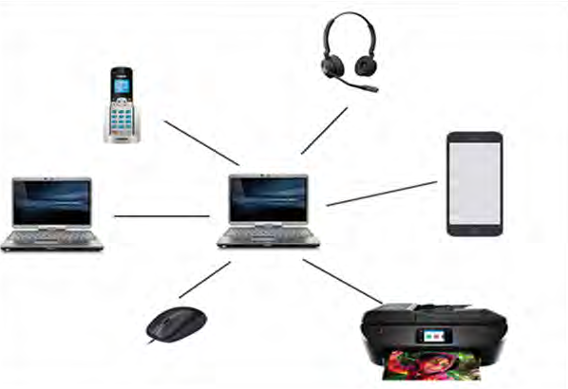
Personal Area Network (PAN)
It is a network formed by connecting a few personal devices like computers, laptops, mobile phones, smart phones, printers etc., as shown in Figure 10.4. All these devices lie within an approximate range of 10 metres. A personal area network may be wired or wireless. For example, a mobile phone connected to the laptop through USB forms a wired PAN while two smartphones communicating with each other through Bluetooth technology form a wireless PAN or WPAN.

Slide 46
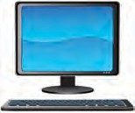
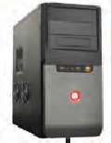

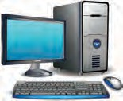
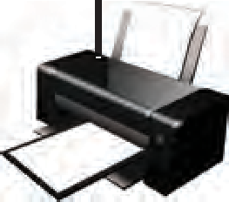
Local Area Network (LAN)
It is a network that connects computers, mobile phones, tablet, mouse, printer, etc., placed at a limited distance. The geographical area covered by a LAN can range from a single room, a floor, an office having one or more buildings in the same premise, laboratory, a school, college, or university campus. The connectivity is done by means of wires, Ethernet cables, fibre optics, or Wi-Fi. A Local Area Network (LAN) is shown in Figure 10.5.

Slide 47










Metropolitan Area Network (MAN)
10.3.3Metropolitan Area Network (MAN) is an extended form of LAN which covers a larger geographical area like a city or a town. Data transfer rate in MAN also ranges in Mbps, but it is considerably less as compared to LAN. Cable TV network or cable based broadband internet services are examples of MAN. This kind of network can be extended up to 30-40 km. Sometimes, many LANs are connected together to form MAN, as shown in Figure 10.6.
LAN1
NetworkingDevice
LAN3
LAN2

Slide 48

























Wide Area Network (WAN)
Wide Area Network connects computers and other LANs and MANs, which are spread across different geographical locations of a country or in different countries or continents. A WAN could be formed by connecting a LAN to other LANs (Figure 10.7) via wired/wireless media. Large business, educational and government organisations connect their different branches in different locations across the world through WAN. The Internet is the largest WAN that connects billions of computers, smartphones and millions of LANs from different continents.
NetworkUser
NetworkUser
NetworkUser
NetworkUser
NetworkUser
NetworkSwitch
NetworkSwitch
NetworkUser
Internet

Slide 49
Network Device
To communicate data through different transmission media and to configure networks with different functionality, we require different devices like Modem, Hub, Switch, Repeater, Router, Gateway, etc. Let us explore them in detail.

Slide 50
Modem
Modem stands for ‘MOdulator DEModulator’. It refers to a device used for conversion between analog signals and digital bits. We know computers store and process data in terms of 0s and 1s. However, to transmit data from a sender to a receiver, or while browsing the internet, digital data are converted to an analog signal and the medium (be it free-space or a physical media) carries the signal to the receiver. There are modems connected to both the source and destination nodes. The modem at the sender’s end acts as a modulator that converts the digital data into analog signals. The modem at the receiver’s end acts as a demodulator that converts the analog signals into digital data for the destination node to understand. Figure 10.8 shows connectivity

Slide 51
What Is Multimedia
In a generic sense, multimedia is simply the use of more than one media element. Hence, Web-based multimedia is defined as an online, interactive experience that incorporates two or more media elements including text, graphics, sound, animation and video. A fundamental feature of most Web-based multimedia is interactivity, which gives user some control over the content
Multimedia – using more than one media:
Text
Graphics
Animation
Sound
Video

Slide 52
Multimedia Application
Examples of Multimedia Applications include:
World Wide Web
Multimedia Authoring, e.g. Adobe/Macromedia Director
Hypermedia courseware
Video
Interactive TV
Computer Games
Virtual reality
Digital video editing and production systems
Multimedia Database systems

Slide 53
Thank you

