Slide 1
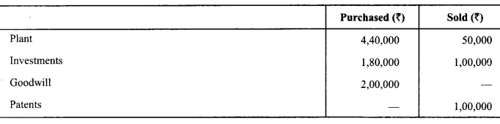
Cash Flow……
Question 1.
From the following particulars, calculate cash flows from investing activities:
Interest received on debentures held as investment ₹ 6000.
Dividend received on shares held as investment ₹ 10,000.
A plot of land had been purchased for investment purposes and was let out for commercial use and rent received ₹ 30,000.

Slide 2
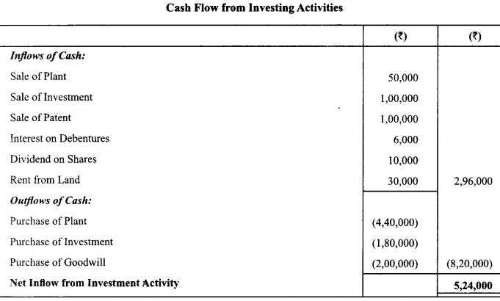
Cash Flow

Slide 3
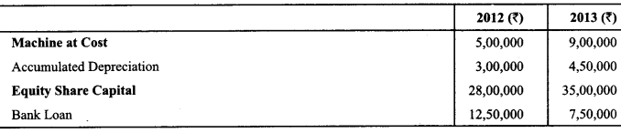
Cash Flow…
Question 2.
From the following information, calculate Cash Flow from Investing and Financing Activities
In year 2013, machine costing ₹ 2,00,000 was sold at a profit of₹ 1,50,000. Depreciation charged on machine during the year 2013 amounted to ₹ 2,50,000.

Slide 4
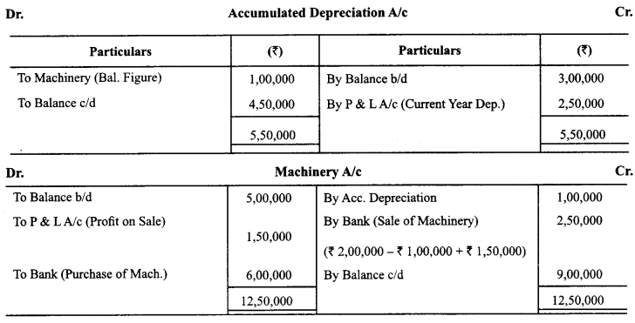
Cash Flow

Slide 5
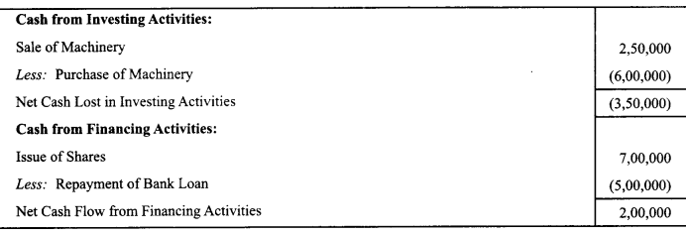
Cash Flow

Slide 6
Cash Flow
Question 3.
Anand Ltd. arrived at a net income of ₹ 5,00,000 for the year ended March 31,2007. Depreciation for the year was ₹ 2,00,000. There was a gain of₹ 50,000 on assets sold which was credited to profit and loss account. Bills Receivables increased during the year ₹ 40,000 and Bills Payables also increased by ₹ 60,000. Compute the cash flow from operating activities by the indirect approach.

Slide 7
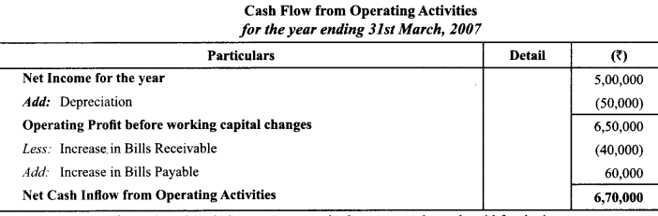
Cash Flow

Slide 8
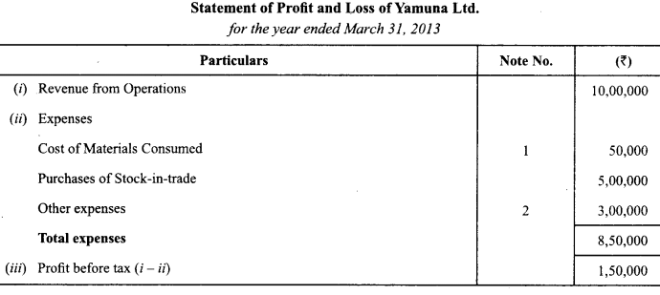
Cash Flow
Question:
The following is the Profit and Loss Account of Yamuna Limited:

Slide 9
Cash Flow
Additional Information:
(i) Trade receivables decrease by ₹ 30,000 during the year.
(ii) Prepaid expenses increase by ₹ 5,000 during the year.
(iii) Trade payables decrease by ₹ 15,000 during the year.
(iv) Outstanding expenses payable increased by ₹ 33.000 during the year.
(v) Other expenses included depreciation off 25,000.
Compute net cash provided by operations for the year ended March 31, 2014 by the indirect method.

Slide 10
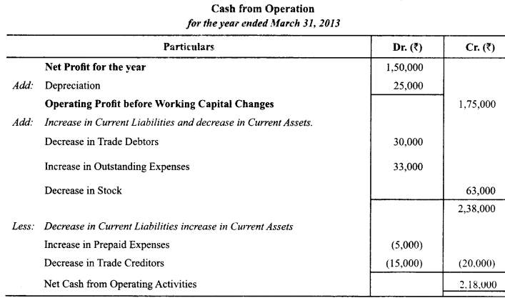
Cash Flow

Slide 11
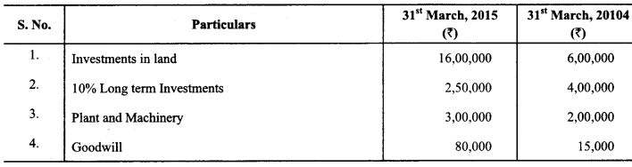
Cash Flow
Question:
Calculate Cash Flows from Investing Activities from the following information:
Note:
A machine costing ₹ 40,000 (depreciation provided thereon ₹ 12,000) was sold for X 35,000. Depreciation charged during the year was ₹ 60,000.

Slide 12
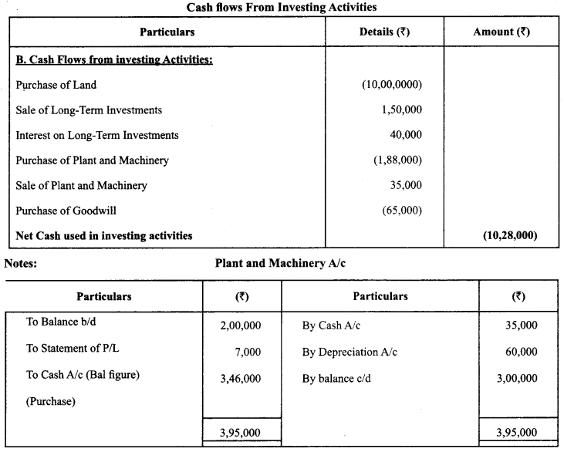
Cash Flow

Slide 13
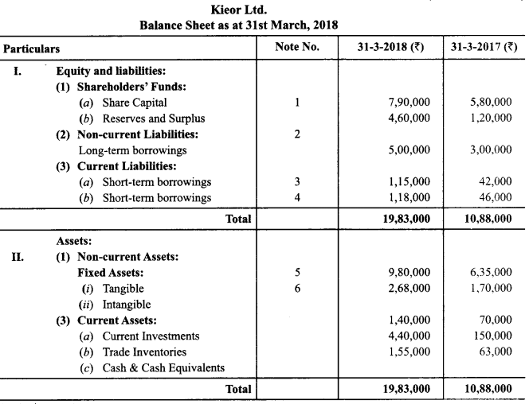
Cash Flow
Question:
From the following Balance Sheet of Kiero Ltd. and the additional information as on 31-3-2018, prepare a Cash Flow Statement. Additional Information:
12% debentures were issued on 1st September, 2017

Slide 14
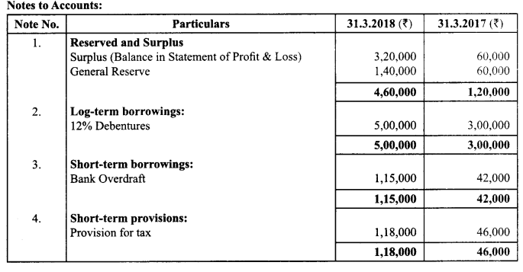
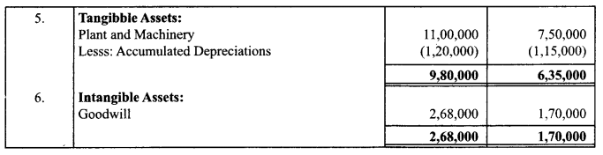
Cash Flow

Slide 15
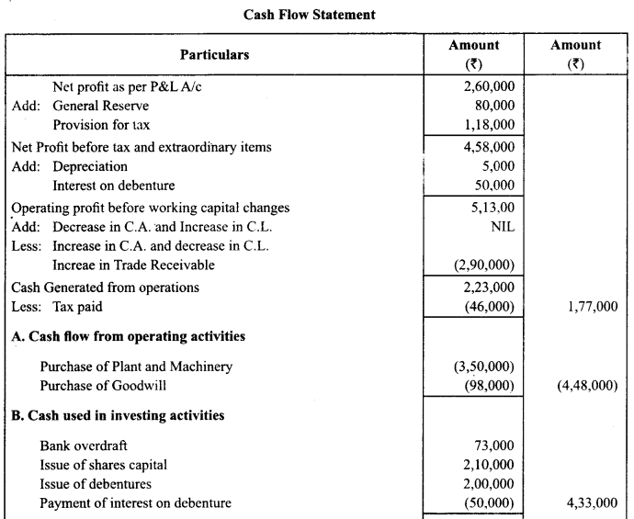
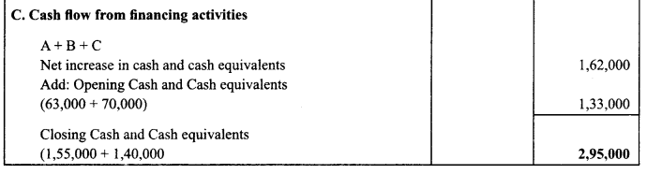

Slide 16
Cash Flow
Question:
From the following Balance Sheet of Dreams Converge Ltd as at 31.3.2018 and 31.3.2017; Calculate Cash from operating activities.
Additional Information:
Machinery of the book value of 80,000 (accumulated depreciation ₹ 20,000) was sold at a loss of ₹ 18,000.
Depreciation provided during the year Rs.40000

Slide 17
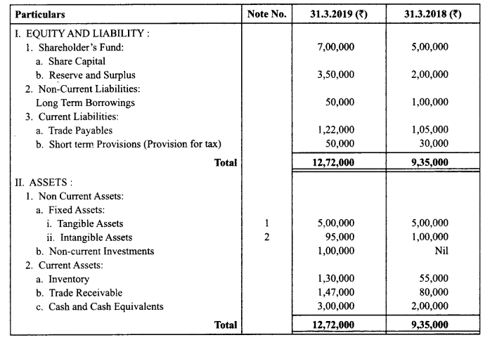
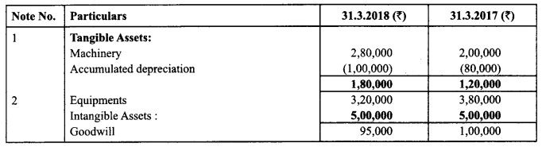

Slide 18
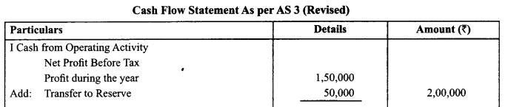
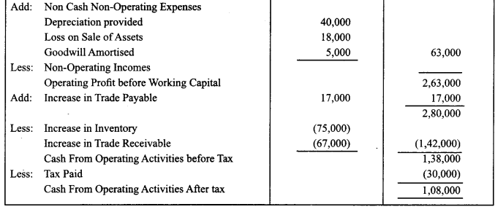

Slide 19
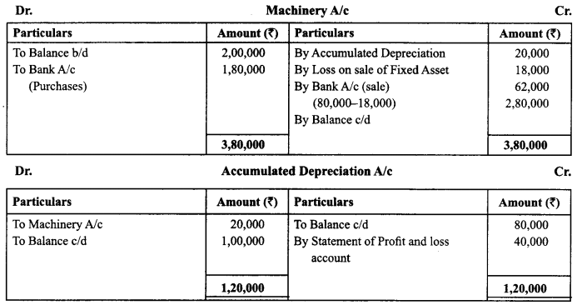
Cash Flow

Slide 20
Direct Method
Cash Flow from Operating Activities:
Cash receipts from customers | ***
Cash paid to suppliers and employers | (***)
Cash generated from operations | ***
Income tax paid | (***)
Cash flow before extraordinary items | ***
+/– Extraordinary items | ***
Net Cash from operating activities | ***
Indirect Method
Cash Flow from Operating Activities:
Net Profit before tax and extraordinary items |  |  |  | ***
 | Add: | Non-Cash Expenses and Non-Operating Expenses
 |  | Depreciation | **
 |  | Goodwill | **
 |  | Interest paid | **
 |  | Loss on sale of fixed assets | **
 |  | Foreign exchange | ** | **
 | Less: | Non Operating Incomes.
 |  | Dividend received | **
 |  | Profit on sale of fixed assets | **
 |  | Interest received | ** | **
Operating profit before working capital changes |  |  |  | ***
 | Add: Decrease in Current Assets |  | ***
 |  | Increase in Current Liabilities | *** | ***
 | Less: Increase in Current Assets |  | ***
 |  | Decrease in Current Liabilities | *** | ***
Cash generated from Operating Activities |  |  |  | ***
Income tax paid |  |  |  | ***
Cash Flow before Extraordinary Items |  |  |  | ***
 | Add/Less: Extra ordinary Items |  |  | ***
Net Cash Flow from Operating Activities |  |  |  | ***

