Slide 1
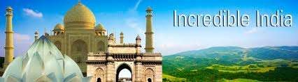
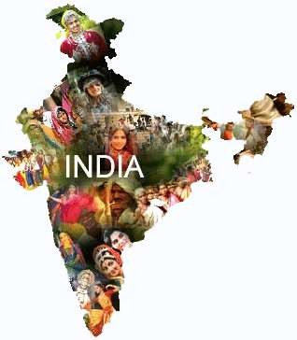
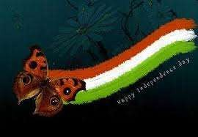
If all of the world´s cultural heritage (sports, music, fashion, architecture, literature, painting, etc..) was contained in a time capsule, what would you include to demonstrate the legacy of your country?
The Legacy of Indian Cultural Heritage

Slide 2
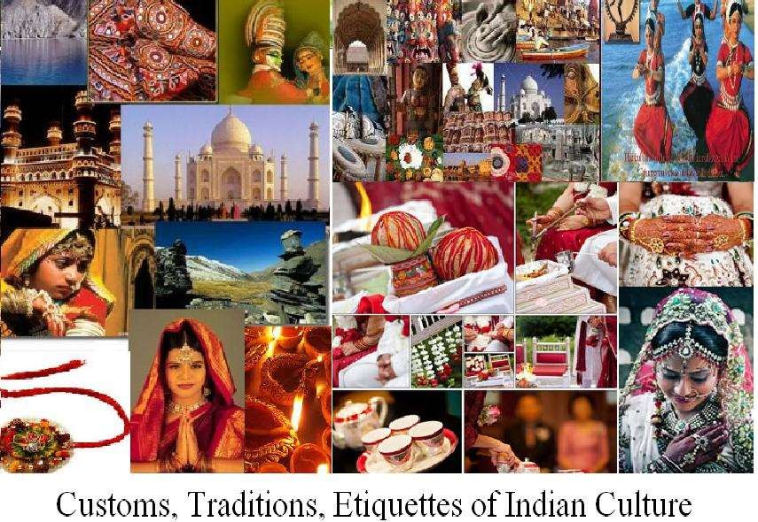

Slide 3



Slide 4
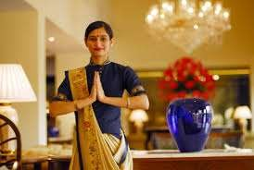
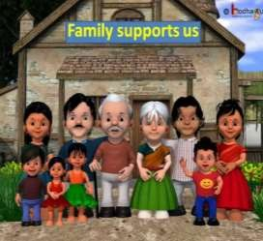
Fundamental Traditions
Namaste expressed as Namaskar or Namaskaram, is a
customary greeting when individuals meet or farewell.
Namaste is spoken with a slight bow and hands pressed together, palms touching and fingers pointing upwards, thumbs close to the chest.
It means "I bow to the divine in you”
A Hindu Joint Family or Joint Family is an extended family arrangement prevalent among Hindus of the Indian subcontinent, consisting of many generations living under the same roof.
Family ties are of utmost priority and the family grows with the marital ties. The arrangement provides a kind of social security in a familial atmosphere.

Slide 5
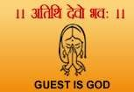
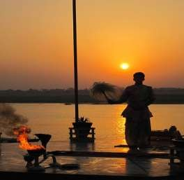
Fundamental Traditions
Atithi Devo Bhavah The guest is God' or 'Guest become God' is a Sanskrit verse, taken from an ancient Hindu scripture which became part of the "code of conduct" for Hindu society.
Atithi devo bhav regards a procedure of the Host-Guest relationship.
Pūjā is a prayer ritual performed by Hindus to host, honour and worship one or more deities, or to spiritually celebrate an event.
It is done either to honour or celebrate the presence of
special guest(s), or their memories after they pass away.

Slide 6


Slide 7
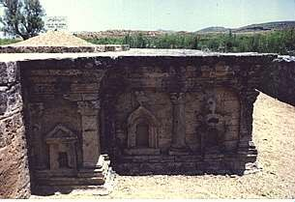
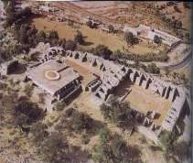
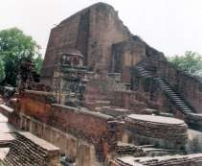
Takshila University
The world's first University was established in Takshila or Taxila or Takshashila (now in Pakistan) in 700BC.
More than 10,500 students from all over the world studied here.
The campus accommodated students who came from as far as Babylonia, Greece, Arabia and China and offered over sixty different courses.
The famous treatise Arthashastra (Sanskrit for The knowledge of Economics) by Chanakya, is said to have been composed in Takshashila itself.
Nalanda University
Founded in the 5th Century A.D., Nalanda is known as the ancient seat of learning.
2,000 Teachers and 10,000 Students from all over the Buddhist world lived and studied at Nalanda, the first Residential International University of the World.
The university attracted scholars and students from Korea, Japan, China, Tibet, Indonesia, Turkey, Greece, and Persia.

Slide 8

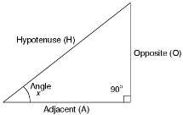

The value of "pi" was first calculated by Budhayana, and he explained the concept of what is known as the Pythagorean Theorem. He discovered this in the 6th century long before the European mathematicians.
Algebra, trigonometry and calculus came from India.
Quadratic equations were by Sridharacharya in the 11th
century.
The largest numbers the Greeks and the Romans used were 106 whereas Hindus used numbers as big as 10**53(10 to the power of 53) with specific names as early as 5000 BCE during the Vedic period.
The place value system, the decimal system was developed in India in 100 BC.
The Binary number system which is used in modern
computers and digital devices was invented in India.

Slide 9
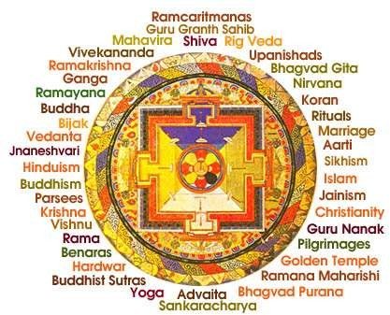

Slide 10

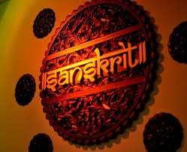
Religions
Religion in India is characterized by a diversity of religious beliefs and practices.
What is indubitably unique about India as a 'land of religions' is that it is the birthplace of several
major world religions.
Three-fourths of the Indian people describe themselves as adherents of Hinduism, the oldest continuous faith in the world.
India is equally a land of other faiths: the world's second largest population of Muslims, nearly 130
million in number, is to be found in India, and there are also some 25 million Christians.
Languages
  India speaks 780 languages excluding 220 languages that have
been lost in last 50 years.
  Sanskrit is the mother of all the European languages. Sanskrit is the most suitable language for computer software - a report in Forbes magazine, July 1987.

Slide 11


Slide 12
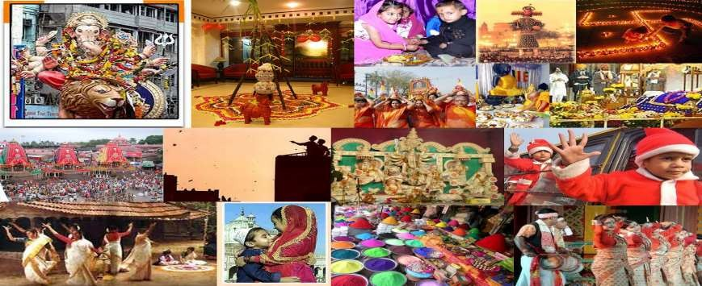
Festivals
India is often described as a land of festivals. India celebrates holidays and festivals of almost all the faiths in the world.
In one region or the other, festivals happen almost every day, each with a specialty of its own.
Each festival in each region has its own particular foods and sweets appropriate to their
customs.

Slide 13


Slide 14
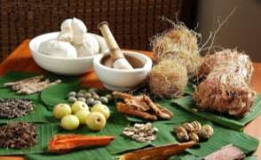
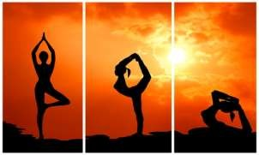
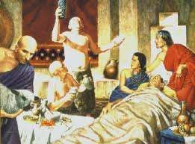
Ayurveda
Ayurveda is the earliest school of medicine known to mankind. The father of medicine, Charaka, consolidated Ayurveda 2500 years ago in India.
Yoga
Yoga are the physical, mental, and spiritual practices or disciplines which aim at transforming body and mind.
Other Contributions and Achievements
Sushruta is regarded as the father of surgery.
Over 2600 years ago Sushrata & his team conducted complicated surgeries like cataract, artificial limbs, cesareans, fractures, urinary stones and also plastic surgery and brain surgeries.
More than 3000 different surgeries were performed and nearly 120 surgical instruments have been used before 2600 years itself.
Usage of anaesthesia was well known in ancient India medicine.

Slide 15


Slide 16
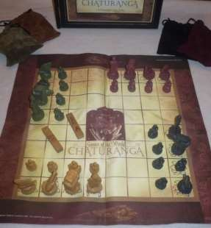
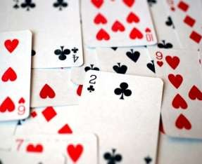
Chess
The game of chess was invented in India and was originally
called Ashtapada (sixty-four squares).
Later this game came to be known as chaturanga.
Chaturanga was played on an authentic cloth game surface by 2, 3 or 4 players.
Chaturanga combines the basic strategy of chess with the dynamic challenge of chance as each move is determined by the random roll of wooden dice.
The Game of Cards
The popular game of cards originated in ancient India and was known as Krida-patram.
It was one of the favorite pastimes of Indians in ancient times. This game was patronized especially by the royalty and nobility.
This game is recorded to have been played in Rajputana, Kashyapa Meru (Kashmir), Utkala (Orissa) the Deccan and even in Nepal.

Slide 17
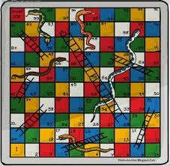


Snakes and Ladder
The game had its origin in India and was called Moksha Patam or Parama Padam or Mokshapat. It was used to teach Hindu Dharma and Hindu values to children.
The game was created by the 13th century poet saint Gyandev. The ladders in the game represented virtues and the snakes indicated vices. The game was played with cowrie shells and dices.
The game serves a dual purpose: entertainment, as well as dos and don’ts, divine reward and punishment, ethical values and morality.
Marshal Arts
Bodhidharma, a Buddhist monk from India, introduced Kalari into China and Japan in the 5th century.
He taught this art in a temple This temple is today known
as the Shaolin temple.
The Chinese called him Po-ti-tama. What he taught has evolved into Karate andKung Fu.

Slide 19
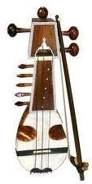
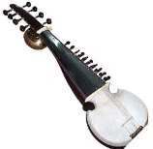
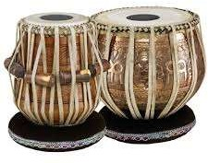
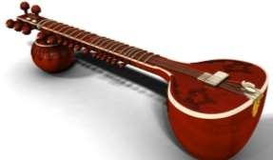
Musical instruments and styles
Music has remained an integral part of the Indian culture since antiquity.
Musical instruments like the sarod, sarangi, tabla and sitar which are very popular in the world of music today had also been a part of the ancient Indian music.
Gazals, khayal, tala, gharana and raga are the musical
genres of the Indian classical music.
In ancient India, music used to be a part of the famous Sanskrit dramas like Mirchakatika and Abhijnana Shakuntalam.
The origin of the ancient Indian music began in the age of
the Aryans, with the chanting of the Vedas.
The music was finally created with the rhythm and melody. References of the ancient Indian music can be found in the Vedas, Puranas, Upanishads, epics and Srimad Bhagavata Gita.

Slide 20
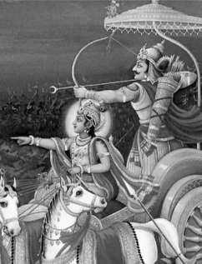
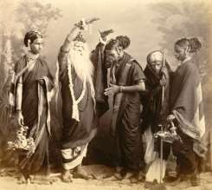
Theatre In India
The ancient Indian theatres played a major role in the Indian culture in the past.
India in the ancient past was invaded several times and this contributed in shaping the culture and heritage of India. Two of the best known ancient Indian theatres are Ramayana and Mahabharata.
Dramatics and folk theatre were very popular with the Vedic people. The main ingredients of the ancient Indian theatres used to be depiction of events of everyday life, dance, ritualism and food.
Natya Shastra
The ancient Indian writer - Bharata Muni who existed between the 5th�2nd century BC became famous for his theatrical treatise Natya Shastra of Bharata.
It included dance, song, music and theatre.
According to the historians this was the first systematic form of drama.

Slide 21


Slide 22
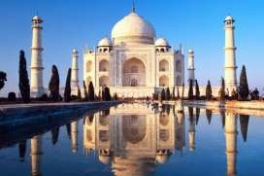
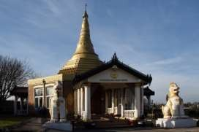
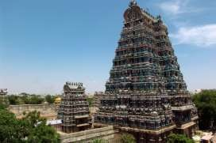
Indian Architecture
The Indian architecture embraces a variety of structures that came into existence in the ancient period of Indian history.
The vast diversity of Indian culture gets reflected in the country's architectural monuments and structures.
The architecture of India exhibits a wonderful amalgamation of ancient and variegated traditions taken from Europe, Central and West Asia.
Buddhist temples and Viharas emerged during the rule of Maurya Empire.
Apart from the Viharas, stone architectural structures also came into existence. The Ashokan Period marked the emergence of rock-cut architecture with wonderful carvings and depictions on them.
During the Mughal empire in India, the artists and sculptors adopted new styles and architectural forms. Most of the structures constructed during the Mughal era are arched or dome-shaped.

Slide 23


Slide 24
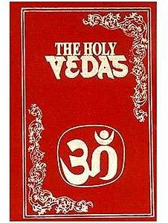
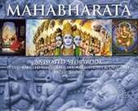
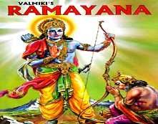
Indian Literature
Indian literature is considered one of the oldest in the world.
India was one of the first places in the world to start the writing system and this began in around the 2500 BC.
The Ancient Indian Literature dates back to the Vedic Age. The oldest literary work of India is the Rig Veda. It also happens to be the world’s oldest literary work.
The scriptures of ancient Indian literature are classified into two categories - The Shruti literature and The Smriti literature. Shruti literature concerns �the revealed� or
�the heard� or 'the revealed' whereas the Smriti literature concerns 'the remembered.‘
Around 300 BC Ramayana was composed followed by Mahabharata. A portion of the Mahabharata is Bhagavad Gita.

Slide 25


Slide 26
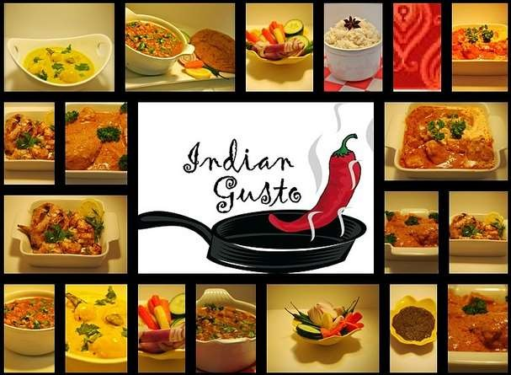
Indian food is as diverse as India.
Indian cuisine varies from region to region, reflecting the local produce, cultural diversity, and varied demographics of the country.
Indian cuisine can be split into five categories - northern, southern, eastern, western, and north- eastern.
The diversity of Indian cuisine is characterised by differing use of many spices and herbs, a wide
assortment of recipes and cooking techniques. From salads to sauces, from vegetarian to meat, from spices to sensuous, from breads to desserts, Indian cuisine is invariably complex.

Slide 28
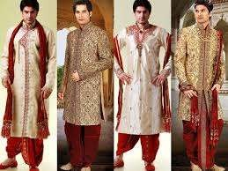


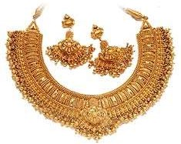
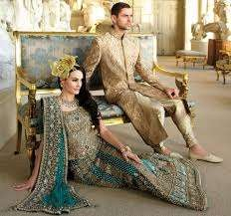

Clothing in India varies from region to region depending on the ethnicity, geography, climate and cultural traditions of the people of that region.
Historically, men and women clothing has evolved to elaborate costumes not only used in daily wear but also on festive occasions as well as rituals and dance performances.
In urban areas, western clothing is common and uniformly worn by people of all strata.
India also has a great diversity in terms of weaves, fibers, colours and material of clothing.
Colour codes are followed in clothing based on the religion and ritual concerned. For instance, Hindu ladies wear white clothes to indicate mourning, while Parsis and Christians wear white to weddings.

Slide 30
Handicrafts and Hand Painting

Slide 31
Shakespeare said the world is a stage (he meant acting - we are all actors) but today, the entire world is a stage not for acting but for business and marketing
You find business anytime, anywhere and in anything. And if there is “Business” (i.e. an economic activity where there are buyers, sellers and transactions for a consideration), there will be a “Market.”
Except perhaps for a few hours at home ,you will always find yourself in some market place or other ..

Slide 32
Ethical Heritage of India
Treasure of Indian Philosophy and Ethical Values:
The Vedas (4)- Rigveda, Samaveda,Yajur-veda, Atharvaveda (Nalayira Divya Prabhandham-Tamil)
The Upanishads (123 books; 13 basic)
The Puranas (18)
The Greatest Epics -The Ramayana & The Mahabharata
The Greatest Book of Philosophy-The Gita
Indian Schools of Philisophy (6)
Buddhism, Jainism, Jataka Tales,Panchatantra and a treasure of unparalled Sanskrit & Pali Literature, Ayurveda, Economics,Law, Logic etc.
1

Slide 33
Many Hindu intellectual traditions were classified
During the medieval period of Brahmanic-Sanskritic
scholasticism into a standard list of six orthodox (astika) schools (darshanas), the "Six Philosophies" (ṣad-darśana), all of which cite Vedic authority as their source:
1.Nyaya, the school of logic
2.Vaisheshika, the atomist school
3.Samkhya, the enumeration school
Yoga, the school of Patanjali (which provisionally asserts the metaphysics of Samkhya)
Purva Mimamsa (or simply Mimamsa), the tradition of Vedic exegesis, with emphasis on Vedic ritual, and
Vedanta (also called Uttara Mimamsa), the Upanishadic tradition, with emphasis on Vedic philosophy.

Slide 34
Ethical Principles of Indian Society
Individuals, Business and Governance
Aims of Life: Four Phases of Life- Brahmacharya(Duties as Student life), Grihastha (Duties as a Householder), Banaprastha (Pilgrimage and Meditation), Moksha (Salvation).
Duties of Life: Artha, Kama, Moksha, Dharma Every individual including businessman and ruler must conduct himself according to DHARMA i.e. honesty, fairness, equity and with a sense of divine duty and Nishkam Karma.
Style of Living: Spiritualistic against Materialistic: Simple Living and High Thinking
Reverence for Elders: Matrideva bhaba, Pitrideva bhava, acharyadeva bhaba , Atithideva bhava
Attitude towards Self: Inner Happiness, peace of mind, Detachment, Yoga and Meditation. Chidanandam
Attitude to the World: Shanti, Sukham, Anandam-let there be peace evrywhere-to humans, to vegetation, to the universe.

Slide 35
Indian Concept of Indebtedness
Five Categories of Indebtedness (Rin)
1.Devarin :-Indebtedness to supra- human powers for the gifts of Sun, air, water light etc.
2.Rishi Rin :-Indebtedness to sages who leading a life of utter self denial, realised the highest truths and gave the wisdoms.
3.Pitri Rin :-Indebtedness to Parents and ancestors for their cumulative contributions to us.
4.Nri Rin :-Indebtedness to humanity at large, to countless people who have contributed to make existence a reality.
5.Bhuta Rin:-Indebtedness to all sub-human species
- trees, animals, birds, fish, insects etc. for their incalculable gifts to us.
•

