Slide 1

TEAM EFFECTIVENESS
“There is no ‘I’ in TEAM! And this is the secret of a team SUCCESS !”

Slide 2


Slide 3

Table of contents
What is Team Effectiveness?
Team Effectiveness using the scaled comparison.
Aspects of excellent team.
Maxims of team management
Boehm’s Principles
What does Team Effectiveness measure?
Structural Elements
Positive Interdependent Behaviors
Four strategies to improve Team
Effectiveness
Clarify your team mission
Set team goals!
Create a plan
Conduct progress reviews.
Team effectiveness model

Slide 4

Background
Defining “Team”
Teams generally consist of two or more people who
Are interdependent
Exist for a purpose/task
Are mutually accountable to achieve that
purpose/task
Perceive themselves as a social entity
Groups versus Teams?

Slide 5
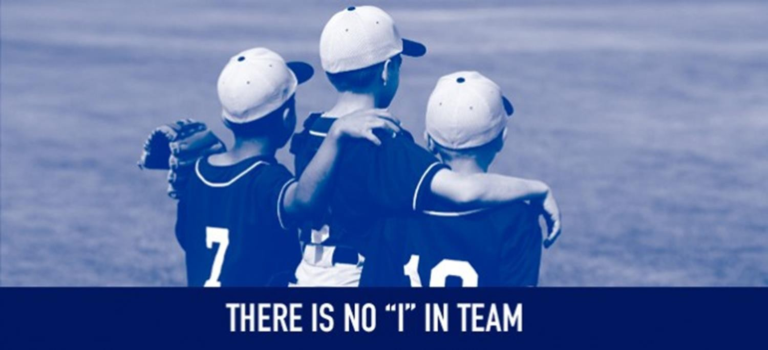


Groups, Teams and Organizational Effectiveness
Group
– Two or more people who interact with each other to accomplish certain goals or meet certain needs.
15-5

Slide 6
WHAT IS TEAM EFFECTIVENESS?
Team effectiveness refers to the system of getting people in a company or institution to work together effectively.

Slide 7

Characteristics of an Effective Team
Effective teams operate in an environment in which there is two way trust in an environment of open and honest communication
9

Slide 8
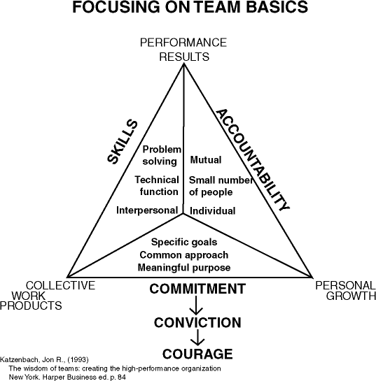

The Team Model
10

Slide 9

Teamwork Represents Values that:
Encourage listening and responding constructively to the views expressed by others
Give others the benefit of the doubt
Provide support
Recognize the interests and achievements of others
John R. Katzenbach and Douglas K. Smith, “The Discipline of Teams”, Harvard Business Review, March-April, 1993, pp. 111-120
- 11 -

Slide 10
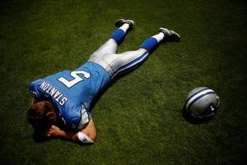
Characteristics of Losing Teams
Dominated by one individual
Compromise between two competing business strategies
Engage in groupthink
Not all team members contribute
- 12 -

Slide 11

Winning Teams
Trust
Clear time frame and agreed upon goals
Get facts and do analyses before making decisions
Divide responsibilities
All team members contribute
Challenge and play devil’s advocate
- 13 -

Slide 12

Team Effectiveness:
Potential for Process Gains
Potential advantages of using teams
As a whole, team has more knowledge, ability, effort
than any single team member
Diversity of views, knowledge, experience can lead to innovation, fewer errors
Potential for constructive conflict – task conflict focused on issue and not personalised
Can increase individual motivation and engagement

Slide 13

Team Effectiveness:
Potential for Process Losses
Social loafing can occur where people exert less effort when working in a team/group
Tips to reduce social loafing
Keep group size small
Increase identifiability and accountability
Specialise tasks to make individual efforts indispensible
Set clear, challenging goals
Increase involvement and engagement
Increase identification with the group

Slide 14

TEAM EFFECTIVENESS USING THE SCALED COMPARISON
Team Effectiveness is a proven and practical diagnostic tool for assessing team effectiveness and improving work group performance.
Team Effectiveness gives the team a very precise and reliable consensus as to what team members see going well and what needs improvement.
Cont..

Slide 15

TEAM EFFECTIVENESS USING THE SCALED COMPARISON
Team Effectiveness helps team members to very
quickly pinpoint the gap between where they are and where they need to be.
With Team Effectiveness, all team members participate
in team improvement through a sharing of their views about team performance and needed improvement.
Unlike other diagnostic tools, Team Effectiveness
works with teams as small as 5 to 7 members.

Slide 16

ASPECTS OF EXCELLENT TEAM
Balance and Coverage are two of the most important aspects of excellent teams:-
Whenever team is out of balance, it is vulnerable.
Great teams need coverage across key positions with strong individual players.

Slide 17

BOEHM’S PRINCIPLES
The principle of top talent : Use better and fewer people
The principle of job matching : Fit the tasks to the skills and motivation of the people available.
The principle of career progression : An organization does best in the long run by helping its people to self- actualize.
Cont..

Slide 18

BOEHM’S PRINCIPLES
The principle of team balance : Select people who will complement and harmonize with one another.
The principle of phase out : Keeping a misfit on
the team doesn’t benefit anyone.

Slide 19

FACTORS AFFECTING TEAM EFFECTIVENESS
The right mix of skills:- Bringing together the people having different skills that complement each other.
The right motivation:- Team effectiveness is directly related to the interest that team is having on the project.
The ability to solve conflicts without compromising the quality of the project.

Slide 20

WHAT DOES TEAM EFFECTIVENESS MEASURE?
Team Effectiveness assesses all of the major components of effective work groups, employing multiple statements for each of a number of basic elements. Some of the elements are :-
Structural Elements
Positive Interdependent Behaviors

Slide 21

WHAT DOES TEAM EFFECTIVENESS MEASURE?
Structural Elements
Shared Team Vision
Clear Team Goals
Clear Team Roles
Effective Leadership Behavior
Positive Interdependent
Behaviors
Effective Decision Making
Encouragement of Innovation
Effective Conflict
Management
Natural Collaboration
Effective Meeting
Management

Slide 22









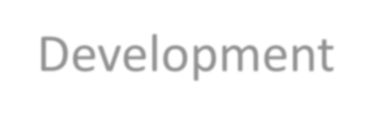



Team Processes
What happens when our team members get to work?
One major issue is Group/Team Development
– How do teams develop
and change over time?

Slide 23
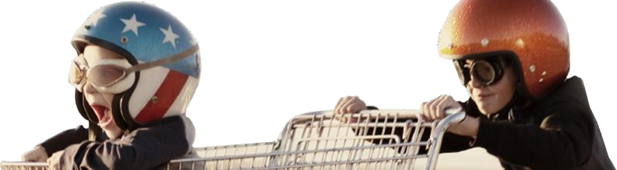
Team Processes: Development
Tuckman’s Model of Group Development (1965)
Performing
Adjourning
Norming
Storming
Return to Independence
Forming
Dependence/
interdependence
Is this a good model for the teams you’ve
experienced? Does it fit all teams?
Independence

Slide 24
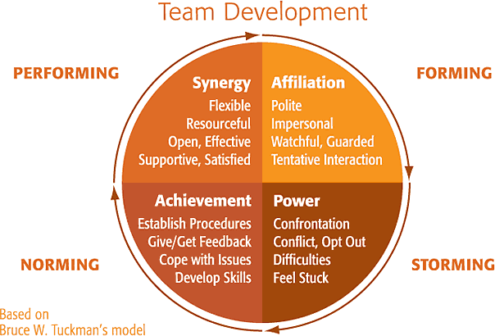

Slide 25

Team Processes: Trust
Trust refers to positive expectations of another person in
situations involving risk
Three levels of trust
Calculus-based trust
Knowledge-based trust
Identification-based trust
Based on emotional bond and mutual understanding
Likely to be present in highly effective teams

Slide 26
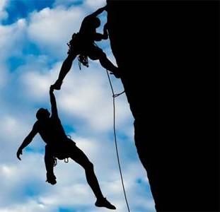
STRATEGIES TO IMPROVE TEAM EFFECTIVENESS
The task of building better teams and improving their effectiveness can be broken down into four simple and straightforward steps:
Clarify Your Team Mission
Set Team Goals!
Create A Plan
Conduct Progress Reviews.

Slide 27
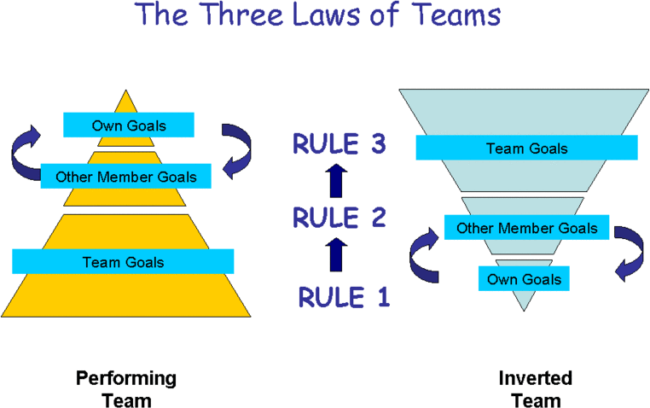

Slide 28
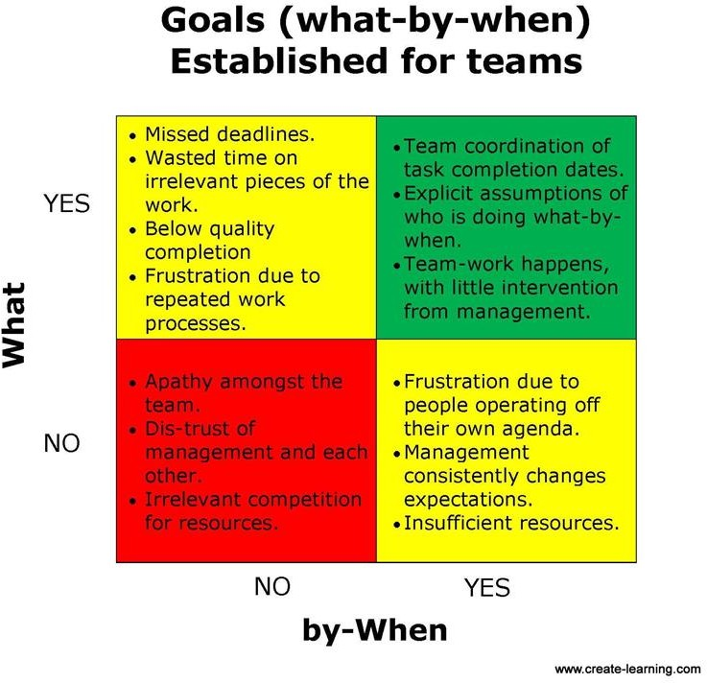

Slide 29
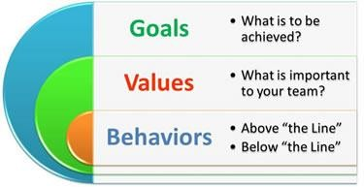

Slide 30

TEAM EFFECTIVENESS MODEL
Teams can continuously improve their effectiveness by focusing on improving their
functioning in five key areas: Goals, Roles, Procedures, Relationships and Leadership

Slide 31

5 key areas for Team Improvement
Goals: What the team aspires to achieve
Roles: The part each member plays in achieving the team
goals
Procedures: The methods that help the team conduct its work
together
Relationships: How the team members ‘get along” with each
other
Leadership: How the leader supports the team in achieving results.

Slide 32

CLEAR ROLES AND
RESPONSIBILITIES
Organization Structure Job Description Accountabilities Resources
Tools and Equipment Qualifications
CLEA• R
CLEAR
POSITIVE
RELATIONSHIPS
Mutual respect and trust Support
Inclusion Involvement Value diversity Listening Feedback
Okay with disagreement
PROCEDURES
PROC• ED^{F}U^{OR}R: ES FOR
Solving Problems
Solving Problems
and Making
and M• akinDegcisions
_{Decis}•_{ions}Communicating
CLEAR GOALS
Vision Mission Values Plans
STRONG LEADERSHIP
Personal Credibility Clear Expectations Clear Communication Engagement and Involvement
Develop People and
Team
All members responsible and accountable
Manage Change
Recognition
Managing Conflict
Comm• uniCcoamtpilnetging Tasks
Mana•ging^{Pl}C^{an}o^{ni}n^{ng}flict
Meetings
Comp• letin_{M}g_{an}T_{ag}a_{in}s_{g}k_{Ch}s_{ange} Plann•ing Evaluating _{Meeti}•_{ngs} Performance
Managing Change Evaluating Performance

