Slide 1

Management Culture and
Ethos

Slide 2
Karma Theory
Nishkama Yoga and Professionalism
Personal and Managerial Effectiveness in Indian Thoughts
Management of the Self
Management of Body, Thoughts and Emotions
Interpersonal and Group Effectiveness.

Slide 3
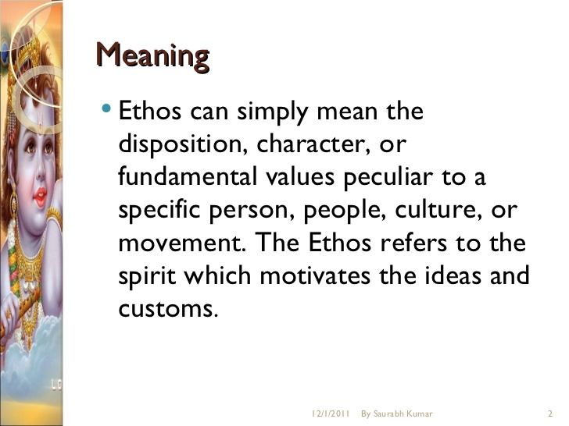

Slide 4
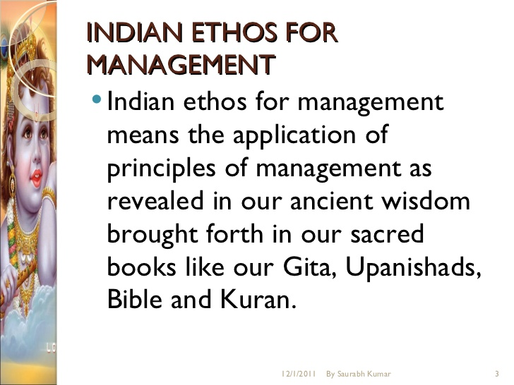

Slide 5
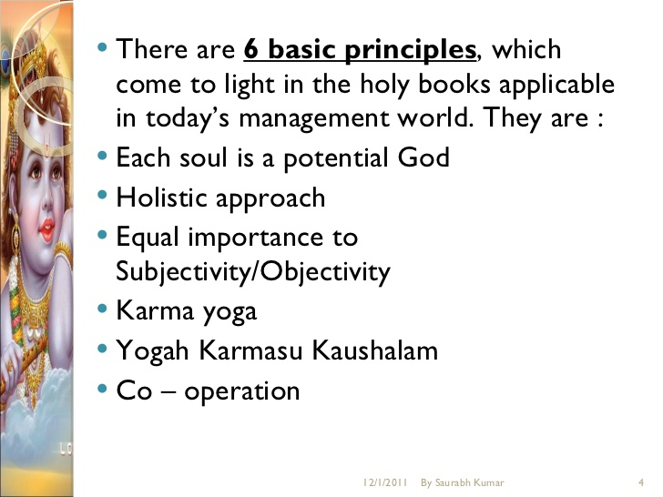

Slide 6
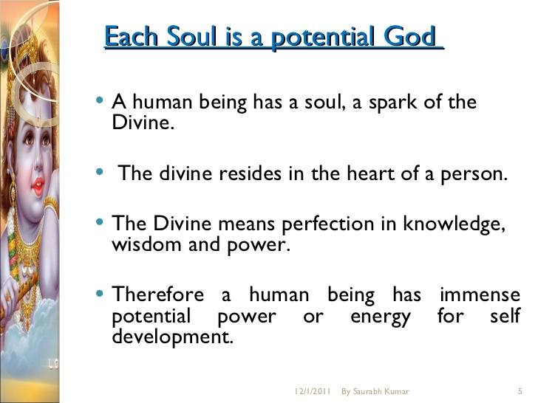

Slide 7
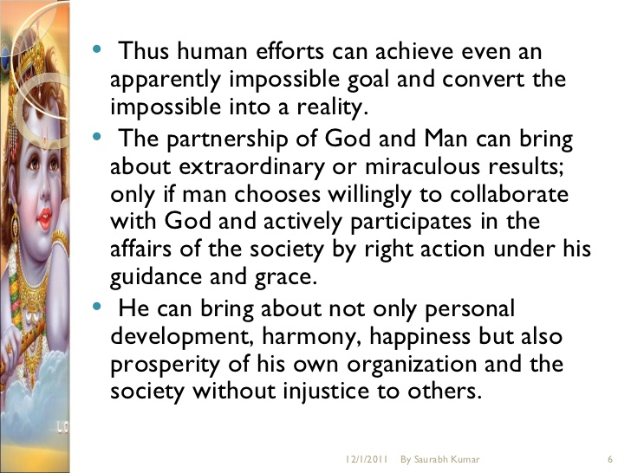

Slide 8
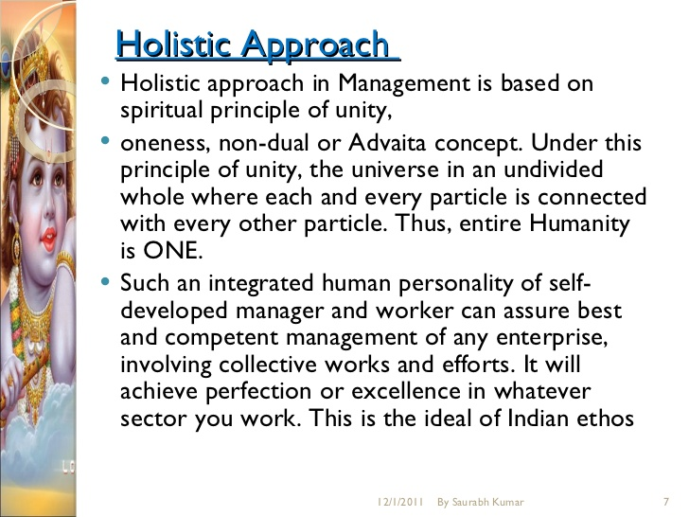

Slide 9
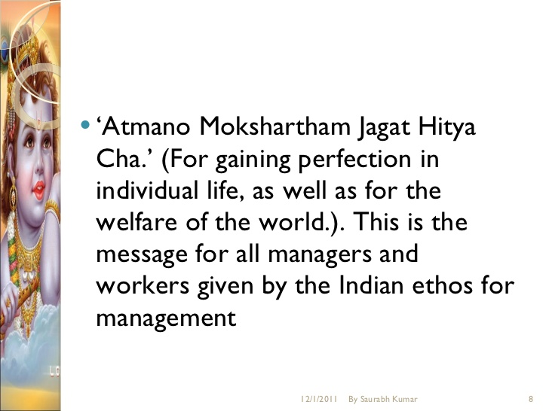

Slide 10
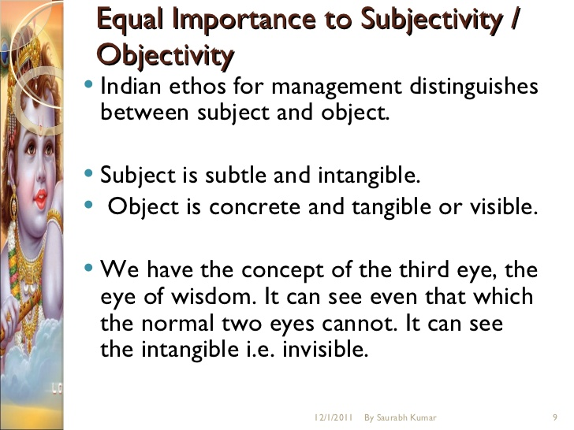

Slide 11
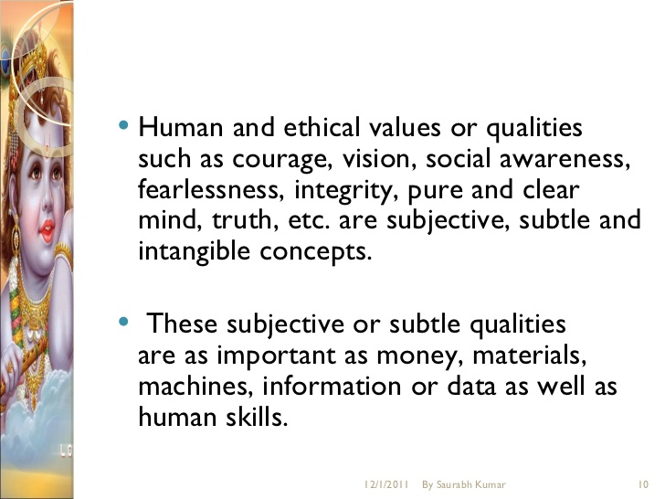

Slide 12
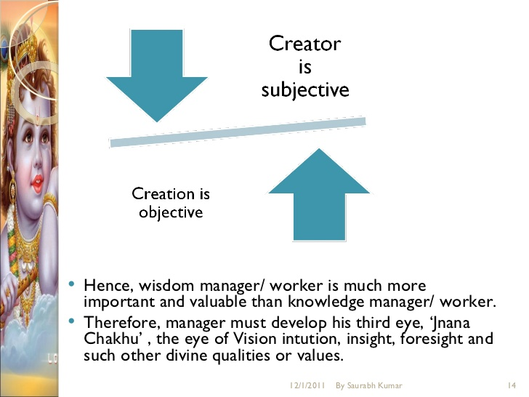

Slide 13
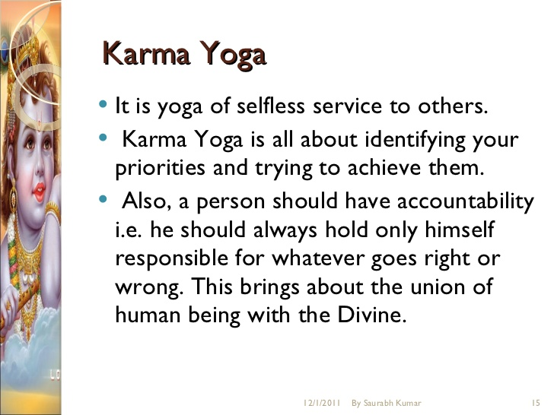

Slide 14
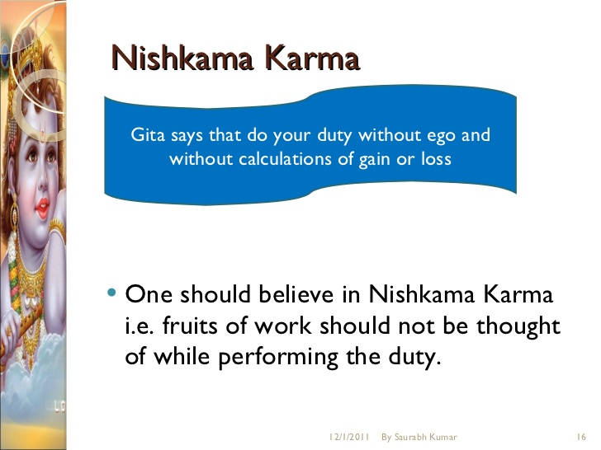

Slide 15
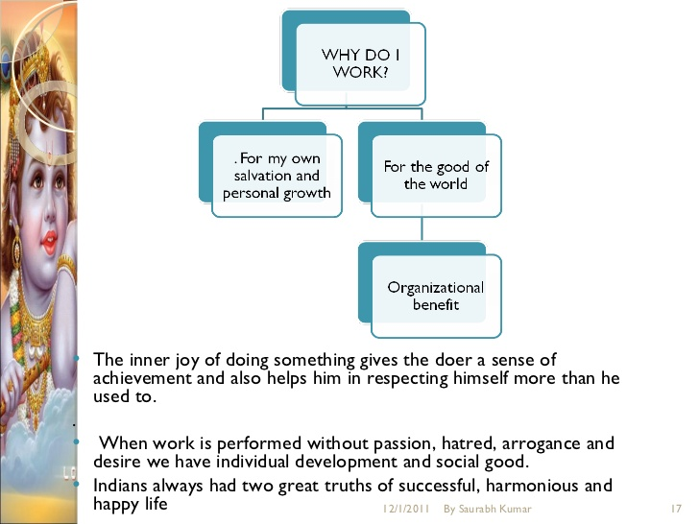
Happy life

Slide 16
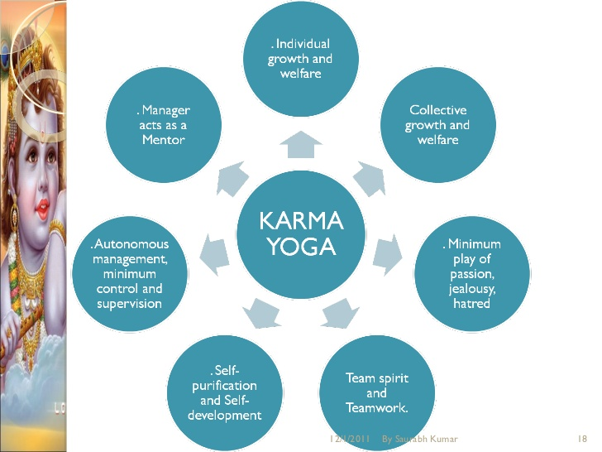

Slide 17
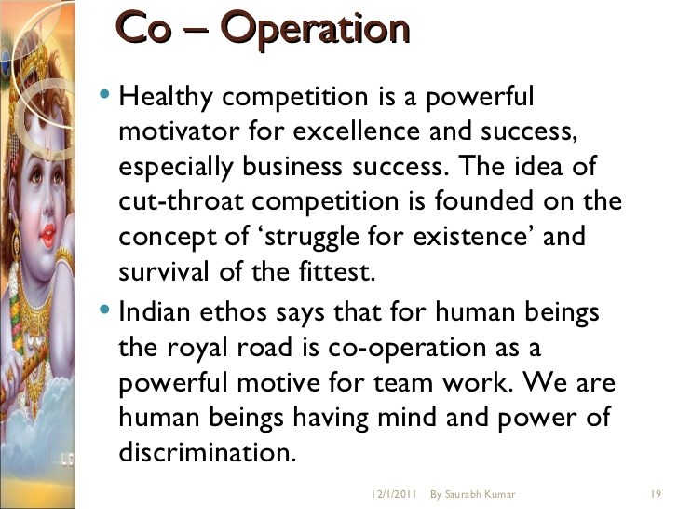

Slide 18
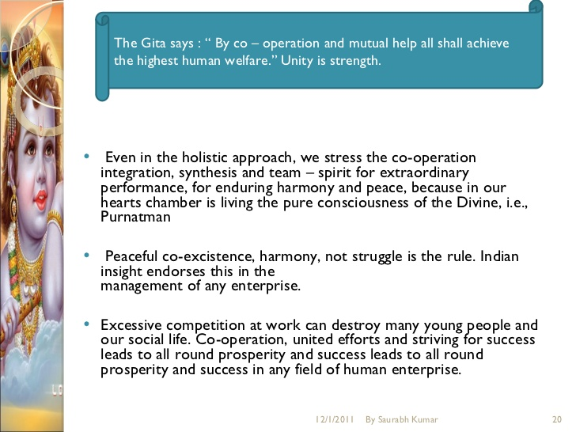

Slide 19
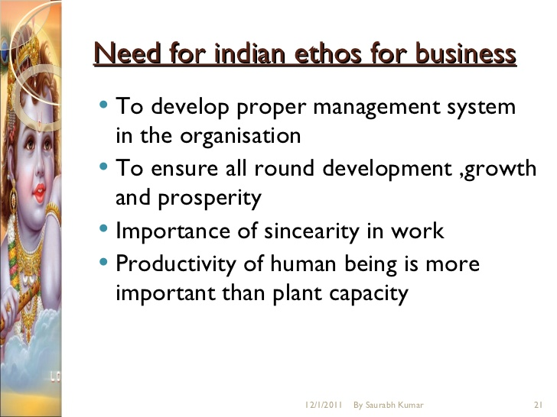

Slide 20
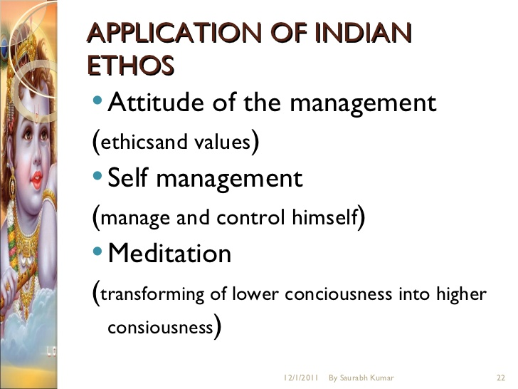

Slide 21
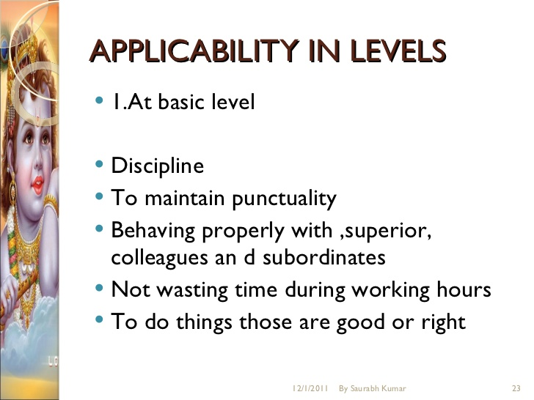

Slide 22
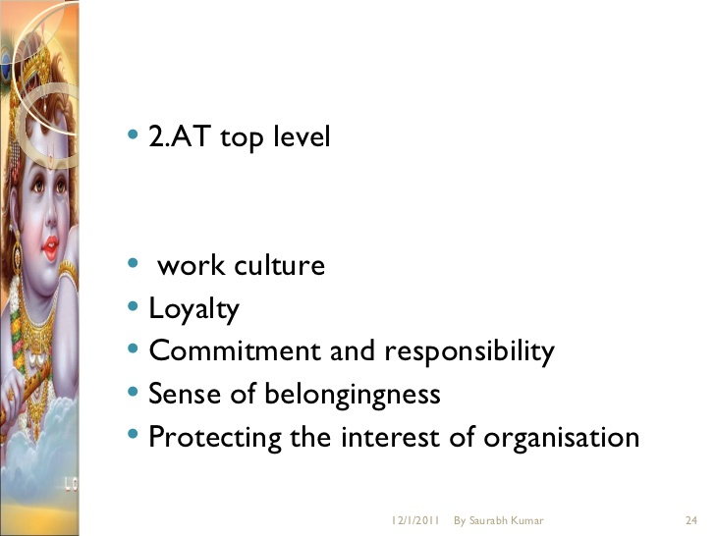

Slide 23
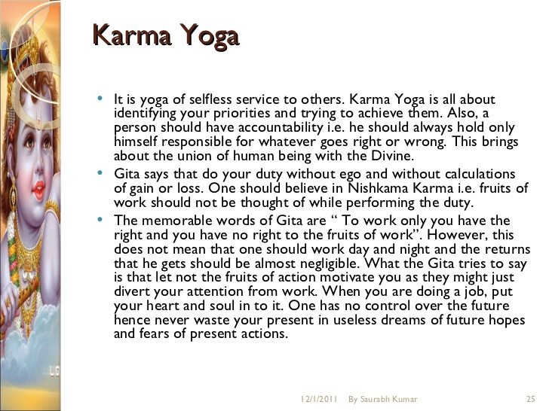

Slide 24
Management of the Self
Management of Body, Thoughts and Emotions
Interpersonal and Group Effectiveness.

Slide 25
What is self : SELF Is YOU
Your identity : Which You Carry For Whole Life
Self is : What You Want To Be In Your Life
Self is of two types : 1. Outer self 2. Inner self
Self management is must : If only if you want to achieve
Something Not Everything
The everything is a life goals
Health Goals
Finance Goals
Family Goals
Social Goals
Spiritual Goals

Slide 26
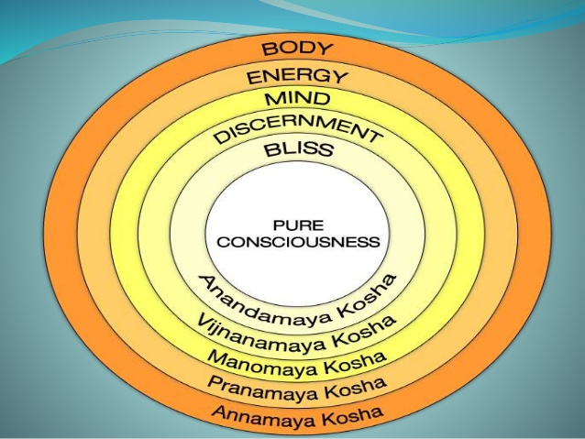
PANCHKOSH OF SELF MANAGEMENT

Slide 27
ANNAMAYA : Body and Food : What You eat : Rajshi, Tamsi, Satvik
Pranayama : Energy and Life : positive, Negative
Manomaya : State of mind : Satgun, Rajogun, Tamogun
Vigyanmaya : Inner soul : Sixth sense (Antaratma)
Aanandmaya : Ultimate Happiness : Be Happy and keep Happy
Pure consciousness

Slide 28
PANCHKOSH OF SELF MANAGEMENT
ANNAMAYA : Body and Food : What You eat : Rajshi, Tamsi, Satvik
Pranayama : Energy and Life : positive, Negative
Manomaya : State of mind : Satgun, Rajogun, Tamogun
Vigyanmaya : Inner soul : Sixth sense (Antaratma)
Aanandmaya : Ultimate Happiness : Be Happy and keep Happy

Slide 29
Skills of self management
Stress Mgt
Time Mgt
Problem-solving
Decision Making
Organizing
Confidence

Slide 30
SELF-MANAGEMENT
Self-regulation or self-management is the second of the three key areas of personal skills that make up Emotional Intelligence.
Self-regulation is concerned with how you control and manage yourself and your emotions, inner resources, and abilities. It also includes your ability to manage your impulses.
Self-regulation also includes an element of taking responsibility for your own actions, and ensuring that what you do matches with your personal values.
Five Elements Make Up Self-Regulation
Self-control
Trustworthiness
Conscientiousness
Adaptability
Innovation

Slide 31
SELF-CONTROL
Self-control is NOT masking or hiding your emotions but recognizing and controlling them appropriately.
This means NOT making rash decisions or over-reacting to a situation but remaining calm and rational. It leads to being able to make balanced decisions based on what is really important, and not just how we feel at the time.
People who have good self-control generally remain calm even when stressed. They are able to think clearly under pressure and still make good decisions.
Self-control usually manifests itself as the absence of visible emotion.

Slide 32
TRUSTWORTHINESS AND CONSCIENTIOUSNESS
Trustworthiness and conscientiousness can be considered as two sides of the same coin, because both are about behaving ‘well’, in accordance with your personal values and code of ethics.
Trustworthiness is your ability to maintain your integrity, which means ensuring that what you do is consistent with your personal values.
People who are trustworthy act ethically. They build trust through their personal actions, and the way that their actions are consistent with their espoused values. They are also prepared to confront unethical actions and take a stand when necessary, even if that stand will be unpopular.
Conscientiousness is taking responsibility for your own personal performance, and making sure that it matches up to your ability and your values.

Slide 33
ADAPTABILITY
Adaptability was defined by Daniel Goleman as being flexible in responding to change.
Change is difficult for many of us to manage. Anyone who has had any close contact with children will recognise that change is unsettling and stressful for small children, and that being able to manage it is very much a learned skill. Without careful control and development of our personal adaptability and resilience, personal change can remain very stressful into adulthood.
However, by understanding what is happening, and developing our ability to manage change, it is possible to greet change as an adventure, rather than as a problem.

Slide 34
INNOVATION
Innovation is being open to novel ideas and approaches.
An Essential Part of Emotional Intelligence
Learning to regulate and manage yourself, your emotions and your inner resources is a key stepping stone to good emotional intelligence.
Only those who understand and value themselves, and are able to draw on their own resources, will be able to relate fully and completely to others.

Slide 35
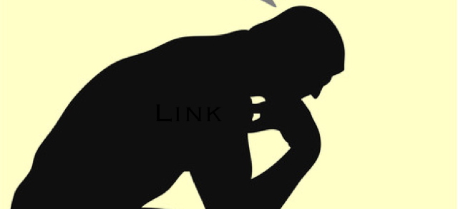
THOUGHT MANAGEMENT
THOUGHT MANAGEMENT
Link Between Thoughts, feelings and behavior

Slide 36
One of the best tools is how to understand and change my thoughts.
It’s estimated that humans have an average of 60,000 thoughts per day! Were you aware you were thinking so much? Probably not, for a vast majority of these thoughts are what called
“Automatic Thoughts”
they come automatically, without any conscious effort on our part, and most of the time we don’t even hear them.
The problem is that our thoughts are linked to our bodily reactions, emotions, and behaviors. Even thoughts we don’t intend or want can set off a cycle of sensations, emotions and behavioral reactions, leaving us feeling out of control. But learning to see the connection between thoughts, feelings, bodily responses, and behaviors empowers us.

Slide 37
The Thought Cycle
Life gives us situations. For example, I am walking through the forest when I see a bear. An automatic thought arises, “Ah! There’s a bear!” This thought creates a physiological response: my blood pressure rises, pulse increases, heart rate speeds up, and adrenaline pumps through my body. Almost simultaneously there is an emotion, or several emotions. Facing the bear I feel anxiety, panic, and fear; I then engage in a behavior. In this case, I run away from the bear. (Now, I have learned recently that the best thing to do when encountering a bear is actually not to run away, but for the sake of this example, we will ignore that little fact). Let’s say I run away to safety. What is my next thought? Perhaps, “Wow! I am safe! Way to go, me! Whew!” And my body’s response is for my parasympathetic nervous system to kick in, my heart rate slows, pulse lowers, and breathing resumes a more natural pattern. I have some emotions—joy, relief, satisfaction! And my next behavior? I go out for an ice-cream cone to celebrate my success!

Slide 38
But let’s say I’ve been raised to believe I am good-for-nothing—I am a wimp, I overreact, I always run away from my problems. In this case, after I find myself safely out of the bear’s reach, my thoughts might sound like, “You are such a wimp! Why did you run? It was just a small bear. You probably could have taken it! Why are you always such a coward?” My body’s response would be to keep the cortisol and adrenaline flowing, my stomach would become upset from tension, and my breathing would remain fast and shallow. My emotions might include frustration, anger, disappointment, and self-loathing. And my behavior? I would go and eat an entire carton of ice-cream as form of self-punishment.

Slide 39
The Thought Cycle
We can see that not only are thoughts, feelings, the body, and behaviors connected; they are influenced by the thoughts, feelings, reactions and behaviors of our past.
And once we can see this cycle, we have a choice: to either ignore what we see, or to listen and intervene when we hear something that doesn’t quite make sense.

Slide 40
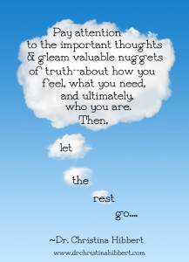
Start Small,
Gain Power

Slide 41
Set Yourself Free
It takes time to master your thinking, but it is well worth the effort.
“The truth shall set you free.”

Slide 42
Emotions are feelings
How do I feel? How do I know?
But others also have emotions. At the same time as being aware of your own feelings, you also need to be aware of those of others.
How do others feel, and how do I know?
There are several ways that we can tell how others are feeling, but particularly by observing what they say, and how they behave, including their body language.
Research suggests that more than 80% of communication is non-verbal, meaning that it comes from body language and facial expression.
Many of us don’t like to talk about our emotions, especially not if they really matter to us, so they tend to be expressed even more in our body language..

Slide 43
Emotions and the Brain
Emotions are not consciously controlled. The part of the brain that deals with emotions is the limbic system. It’s thought that this part of the brain evolved fairly early on in human history, making it quite primitive. This explains why an emotional response is often quite straightforward, but very powerful: you want to cry, or run away, or shout.
It’s because these responses are based around the need to survive.
Emotions are strongly linked to memory and experience. If something bad has previously happened to you, your emotional response to the same stimulus is likely to be strong.
Babies feel emotion, but can’t necessarily reason. Emotions are also closely linked to values: an emotional response could tell you that one of your key values has been challenged.
Understanding this link to memory and values gives you the key to managing your emotional response. Your emotional responses don’t necessarily have much to do with the current situation, or to reason, but you can overcome them with reason and by being aware of your reactions.

Slide 44
You can’t control other people, but you can control how you react to them.
- Anon.
“Anybody can become angry - that is easy, but to be angry with
the right person and to the right degree and at the right time and for the right purpose, and in the right way -
that is not within everybody's power and is not easy”

Slide 45
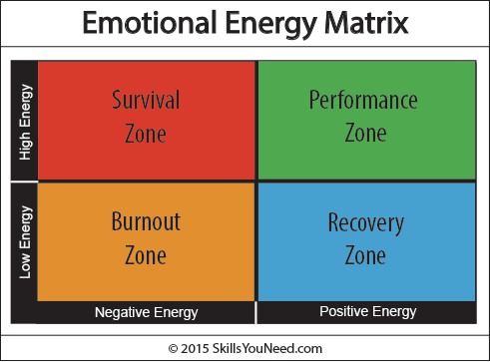

Slide 46
Positive steps to help you manage Emotions
Exercise: this releases reward and pleasure chemicals in the brain such as dopamine, which makes you feel better. Being fit also makes you healthier, which helps in managing emotions.
Be kind to others, because this helps stop you worrying about yourself.
Be open and accept what is going on around you. Learn to appreciate what is happening and avoid excessive criticism of others or of situations. It’s good to talk. Spend time with other people and enjoy their company.
Distract yourself. Yes, you really are that shallow. Watching a bit of TV, reading, or surfing the internet will probably help you
Don’t give in to negative thinking. If you find yourself having negative thoughts, then challenge them by looking for evidence against them.

Slide 47
Positive steps to help you manage Emotions
Spend time outside. Being in the fresh air, especially around nature, is very helpful for calming the emotions.
Be grateful. Thank people in person for doing nice things for you, and remember it.
Play to your strengths. That often means doing things that you enjoy, but it also involves doing things that are good for you.
Notice the good things in your life. In old-fashioned terms, count your blessings.
This list may sound quite old-fashioned, but then perhaps our grandparents knew a thing or two about managing emotions that we may have forgotten. Finding the right balance for you can help reduce your stress levels and may help fight depression.

Slide 48
Applying Reason to Emotion
you can change how you feel. The key is to be aware of your emotional response, and understand what might be behind it. That way, you can apply some reason to the situation.
Decisions with Emotions
When you make decisions, you can draw on reason, emotion, or a mixture of the two.
Emotional decisions are sometimes seen as made in the ‘heat of the moment’, but emotions play a greater part in most decisions than we may be aware.
The best decisions are made using both logic and emotion.
If you only use one or the other, your decisions may either not be very balanced, or not support your emotional needs. Instead, you need to combine your emotional response with more rational considerations.

Slide 49
Emotions are Important
It pays to be aware of our own and others’ feelings. Highly emotionally intelligent people do this all the time. Like any other, it is a skill that can be developed and which is well worth acquiring.
I've learned that people will forget what you said, people will forget what you did, but people will never forget how you made them feel.

