Slide 1

INTERPERSONAL SKILL?
Interpersonal skills are the life skills we use every day to communicate and interact with other people, both individually and in groups. People who have worked on developing strong interpersonal skills are usually more successful in both their professional and personal lives.
Why Can’t We All Just Get Along?

Slide 2
WHY IS INTERPERSONAL SKILL NEEDED?
IMPROVING POWER OF EXPRESSION
BEING ACCOUNTABLE
IMPROVING SELF MANAGEMENT SKILLS USING STRESS TO WIN
IMPROVED EMOTIONAL QUOTIENT

Slide 3
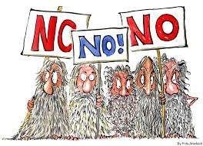

Three Objectives of Interpersonal Effectiveness:
1- Be skillful in achieving objectives with others by…
…asking for help.
…saying no to unwanted requests.

Slide 4

Relationships…
…are precious
…are vulnerable
…provide love, companionship, and support
…require skills to remain healthy

Slide 5

Goals in Interpersonal Situations:
Relationship Effectiveness – Ask yourself, “How do I want the other person to feel about me after the interaction, whether or not I get what I want?”

Slide 6


2- Build healthy relationships and end destructive ones by….
…heading off problems
…not letting hurts and problems build up
…repairing relationships or ending them effectively

Slide 7

3- Walk the Middle Path by…
…balancing own priorities with demands of others.
…balancing acceptance and change in relationships

Slide 8

Goals in Interpersonal Situations:
1- Clarify Your Priorities – Ask yourself, “What do I want and how important is getting it?”

Slide 9

Goals in Interpersonal Situations:
2 – Objectives Effectiveness – Ask yourself, “What specific result or change do I want from this interaction?

Slide 10
TYPES OF INTERPERSONAL SKILL NEEDED?
Verbal Communication - What we say and how we say it.
Non-Verbal Communication - What we communicate without words, body language is an example.
Listening Skills - How we interpret both the verbal and non-verbal messages sent by others.
Negotiation - Working with others to find a mutually agreeable outcome.

Slide 11
Problem Solving - Working with others to identify, define and solve problems.
Decision Making – Exploring and analysing options to make sound decisions.
TYPES OF INTERPERSONAL SKILL NEEDED?
Assertiveness – Communicating our values, ideas, beliefs, opinions, needs and wants freely.

Slide 12
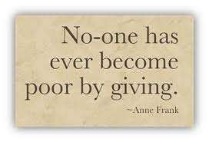

Skill: GIVE
Be Gentle.
Act
Interested.
Validate.
Maintain an Easy Manner.

Slide 13
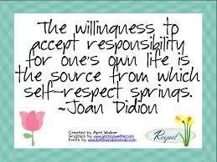
Goals in Interpersonal Situations:
4 – Self Respect Effectiveness – Ask yourself, “How do I want to feel
about myself after the interaction, whether or not I get what I want?”

Slide 14

Skill: FAST
Be Fair.
(No) Apologies.
Stick to your values.
Be Truthful.

Slide 15

And above all, be Mindful…

Slide 16
COMMUNICATION SKILL
Effective verbal or spoken communication is dependant on a number of factors and cannot be fully isolated from other important interpersonal skills such as non-verbal communication, listening
skills and clarification.
Clarity of speech, remaining calm and focused, being polite and following some basic rules of etiquette will all aid the process of verbal communication.

Slide 17
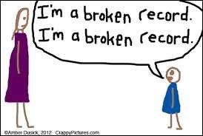
Skill: DEARMAN
Describe the situation. Express feelings and opinions. Assert what you want.
Reinforce with rewards and consequences.
Be Mindful.
“Broken record”; Ignore attacks.
Appear confident.
Negotiate.

Slide 18
LISTENING SKILL
Listening is the ability to accurately receive and interpret messages in the communication process.
Listening is key to all effective communication, without the ability to listen effectively messages are easily misunderstood – communication breaks down and the sender of the message can easily become frustrated or irritated.

Slide 19
Negotiation is a method by which people settle differences. It is a process by which compromise or agreement is reached while avoiding argument and dispute.
In any disagreement, individuals understandably aim to achieve the best possible outcome for their position (or perhaps an organisation they represent). However, the principles of fairness, seeking mutual benefit and
maintaining a relationship are the keys to a successful outcome.

Slide 20
PROBLEM SOLVING SKILL
Everybody can benefit from having good problem solving skills as we all encounter problems on a daily basis; some of these problems are obviously more severe or complex than others.
It would be wonderful to have the ability to solve all problems efficiently and in a timely fashion without difficulty, unfortunately there is no one way in which all problems can be solved.

Slide 21
DECISION MAKING SKILL
People often find it hard to make decisions - inevitably we all have to make decisions all the time, some are more important than others.
Some people put off making decisions by endlessly searching for more information or getting other people to offer their recommendations.
Not necessarily, decision taken at that moment is best, but one should never delay it.

Slide 22
ASSERTIVE SKILL
Assertiveness is a skill regularly referred to in social and communication skills training.
Often wrongly confused with aggression, assertive individuals aim to be neither passive nor aggressive in their interactions with other people.
Although everyone acts in passive and aggressive ways from time to time, such ways of responding often result from a lack of self-confidence and, therefore, are inappropriate expressions of what such people really need to say.

Slide 23
ADVANTAGE OF HAVING GOOD INTERPERSONAL SKILLS
Good interpersonal skills create significant advantages when communicating to build successful relationships.
Consciously gathering information as you enter the process will make you more effective. Think of it as gathering intelligence to become more efficient. Looking, listening, and reacting to the situation before you begin the process is far more effective than blindly moving forward into communication?

Slide 24
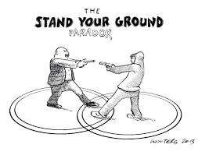
Goals in Interpersonal Situations:
5- Evaluate your Options – Before asking for what you want, or saying no to what another wants, ask yourself, “How intensely do I want to hold
my ground?”

Slide 25
Factors Reducing Interpersonal Effectiveness:
◆ Lack of needed skills
◆ Indecision
◆ Interference from Emotions
◆ Prioritizing Short Term Goals over Long Term Goals
◆ Interference from Environment
◆ Interpersonal Myths

