Slide 1
Unit 2
Moral Responsibility

Slide 2
Moral Responsibility
Introduction
Balanced Concept of Freedom
Individual Responsibility
Implications Related to Modern Issues
Public Accountability and Entrepreneurial responsibility
Moral corporate excellence

Slide 3
Definition: Moral responsibility is the voluntary attributable responsibility ensuring that acts knowingly and intentionally carried out by rational human beings don't cause injury to other individuals.
Importance :
Making judgments about whether a person is morally responsible for her behavior, and holding others and ourselves responsible for actions and the consequences of actions, is a fundamental and familiar part of our moral practices and our interpersonal relationships.

Slide 4
ELEMENTS OF MORAL RESPONSIBILITY
causality. ( the relation between cause and effect)
knowledge. ( the facts, information and the skills acquired by the person through education or experience)
Freedom. ( freedom of speech and act without any restraints)

Slide 5
Business leaders have long recognized that they play a key role in promoting ethical conduct in their businesses.
They set the ethical tone that pervades the entire organization. ... They lead by example. Ethics is communicated through words, but words are compelling only when they are supported by action.

Slide 6
Balanced Concept of Freedom
The idea of balanced concept of freedom is that to be morally responsible for something, an individual had to have some amount of freedom, at some suitable time prior to the action to the action or outcome for which he is responsible.

Slide 7
Freedom

Slide 8
“
Freedom is not worth
having if it does not
include the freedom to
”
make mistakes
-Mahatma Gandhi

Slide 9

What does
FREEDOM
means to you?

Slide 10

There are plenty definitions of
FREEDOM
Freewill
Freedom of Speech
Liberty
Freedom of Choice
Rights
Autonomy

Slide 11

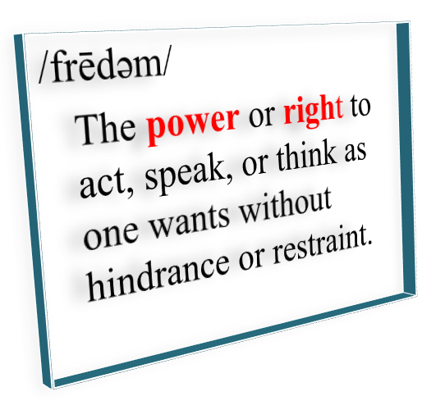
FREEDOM

Slide 12








Internal Freedom
Self
Freedom
External Freedom
Political Freedom
TYPES OF
FREEDOM
Collective Freedom
Spiritual
Freedom

Slide 13
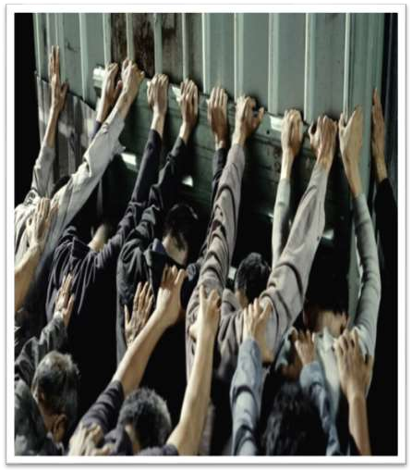

Internal Freedom
The first and most basic type of freedom is embodied by the chap in jail.
is of the greatest personal intimacy and secretiveness, indeed it is the hidden core of our being and unknowable by others.
some people call this moral freedom. But this kind of freedom is not in itself moral.

Slide 14

Self Freedom
in the sense of learning how to escape the ever-present danger of enslavement by our own passions and ignorance.
practice of self-control, restraint, and balance to achieve the admired master- slave relationship of soul over body
“to find my self”

Slide 15

External Freedom
This refers to the normal and common freedoms expected in daily life, in most countries, throughout history.
Sometimes called “freedom from...”
it implies immunity from undue interference by authority, especially by government.

Slide 16
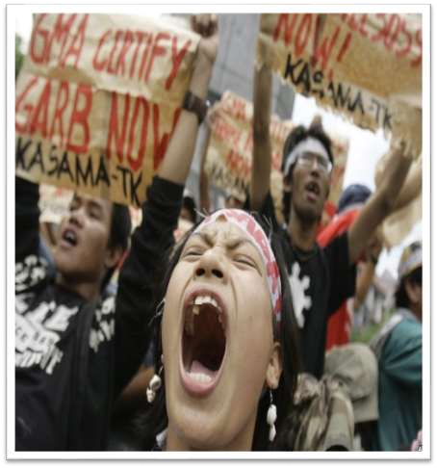
Political Freedom
Sometimes called “freedom
to...”
has to do with establishing certain rights of action and limits to government power that help to guarantee the practice of those rights.
the right to speak freely, to associate with people of your choice, to own property, to worship.

Slide 17

Collective Freedom
Sometimes called “freedom for…”
based on an ideology of collective unity that prescribes distinct social and moral values and objectives for all.
example, often under this ideal of freedom the state is allowed to control the production of all basic citizen needs, thus giving them freedom-from-want.

Slide 18

Spiritual Freedom
In its purest form this type of freedom comes from striving for a complete identification with God to arrive at a condition of soul that transcends the confusion and disharmony of the self and the material world.
For this type, strict control if not denial of the allurements of the body leads to complete freedom of the spirit.

Slide 19
“With great power comes
”
great responsibility
-Spiderman

Slide 20

What does
RESPONSIBILITY
means to you?

Slide 21
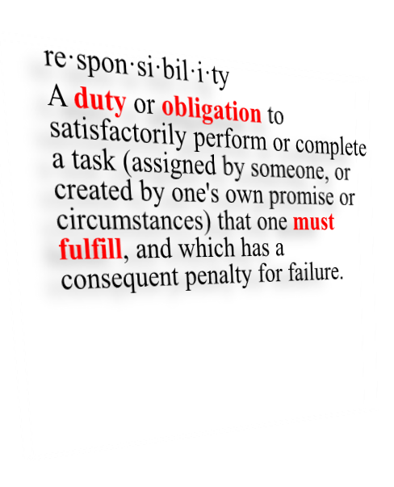

RESPONSIBILITY

Slide 22



RESPONSIBILITY CONTEXT
LEGAL MORAL
what can be established in a court on the basis of evidence.
Subject to additional legal criteria
what the person actually did (truth, discovery)
Subject to further moral criteria

Slide 23


RESPONSIBILITY CONTEXT
LEGAL MORAL

Slide 24
RESPONSIBILITY AND JUSTICE
A distinction between the objects of justice:
“Goods”
The traditional concern of distributive justice.
e.g. wealth, income, liberty, rights, happiness.
“Bads”
The traditional concern of theories of punishment (“retributive justice”)
poverty, deprivation, constraint, ill-treatment, misery

Slide 25
RESPONSIBILITY AND JUSTICE
An asymmetry in desert:
Deserving a “good” need not entail responsibility (mugging victim deserves compensation; patient deserves medical care; everyone deserves respect; even a criminal deserves a fair trial)
Deserving a “bad” does seem to require responsibility (as in punishment)

Slide 26




Four Kinds of Responsibility
Role Responsibility
The duties one has for doing various things which come with occupying a certain role in society
Causal Responsibility
What caused something to happen
Liability Responsibility
Who is liable for something’s happening
Capacity Responsibility
The capacity of a person to be held liability responsible for their actions

Slide 27



The Relata of Responsibility
The Party the Agent is Responsible to
The Agent of Responsibility
The Object of Responsibility

Slide 28
“ Price of
Responsibility is the
freedom"
-Elbert Hubbard

Slide 29
Implications Related to Modern Issues
&
Moral corporate excellence

Slide 30


Bribery in corporate world.
Insiders Trading – Leaking of confidential information or data to third party.
Unnecessary Bureaucratic Delays.

Slide 31
Conflict of Interest between employee and employer.
Unfair discrimination.
Political Donations and Gifts.

Slide 32
Presentation of false financial reports related to Income and profits and Loss statements.
Accumulation of Profits by illegal trade practices.
Greed and falling moral values of people.

Slide 33

Corporate excellence is defined as the company’s ability to outsmart its competitors consistently over a long period of time.
Corporate excellence is to set internal framework of standards and processes to engage and motivate employees to produce and deliver quality products to its customers.

Slide 34
Excellence is a requirements and expectations without demonstrating significant flaws or waste.
of consistently
surpasses
that

Slide 35


Leadership and Initiative.
People involvement in process.
Partnership and resource allocation.
Customer Focus

Slide 36


Process standardization.
Quality Assurance.
Planning and Quality information.
Top Management involvement and commitment.

Slide 37
Sustainable Development and maintaining ecological balance.
Developing Core Competence.
Defining Business Processes Through Business Process Re engineering.

Slide 38
Shifting to e-commerce to wider range of markets.
Maintaining Customer Relationship through electronic Customer relationship and resolving issues promptly.
Developing Social Consciousness through organizing social activities and Programs.

Slide 39
Zero Defect and Zero Effect.
Maintaining Total Quality Management Policies.
Going Green.
Measuring Social Impact through Social Audits.

Slide 40
Setting Priorities of objectives and running business through effective policies.
Working coherently with Mission Statement of the company.
Setting Broader Goals for shouldering Social responsibility.

Slide 41
Setting Priorities, Premises .
Getting Inputs in the form of relevant information.
Setting SMART – goals ( Specific, Measurable, Achievable, Realistic and time bound)

Slide 42
Avoid Nepotism and Discriminatory Policies.
Consulting a Lawyer for drafting Ethics.
Appointing a Compliance Officer.

Slide 43
Tata Group- Through its 22 Clause code of Ethical Practices
Patagonia – American Company making Outdoor Clothing.
Starbucks : 100% Sustainably Sourced Coffee Under its CAFÉ Program- Coffee and Farmer Equity Practices.

Slide 44
H & M: Clothing Retailer by maintaining 98.5% transparency.
WIPRO Ltd. : Spent nine hundred Crore Rupees in Karnataka and Andra Pradesh for developing School for raising education standard.
ISHA Foundation: Developing Schools for Poor and Running Kaveri calling program for intense plantation drive.

