Slide 1
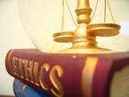
BUSINESS ETHICS

Slide 2
UNIT I
The Nature and Purpose of Ethical Reflections
Introduction Definition of Ethics
Moral Behaviour.
Charactenstics of Moral Standards
Business Ethics Mediating between Moral Demands and Interest
Relative Autonomy of Business Morality.
Studies in Business Ethics
Role of Ethics in Business.
Theory of Voluntary Mediation
Participatory Ethics.
Duty ethics in the Business Environment
Theories of Virtue
Case Study : Trade In Human Organs.

Slide 3
Ethics: What Does It Really Mean???
Derived from Greek
word
‘Ethicos’
meaning
Character or Manners
Science of character of a person expressed as right or wrong conduct or action.
▪
Set of moral principles prescribing code, explains what is good and right, or bad and wrong.

Slide 4
Definition:
“An area of study that deals with ideas about what is good and bad behavior “
EHICAL DELIMA RELATES TO TWO DIMENSIONS:
Personal
Professional

Slide 5
FORD MOTORS
The Ford Motor Company decided to produce the first lowest-priced car in the USA. The Company President Mr. Lee Iacocca wanted to rush the development of a car costing less than $2,000, as he promised the public that his company will bring out a car at that price (as low as $2,000) and also fight the growing popularity of Volkswagen’s Beetle. Preliminary tests showed that it involved an additional cost of $11 to enhance the safety of the car.
He organized a meeting of company executives to decide how to reduce the cost below $2,000. Many executives suggested that the company should sell the car at $2,011 but include the safety feature. Some executives thought that the company should sell the car at $2,000 as promised but exclude the safety feature. The company decided to go ahead without the safety feature.

Slide 6
The car was released and sold at $2,000. After six months of release, one of the cars was involved in an accident killing all the passengers. Competitors influenced newspapers to publish this accident and the newspapers in the U.S.A. highlighted the absence of the safety feature. This incident resulted not only in the loss of sales, but also in the closure of the unit resulting in a loss of $250 million to the company.

Slide 7
Business Ethics – History
The history of Ethics goes back to 1970’s when the term Business Ethics was commonly used. Increasingly unethical conduct was found by corporations during the 1960s. To counter this, corporations developed social responsibility programmes which included charitable donations and funding local community projects.
This new aspect of business ethics differentiated it from social issues courses in three ways:
It provides an ethical framework for evaluating business and the corporate world.
ii. It allows critical analysis of business and development of new and different methods.
iii. It fused personal and social responsibility together and gave it a theoretical foundation.

Slide 8
Definition
Everything you need to know about business ethics. Business ethics implies general ethical ideas to business behaviour.
Ethical behaviour not only improves profitability but also fosters business relations and employees productivity. Business ethics is concerned with the behaviour of businessman in doing a business. Unethical practices create problems to businessman and business units.
“Business Ethics is an art and science for maintaining harmonious relationship with society, its various groups and institutions as well as recognizing the moral responsibility for the tightness and wrongness of business conduct” -Wheeler.

Slide 9
Meaning of Ethics
Good or Bad, Right or wrong, Moral or Immoral
Taken
together
Considered As
Character
of a man
Decided by
Conduct
of a person
Leads to
Series of Actions
By which we can Judge again
Known as Moral Judgement
Moral Standards
Requires

Slide 10
Treat others as you would be treated
Foundation of ethical Behavior
Respect
Honesty
Trust

Slide 11
Principal Components of ‘Ethics’:
i. Ethics are principles, values and beliefs that define what is right and wrong behavior.
ii. Ethics are broader than what is stated by law, customs and public opinion. For example, accepting gifts from father-in-law might be socially acceptable but not ethical; owners pocketing profits without sharing the gains with workers might be legally permissible but not ethical.
iii. Ethical behaviour may differ from society to society. For example, birth control is mandatory in Communist societies but not in Catholic Christian societies.
iv. Ethical standards are ideals of human conduct. Defining ethical stand­ards is not an easy task.

Slide 12
Objective of Ethics
Studies human behavior and makes evaluative assessment about them as moral or immoral
Establishes moral standards and norms of behavior
Makes judgment
upon human behavior based on these
standards and norms
Prescribes moral behavior and makes recommendations about
how to or how not to behave
Expresses an opinion or attitude about human conduct in general

Slide 13
Normative Science
Deals with human beings only
Nature of Ethics
Deals with Human Conduct
Dealing with Moral Judgment

Slide 14
Business Ethics
Business ethics can be defined as written and unwritten codes of principles and values that govern decisions and actions within a company.
In the business world, the organization’s culture sets standards for determining the difference between good and bad decision making and behavior.

Slide 15
Business Ethics: What Does It Really Mean???
comprises principles and standards that guide behavior in the world of business
According to John Donaldson “Business Ethics can be described as the systematic study of moral (ethical) matters pertaining to business, industry or related activities, institutions, or practices and beliefs. It is the systematic handling of values in business and industry.”

Slide 16
Business Ethics – 13 Main Characteristics
There are several characteristics or features of business ethics.
1. Business ethics are based on social values, as the generally accepted norms of good or bad and ‘right’ and ‘wrong’ practices.
2. It is based on the social customs, traditions, standards, and attributes.
3. Business ethics may determine the ways and means for better and optimum business performance.
4. Business ethics provide basic guidelines and parameters towards most appropriate perfections in business scenario.
5. Business ethics is concerned basically the study of human behaviour and conducts.
6. Business ethics is a philosophy to determine the standards and norms to make mutual interactions and behaviour between individual and group in organisation.

Slide 17
7. Business ethics offers to establish the norms and directional approaches for making an appropriate code of conducts in business.
8. Business ethics are based on the concepts, thoughts and standards as contributed as well as generated by Indian ethos.
9. Business ethics may be an ‘Art’ as well as ‘Science’ also.
10. Business ethics basically inspire the values, standards and norms of professionalism in business for the well-being of customers.
11. Business ethics is to motivate and is consistently related with the concept of service motives for the customers’ view point.
12. Business ethics shows the better and perspective ways and means for most excellences in customisation.
13. Business ethics aims to emphasise more on social responsibility of business towards society.

Slide 18
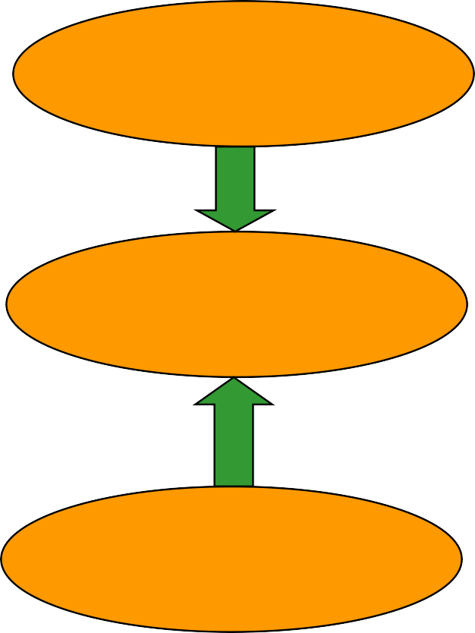
Views on relationship between Business & Ethics
Unitarian View: Business & morality cannot be separated and it must
play by the rules of ethics of the community.
Moral Structure
Business
Moral Ethics

Slide 19
Separatist view of Ethics
Proposed by Adam Smith and Milton Friedman: Business is a distinct entity and does not include ethics and morality
Business
Ethics

Slide 20
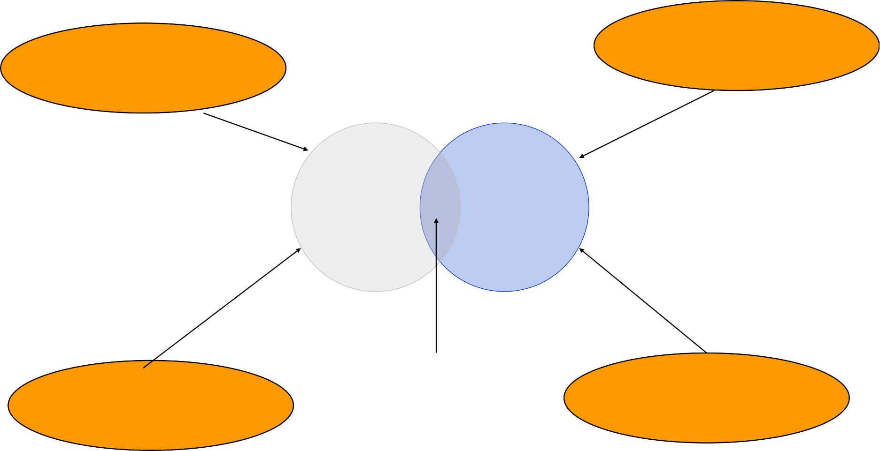
Integration view of ethics
Proposed by Talcott Parsons
Law
Government
Morality & Ethics
Business
Business Ethics
Society
Market Systems

Slide 21
Business Ethics
When business people speak about “business ethics” they usually
mean one of three things:
1.
Avoid breaking the criminal law in one’s work related activity
2.
Avoid action that may result in civil law suits against the company
3. Avoid actions that are bad for the company image
Businesses are especially concerned with these three things since they involve loss of money and company reputation.

Slide 22
Why ethical behavior is important???
Business is a subsystem of society
Empowers all stakeholders concerned
Reduction in cost of friction with social environment
Important for organizations leaders because they influence the ethical climate for the rest.

Slide 23
Why Ethical problems occur?
Personal gain
▪
Individual values widely differ with organizational goals
Managers values and attitudes
Competitive pressures
Cross-Cultural contradictions

Slide 24
Sources of Ethical Norms
Fellow Workers
Regions of Country
Culture
Family
Profession
The Individual
Friends
Conscience
Employer
The Law
Society at Large
Religious Beliefs

Slide 25
Moral behavior
Moral behavior is action or actions that produce good outcomes for the individuals as members of a community, or society, it can be applied to the whole global society.

Slide 26
Moral Standards
Moral standards include the norms we have about the kinds of actions we believe are morally right and wrong as well as the values we place on the kinds of objects we believe are morally good and morally bad. Moral norms can usually be expressed as general rules, ie. “Always tell the truth.” Moral values can usually be expressed as statements describing objects or features of objects, i.e. “ Honesty is good.”
Origin Of Moral Standards-
During childhood moral standards are absorbed from family, friends and various societal institutions. Later in life experiences, learning and intellectual development help a person in forming these standards.

Slide 27
Moral Standards
Moral standards deal with matters, which can seriously injure or seriously benefit human beings while it is not the case with non-moral standards. Examples of non-moral standards include the standards of etiquette by which we judge manners as good or bad, and the standards we call “law” by which we judge legal right and wrong.
Moral standards are not formed or changed by the decision of particular authoritative bodies and the validity of these standards lies on the adequacy of the reasons that are taken to support and justify them.
If a person has the moral obligation to do something, then the person is supposed to do that even if this conflicts with other non-moral values or self-interest.

Slide 28
Moral standards does not evaluate standards on the basis of the interests of a particular individual or group, but one that goes beyond personal interests to a universal stand point in which everyone’s interests are impartially counted as equal.
Moral standards are associated with special emotions and a special vocabulary. If a person tells a lie so as to fulfill a purpose and then afterwards he starts feeling guilty or ashamed of his behavior.

Slide 29
Mediate between Moral Demand & Interest
Business always faces the problem of developing well informed ideas on how to mediate between moral demands and strategic concerns. The reason behind strategic concerns (interest) in business ethics is to know how business can survive in the long run without sacrificing justified moral demands against inflated economic concerns.
Business ethics is concerned with integrating the values of society like trust, honesty etc. with that of the business so that the activities of the business is carried out in a fair manner helpful for the society.
Moral demands are the requirement that the society demands form any individual entity

Slide 30
According to Peter Pratley, “Business ethics adapts the methods and purpose of normative ethics to the specific requirements of moral issues in business. It studies the specific moral demands that apply to this particular sphere of modern civilization”.
Business ethics is concerned with integrating the values of society like trust, honesty, etc., with that of the business so that the activities of the business is carried-out in a fair manner helpful for the society. Moral demands are the requirement that the society demands from any individual entity.

Slide 31
Relative Autonomy of Business Morality
A very basis of business ethics refers to an idea of how business fits into modern society as a whole, a social philosophy of business. Characteristics of Modernity: Private Life Economic Life Political Life
Fundamental division of modern civilization:
1. Moral Community: The values (warmth, recognition, support) of each moral community drawn from the pre-modern local traditions.
2. Specialized functional spheres: Modern social experience consist of specialized functional spheres (healthcare, tourism, etc.) where each sphere performs their specific task through formal procedure and rules.

Slide 32
Social Philosophies of Business
Unitarian view of ethics Moral Structure Business Moral Ethics
Separatist view of ethics (Adam Smith & Milton Friedman) Business Ethics
Integration view of ethics (Talcott Parsons) Business ethics Law Market System Society Morality & Ethics Business Government
Theory of Voluntary Mediation In situation of conflicts when two or more parties come together voluntarily to resolve the dispute and achieve their goals by taking help of a third eligible party (known as mediator) then this process is known as voluntary mediation. It includes following three types of ethics: 1. Participatory ethics. 2. Transactional ethics. 3. Recognition ehtics.

Slide 33
Principles of mediation: Self-determination Impartiality Conflicts of interest Competence Confidentiality Quality of the process
Participatory Ethics: It provides idea about how to mediate between business goals and moral demands and how to serve the society in more ethical way and gain corporate excellence. Example; Ford Foundation
Transactional Ethics Here all parties involved in the action pattern have interests that happens to coincide in time but that do not affect each other. In order to let each party’s transaction run smoothly, all parties have to accept the principle of equality. In order to let things run smoothly following principle requires: 1. Honesty 2. Reciprocity
Recognition Ethics It regards moral interaction as a matter of protecting individual liberty and granting public welfare. According to this view the rights of individuals and our duties to them override personal egocentric interests. Moral agents are bound to the whole of society by a tacit social contract.

