Slide 1
Public Accountability
and
Entrepreneurial responsibility

Slide 2
The Concept of Public Accountability
Accountability is one of those golden concepts that no one can be against. It is increasingly used in political discourse and policy documents because it conveys an image of transparency and trustworthiness.
However, its evocative powers make it also a very exclusive concept because it can mean many different things to different people,

Slide 3

From Accounting to Accountability
Historically and semantically, it is closely related to accounting, in its literal sense of bookkeeping.

Slide 4
Accountability will here be defined as a relationship between an actor and a forum, in which the actor has an obligation to explain and to justify his or her conduct, the forum can pose questions and pass judgment, and the actor can be sanctioned.
With public accountability, the actor will often be a public institution or a government agency.

Slide 5
Public office is a public trust. Public officers and employees must, at all times, be accountable to the people, serve them with utmost responsibility, integrity, loyalty, and efficiency; act with patriotism and justice, and lead modest lives.

Slide 6

Civic consciousness

Slide 7
ACCOUNTABILITY DEFINED
» Accountability implies responsibility and public trust. The contemporary emphasis is on everybody’s assuming responsibility and being accountable.
» The word accountability evokes, to some, a set of lofty ideals intuitively and eminently sensible. To others, it is a normal expectation from anyone entrusted with a responsibility.

Slide 8
INDIVIDUAL VERSUS INSTITUTIONAL ACCOUNTABILITY
» Some people argue that it is the institution as a whole that should be held responsible, not the individual. Conventional wisdom has it, however, that in the final analysis individuals only can be made responsible and accountable because only they are entrusted with specific responsibilities.
If an institution is not as accountable as it should be, it is because the individual or individuals in charge prevent it from being so. That debate has never been entirely resolved in a convincing manner.

Slide 9



Slide 10

Public accountability pertains to the obligations of persons or entities entrusted with public resources to be answerable for the fiscal, managerial and program responsibilities that have been conferred on them, and to report to those that have conferred these responsibilities

Slide 11
OBJECTIVE ACCOUNTABILITY VERSUS SUBJECTIVE ACCOUNTABILITY
» In objective accountability, someone is responsible for something and accountable to some person or body in a formal way, through clearly defined rules and mechanisms.
» In subjective accountability, a person feels a duty towards the profession of public service or a sense of the public good and the nation which determines and defines conduct even though there are no formal mechanisms through which the accountability can be enforced.

Slide 12

Strong Accountability Mechanisms
Established rights for civil society groups

Slide 13
EXTERNAL INDUCEMENT FOR ACCOUNTABILITY
» Accountability often does not come easily; not everybody has the proper attitude, or a natural disposition reinforced by a strong set of personal values or ethics. Sometimes, accountability is legislated, and sometimes it is promulgated as an institutional value and becomes a managerial policy. Often accountability remains merely an exhortation.

Slide 14
EXTERNAL INDUCEMENT FOR ACCOUNTABILITY cont.
» Where there is an insufficient natural disposition for accountability, for assumption of responsibility, or for a rendering of account, an external pressure becomes necessary. It may take the form of legislation that is quite specific. Or it may be a social pressure, quite general and ill-focused.
Sometimes, the pressure takes the form of rewards and punishment. There is a widespread belief that such a regime is sound and appropriate and that many people humanely react to it. Nevertheless, it has limitations.

Slide 15
EXTERNAL INDUCEMENT FOR
ACCOUNTABILITY cont.
» Depending on people’s cultural backgrounds and the values that inspire them, reactions to external inducement vary.

Slide 16

Dilemmas and challenges
One of the hurdles in the practice of social accountability is the inability or unwillingness of the society to call powerful and prominent people in their wrong doings.

Slide 17
THE ENVIRONMENT FOR ACCOUNTABILITY
» A number of factors must be present for accountability to be effective; it has to rest on a solid psychological foundation. In proximity to accountability reside ethics, morality, and codes of conduct, all serving to compensate for obscure accountability links or to reinforce them. Fully informed and morally fit people are able to make highly defensible decisions and naturally feel responsible and are accountable.

Slide 18
THE ENVIRONMENT FOR ACCOUNTABILITY
cont.
»
Having a proper attitude, a healthy disposition towards accountability is not sufficient. It requires a technical structure, one that is organizationally sound.

Slide 19
AUTONOMY AND ACCOUNTABILITY
» Certain institutional arrangements, particularly in government, have conferred a status of independence or autonomy to particular agencies that have to be managed free of political interference, or dealt with at arm’s length, given the politically sensitive nature of their activities. There are many such agencies: the central banking authority, the state broadcasting system, grant-giving agencies, regulatory and quasi-judicial agencies, and so on. They are placed at a deliberate distance from the very body – Congress or the government that created them. This autonomous status should not exempt them from being accountable, although some would argue that to make them directly accountable to the body that created them is to invite interference.

Slide 20
DIMENSIONS OF ACCOUNTABILITY
Internal and
External Accountability

Slide 21
Internal
A rendering of account from the lowest echelons to the top , in a hierarchy. Objectives are defined at the top and transmitted to lower level for execution.Authority is delegated accordingly, followed later by the rendering of account and possibly the application of a reward system. Within a government structure, for instance, the rendering of account would take place at successive echelons up to the deputy minister/secretary. In turn, the latter would be accountable to the minister/Secretary responsible for that particular department. Generally, this internal accountability is not public; it remains within management.

Slide 22
External
» a rendering of account by management to their governing bodies. This rendering of account is public when it takes place, for instance, at the assembly of the people’s representatives, the elected body, or when it is directed at stakeholders.

Slide 23
Polical Accountability
» Constitutional
» Decentralized
» Consultative

Slide 24

Political competition, fair distribution of power and informed participation

Slide 25
Constitutional
The accountability of a government agency conferred by the Constitution.

Slide 26
Decentralized
» the establishment of local government units, regional offices as a response to the overloads in a central or a provincial govt. engenders a dispersion of accountability and possible conflicts between the central and the locality.

Slide 27
Consultative
» representative democracy is supplemented by participatory democracy. Elected representative feel obligated to consult the population; they have a close rapport with special interest groups and even feel a certain accountability to them. The accountability relationships are not very clear in such circumstances.

Slide 28
Consultative
» representative democracy is supplemented by participatory democracy. Elected representative feel obligated to consult the population; they have a close rapport with special interest groups and even feel a certain accountability to them. The accountability relationships are not very clear in such circumstances.

Slide 29


Slide 30
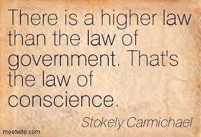

Slide 31
Managerial Accountability
» Commercial
» Resource
» Professional

Slide 32
Commercial
» when government services are financed by user fees rather than by budget appropriations, they may be judged as much, if not more on their commercial performance as on the attainment of their public policy purposes. The framework of accountability of many GFIs, GOCCs and water districts would assume this character.

Slide 33
Resource
» Accountability for resources is typically indicated for nonmarket provision of services. Budget control framework must ensure efficiency and be capable of evaluating management performance. accountability can be divided into:Resource

Slide 34
financial-management accountability framework
human resources accountability framework
asset-management accountability framework
» The human resources component within the context of an administration at the service of a representative government agency takes on a special dimension. Merit is the principle of competence, and the so-called merit system characteristic of our public service has some definite implications on accountability for human resources.

Slide 35
Resource cont.
Appointments in the civil service shall be made only according to merit and fitness to be determined, as far as practicable, and, except to positions which are policy- determining, primarily confidential, or highly technical, by competitive examination

Slide 36
Professional
» the allocation of resources in a public institution is often largely influenced, when not decided, by professionals who owe their standards to a self-regulating body.

Slide 37

Social Responsibility
The obligation of an organization`s management towards the welfare and interests of the society in which it operates.

Slide 38
Judicial
» the government allows reviews of public servants’ actions through judicial review of cases brought by aggrieved citizens.

Slide 39

Legal system with the capability to enforce the law
and to make the rulers obey the law.

Slide 40
Procedural and Consequential Accountability
» Procedural
» Consequential

Slide 41
Procedural
» In the sense that if all the requirements with regards to inputs are satisfied, the output, or the intended outcomes, or results are deemed assured. Emphasis is on the management procedures, practices and systems, as well as on compliance to rules and regulations.

Slide 42
Consequential
» The most significant signals emanate from the monitoring of the output to determine, if intended goals have been attained, presumably as a result of the efforts that went into the initiative. Outputs may not all lend themselves to retracing the corresponding inputs. The emphasis is on results, eventual outcomes, impacts, and constitutes an enlargement of the scope of accountability into what is called effectiveness.

Slide 43
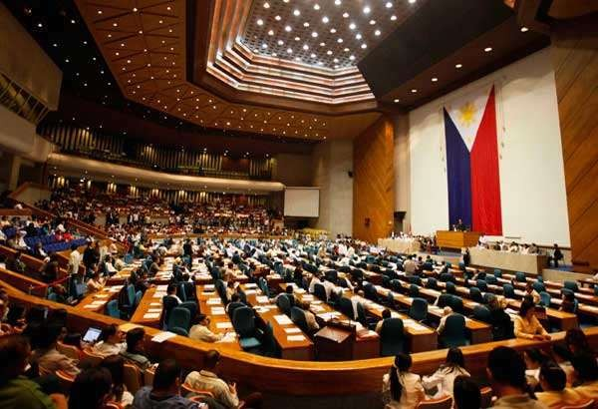
These actions convey the message that the public interest is not that important after
all and that a “thick face” – with power and wealth – could violate it with little risk.

