Slide 1
OPERATIONS RESEARCH Sem II
Dr. SHWETA SHARMA

Slide 2
UNIT I
INTRODUCTION
TO
OPERATIONS RESEARCH

Slide 3
MEANING AND HISTORY
HISTORY:-The main origin of OR was during the Second World-War .
At that time the military management in England called upon a team of scientists to study the strategic and tactical problems related to air and land defence of the country. since they were having very limited military resources, it was necessary to decide upon the most effective utilization of them.
The OR teams were not actually engaged in military operations and in fighting the War. But , they were only advisors and significantly instrumental in winning the war.
The work of this team of scientist was named as OPERATIONAL RESEARCH in England.
Hence OR can be associated with “an art of winning the war without actually fighting it” .
The first mathematical technique was developed in 1947 by American Mathematician, George B. Dantzig.

Slide 4
MEANING OF OR
Operational Research can be considered as being the application of scientific method by inter-disciplinary teams to solve problems involving the control of organized (man-machine systems) so as to provide solutions which best serve the purposes of the organization as a whole.
Operation Research is concerned with the application of the principles and the methods of science to the problems of strategy.
O.R. is the application of modern methods of mathematical science to complex prob­lems involving management of large systems of men, machines, materials, and money in industry, business, government and defence. The distinctive approach is to develop a scientific model of the system incorporating measurement of factors such as chance and risk, to predict and compare the outcome of alternative decisions, strategies or controls.

Slide 5
OR IN INDUSTRY
After World War II: success attracted industrial managers to solve complex managerial problems
•1950: O.R. began to develop in industrial field in US
•1953: Operations Research Society of America was formed
•1959:International Federation of Operational Research Society
OR IN INDIA
OR came into existence in India in 1949, Regional research laboratory, Hyderabad.
In INDIA OR society founded in 1959, , also became a member of international Federation of OR societies in 1959.
The Journal OPSEARCH was published for the first time in 1963.

Slide 6
OR ACTIVITIES IN DIVERSE FIELDS
Hospitals
Libraries
City planning
Transportation system
Crime investigation
SOME INDIAN ORGANISATIONS USING OR TECHNIQUES
Indian Airlines
Railways
Indian Defence organisations
Fertilizer Corporation of India
Tata Iron And Steel Company , BHEL ,SAIL etc.

Slide 7
NATURE OF OR
Inter-disciplinary team approach
Systems approach
Helpful in improving the quality of solution
Scientific method
Goal oriented optimum solution
Use of models
Require willing executives
Reduces complexity by use of computer

Slide 8
SCOPE OF OR IN MANAGEMENT
1.Finance, Budgeting and Investment:
i. Cash flow analysis, long range capital requirement, investment portfolios, divi­dend policies,
ii. Claim procedure, and
iii. Credit policies.
2. Marketing:
i. Product selection, competitive actions,
ii. Number of salesmen, frequencies of calling on, and
iii. Advertising strategies with respect to cost and time.
3. Purchasing:
i. Buying policies, varying prices,
ii. Determination of quantities and timing of purchases,
iii. Bidding policies,
iv. Replacement policies, and
v. Exploitation of new material resources.

Slide 9
4. Production Management:
i. Physical distribution: Location and size of warehouses, distribution Centre's and retail outlets, distribution policies.
ii. Facilities Planning: Number and location of factories, warehouses etc. Loading and unloading facilities.
iii. Manufacturing: Production scheduling and sequencing stabilization of produc­tion, employment, layoffs, and optimum product mix.
iv. Maintenance policies, crew size.
v. Project scheduling and allocation of resources.
5. Personnel Management:
i. Mixes of age and skills,
ii. Recruiting policies, and
iii. Job assignments.
6. Research and Development:
i. Areas of concentration for R&D.
ii. Reliability and alternate decisions.
iii. Determination of time-cost trade off and control of development projects.

Slide 10
PHASES OF OR
JUDGMENT PHASE
– Determination of the problem
– Establishment of the objectives and values
– Determination of suitable measures of effectiveness
–Formulation of problem relative to objectives
• RESEARCH PHASE
– Observation and data collection
– Formulation of hypothesis and models
– Observation and experimentation to test the hypothesis
– Prediction of various results, generalization, consideration of alternative method
• ACTION PHASE
– Implementation of the tested results of the model

Slide 11
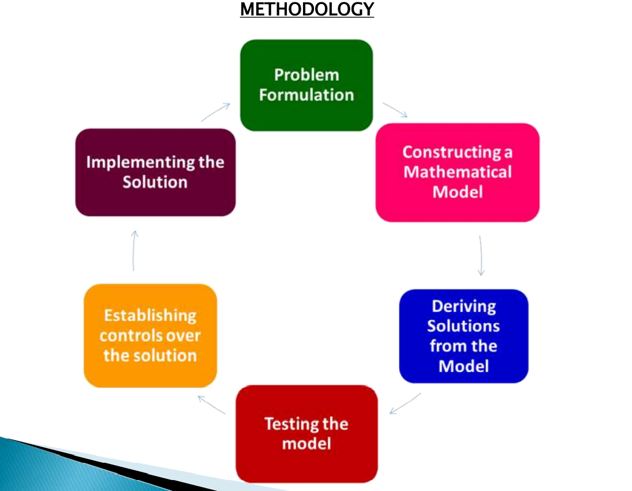

Slide 12
ADVANTAGES
Provides a tool for scientific analysis
Provides solution for various business problems
Enables proper deployment of resources
Helps in minimizing waiting and servicing costs
Enables the management to decide when to buy and how much to buy?
Assists in choosing an optimum strategy
Renders great help in optimum resource allocation
Facilitates the process of decision making
Management can know the reactions of the integrated business systems
Helps a lot in the preparation of future managers

Slide 13
LIMITATIONS OF OR
Magnitude of Computation
Operations research models try to find out optimal solution taking into account all the factors. These factors are enormous and expressing them in quantity and establishing relationships among these require voluminous calculations which can be handled by computers.
(ii) Non-Quantifiable Factors
OR provides solution only when all elements related to a problem can be quantified. All relevant variables do not lend themselves to quantification. Factors which cannot be quantified find no place in OR study. Models in OR do not take into account qualitative factors or emotional factors which may be quite important.
(iii) Distance between User and Analyst
OR being specialist’s job requires a mathematician or statistician, who might not be aware of the business problems. Similarly, a manager fails to understand the complex working of OR. Thus there is a gap between the two. Management itself may offer a lot of resistance due to conventional thinking.

Slide 14
(iv)Time and Money Costs
When basic data are subjected to frequent changes, incorporating them into the OR models is a costly proposition. Moreover, a fairly good solution at present may be more desirable than a perfect OR solution available after sometime. The computational time increases depending upon the size of the problem and accuracy of results desired.
(v) Implementation
Implementation of any decision is a delicate task. It must take into account the complexities of human relations and Behaviour. Sometimes, resistance is offered due to psychological factors which may not have any bearing on the problem as well as its solution. thinking.

Slide 15
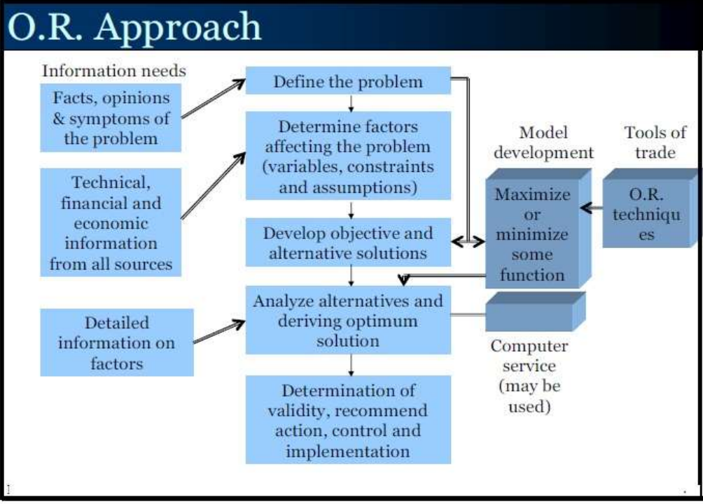

Slide 16
OR MODELS CLASSIFICATION
Based on Structure
Based on Purpose and Nature
Based on Certainty
Based on Time Reference
Based on Method of Solution

Slide 17
I. BASED ON STRUCTURE
(1) Physical Models: These models give a physical appearance of real object in reduced or scaled up form .These are further divided into two categories:
a) Iconic Models: Physical or Pictorial representation of the various aspects of the system. Ex. Blue Prints, Globe, Templates etc.
b) Analogue Models/ Schematic Model : These models represent a system by a set of properties different from the original system. Ex: A network of water pipes to show flow of current in electrical network. Level Indicator in a automobile petrol tank.
(2) Symbolic Models : These models use symbols either in the form of letters or mathematical operators to represent the properties of the system. These are further classified into two types:
a) Verbal Models: These models used to describe a situation in written or spoken language in form of letters , words or symbols. Ex: word problems in mathematics..
b) Mathematical Models: The decision variables of the system under consideration are represented by mathematical equations or inequations. Ex. Linear programming model to decide Product –Mix problem in manufacturing.

Slide 18
II. BASED ON PURPOSE AND NATURE
(1)Descriptive Models: These models use surveys , questionnaire results, inference of of observations to describe the situation. Ex. Plant Layout diagram. Block diagram of an algorithm.
(2)Predictive Models : These models are the results of query: “ What will follow if this occurs or does not occur?”. Ex. Preventive Maintenance, Trouble Shooting chart or procedures.
(3) Normative Model or Optimisation Models: These models are designed to provide optimal solution to the problem subject to a certain limitations or constraints on use of resources. Ex. LP Problem

Slide 19
III. BASED ON CERTAINITY
(1)Deterministic Models: If all the parameters of decision variables, constants and their functional relationship are known with certainty, then the model is said to be deterministic. E.g. LP, Transportation , Assignment Problem.
(2)Probabilistic or Stochastic Models: This is the model in which at least one of the decision variable or parameter is random in nature. Queuing Models; Forecasting demand.

Slide 20
IV. BASED ON TIME REFERENCE
Static Models: These models present a system at a specified time, which do not account for changes over a certain period of time. E.g. Replacement of Machines when money value is not changing with time.
(2) Dynamic Model: Time is considered as one of the variables and impact of changes generated by time is . accounted while selecting optimal course of action. E.g. Replacement Models where money value changes with time.

Slide 21
V. BASED ON METHOD OF SOLUTION
(1) Analytical Model: These have a specific mathematical structure and can be solved by analytical and mathematical techniques. E.g. Any Optimisation model such as inventory models, waiting lines etc.
(2) Iterative or Heuristic Model: In these models solution is obtained from the conclusion of previous step. E.g. Simplex Method for LPP.
(3) Simulation Models: A computer assisted mathematical representation of real life problem under certain assumptions. E.g. Monte-Carlo Simulation , Use of Random Numbers, Forecasting Models.

Slide 22
EXAMPLE OF MODEL FORMATION
Consider making a maximum area rectangle out of a piece of wire of length ‘L’ inches. What should be the width and height of the rectangle.
– Let ‘W’ be the width of the rectangle in inches and
– ‘H” be the height of the rectangle in inches
What is the objective?
– Maximization of the area of the rectangle.
Let ‘Z’ be the area of the rectangle.
– Then the model becomes
Maximize Z =WH
Subject to
2(W+H) = L
W,H ≥ 0

Slide 23
OR MODELS IN PRACTICE
Allocation models
• Inventory Models
• Replacement Models
• Sequencing Models
• Competitive(Game Theory) Models
• Waiting Line or Queuing Models
• Network Models
• Simulation Models

Slide 24
OTHER OR TECHNIQUES
NON-LINEAR programming
• Dynamic programming
• Heuristic programming
• Integer programming
• Algorithmic programming
• Quadratic programming
• Parametric programming
• Probabilistic programming
• Search theory

Slide 25
UNIT III
THE TRANSPORTATION MODEL

Slide 26
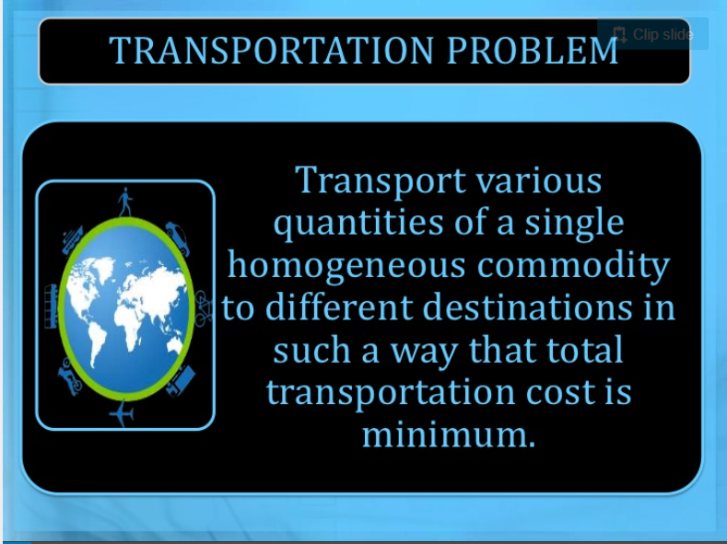

Slide 27
Assumptions in the Transportation Model
Total quantity available at sources = requirement at destination
Items transported conveniently from all sources to destinations
Unit transportation cost is precisely known
Transportation cost on a given route α no of units shipped on that route
Objective is to minimize the total transportation cost as a whole and not for individual supply and distribution centers.

Slide 28
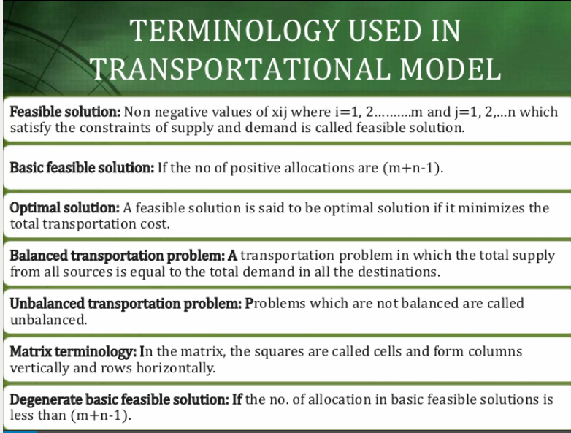

Slide 29
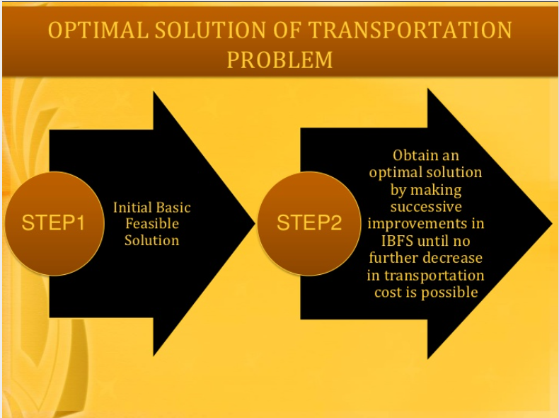

Slide 30
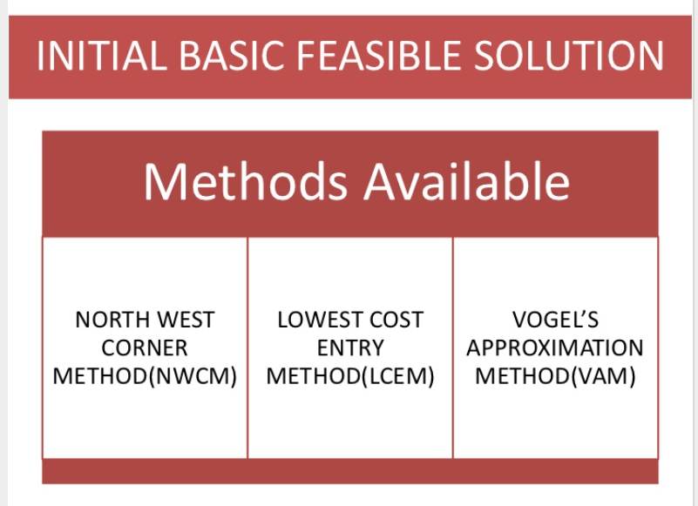

Slide 31
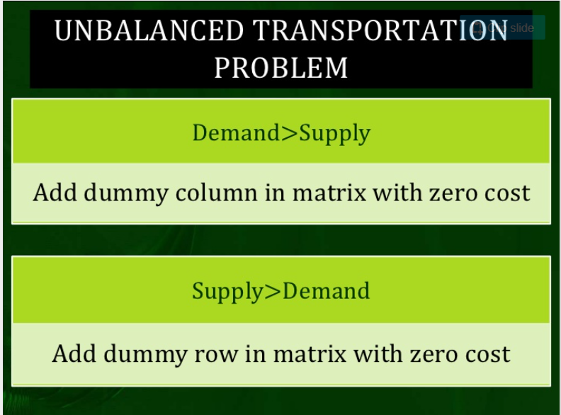

Slide 32
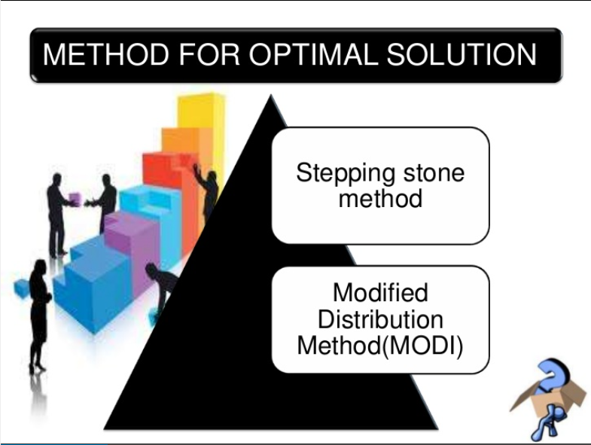

Slide 33
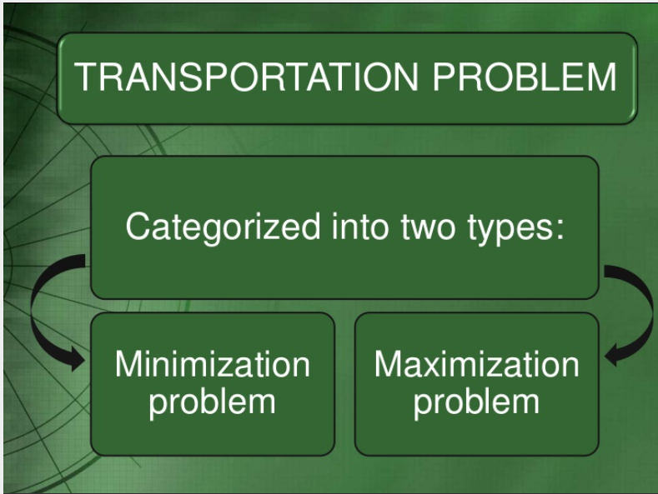

Slide 34
MINIMIZATION PROBLEM In this transportation cost is given which is to be minimized.
MAXIMIZATION PROBLEM In this profit is given which is to be maximized. To solve this problem we convert the problem into minimization. Conversion is done by selecting the largest element from Profit Pay off matrix and then subtracting all elements from largest element including itself. Reduced matrix obtain becomes minimization case and then same steps are taken to solve it as is done in minimization problem

