Slide 1
CONTROLLING

Slide 2
Concept and process of control.
Control techniques
Human aspects of control as a feedback system
Feed forward control
Preventive control
Profit and loss control through return on investment
The use of computer for controlling and Decision making
The challenges created by IT as a control tool.

Slide 3
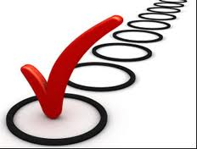
Controlling
  A process of monitoring performance and taking action to ensure desired results.
  It sees to it that the right things happen, in the right ways, and at the right time

Slide 4
Characteristics of controlling
Continuous process
End Function
Exercised at all levels
Forward looking
Dynamic process
Action Oriented
Manage-ment Function

Slide 5
Control Process
Setting Standards
Measurement of actual Performance
Comparison of Actual Performance with
Standards
Follow Up
Taking Corrective Action

Slide 6
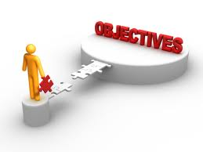
Goals and Objectives
Organizational
Divisional
Departmental
Individual

Slide 7
Establish Objectives and Standards
Standards are the plans or the targets which have to be achieved in the course of business function
They can also be called as the criterions for judging the performance
Standards generally are classified into two
Measurable or tangible - Those standards which can be measured and expressed are called as measurable standards. They can be in form of cost, output, expenses, time, profit, etc.
Non-measurable or intangible- There are standards which cannot be measured monetarily. For example- performance of a manager, deviation of workers, their attitudes towards a concern.

Slide 8
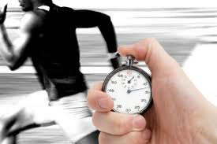

Measuring Actual Performance
Measurements must be accurate enough to spot deviations or variances between what really occurs and what is most desired.
Without measurement, effective control is not possible.

Slide 9
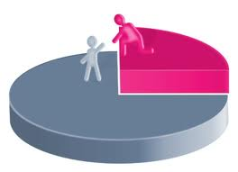
Comparing Results with Objectives and Standards
Comparison of actual performance with the planned targets is very important.
Deviation can be defined as the gap between actual performance and the planned targets.
The manager has to find out two things here- extent of deviation and cause of deviation
For example, if stationery charges increase by a minor 5 to 10%, it can be called as a minor deviation.
On the other hand, if monthly production decreases continuously, it is called as major deviation.

Slide 10
Once the deviation is identified, a manager has to think about various cause which has led to deviation. The causes can be-
Erroneous planning,
Co-ordination loosens,
Implementation of plans is defective
Supervision and communication is ineffective, etc.

Slide 11

Taking Corrective Action
Once the causes and extent of deviations are known, the manager has to detect those errors and take remedial measures for it. There are two alternatives here-
Taking corrective measures for deviations which have occurred;
After taking the corrective measures, if the actual performance is not in conformity with plans, the manager can revise the targets. It is here the controlling process comes to an end.
Follow up is an important step because it is only through taking corrective measures, a manager can exercise controlling.

Slide 12
Relationship between planning and controlling
Planning and controlling are two separate fuctions of management, yet they are closely related.
Without the basis of planning, controlling activities becomes baseless and without controlling, planning becomes a meaningless exercise.
In absence of controlling, no purpose can be served by. Therefore, planning and controlling reinforce each other

Slide 13
According to Billy Goetz, " Relationship between the two can be summarized in the following points:
Planning precedes controlling and controlling succeeds planning.
Planning and controlling are inseparable functions of management.
Activities are put on rails by planning and they are kept at right place through controlling.
The process of two works on Systems Approach
Planning → Results → Corrective Action
Planning and controlling are integral parts of an organization as both are important for smooth running of an enterprise.
Planning and controlling reinforce each other. Each drives the other function of management.

Slide 14
COMMONLY KNOWN CONTROL TECHNIQUES
BUDGET AS CONTROL TECHNIQUES
FINANCIAL RATIO ANALYSIS
OTHER FINANCIAL CONTROL TECHNIQUES
B.E.P ANALYSIS
BALANCED SCORECARD
BENCHMARKING

Slide 15
LINEAR PROGRAMMING
GANTT CHART
PROGRAM EVALUATION & REVIEW TECHNIQUES(PERT)
INFORMATION TECHNOLOGY
MANAGEMENT BY EXCEPTION
VALUE CHAIN ANALYSIS
INVENTORY MANAGEMENT

Slide 16
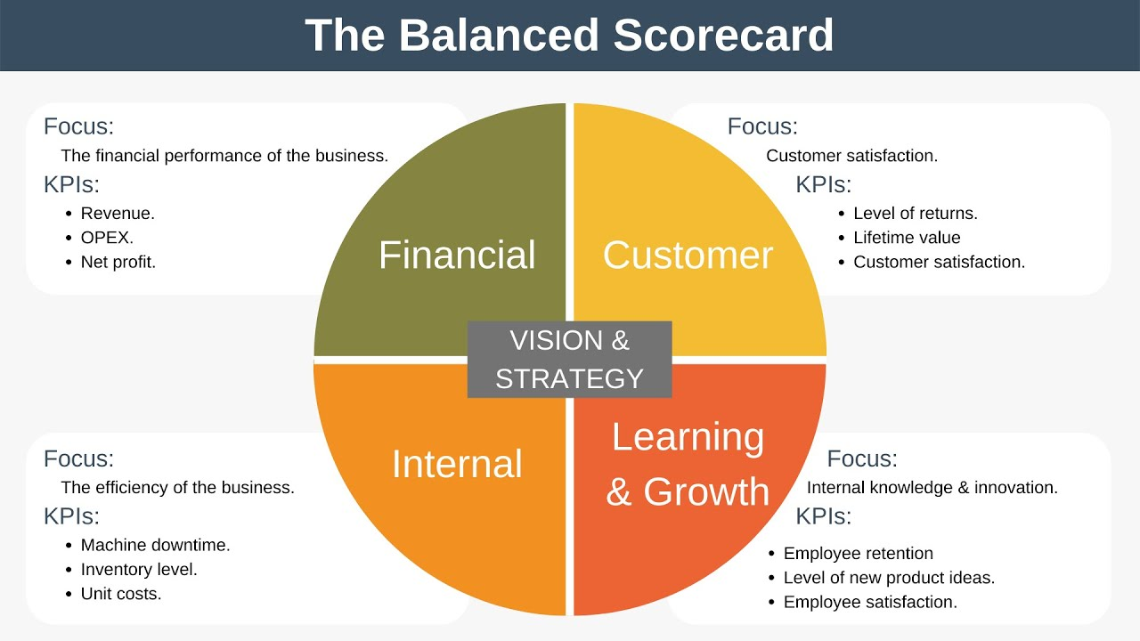

Slide 17
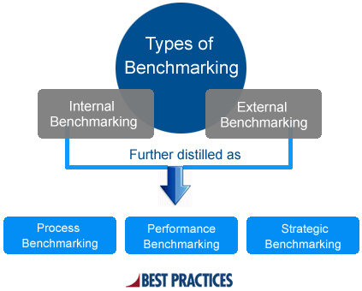

Slide 18
GANTT CHART
This chart system was developed by henry l. Gantt.
Gantt chart- a bar chart that shows the time relationships between the “events” of a production program.
Milestone budgeting or milepost- advanced technique of gantt chart milestone breaks a project down into controllable pieces.

Slide 20
CRITICAL PATH METHOD(CPM)
Developed by m.R. Walker of usa in 1956.
It is used for optimising resource allocation and minimising overall cost for a given project.
Procedure-
Break down the project into various activities systematically.
Number all the events and activities.
Calculate the earliest start time, earlier finish time, latest start time and latest finish time.
Determine total float time.
Identify the critical activities and connect them with double line arrow.
Calculate total duration of project.

Slide 21
CPM NETWORK DIAGRAM

Slide 22
ADVANTAGES
Highlights the critical activities.
Provides a technique of planning and scheduling.
Gives complete information of activity.
Helps to identify potential bottlenecks.

Slide 23
LIMITATIONS
Operates on assumption of precise time.
Does not incorporate statistical analysis in determinig time estimates.
For every change introduced entire project evaluation has to be repeated.
Not suitable for a situation which does not have definite start and finish time.

Slide 24
PROGRAM EVALUATION AND REVIEW TECHNIQUE(PERT)
Pert- a time event network analysis system in which the various events in a project or program are identified with a planned time established for each.
Methodology
Preparation of the network .
Network analysis.
Scheduling.
Time cost trade offs.
Resource allocation.
Project control.

Slide 26
Advantages
Forces manager to plan.
Forces planning all the way down the line.
Concentrates attention on critical element that may need correction.
Makes possible a kind of forward looking control.
Enables managers to aim reports and pressure for action at the right spot and level in the organisation structure at the right time.

Slide 27
LIMITATIONS
Technique is not useful when the program is nebulous and no reasonable estimates of schedule can be made.
Pert has its emphasis only on time and not cost.
Not practicable for routine planning of recurring activities.

Slide 28
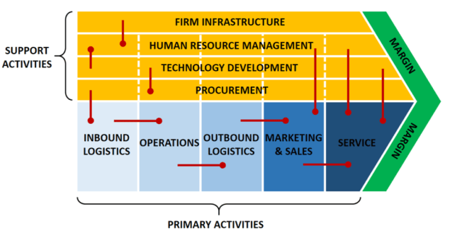
Value Chain Analysis

Slide 29
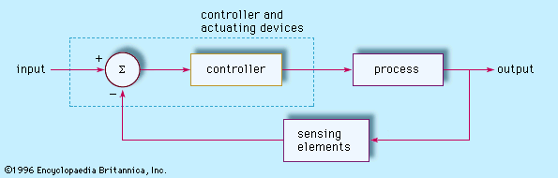
Feedback controls
Widely used in modern automated systems. A feedback control system consists of 5 basic components:
(1) input
(2) process being controlled
(3) output
(4) sensing elements
(5) controller and actuating devices.

Slide 30
Human aspects of control as a feedback system
The human body is, indeed, a very complex and highly perfected adaptive feedback control system.
Consider, for example, the human actions required to steer an automobile. The driver's objective is to keep the automobile traveling in the center of a chosen lane on the road.

Slide 31
Feedforward controls
Feedforward controls involve identifying and preventing problems in an organization before they occur. Feedforward controls are proactive and preventative.
Feedforward control is an open-loop scheme that compensates the system dynamics without needing information about the system states as the tracking error. For such reason, it requires precise knowledge about the dynamics of the system to be controlled.

Slide 32
Preventive controls
Preventive controls aim to decrease the chance of errors and fraud before they occur, and often revolve around the concept of separation of duties. From a quality standpoint, preventive controls are essential because they are proactive and focused on quality.
Examples of preventative controls include policies, standards, processes, procedures, encryption, firewalls, and physical barriers.
CCTV Cameras can detect and deter unauthorized access, but they can do nothing to actually stop it, thus they are not preventive. Recovery refers to restoring systems to their operational state, which cameras also cannot do.

Slide 33
Return on investment
Return on investment (ROI) is a metric used to understand the profitability of an investment. ROI compares how much you paid for an investment to how much you earned to evaluate its efficiency. Let's take a look at how it's used by both individual investors and businesses
ROI = Net Profit / Cost of Investment
Example, an investor purchases ₹1,000 worth of shares and sells the stock two years later for ₹1,200. The net profit from the expenses would be ₹200.
Return on Investment= 200/1000= 20%
So, in the above example, the Return on Investment will be 20%. However, the estimation can be modified by subtracting taxes and fees to view more detailed Return on Investment total.

Slide 34
The use of computer for controlling and
decision making
Computers and Information Technology, We use computers to collect and share information, develop new products, and control processes, as well as to communicate between workers and engage in electronic commerce.
IT controlling is responsible for IT cost and performance accounting, IT efficiency analysis and analysis of IT performance indicators, procedures for planning, analysis, forecast and decision support.

Slide 35
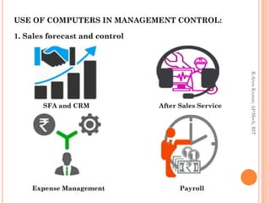

Slide 36
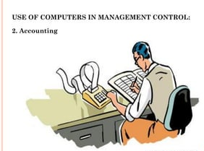

Slide 37
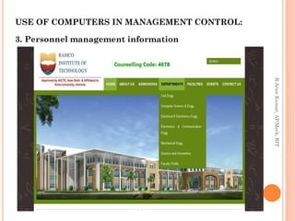

Slide 38
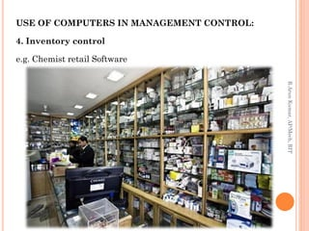

Slide 39
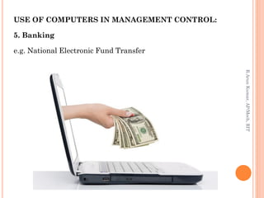

Slide 40
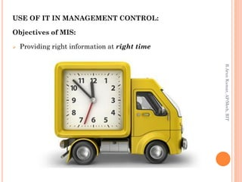

Slide 41
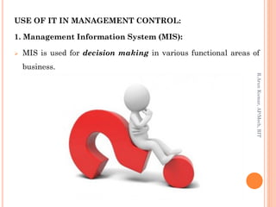

Slide 42
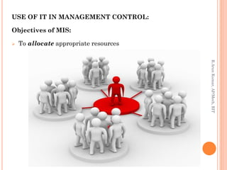

Slide 43
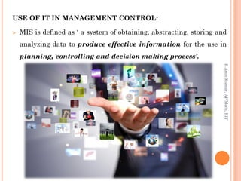

Slide 44
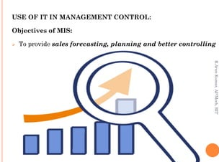

Slide 45
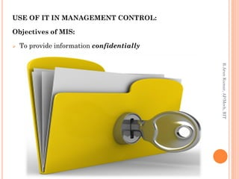

Slide 46
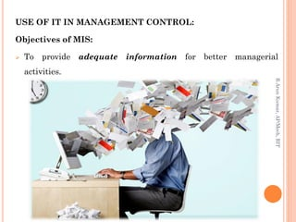

Slide 47
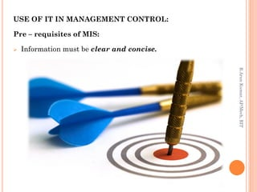

Slide 48
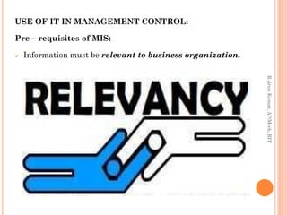

Slide 49
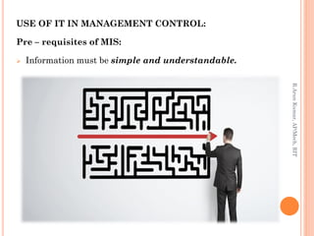

Slide 50
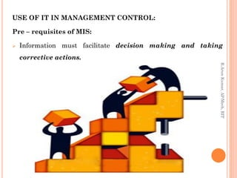

Slide 51
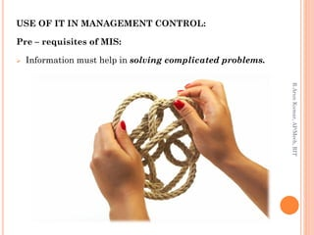

Slide 52
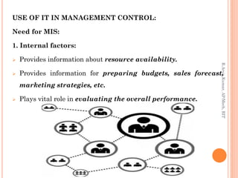

Slide 53
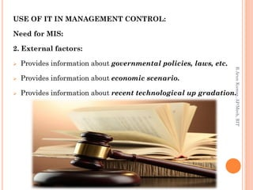

Slide 54
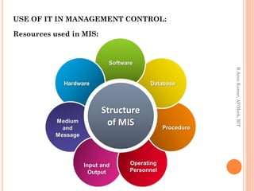

Slide 55
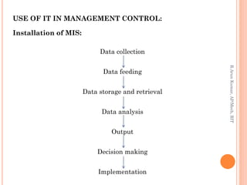

Slide 56
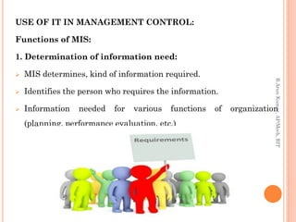

Slide 57
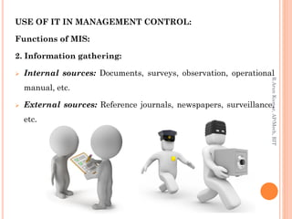

Slide 58
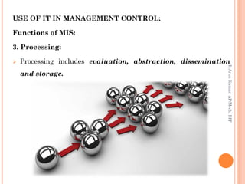

Slide 59
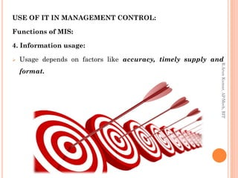

Slide 60
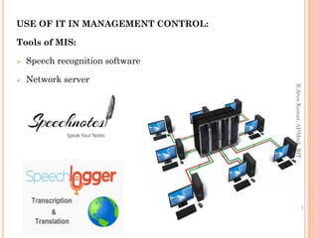

Slide 61
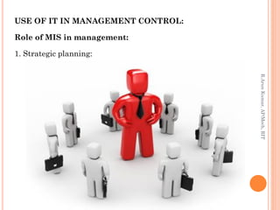

Slide 62
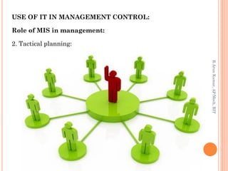

Slide 63
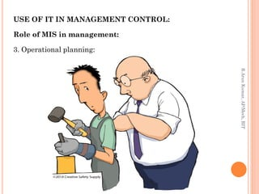

Slide 64
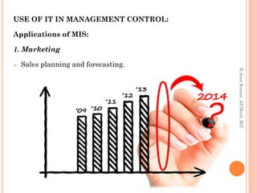

Slide 65
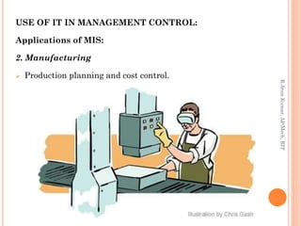

Slide 66
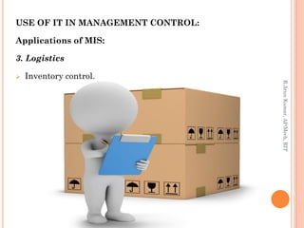

Slide 67
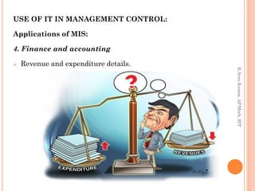

Slide 68
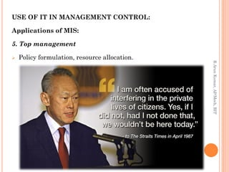

Slide 69
