Slide 1
ACCOUNTING FOR MANAGERS
MBA- Ist SEM
Basics of Book Keeping & Accounting
GSIMR
CA Prem K Dua

Slide 2
Meaning of Book Keeping
Book Keeping is that Branch of Knowledge that tells us how to record a financial transaction.
“Book Keeping is the science and art of correctly recording in books of account all those business transactions that results in the transfer of money or money’s worth” (R.N. Carter)
Two Main Objective
To have a permanent record of each transaction and its financial
effect.
b) To show the combined effect of all the transactions made during a
particular period upon the financial position of the concern as a
whole.

Slide 3
Necessity of Book Keeping
Limitation of human memory
Owners and managers are different persons
Determination of A/R and A/P
Preparation of Financial Statements
Need for Financial Information
Requirement of exercising control
Information needs of various users
Need of taxation authorities
Prevention of Frauds
Provide evidence

Slide 4
Process of Book keeping
Step 1- Identification of Transaction/event
Step 2- Recording at first stage (Journal)
Step 3- Posting in the Book (Ledger)
Step 4- Ledger Account Balancing
Step 5- Preparation of Trial Balance
Step 6- TB must tally, if not errors

Slide 5
Meaning of Accounting
“Accounting is the art of recording, classifying and summarizing , in a significant manner, and in terms of money, transactions and events which are, in part at least , of a financial character, and interpreting the results thereof.”
Objectives of Accounting:
To ascertain the business operations –Profit & Loss Statement
To ascertain the financial position of the business- Balance Sheet

Slide 6
Branches of Accounting
Accounting
Financial Accounting
Cost Accounting
Management Accounting

Slide 7
Functions of Accounting
To keep systematic records of financial transactions
To communicate the results to different interested parties
To provide information regarding performance & position
To meet legal requirements/evidence in legal matters
To protect the properties of the business from unwanted use
To enables comparison of costs , expenses, sales , profits
Valuation of business
Useful for owner/management

Slide 8
Limitations of Financial Accounting
FA permits alternative treatment –FIFO, LIFO,AVG, SC
FA is influenced by personal judgment- Depreciation
FA ignores importance of non monetary information
FA does not provide timely information –historical /Postmortem
FA dose not provide detailed analysis
Accounting Mechanism:
Single Entry System
Double Entry System

Slide 9
Accounting Terminology
Proprietor
Capital
Drawings
Business Transactions
Debtors- Receivables
Creditors- Payables
Goods- Purchase/Sales
Stocks- Inventory
Assets- Fixed (Tangible & Intangible)
Current Assets
Fictitious Assets

Slide 10
Accounting Terminology
Equity : Owner’s Equity & Outsiders Equity
Liabilities- (Current/ Fixed/Contingent)
Expenses/Cost
Expenditure- Capital & Revenue
Loss- Normal & Abnormal
Profit
Revenue
Discount- Trade & Cash

Slide 11
Types of Account- Golden Rules
Personal Account
Debit the receiver
Credit the giver
Real Account
Debit What Come’s in
Credit What goes out
Nominal Account
Debit all the expenses & losses
Credit all the incomes & gains

Slide 12
Users of Accounting Information
Internal Users
Top/ Middle/Executive level
External Users-
Directly Connected | Indirectly Connected
Creditors | Regulatory Agencies
Investors | Public
Employees | Researchers
Tax Authorities | Print & Electronics Media
Consumers
Foreign Entrepreneurs

Slide 13
Basis Of Accounting
Accrual Basis/Mercantile Basis:
It’s a method of recording the transactions by which revenue , cash, assets and liabilities are reflected in the accounts for the period in which they accrue. Under Companies Act , all companies are required to maintained the books of accounts according to accrual system.
Cash Basis:
It’s a method of recording the transactions by revenue, costs. Assets and liabilities are reflected in the accounts for the period in which actual receipts or actual payments are made.

Slide 14
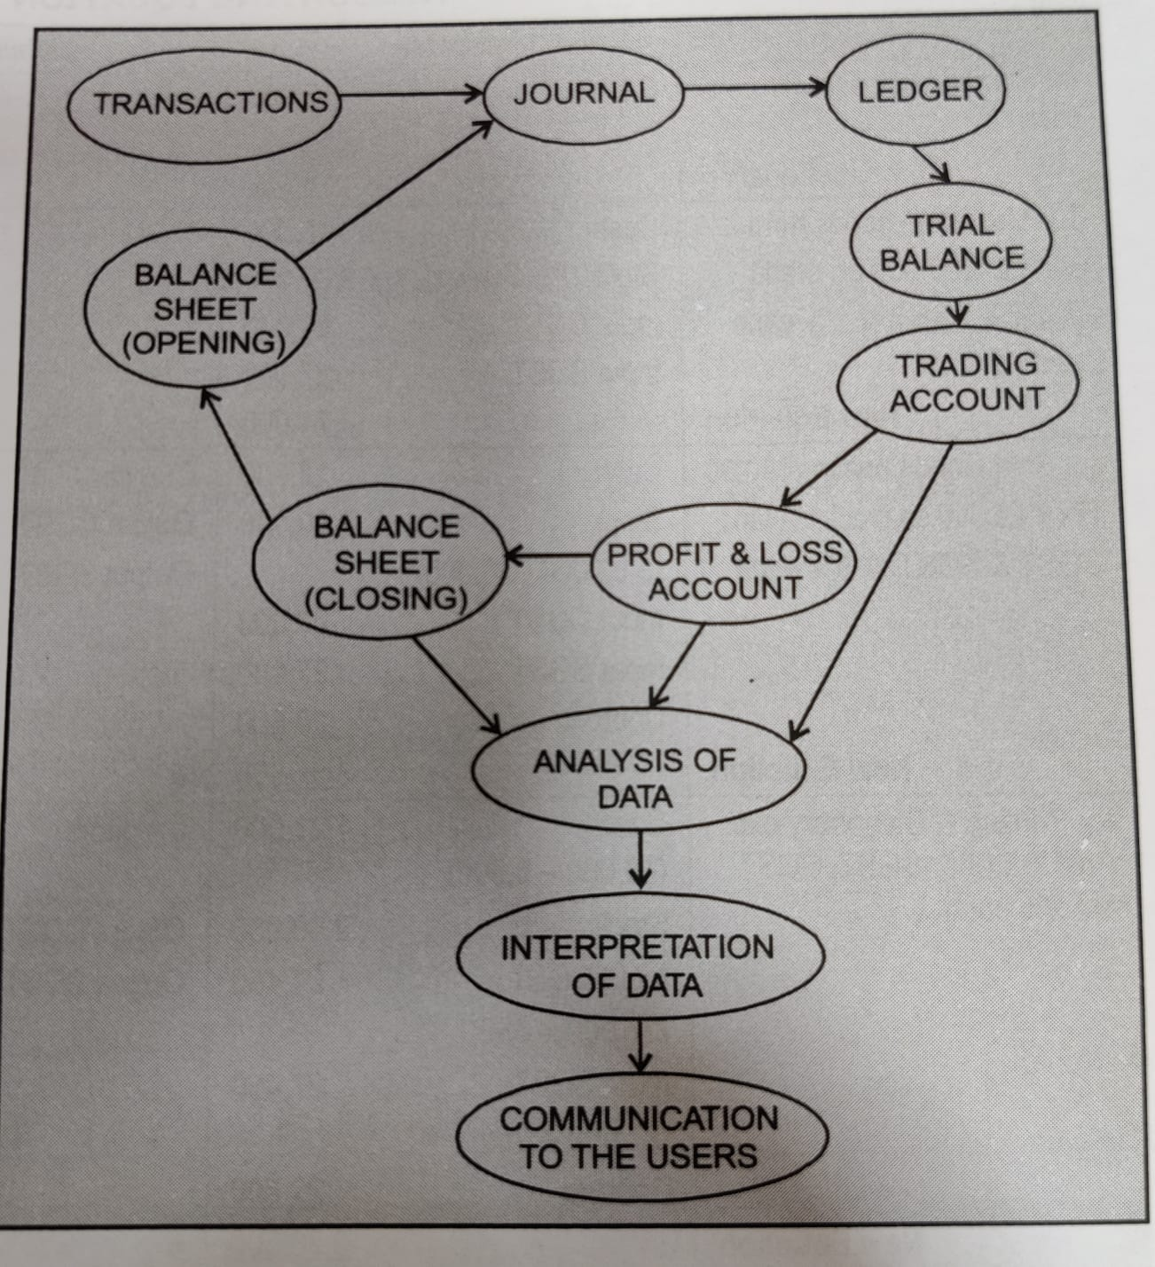
Meaning of Accounting Cycle

Slide 15
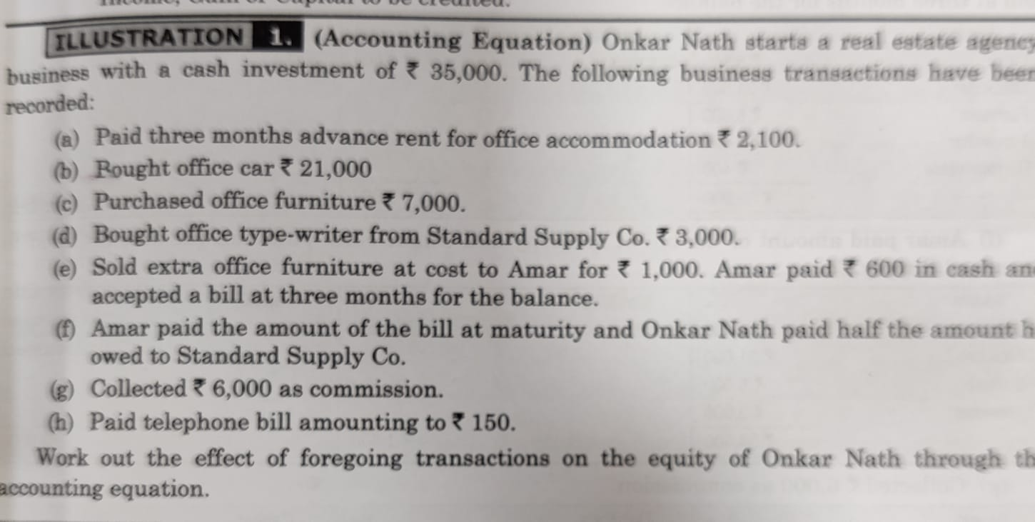
Accounting Equation
Dual Concept is the basis of Accounting Equation.
Total Assets = Total Equities
Owner’s Equity + Creditors Equity= Assets
Capital+ Liabilities= Assets
Assets- Liabilities= Capital

Slide 16
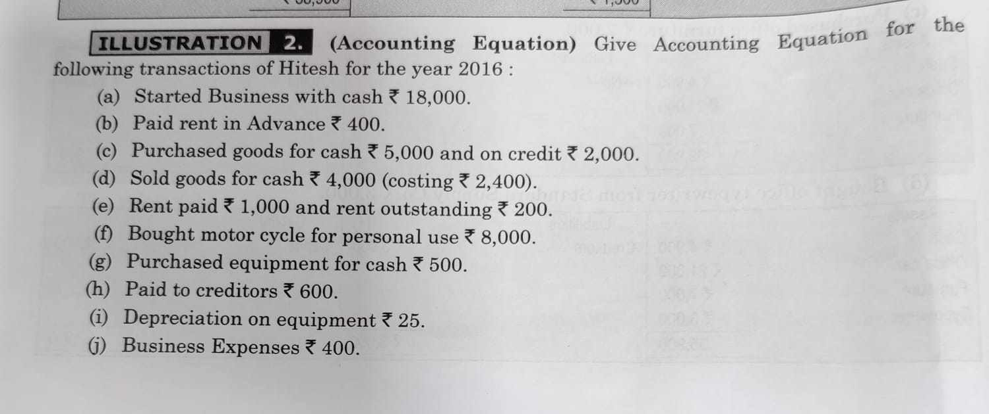
Accounting Equation

