Slide 1
ADVERTISING
AND
DIGITAL MARKETING
Unit iii
Dr. sangeeta jain

Slide 2

TECHNIQUES IN PRINT & BROADCAST ADVERTISING
Copywriting
Copywriting is the use of words to promote a person, business, opinion or idea.
Broadly the whole ad is called a copy but specifically the matter written in words is called copy.
The rest of the ad may have visual elements like photographs, pictures, illustrations, logos etc.
Those who write verbal messages are called copywriters.
The writing aims to achieve business objectives.
Copywriting is a composite art that requires a combination of linguistic ability & business sense.
COPYWRITING

Slide 3
TECHNIQUES IN PRINT & BROADCAST ADVERTISING
Copywriting
Copywriters write copy and the associated headlines, slogans, base lines etc
They also develop copy for TV, cinema commercial etc.
Here copy is the audio part that is co-ordinated with the video part.
They prepare drafts for press releases & promote other promotional materials like direct mailing & catalogues.
COPYWRITING

Slide 4
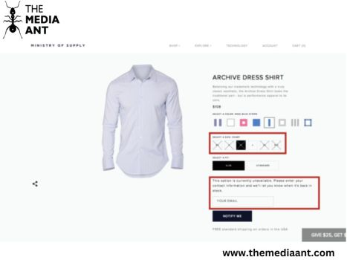
1. Scarcity Ad Copy
Amazon excels at this task by offering ‘lightning deals,’ which are limited-time offers that entice customers to spend money on the goods due to a sense of scarcity.

Slide 5
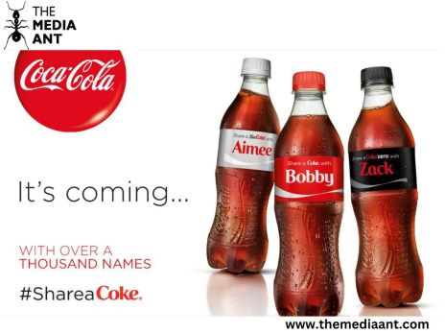
2. Appeal to Ego Ad Copy
Running shoes that are designed to complement the healthier you.
L’Oréal’s slogan: ‘Because you’re worth it!’

Slide 6

3 Luxury Ad Copy
<a

Slide 7
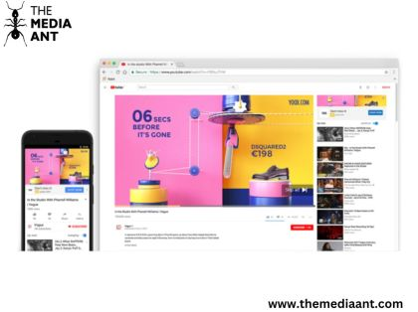
4 Exclusivity Ad Copy
<a

Slide 8

5 Discounts & Benefits Ad Copy
<a

Slide 9
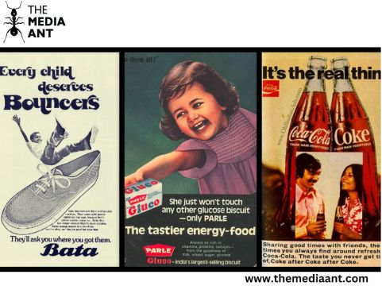
6 Nostalgia Ad Copy
<a

Slide 10
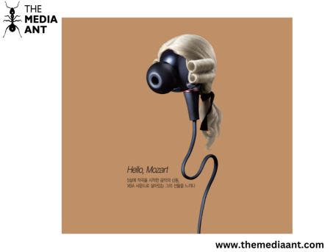
7 Quality Ad Copy
<a

Slide 11

8 Durability Ad Copy
<a

Slide 12
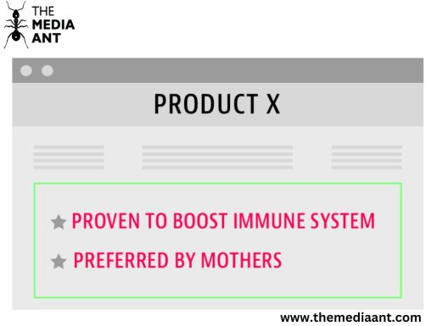
9. Factoid Ad Copy

Slide 13
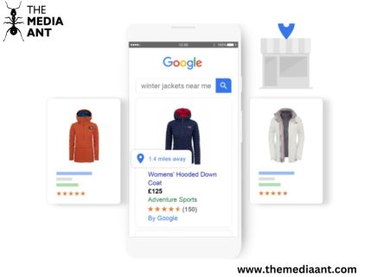
10 Feature Showcase Ad Copy
<a hr

Slide 14



Copywriting Reminder
The propositional benefit or unique selling proposition (USP) should be APPEALING and CLEAR to your target audience

Slide 15

Tips for Great Copywriting
Get to the main point fast.
Emphasize one major idea, simply and clearly.
Be single-minded.
Position product clearly.
Brand name should be up front and reinforced
Keep consumer propositional benefit in mind

Slide 16

Tips for Great Copywriting…Cont’d
Keep sentences short. Don’t waste words.
Avoid bragging and boasting.
Avoid clichés, write with flair.
Use lots of verbs and adverbs.
Write in the present tense and in the active voice.
Use personal pronouns (you)

Slide 17

Tips for Great Copywriting…Cont’d
Use contractions. (eg. Don’t, Can’t)
Don’t over punctuate!?!..,,
Read aloud / rewrite

Slide 18

Copy Writing Format
Attention | Visual, headline, subhead
Interest | Subhead, body copy
Desire | Body copy
Action | Logo, slogan, signature block, reply device

Slide 19
Other optional elements
Blurb
Violator
Caption

Slide 20

HEADLINE
Leading position in ads and the most important.
Effective headlines attract attention, engage the audience, explain the visual, lead the audience into the body of the ad and present the selling message
On average, most headlines have 8-10 words.
Sometimes, visual can be the headline

Slide 21
Role of the Headlines
Attract attention
Engage the audience
Explain the visual
Lead the audience to the body of the ad
Present the key benefit

Slide 22

Power words that you can use if applicable
Free, now, amazing, suddenly, announcing, introducing, it’s here, improved, at last, revolutionary, just arrived, important development

Slide 23

Headline Types
Benefit (Eg. Fit to Fight)
News or information (Eg. 50% of marriages in the US end in divorce)
Provocative headline (Eg. He finally nailed it!)
Question (Eg. Where have you been lately?)
Command (Eg. Hold that thought!)

Slide 24
Benefit Headline
Promises the audience that using the product will be rewarding
Keep you warm and dry,
Speak a
Regardless of what falls
foreign
Out of the sky
language in
30 days or
Includes the name of the product
your money
back.

Slide 25

Benefit
Headline

Slide 26
Announces news or promises information Sea World’s It’s a Girl!
News/Information Headline

Slide 27

Provocative Headlines
To stimulate questions or thoughts
Provoke reader’s curiosity
Provides story appeal
Lay’s Potato ad ‘Betcha can’t eat just one’

Slide 28
Question Headline
 Asks a question
 Encouraging readers to look for answers in the body of the ad
 “What makes out tires smarter & richer than others?”

Slide 29
Command Headlines
Orders readers to do something
“Obey your thirst.”
“Please don’t squeeze the Charmin”

Slide 30
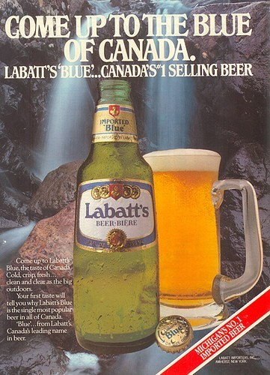
Subheads
the headline
-above [kickers/overlines]
-Below [underlines
Also transmits key sales points fast
Carries less important information than the headline
Subheads are longer and more like sentences than headlines
They bridge the headline to the copy

Slide 31

Asks a question
Encouraging readers to look for answers in the body of the ad
“What makes out tires smarter & richer than others?”
Question Headline

Slide 32

BODY COPY or TEXT
Answer questions posed by the visual or headline if any.
Main function is to give information and/or create desire.

Slide 33

Body Copy Styles
Straight sell-immediately explain or develop headline and visual in a straightforward, factual presentation
Institutional copy-promote philosophy or extol the merits of the organization rather than product features.
Narrative copy-tells a story

Slide 34

Body Copy Styles…Cont’d
Dialogue/monologue copy-character in the print ad do the selling in their own words
Picture-caption copy-using illustrations and captions
Device copy-use figures of speech (puns, alliteration, assonance, rhymes)

Slide 35

Formatting Body Copy
Lead-in paragraph-bridge between the headline and the sales ideas presented in the headline.
Interior paragraph-develop credibility by providing proof for claims and promises and create desire

Slide 36

Formatting Body Copy…
Cont’d
Trial close-suggestions to act now
Close-real action step. Ask them to do something.

