Slide 1
ADVERTISING
AND
DIGITAL MARKETING
Unit iii
Dr. sangeeta jain

Slide 2
UNIT III: ADVERTISING DESIGN
Appeal,
Message strategy and execution frame work
Advertising design
Structure of an advertisement
Message strategy
Cognitive strategy
Creating an advertisement,
Meaning and definition of copywriting,
Copywriting for different media.

Slide 3
Integrated Marketing Communications
The essence of an integrated marketing communications is designing messages that effectively reaches the target audience. They are designed to change or shape attitudes. They must be remembered. They should lead to some kind of short- or long- term action.

Marketing messages travel in two ways. First, a personal message can be delivered through a personal medium. A sales rep closing the deal, shaking the hand of the buyer, giving a reassuring tap on the shoulder, and smiling while talking is delivering a message in an intimate, warm, human fashion.

The second way marketing messages travel is through the various forms of advertising media. Many of these media are completely impersonal.
Television sets are indifferent as to what appears on the screen. Radios deliver any sound that can be transmitted. Computer screens are nothing more than special-purpose television screens.


Slide 4






Slide 5



Introduction
Designing messages that effectively reaches the target audience.
Designed to change or shape attitudes.
Must be remembered.
Should lead to some kind of short or long term action.
?

Slide 6
Message Strategy
The message theme, or the outline of the key ideas in the ad, is a central part of the creative brief.
The message theme can be created using a number of message strategies.
A message strategy is the primary tactic or approach used to deliver the message theme. There are three broad categories of message strategies:
Cognitive strategies
Affective strategies
Conative strategies

Slide 7
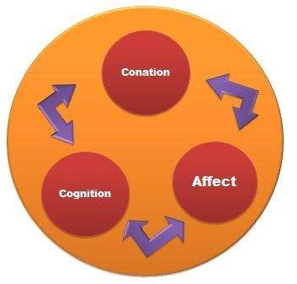
Message Strategies
3 broaad categories of message strategies:
Cognitive
Affective
Conative

Slide 8
Cognitive Message Strategy
A cognitive message strategy is the presentation of rational arguments or pieces of information to consumers.
These ideas require cognitive processing.
When a cognitive message strategy is used, the advertisement’s key message is about the product’s attributes or the benefits. Customers can obtain these benefits by using the product.
The goal of the cognitive message strategy approach is to design an ad that will have an impact on a person’s beliefs and/or knowledge structure.
This can be accomplished by suggesting any one of a wide variety of potential product benefits.
Foods may be described as healthful, pleasant tasting, or low calorie.
or
A tool can be shown as durable, convenient, or handy to use.

Slide 9
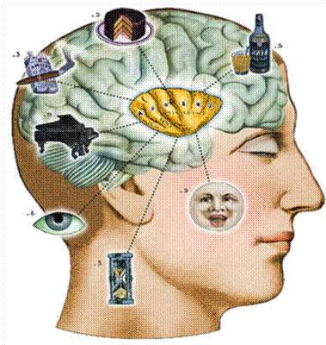
Cognitive Strategies
Presentation of rational arguments or pieces of
information to consumers.
The advertiser’s key message is about the product’s attributes or benefits.
5 major forms of cognitive strategies:
Generic messages
Preemptive messages
Unique Selling Proposition
Hyperbole
Comparative Advertisements

Slide 10
Cognitive Strategies
Generic Messages –
Direct promotions of product attributes or benefits without any claim of superiority.
Work best for the brand leaders
Example: Campbell’s Soup – Soup is good food

Slide 11
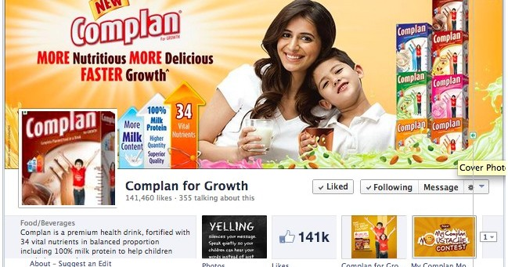
Generic messages which are direct promotions of good or service attributes or benefits without any claim of superiority. They work best for a firm that is clearly the brand leader and dominant in the industry within which it operates.

Slide 12

Preemptive messages: which are claims of superiority based on a specific attribute or benefit of a product. Once made, the claim normally preempts the competition from making such a statement. Example: Crest – the cavity fighter

Slide 13
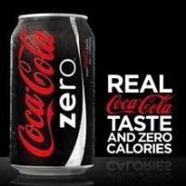



A unique selling proposition : which is an explicit, testable claim of uniqueness or superiority, which can be supported / substantiated /verified in some manner. Example: Dove – 25% moisturizer.

Slide 14
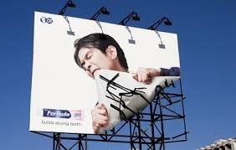
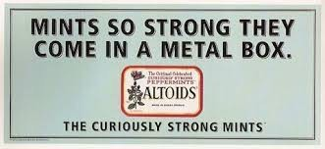
Hyperbole , which is an untestable claim based upon some attribute or benefit. Eg. NDTV is promoting ‘Bangladeshi’s favorite color GREEN’

Slide 15
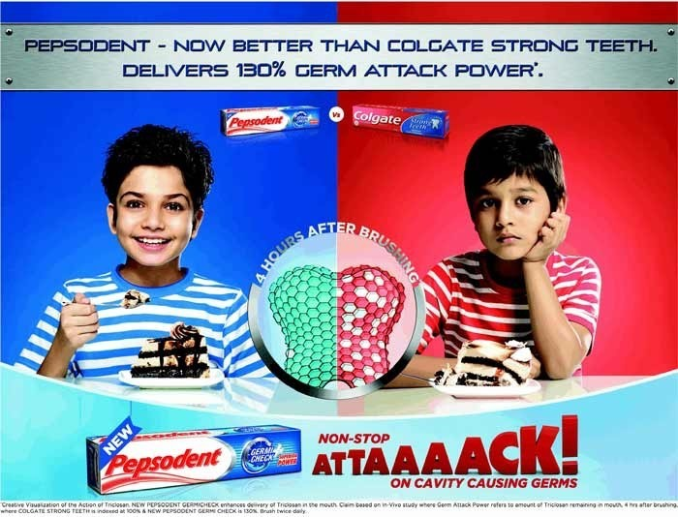
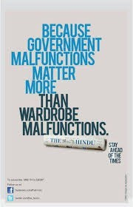
Comparative advertisements , which is when an advertiser directly or indirectly compares a good or service to the competition. The competitor may or may not be mentioned by name in the advertisement.

Slide 16
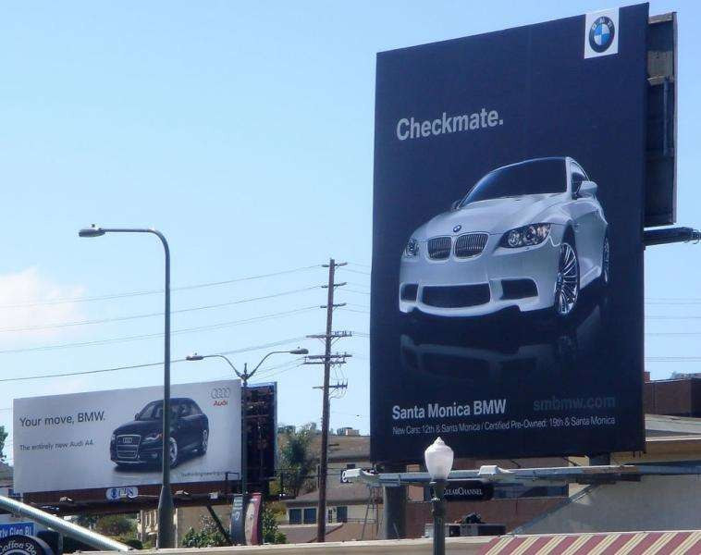

Slide 17
Points to Remember
All five of these cognitive message strategies are based on some type of rational logic
Ensure consumer pay attention and take time to cognitively process the information
Informing people about the product

Slide 18
Affective Strategies
Affective message strategies invoke feelings or emotions and match those feelings with the good, service, or company. Such ads are prepared to enhance the likeability of the product recall of the appeal, or comprehension of the advertisement. Affective strategies elicit emotions that, in turn, lead the consumer to act, prefer- ably to buy the product, and subsequently affect the consumer’s reasoning process and to developing a strong brand name..
Affective strategies fall into two categories: (1) resonance, and (2) emotional.
Resonance advertising attempts to connect a product with a consumer’s past experiences in order to develop stronger ties between the product and the consumer.
Emotional advertising attempts to elicit powerful emotions which eventually lead to product recall and choice, including trust, reliability, friendship, happiness, security, glamour, luxury, serenity, pleasure, romance, and passion.

Slide 19


Resonance Advertising

Slide 20
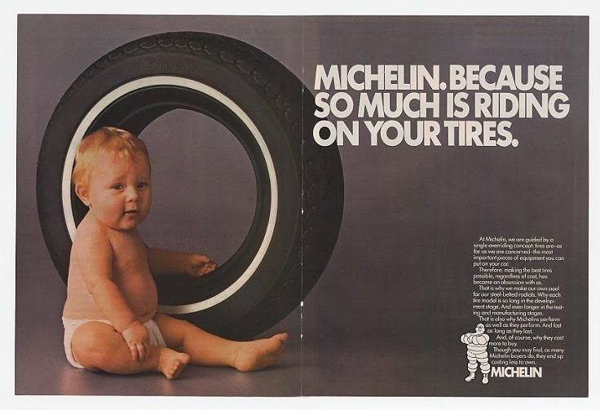

Emotional advertising

Slide 21
Conative Message Strategies
Conative message strategies are designed to lead more directly to some type of consumer response. They can be used to support other promotional efforts, such as coupon redemption programs, Internet “hits” and orders, and in-store offers such as buy-one-get-one-free.
The goal of a conative advertisement is to elicit behavior.
A conative strategy is present in any television advertisement for music CDs that seeks to persuade viewers to call a toll-free number to purchase the music. These ads typically encourage quick action by stating that the CD cannot be purchased at stores and is available for only a limited time.

Slide 22
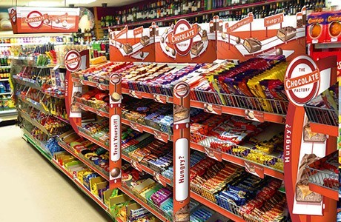
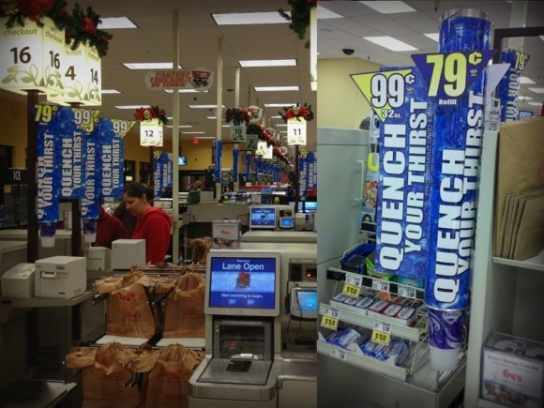
Action-inducing conative advertisements create situations in which cognitive knowledge of the product or affective liking of the product may come later (after the actual purchase) or during product usage.
For instance, a point-of- purchase display is designed (sometimes through advertising tie-ins) to cause people to make impulse buys. The goal is to make the sale, with cognitive knowledge and affective feelings forming as the product is used.
In terms of an attitude sequence, conative message strategies typically utilize the conative → cognitive → affective approach.

Slide 23

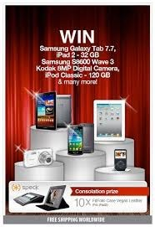
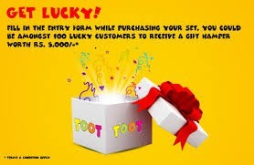
Promotional support conative advertisements are used to support other promotional efforts. Besides coupons and phone-in promotions, a company may advertise a sweepstakes that a consumer enters by filling out the form on the advertisement or by going to a particular retail store.

Slide 24



Slide 25
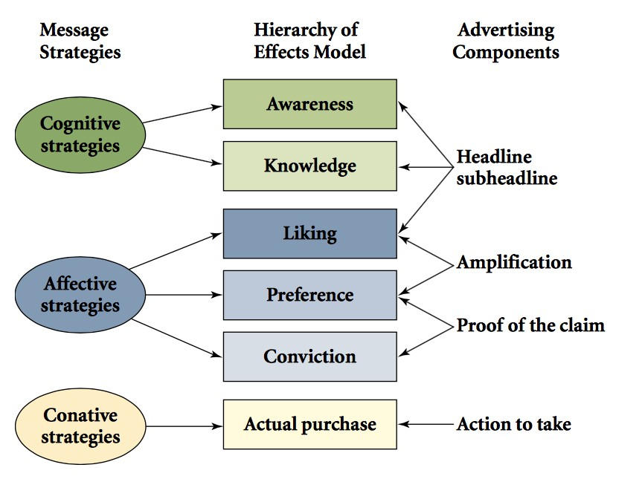

Slide 26
Executional Frameworks

Slide 27
Executional Framework
An executional framework is the manner in which an ad appeal is presented.
It is chosen after an advertising appeal has been
selected
Animation
Slice-of-life
Dramatization
Testimonial
Authoritative
Demonstration
Fantasy
Informative

Slide 28






Animation
Has seen a lot of development in recent years.
Rotoscoping
Clay animation

Slide 29

Slice-of-Life In slice-of-life commercials, advertisers attempt to provide solutions to the everyday problems consumers or businesses face. This format was made famous by Procter & Gamble during the early days of television advertising in the 1950s. The advertisements normally show the common experiences and especially the problems people encounter. Then, the good or service is made available to solve the problem. The most common slice-of-life format has four components:
Encounter
Problem
Interaction
Solution
In some of the ads, the actors portray the dilemma or problem and solve the problems themselves. In others, a voice-over explains the benefits or solution to the problem that the good, service, or company provides.

Slide 30
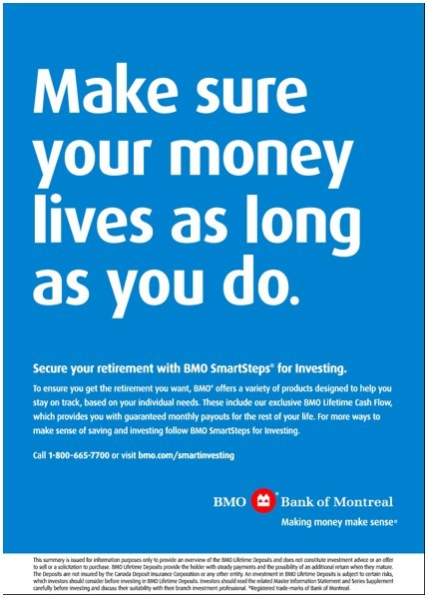

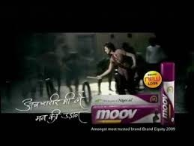

Slice-Of-Life

Slide 31
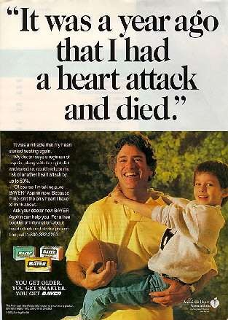

Slide 32
Dramatization
It is similar to the slice-of-life framework.
However, the intensity of the situation is heightened in this framework.
Make it Big

Slide 33
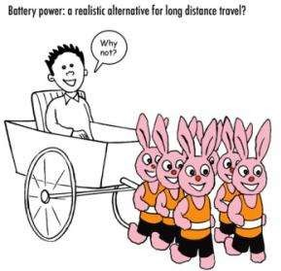

Slide 34


Slide 35
Testimonials
Especially successful in the B2B and services marketing sectors.
Customer is presented in an ad talking about a
positive experience with a product.
It is an effective method for promoting services.
Testimonials enhance company credibility. In such ads, it is the everyday people, often actual customers are the main characters – they are found to be more credible than endorsers and famous individuals.
Example: BTI – our clients speak for us campaign

Slide 36



Testimonials

Slide 37


Authoritative
The advertiser tries to convince viewers that a given product is superior to other brands.
Expert authority – dentists, physician, engineer, or chemist talks about the brand’s advantages compared to other brands.
Example: Colgate
May include scientific or survey evidence.

Slide 38

 It shows how a product works.
Demonstration
Effective way to communicate the attributes of a product to viewers.
Well-suited to television and internet flash
It is difficult to portray it in other media like print.
Demonstrations have been found to be
effective for B2B marketing

Slide 39


Slide 40


Fantasy
 Such executions are designed to lift the audience beyond the real world to a make-believe experience.
Most common fantasy themes still involve sex, love and romance.
Fantasy is widely used for fragrances and other fashion items.
Example: AXE

Slide 41


Slide 42


Slide 43
Informative
Here, information is presented to the audience in a straightforward manner.
Seen commonly in RDCs, rather than in TVC or print
– where consumers tend to ignore them.
Consumers who are highly involved in a particular
product category pay attention to such ads.
Such ads thus tend to work best for high-involvement
situations.

Slide 44
Sources and Spokesperson

Slide 45
Sources and Spokespersons
Selecting the right source and spokesperson to use in an advertisement is a critical decision.
4 types of sources are available to advertisers:
Celebrities
CEOs
Experts
Typical persons

Slide 46





Source Characteristics

Slide 47
Matching Source Types and Characteristics
Amitabh Bachchan
Sachin Tendulkar
If there is a match between the product and celebrity, the virtue of such an endorsement increases.
Problems
Brand ambassadors to the bringing disgrace brand l cebrities endorsing too many products – they lose credibility
People know that the celebrities are paid – they lose credibility

Slide 48
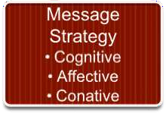

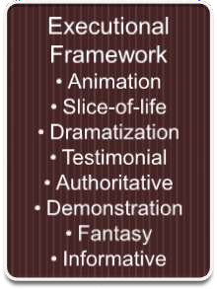



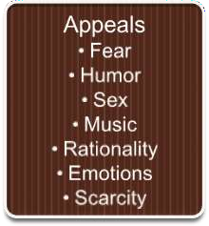




Creating an Advertisement

Slide 49
Effective Advertising – Key Points
An effective ad requires the joint efforts of the account exec, creative, media planner, and media buyer.
If the ad can break through the clutter – half the battle is won.

Slide 50
Key points to keep in mind are:
Visual consistency
Campaign duration
Repeated taglines
Consistent positioning – avoid ambiguity (doubt)
Simplicity
Identifiable selling point
Create an effective flow

Slide 51
Beating Ad Clutter
Repetition – it can lead to better brand and ad recall.
Variability theory
Suggests that variable encoding occurs when a consumers sees the same advertisement in different environments. These varied environments increase an ad’s recall and effectiveness by encoding it into the brain through various methods.
Creatives can generate the effect by varying the situational context of a particular ad.
Example: Mastercard ads or Zoo Zoo

Slide 52

