Slide 1
ADVERTISING
AND
DIGITAL MARKETING
Unit ii
Dr. sangeeta jain

Slide 2
UNIT II ADVERTISING OBJECTIVES & COMMUNICATION PROCESS 1. Marketing objectives 2. advertising objectives 3. sales oriented behavioral objectives 4. communication oriented objectives 5. The DAGMAR approach to setting objectives 6. measuring advertising effectiveness 7. kinds of advertising objectives 8. the advertisement communication system 9. the communication process 10.the advertising exposure model 11. need for clear objective.

Slide 3
















Advertising

Slide 4
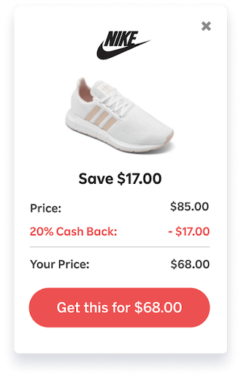

Slide 5
Marketing and Promotions Process Model
Marketing Strategy and Analysis
Target Marketing Process
Marketing Planning Program Development
Target Market
Promotion to
Competitive analysis
Target marketing
Identifying markets
Product decisions
Pricing decisions
Channel of distribution decisions
Promotional decisions
advertising
direct marketing
internet/ interactive
marketing
sales promotion
publicity
and public relations
personal selling
final buyer
Ultimate customer
Consumers
Businesses
Market segmentation
Promotion
Selecting a target market
to trade
Resellers
Positioning
through marketing strategies
Purchase

Slide 6







Slide 7
Framework of Advertising Planning & Decision Making
Situation Analysis
Marketing Programme
Integrated Mar. Com. Plan
Advertising Plan
Implementation

Slide 8
Process starts with an analysis of the Brand’s external & internal environment
Market analysis
Situation Analysis
Competitor analysis
(external and internal)
Brand Analysis- SWOT
Marketing Programme
Advertising Plan
Implementation

Slide 9
The Role of Advertising emerges from the Marketing Programme
Situation Analysis
Determines the role of each elements of the marketing mix including Marketing Communications
Indicates how all elements will be coordinated to support and synergise with each other
Marketing Programme
IMC & Advertising plan
Implementation

Slide 10
The Advertising Plan Includes…
Situation Analysis
Marketing Programme
Setting Objectives - (Segmentation-positioning)
Message – strategy & tactics
IMC & Advertising Plan
Media – strategy & tactics
Implementation and Coordination (synergy with other IMC tools)
Implementation

Slide 11
Framework of Advertising & Decision Making
Situation Analysis
Marketing Programme
IMC /Advertising Plan
Facilitating Agencies
Implementation
Social, legal & other constraints

Slide 12
Why Advertising?
Today with the increasing consumer awareness, business can not
survive for long without advertising.
With growing competition it is pertinent to ensure right media mix to each target audience.
Advertising agencies are now focusing their attention to consumer needs and providing creative designs with concept and ideas accordingly.

Slide 13
Strategic Planning for Advertising

Slide 14
Strategic Planning for Advertising
A strategy is a broad plan of action with an objective and goal in
mind.
The notion of strategic planning in advertising and marketing communications refers to the consideration on the objectives and goals set for overall marketing and developing plans to achieve those objectives.

Slide 15
Advertising Process
The advertising process involves the following steps: Review internal / external strategies and plan
This relates to the overall marketing plan of the organization Identify target audience
Before planning for advertising campaign it is important to take into consideration the consumers needs and wants, their preference, lifestyles, purchasing power etc.
Set advertising objectives and budget
Based on the analysis of the target audience and the overall objectives of the organization, the advertising objectives can be developed and budget earmarked accordingly for the purpose.

Slide 16
Advertising Process contd.
Develop creative approach
Different market segments will require different marketing approach.
One must develop creative approaches of communication to reach out the target audience effectively.
Conduct advertising research
Advertising research may be conducted to identify the appropriate media that will reach out to the maximum number of target consumers.
Selecting media
Appropriate media for advertising may be selected based on the adverting research.

Slide 17
Advertising Process contd.
Producing advertising
After thorough analysis of the target audience and selection of appropriate media the next step is to develop the message in appropriate format for presentation.
Depending on the type of media to be used advertising preparation requires specialist like copy writers, media persons, graphic artists, editors for production of an effective advertisement.
Evaluation
The impact of the advertisement campaign needs to be studied to rectify defects and decide future course of action.

Slide 18
Major Marketing Decisions
In developing marketing programs following five major decisions
are required:
Advertising objective setting
Advertising budget decision
Message decision
Media selection
Advertising evaluation

Slide 19
Major Marketing Decisions contd.
The major decisions in advertising management are represented in the following table
Sr. No. | Decisions | Tasks
1 | Advertising objective setting | target market, target response, target reach and frequency.
2 | Advertising budget decision | Affordable approach, percent of sale, competitive parity, objectives and task involved
3 | Message decision | Message generation, message evaluation and selection and message execution
4 | Media selection | Media categories, media vehicles, media timing
5 | Advertising evaluation | Copy testing, media testing, advertising expenditure level testing

Slide 20
Needs as base for advertising
Whether hierarchical or horizontal, utilitarian or hedonic the fact
remains that consumers have needs which they want to satisfy.
Advertisement that appeals them to fulfil these needs with the purchase of products and services actually try to motivate them to do so.
When large and identifiable number of consumers has similar needs then it forms the basis to segment the market.

Slide 21
Needs as base for advertising
One of the roles of advertising is to show consumers how a particular brand is effective in meeting a need.
The effectiveness of advertising to a great extent must be based on understanding the consumer behaviour.
A consumer behaviour comprises the entire consumer decisions and activities connected with choosing, buying, using and disposing of goods and services.
Advertisers have to pay attention to consumer behaviour that occurs before the purchase and continues after the product has been used.
Consumer behaviours are guided by external and internal factors.

Slide 22
External Influences
External Influences are;
Family and household influence
Opinion leaders and word of mouth
Reference groups
Social class
Culture, subculture and core values
Situational influence

Slide 23
External Influences- Family and household influence
1. Family and household influence:
Over the last four five decades the traditional family structures are changing.
As a result the researchers now look into household influence rather than the family influence for their study.
A household differs from a family in that it includes all members living under one roof regardless of their blood relationships.
This could include single parent homes, step- families, persons living together without marriage and persons living alone.
Family and household members play important role in purchasing decisions that effect themselves as well as other members of the family/ household.
The advertisers trying to sell products need to take into consideration the primary decision maker for purchases in a family/household.

Slide 24
External Influences - Opinion leaders and word of mouth
2. Opinion leaders and word of mouth
Consumers often seek advice from people who have knowledge about the product.
Opinion leaders are those who can influence the attitudes or behaviours of others.
They are generally the first users of a new product. They are at times the specialists for a certain product.
Word of mouth communication on the other hand is the transfer of information informally from person to person.
Word of mouth communication can be harmful for the marketers if it is negative.

Slide 25
External Influences - Reference groups
Reference groups
A any group with which a person feels some kind of identification or emotional attachment and which is used to guide and define his/ her beliefs, values and goals.
Consumers can be influenced by reference groups in three ways:
Their search for information before purchase
Their attitudes towards a product
The way they buy and use the product.
A reference group can influence the products people buy at both category and brand levels.
iii.

Slide 26
External Influences - Social class
Social class
Consumer behaviour are subtly influenced by social class, i.e., groupings of people who share similar lifestyles, values, interests, behaviours and status.
The social class concept is important for the advertisers and marketers because it is related to how much people spend on products and services.
Culture, subculture and core values
Culture is the set of values, beliefs and attitudes that is shared by a group and passed down from one generation to another.
Subculture is a group that preserves its unique values and lifestyles within a dominant culture. For instance various ethnic and religious subcultures exists within the Indian culture.
Advertisers and marketers study and respond to these groups’ buying behaviour.

Slide 27
External Influences - Situational influence
6. Situational influence
Situational influences are elements of time and place that can effect consumer behaviour.
The situational elements influencing consumer behaviour are:
Physical surrounding or condition like weather, decoration of the store etc.
Social surroundings
Time available for gathering information, making decision and buying and using the product
Purpose of purchase
Antecedent states that is momentary conditions and moods before and during purchase.

Slide 28
Internal Influences
Internal influences such as
Perception
Motivation
Attitude
Learning
Personality
self-concept
lifestyle
All these internal influences consumer behaviour to a great extent.

Slide 29
Internal Influences - Perception
1. Perception
It is the process of determining meaning by selecting, organizing and interpreting stimuli in the environment.
The four stages of perception are:
Exposure to a stimulus through senses (advertising messages)
Attends to a selected stimulus
Interpretation of what the senses have detected
iv. Storing in memory to be used during purchase- decision stage
Since the environment is full of stimuli the consumer will choose only a few. This is known as selective perceptions
iii.

Slide 30
Internal Influences - Motivation
2. Motivation
When people feel need they are driven to act by their motives. According to Maslow’s theory of hierarchy of needs,
People are initially motivated to satisfy their basic needs for survival.
After that they are able to concentrate on satisfying their higher needs.

Slide 31
Internal Influences - Attitude
3. Attitude
Consumers attitude towards a product or brand are formed over time through experience, use, information gathering and interaction with other people.
Attitude comprises three components that can be moulded or changed through marketing strategy.
These components are:
Cognitive component i.e. The set of knowledge consumer has about a product
Affective component representing consumers feelings or emotional reaction to a product
Behavioural component i.e. The consumer’s tendency to act in a certain way.

Slide 32
Internal Influences - Learning
4. Learning
Learning can influence the way people recognize needs, collect and assess product information, make buying decisions and evaluate results.
Changes in consumer’s behaviour is greatly influenced by their behavioural and cognitive learning.
Behavioural learning takes place when a person reacts in a certain way in response to the experience of an external stimulus.
The cognitive learning on the other hand occurs when people change their behaviour as a result of thinking about their situations.
Both behavioural and cognitive learning can lead to buying by habit.

Slide 33
Internal Influences – Personality and Lifestyle
Personality
Marketers at times group consumers on the basis of their certain personality traits and develop marketing approaches accordingly.
Lifestyle
It is an individual pattern of living as exhibited in a person’s activities, interests and opinions.
Marketers analyses consumer’s lifestyles by looking at a range of psychographic variables.
Shift in lifestyles can create new markets for the sellers.

Slide 34
Setting Advertising Objectives

Slide 35
Setting Advertising objective
After thorough analysis of the consumer behaviour and the marketing environment, the next step is to set advertising objectives.
The basic objective of advertising is persuasion.
The specific technique of advertising may be informative, educational, emotional etc. but advertising is meant to persuade people.
Developing adverting objective calls for defining the target market, target response and target reach and frequency.

Slide 36
The value of objectives
Communication
Planning and decision making
Measurement and evaluation of result

Slide 37
Advertising Goal
Long run impact of Advertising
For consumer goods, the effect of an advertising exposure can last
up to nine months
New Customers
Immediate Sales
Advertising
Future sales
Change attitude
Improve Image

Slide 38
Advertising Objectives
Advertising is one of the most creative fields and is a part of Marketing. In fact, Advertising has become so big that many people get confused about the differences between marketing and advertising. Nonetheless, the objectives of Advertising are completely different from Marketing.
In summary, it is the objective of advertising to carry out communications between the brand and the customer. Before the adoption of digital marketing and advertising, most of the communication between the brand and the customer was one way.
However, nowadays even digital advertising like sponsored ads are a chance of two-way communication.

Slide 39
Marketing objective of advertising
Introduce Brand
Awareness ceation
Acquire Customers
Diffrenciation
Increase Profit
Increase Sales
Introduce Product
Creat Desire
Brand building
Positioning
Call to Action

Slide 40
These must be Operational objectives
Meaningful Advertising Objectives
Provide criteria for decision making
Serve as a communication and coordination tool
Provide criteria for evaluate performance
Can ‘Sales’ be meaningful Objectives?

Slide 41
‘Sales’- Meaningful Advertising Objective?
Difficult to identify the impact of Advtg.on ‘Sales’
‘Advtg. impact is felt over time
Isolating ad impact from other elements of the marketing mix is difficult
New customer
Advertising
Immediate Sales
Future sales
Change attitude/improve image Advertising

Slide 42
‘Sales Strategy’ the basis for Advertising Objectives
Sales growth comes from -
New customers buying
Old customers staying loyal
Old customers consuming more

Slide 43
FACTORS INFLUENCING SALES
TECHNOLOGY
ADVERTISING
ECONOMY
DISTRIBUTION
SALES
PROMOTION
COMPETITION
PRICE
PRODUCT QUALITY

Slide 44
How Advertising Works
There is a popular notion that usually advertising is not well suited
to directly precipitate action.
Advertising is better at conducting some communication, association, or persuasion task that will hopefully result in the desired action being precipitated.
A communication results in the audience members learning something new or gaining an improved understanding or memory of some fact; for example, Sugar Free comes in a low-calorie form or Diet Pepsi is exactly the Pepsi you love , without the sugar.

Slide 45
How Advertising Works contd.
Many of you will feel that the model distances advertising from sales even further.
You would have preferred a straight arrow running from ad. exposure on the extreme left to purchase behaviour on the extreme right .
Wish that was true .
Wish advertising could do the job of the salesman .
You wouldn’t need a sales force then and that is the case with a lot of advertising of a special kind – mail order, for instance but that is the best and most exceptional use of advertising .
The truth is that, in general, the persuasion process leads to purchase in a very definite way and good advertisers have learnt to hasten it without aborting the intervening steps .
That is why advertising is considered an investment and whoever shorts the circuit loses more than s/he gains in the main.

Slide 46
The Communication Process
Perception Process
Source
Receiver
Destination
Message
Message
Media
WOM

Slide 47
The Persuasion Process of Advertising
Awareness/ familiarity
The Persuasion Process of Advertising is through
a variety of advertising effects
Brand Benefit
/ Information
Creating image / personality
Brand
Attitude
Purchase Behavior
Associating feelings with Brand
Linkage of Brand with peers/experts/group norms /culture
Reminder / Brand trial inducement
Ad Expouser model

Slide 48
COMMUNICATIONS EFFECT PYRAMID
8%
Repurchase
20% trial
25% preferances
40% liking
70% knowledge /comperehension
90%awareness

Slide 49
Developing Advertising Objectives
Involves 3 considerations -
Behavioral decisions (behavioral objectives) that Advertising must influence
The Target Segment
The decision making process that communication must precede to influence behavior

Slide 50
Towards operational objectives Targeting
Who is the target segment?
What is the ultimate behaviour within that segment that advertising is attempting to precipitate / reinforce / change/ influence?
What is the process that will lead to the desired behaviour?
Is it necessary to create awareness / give information / create image / build attitudes / brand equity / associated feelings / type of user personality with a brand?

Slide 51
Target market
An advertiser must start with a clear target audience in mind.
Audience may comprise individuals, groups, particular public or general public.
The target audience can influence the advertiser’s decision on what is to be said, how it is to be said, when it is to be said, where it is to be said and how it is to be said.
Each target market warrants a different advertising campaign.

Slide 52
Target response
Once target audience is decided the advertisers must decide the response that is sought from the target market.
The ultimate response will be the purchase behaviour, which results from a long process of consumer decision making.
Any member of the target audience can be in any of the six buyer’s readiness states
Awareness
Knowledge
Liking
Preference
Conviction
Action.
The advertisers need to know in which state the target audience stands at the present time and to which state it should be moved through ad campaigns.

Slide 53
Target reach and frequency
Determination of optimal target reach and frequency is important, as funds are limited.
Decision needs to be taken as to how many exposures are required to create the desired response in a given market.
One exposure could be enough to create awareness but it may not be enough to convert a person’s awareness into preference.
While setting advertising objectives the following aspects must be covered:
Specifically state the basic message to be sent
Detail the description of the audience intended to receive the message
Explicitly state the intended effect on the audience Detail on how the campaigns success may be measured.

Slide 54
The Influence of Advertising on Desired Behavior
Advertising is not as effective in directly evoking desired action -‘Purchase’
Advertising causal intervening response
desired behavioral response Sales
Sales Promotions, DM & Retail Advertising should be used in conjunction with Advertising to drive sales.

Slide 55
Secondary Demand- New customers using other brands
Primary Demand - Customers trying the category for the first time
 |  | Trial Purchase
Trial
Purchase
Behavioral Responses that drive Purchase
Existing customers Loyalty
Loyalty
More consumption news uses and more usage
Increased usage / SOR
Marketing / Sales Strategies & Behavioral Objectives

Slide 56
Demand Generation - Offensive Strategy
Market dynamics:
- Sales grow because of new customers buying
Those not the buying product
Those buying Other brands
Existing
customers
Offensive Marketing Strategies’
Primary demand generation
Secondary demand generation

Slide 57
Demand Generation - Defensive Strategy
Market dynamics:
Sale grow with old customers staying loyal ‘Defensive Marketing Strategy’
Recall the important brand features
Reinforce use experience
Consumer promotions

Slide 58
Demand Generation through Increased Consumption
Market dynamics:
Sales grow with ‘Product form expansion’
More frequent usage / share of requirement (SOR)
New use applications

Slide 59
Measuring Tools
View of the above , it becomes important to study the historical
underpinnings, the historical foundations for our approach to setting advertising objectives the way we do.
Research findings, constructs, and measurement tools have all been developed around these that will serve to make the approach effective and operational.
It therefore provides a rationale and basis for the introduction of advertising response measures in advertising objectives and for the concept of measuring such objectives over time.

Slide 60

DAGMAR

Slide 61
DAGMAR
The effectiveness of advertising can be measured through DAGMAR (Defining Advertising Goals for Measured Advertising Results).
In 1961, Russell H. Colley wrote a book under the sponsorship of the Association of National Advertisers called Defining Advertising Goals for Measured Advertising Results.
The book introduced what has become known as the DAGMAR approach to advertising planning and included a precise method for selecting and quantifying goals and for using those goals to measure performance.

Slide 62
DAGMAR
The DAGMAR approach can be summarized in its statement "defining an advertising goal."
An advertising goal is a specific communication task, to be accomplished among a defined audience, in a given period of time.
Note that a communication task is involved as opposed to a marketing task and that the goal is specific, involving an unambiguously defined task, among a defined audience, in a given time period.
DAGMAR is aimed at setting advertising goals / planning's and not marketing goals.
The DAGMAR suggested a precise method for selecting and quantifying advertising goals.
It proposed that advertisers should collect feedback measures to determine if their advertising met those goals.

Slide 63
DAGMAR
DAGMAR is basically an approach to advertising planning and a precise method for selecting and quantifying goals and for using those goals to measure performance.
An advertising objective involves a communication task, intended to create awareness, impart information, develop attitudes or induce action.
In the DAGMAR approach, the communication task is based on a specific model of the communication process, as shown below.
In the DAGMAR approach, the communication task is based on a specific model of the communication process, as illustrated in figure below (next slide), which is a simplified version of fig. above (previous slide)

Slide 64
DAGMAR
DAGMAR approachs are the steps that consumers must go through
to buy a product.
These steps known as hierarchy of effects have become the basic criteria for advertising objectives and goals.
The hierarchy that provides the basis for DAGMAR is linear and conceptualizes consumers going from unawareness to awareness, comprehension, conviction and action.
This is illustrated in the following figure;

Slide 65
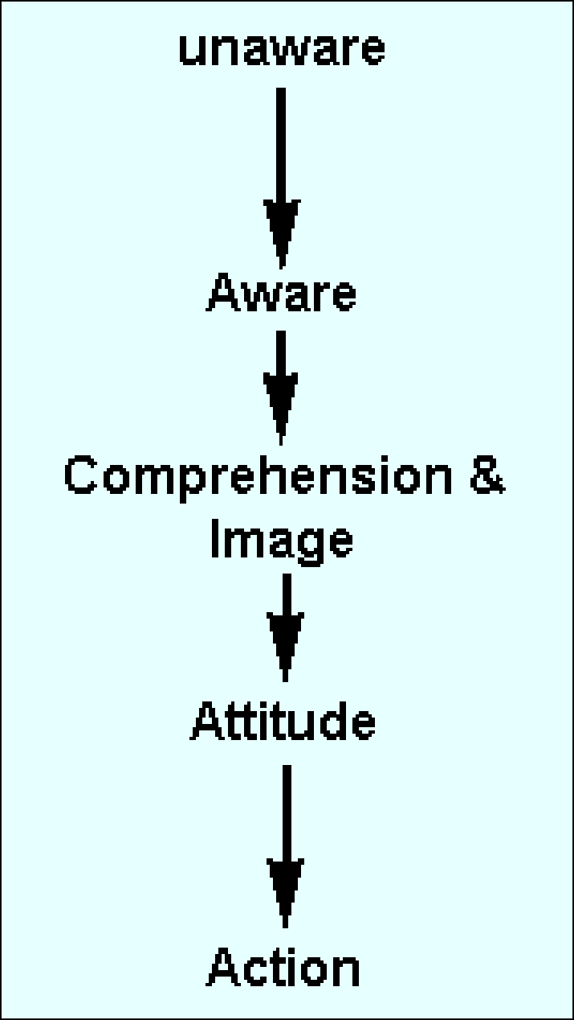
DAGMAR Model
Communication Process in DAGMAR Approach
or
A Hierarchy of effects model of the communications process

Slide 66
PROMOTION USER RECOMMENDATIONS EXHIBITS
PRICE DISPLAY ADVERTISING PACKAGING PRODUCT DESIGN PUBLICITY AVAILABILITY
MARKETING
FORCES
UNAWARENESS
AWARENESS
COMPREHENSION
CONVICTION
ACTION
COUNTERVAILING FORCES

Slide 67
DAGMAR Steps
The model suggests that before the acceptance of a product by an
individual, there is a series of mental steps which the individual goes through.
At some point of time, the individual will be unaware of the product or offer in the market.
First Step:
The initial communication task of the advertising activity is to increase consumer awareness of the product or offer.

Slide 68
DAGMAR Steps contd.
The second step:
The second step of the communication process is comprehension of the product or offer and involves the target audience learning something about the product or offer.
What are its specific characteristics and appeals, including associated imagery and feelings?
In what way does it differ from its competitors? Whom is it supposed to benefit?

Slide 69
DAGMAR Steps contd.
The third step
The third step is the attitude (or conviction) step and intervenes between comprehension and final action.
The action phase involves some overt move on the part of the buyer such as trying a brand for the first time, visiting a showroom, or requesting information.

Slide 70
DAGMAR Process
The whole communication process is a bit more complex.
Under different circumstances, process may differ slightly, but the basic concept revolves around what is mentioned in above.
The DAGMAR approach emphasizes the communication task of advertising.
The second important concept of the approach is that the advertising goal be specific.
Goal should be a written, measurable task involving a starting point, a defined audience, and a fixed time period.

Slide 71
A Measurable Objective
The DAGMAR approach sounds impractical once we talk of measurements, surveys, questionnaires and all that stuff.
The approach emphasizes the importance of objectives, we must have some form of measurement to indicate the effectiveness of the advertising / promotional campaign.
For any promotional campaign , it must have an objective. And an objective that is measurable.
For a yellow page advertisement, the measurement could be the number of phone calls received before and after the ad was published or the number of referrals through yellow pages.

Slide 72
A Measurable Objective
The measurable objective must be written, clear and unambiguous.
Goals like 'Improve store image‘ / Increase awareness of our store' etc are too vague and do not lead to anywhere.
A good starting point to work on the goal would be:
Increase awareness of our store by 10%

Slide 73
A Conceivable Benchmark
When we talk of measurement, its both current and future.
We must, first, know where we stand now, and know in quantitative terms.
The current position is your starting point which will help in establishing a goal and selecting a campaign to reach it.
Getting more customer into your store might not be an optimal goal, if you already receive a large number of visitors.
If you know that already many customers are visiting your store, then your advertising can be aimed at converting your visitors to customers.
Increase awareness of our store from the current level of 20% to 30%

Slide 74
Other Communication Model

Slide 75
A communication model such as the DAGMAR , which implies that the audience member will sequentially pass through a set of steps, is termed a hierarchy-of-effects model.
A host of hierarchy models have been proposed.
Hierarchy of Effects (DAGMAR)
AIDA Model
New Adopter Hierarchy Model
Lavidge and Steiner Model

Slide 76
The Effects Behind Advertising Effectiveness
AIDA (attention, interest, desire, action)
Hierarchy of Effects (think, feel, do)
Key Advertising Effects
Facets models of effective advertising
The facets come together to make up the unique consumer response to an advertising message

Slide 77
Three Models of Advertising Effect
Hierarchy of Effects Model
AIDA Model
Key Advertising
Effects Model
Perception
Attention
Think
Cognition
Association
Interest
Affective Response
Feel
Desire
Persuasion
Do
Action
Behavior

Slide 78
Perception
The process by which we receive information through our five senses and assign meaning to it
Exposure
Being seen or heard
Media planners try to find the best way to expose the target audience to the message
IMC planners consider all contacts a consumer has with a company or brand

Slide 79
Perception - Measures
Selection and Attention
The ability to draw attention, to bring visibility
One of advertising’s greatest strengths
Awareness
Results when an ad initially makes an impression
Most evaluations of advertising effectiveness include a measure of awareness as an indicator of perception
Interest and Relevance
Interest
The receiver of the message has become mentally engaged with the ad and the product
Relevance
The message connects on some personal level
Recognition
Memory
Recognition
Recall

Slide 80
Cognition
How consumers respond to information, learn, and understand something
Cognitive Learning
When a presentation of facts, information, and explanations leads to understanding
Used by consumers who want to learn everything about a product before they buy it

Slide 81
Cognition - Objectives
Information
Facts about product performance and features
Particularly important for products that are complex, have a high price, or are high risk
Needs
The cognitive impact of an advertising message
A cognitive ad explains how a product works and what it can do for the consumer

Slide 82
Cognition - Measures
Differentiation
Occurs when consumers understand the explanation of a competitive advantage
A consumer has to understand the features of a brand and be able to compare competing products
Recall
When the consumer remembers seeing the advertisements and remembers the copy points
Ads use jingles, slogans, catchy headlines, intriguing visuals, and key visuals

Slide 83
Association
The process of making symbolic connections between a brand and characteristics that represent the brand’s image and personality
Symbolism
The brand stands for a certain quality
A bond or relationship is created based on these meaning
Conditioned Learning
The way association implants an idea in a consumer’s mind

Slide 84
Association - Measures
Brand Transformation
A brand takes on meaning when it is transformed from a product into something special
Differentiated from other products in the category by virtue of its image and identity
Brand Communication
Brand identity
Brand position
Brand personality
Brand image
Brand promise
Brand loyalty

Slide 85
The Affective or Emotional Response
Mirrors a person’s feelings about something
Stimulates wants
Touches the emotions
Creates feelings
Wants
Influenced more by emotion or desire
Desire is based on wishes, longings, and cravings
Emotions
Agitates passions or feelings

Slide 86
The Affective or Emotional Response - Measures
Liking
Liking a brand or ad is one of the best predictors of consumer behavior
If a consumer likes the ad, the positive feeling will transfer to the brand
Resonance
Help the consumer identify with the brand on a personal level
Stronger than liking because it involves an element of self-identification

Slide 87
Persuasion
The conscious intent on the part of the source to influence the receiver of a message to believe or do something
Motivation
When something prompts a person to act in a certain way
Marketing communications uses incentives to encourage response

Slide 88
Persuasion - Objectives
Arguments
Uses logic, reasons, and proofs to make a point and build conviction
Conviction/Preference
Conviction
Consumers believe something to be true
Preference
An intention to try or buy a product
Source credibility

Slide 89
Persuasion - Measures
Loyalty
Measured both as an attitude and by repeat purchases
Built on customer satisfaction
Attitudes
Mental readiness to react to a situation in a given way
Involvement’s Role
The degree to which a consumer is engrossed in attending to an ad or making a product decision
High involvement
Low involvement

Slide 90
Behavior
The action response
Effectiveness is measured in terms of its ability to motivate people to do something
Contact
Making contact with the advertiser can be an important sign of effectiveness
Try and Buy
Initiating action through trial
Trial is important because it lets a customer use the product without investing in its purchase
Prevention
Involves counter-arguing by presenting negative messages about an unwanted behavior

Slide 91
Typical Communication Objectives
Attitude toward the Ad/Brand
(encompasses all three components of the HOE Model)
Brand Image/Positioning
Ad/Brand liking
Brand learning
Ad/Brand Cognitions
Purchase Intention
Awareness
Ad Recall
Ad Recognition
Involvement

Slide 92
Other Communication Model
The AIDA model:
The AIDA model, developed in the 1920s
It suggest that an effective personal sales presentation should attract Attention, gain Interest, create a Desire, and precipitate Action.
The new adopter hierarchy model:
The new adopter hierarchy model, conceived by rural sociologists, postulated five stages: awareness, interest, evaluation, trial, and adoption.

Slide 93
Robert Lavidge and Gary Steiner Hierarchy Model:
This hierarchy model is particularly interesting because of its close ties with social psychological theory.
Developed by Robert Lavidge and Gary Steiner
It includes six stages: awareness, knowledge, liking, preference, conviction, and purchase.

Slide 94
They divided this hierarchy into the three components corresponding to a social psychologist's concept of an attitude system.
The first stage, consisting of the awareness and knowledge levels, is comparable to the cognitive, or knowledge, component of attitude.
The affective component of an attitude, the like-dislike aspect, is represented in the Lavidge and Steiner hierarchy by the liking and preference levels.
The remaining attitude component is the conative (action tendencies such as intention to purchase or trial) component, the action or motivation element, represented by the conviction and purchase levels, the final two levels in the hierarchy.

Slide 95
Cognitive : Awareness, Knowledge
Attitude : Liking, Preference
Conative / Action : Conviction, Purchase

Slide 96
A lot of other customer-response models are based on those 3 stages (Cognitive, Affective, Behavior):
AIDA model
Innovation – Adoption Model
Information processing Model
Operational Model
Customer Awareness Model

Slide 97
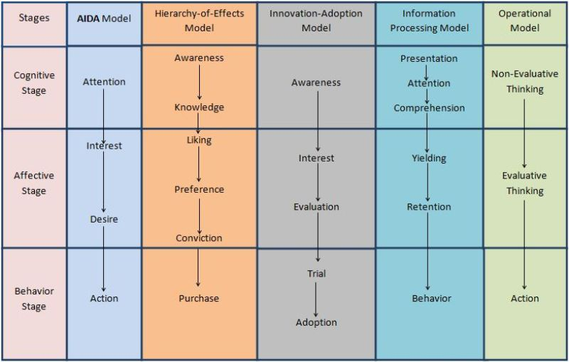

Slide 98


Thank You

