Slide 1
ADVERTISING
AND
DIGITAL MARKETING
Dr. sangeeta jain

Slide 2
UNIT I: ADVERTISING MANAGEMENT:
Integrated marketing communication
Introduction to advertising
role of advertising in MARKETING mix and positioning
advertiser and advertising agencies
key players in advertising
types of advertising
types of media
media planning and strategy
Responsible advertising.

Slide 3

INTRODUCTION TO ADVERTISING
According to “Philip Kotler” & American Marketing Association. The advertising is any paid form of non personal presentation of Ideas,Goods, Services by an identified sponsor that is called Advertising.
Although advertising is an accepted part of every day life, there is still great debate as to how advertising works and the role it can and should perform within the marketing communication mix. This module enables the applicants to review this debate and apply the theories to the advertising in our media today. They will learn how to put together an advertising plan and will examine the ingredients of an effective advertisement and ways in which this effectiveness can be measured

Slide 4
Advertising in general refers to any openly sponsored offering of goods, services, or ideas through any medium of public communication.
It is a non-personal form of communication conducted through paid media under clear sponsorship.
At initial stages of development, advertising was merely an announcement; for instance the entrepreneurs in ancient Egypt used criers to announce ship and cargo arrivals.

Slide 5
Importance of Advertising
1.5 IMPORTANCE OF ADVERTISING
Advertising has become an essential marketing activity in the
modern era of large scale production and serve competition in the
market. It performs the following functions:
Promotion of Sales
Introduction of New Product
4. Mass Production
5. Research
6. Education of People
7. Support to Press
Advertising has become an essential marketing activity in the
modern era of large scale production and serve competition in the market. It performs the following functions:
Promotion of Sales
Introduction of New Product
4. Mass Production
5. Research
6. Education of People
7. Support to Press

Slide 6
FEATURES OF ADVERTISING
Communication
Information
Persuasion
Profit Maximization
Non-Personal Presentation
Identified Sponsor
Consumer Choice
Art, Science and Profession
Element of Marking Mix
Element of Creativity

Slide 7
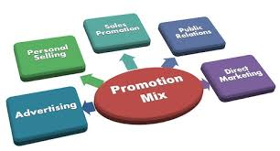

Slide 8
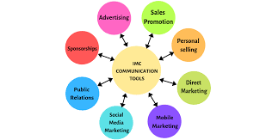
Integrated Marketing Communication
Integrated Marketing Communications is a simple concept. It ensures that all forms of communications and messages are carefully linked together. At its most basic level, Integrated Marketing Communications, or IMC, as we'll call it, means integrating all the promotional tools, so that they work together in harmony.

Slide 9
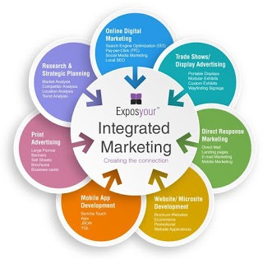

Slide 10
Integrated Marketing Communications (IMC)
According to The American Marketing Association, is ―a planning process designed to assure that all brand contacts received by a customer or prospect for a product, service, or organization are relevant to that person and consistent over time.‖ (Marketing Power Dictionary)
Integrated Marketing Communications is a term used to describe a holistic approach to marketing. It aims to ensure consistency of message and the complementary use of media. The concept includes online and offline marketing channels. Online marketing channels include any e-marketing campaigns or programs, from search engine optimization (SEO), pay-per-click, and affiliate, and email, banner to latest web related channels for webinar, blog, RSS, pod cast, and Internet TV. Offline marketing channels are traditional print (newspaper, magazine), mail order, public relations, industry relations, billboard, radio, and television. A company develops its integrated marketing communication programmer using all the elements of the marketing mix (price, place, product, and promotion).

Slide 11
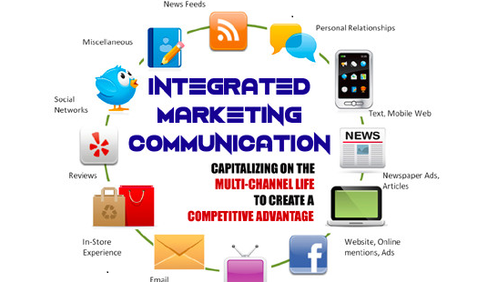

Slide 12
Brodcaste
Media
Print Media
Publicity
Internet
Direct
Marketing
Out of
home Media
Target
audiance
Personal
Selling
Sales
promotiom
Points of
purchase
Word of
mouth
Events and
Sponsership
Product
Placement

Slide 13
Characteristics of I M c
A shifting of marketing expenditure from traditional media advertising to other form of promotion.
Rapid growth of internet and social media
Ashift in market place power from manufacturing to retailer
The growth and development of data base marketing
Demand for greater accountability from advertising agencies
1. Amul Example.pptx

Slide 14
The modern advertising methods started with the invention of printing.
After the influence of salesmanship came into public notice in the 18th century, the present elaborate form of advertising began to evolve.
The advertising agencies, working on a commission basis were mainly responsible for this evolution.
The largest group of advertisers in the present day are the food marketers, followed by marketers of drugs and cosmetics, soaps, automobiles, tobacco, appliances, and oil products.

Slide 15
Advantages of Advertising
Advertising has several advantages for marketing products and services.
It enables to reach out maximum number of the target audience at a comparatively low cost.
Repetition of message is also possible and this also reduces the cost.
Moreover, with advertising impact can be created by dramatization of company and its products, which in the long term helps in building image for the organization.
It is further believed that advertising can create a new market for products that fill a genuine, though latent, need.
It also furthers product improvement through free competition.
15

Slide 16
1 और कुछ चल रहा हो ना हो, फॉग तो चल ही रहा है
२. फोन पे पर छोटी transactions के लिये पिन नही लगता
३. प्युरो नमक मे केमिकल्स नही हैं
४. नयी पुरानी दोनो generations को कमला पसंद इलायची पसंद है
५. इन्शुरन्स ना हो तो आधी ट्रीटमेंट से भाग जाना पडता है

Slide 17
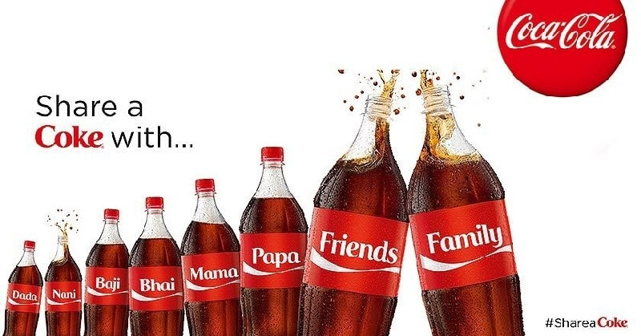
COCA COLA – Share a Coke Campaign

Slide 18

Nike – Just Do It Ads

Slide 19

Always – #LikeaGirl

Slide 20
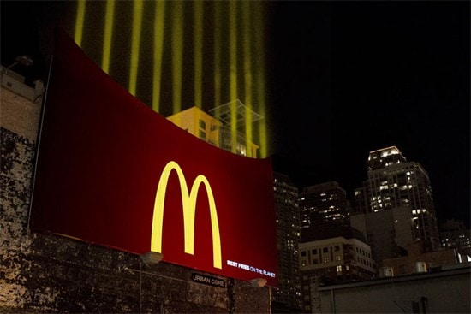
McDonald’s – Night-Time Service Advertisement

Slide 21

5. Colgate – Torture Test Approach

Slide 22

Adidas – Behind the Scenes Advertisement

Slide 23
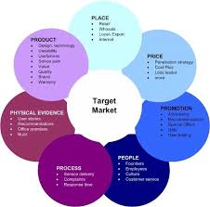

Slide 24
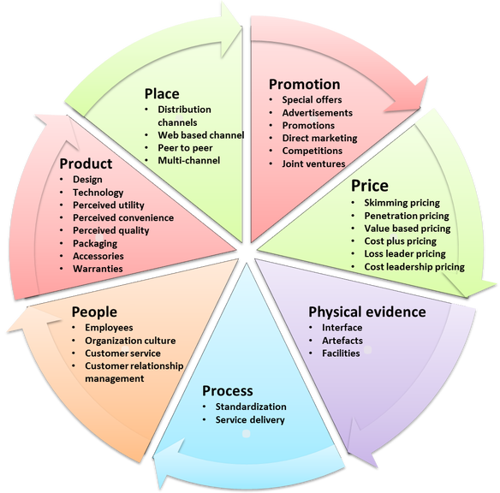
role of advertising in MARKETING Mix AND positioning

Slide 25
ROLE OF ADVERTISING
Assuming that a customer is aware of a brand or company through most of the other elements of the promotional mix, the role of advertising in the marketing mix can serve as the cementing force, fortifying and reinforcing the messages in a small-business owner's direct marketing and sales promotion
Advertising exists to help sell things.
It is mainly about brands
It is mainly designed to create and strengthen consumer impressions of the brand
Exception is public service advertising

Slide 26
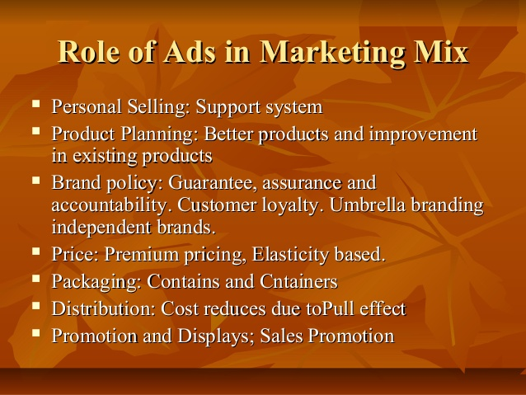

Slide 27
MARKETING ROLE
Can reach a mass audience, Introduces products, Explains important changes. Reminds and reinforces Persuades. The process a business uses to satisfy consumer needs by providing goods and services
Product category
Target market
Marketing mix
Brand
COMMUNICATION ROLE
Advertising is a form of mass communication.
Can reach a mass audience
Introduces products
Explains important changes
Reminds and reinforces
Persuades

Slide 28
ECONOMIC ROLE
Improves standard of living and the economy by generating material consumption.
Advertising is an objective means for providing price-value information, thereby creating a more rational economy.
Moves from being informational to creating demand
SOCIETAL ROLE
Informs consumers about innovations and issues
Mirrors fashion and design trends
Teaches consumers about new products
Helps shape consumer self-image
Perpetuates self- expression

Slide 29
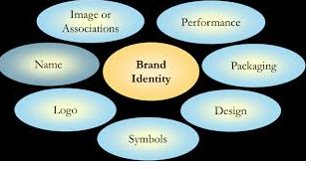
Role of advertising in positioning
Advertising has a central role to play in developing a brand image. It informs consumers of the functional capabilities of the brand while simultaneously inspiring the brand with symbolic values and meanings relevant to the consumer.

Slide 30
ADVERTISER AND ADVERTISING AGENCIES
There are basically 5 types of advertising agencies.
Full service Agencies. Large size agencies. ...
Interactive Agencies. Modernized modes of communication are used. ...
Creative Boutiques. Very creative and innovative ads. ...
Media Buying Agencies. Buys place for advertise and sells it to the advertisers. ...
In-House Agencies.

Slide 31
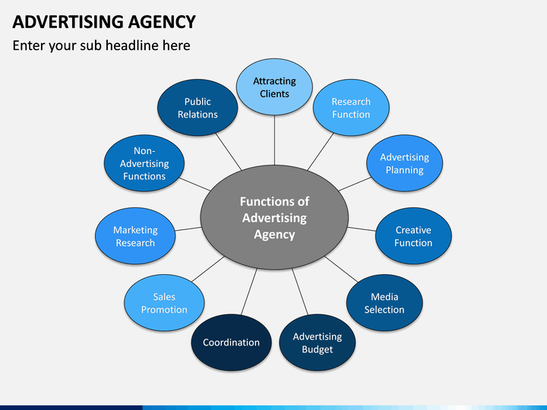

Slide 32
THE KEY PLAYERS
Advertiser (client)
Agency
Media
Supplier
Audience
Uses advertising to send out a message about its products
Initiates the advertising effort by identifying a marketing problem
Approves audience, plan and budget
Hires the advertising agency
♦

Slide 33
THE KEY PLAYERS
Advertiser (client)
Agency
Media
Supplier
Audience
Has strategic and creative expertise, media knowledge, workforce talent, and negotiating abilities
Advertising department
In-house agency

Slide 34
THE KEY PLAYERS
Advertiser (client)
Agency
Media
Supplier
Audience
Has strategic and creative expertise, media knowledge, workforce talent, and negotiating abilities
Advertising department
In-house agency
DEEPAK AD AGENCY

Slide 35
THE KEY PLAYERS
Advertiser (client)
Agency
Media
Supplier
Audience
The channels of communication that carry the message to the audience
Are also companies or huge conglomerates
Mass media advertising can be cost effective because the costs are spread over the large number of people the ad reaches
PRINT ,Electronic,Social etc

Slide 36
THE KEY PLAYERS
Advertiser (client)
Agency
Media
Supplier
Audience
Assist advertisers, agencies, and the media in creating and placing the ads
Vendor services are often cheaper than those in-house
Graphic designer

Slide 37
THE KEY PLAYERS
Advertiser (client)
Agency
Media
Supplier
Audience
The desired audience for the advertising message
Data-gathering technology improves accuracy of information about customers
Advertisers must recognize the various target audiences they are talking to and know as much about them as possible

Slide 38
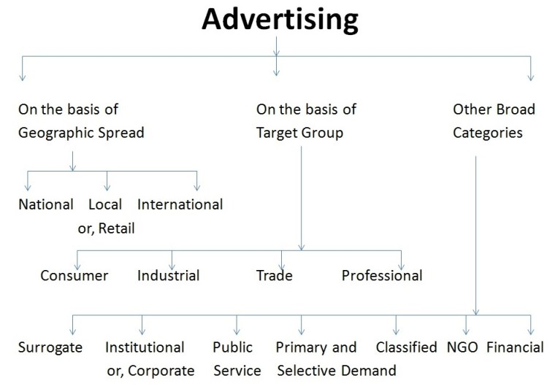
classification of advertisement

Slide 39
Interactive
Brand
Advertising
Advertising
Public Service
Retail or Local
Advertising
Advertising
Institutional
Advertising
Business-to-
Business
Advertising

Slide 40
Types of Advertising
Brand advertising
Retail or Local advertising
Direct-Response advertising
Business-to-Business advertising
Institutional advertising
Nonprofit advertising
Public Service advertising

Slide 41
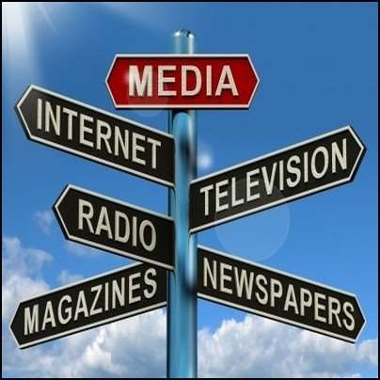
types of media
Media can be classified into four types:
Print Media (Newspapers, Magazines)
Broadcast Media (TV, Radio)
Outdoor or Out of Home (OOH) Media.
Internet.

Slide 42








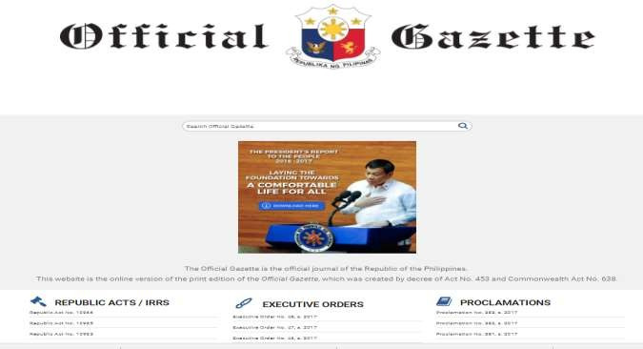
Print media
Book, Newspapper, Magzine, jouranal, Gazette, News letter, pamplet ,flyer, broucher, leaflet,

Slide 43
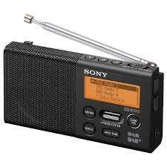
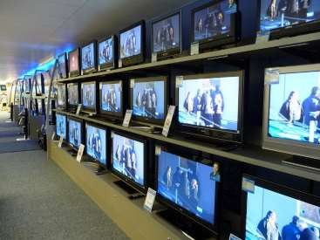


Broadcast media
RADIO,TELEVISION,MOVIE,

Slide 44

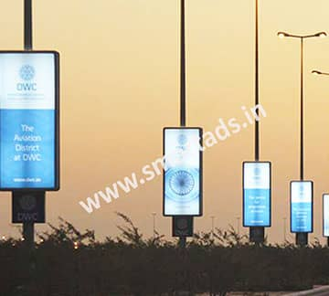

OUT DOOR/OUT OF HOME media

Slide 45

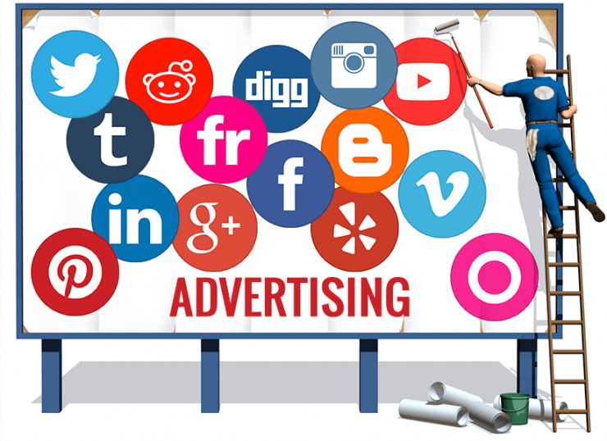
INTERNET SOCIAL MEDIA
Social media advertising, or social media targeting, are advertisements served to users on social media platforms. Social networks utilize user information to serve highly relevant advertisements based on interactions within a specific platform.
Social networking (Facebook, LinkedIn, Google+).
Microblogging (Twitter, Tumblr).
Photo sharing (Instagram, Snapchat, Pinterest).
Video sharing (YouTube, Facebook Live, Periscope, Vimeo).

Slide 46
COMPONENT OF ADVERTISING
Strategy
Creative idea
Execution
Media
•
•
•
•
•
The strategy is the logic and planning behind the ad that gives it direction.
Advertisers develop ads to meet objectives.
Advertisers direct ads to identified audiences.
Advertisers create a message that speaks to the audience’s concerns.
Advertisers run ads in the most effective media.
1-31

Slide 47
COMPONENT OF ADVERTISING
Strategy
Creative idea
Execution
Media
•
The central idea grabs the consumer’s attention and sticks in memory.
Planning strategy require creative problem solving.
Research involves creativity.
Buying and placing ads requires creative thinking.
•
•
•
1-32

Slide 48
COMPONENT OF ADVERTISING
Strategy
Creative idea
Execution
Media
•
•
Effective ads are well executed reflecting the highest production values in the industry.
Clients demand the best production the budget allows.
1-33

Slide 49
MEDIA TERMINOLOGY
media planning and strategy
◆ Media planning : series of decisions involved in delivering the promotional message to the prospective purchasers and/or users of the product or brand.
◆ Media Objectives : Goals to be attained by the media strategy and program.
◆ Media Strategy : Decisions on how the media objectives can be attained.
◆ Media : The various categories of delivery systems, including
broadcast and print media.

Slide 50
MEDIA TERMINOLOGY
Media Vehicle : The specific message carrier, such as The Hindu or Times of India.
Coverage :The potential audience that might receive the message through the vehicle
Reach :The actual number of individual audience members reached at least once by the vehicle.
Frequency :The number of times the receiver is exposed to vehicle in a specific time period.

Slide 51
THE SITUATION ANALYSIS
THE MARKETING STRATEGY PLAN
THE CREATIVE STRATEGY PLAN
SETTING MEDIA OBJECTIVE S
DETERMINING MEDIA STRATEGY
SELECTING BROAD MEDIA CLASSES
SELECTING MEDIA WITHIN CLASSES
MEDIA USE DECISIONS BROAD -CAST
MEDIA USE DECISIONS
PRINT
MEDIA USE DECISIONS OTHER MEDIA

Slide 52
Developing and Implementing Media Strategies
The media mix
Target market coverage
Geographic coverage
Scheduling
Reach versus frequency
Creative aspects and mood
Flexibility
Budget considerations

Slide 53
Target Market Coverage
Target Market Proportion
Full Market Coverage
Population excluding target market
Target market
Media Coverage
Media Over exposure
Partial Market Coverage
Coverage Exceeding Market

Slide 54
Geographic coverage
Brand development Index (BDI)
= Percentage of brand to total (country) sales in the market X 100
Percentage of total (country) population in the market
Category development index (CDI)
= Percentage of product category total (country) sales in the market X 100 Percentage of total (country) population in the market

Slide 55
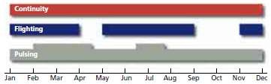
Scheduling

Slide 56
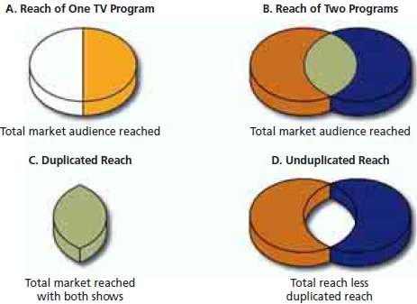
Reach versus frequency
◆ Reach -The actual number of individual audience members reached at least once by the vehicle.
◆ Frequency -The number of times the receiver is exposed to vehicle in a specific time period.
◆ GRP (Gross rating point) = Reach x frequency

Slide 57
Reach and Frequency
Spot run | Home A | Home B | Home C | Home D | Total Exposures
1st time | X |  | X |  | 2
2nd time |  |  | X | X | 2
3rd time |  |  |  | X | 1
4th time | X |  | X | X | 3
Total Exp. | 2 | 0 | 3 | 3 | 8

Slide 58
Reach and Frequency
Four television homes = universe.
Three homes or 75% of universe receive message. That’s a rating of 75.
In total, the message had 8 exposures.

Slide 59
Reach and Frequency 3
◆ 8 exposures divided by number of homes hit = exposures.
8 exposures = 2.67 average exposures 3 homes
◆ Reach times frequency equals gross ratings points:
◆ 75 rating (3 homes hit in universe of 4) times 2.67 exposures = 200.25 gross rating points.

Slide 60
Marketing Factors Important in determining Frequency
Brand history
Brand share
Brand loyalty
Purchase cycles
Usage cycle
Competitive share of voice
Target group

Slide 61
Creative Factors In determining Frequency
Message complexity
Message uniqueness
New vs. continuing campaigns
Image versus product sell
Message variation
Wearout
Advertising units

Slide 62
Media Factors Important in determining Frequency
Clutter
Editorial environment
Attentiveness
Scheduling
Number of media used
Repeat Exposures

Slide 63
Creative aspects and mood
Flexibility

Slide 64
Budget Considerations
◆ Absolute cost
example, a full-page four-color ad in Newsweek magazine costs about 183,000.
◆ Relative cost

Slide 65
◆ Daily inch rate : For newspapers, cost effectiveness is based on the daily inch rate, which is the cost per column inch of the paper
◆ TV ------
Cost of 1 unit of time × 1,000 Program rating
◆
Newspapers------- ----- Cost of ad space × 1,000 Circulation

Slide 66
Responsible advertising.
The new era of “Responsible Advertising” seeks to protect consumers from advertising that someone, somewhere, deems socially irresponsible.
Even if we stipulate there are categories of advertising that can—and should be—disallowed, responsible advertising goes well beyond traditional notions of content regulation.

Slide 67
Effects of Advertising
The major criticisms of advertising are
Advertising creates false values
It pushes people to buy things they neither need nor want
May be sometimes harmful, such as in the case of cigarettes.

