Slide 1
ADVERTISING
AND
DIGITAL MARKETING
Unit iii
Dr. sangeeta jain

Slide 2


ADVERTISING APPEALS

Slide 3
Advertising Appeals
Advertising appeals aim to influence the way consumers view themselves and how buying certain products can prove to be beneficial for them.
The message conveyed through advertising appeals influences the purchasing decisions of consumers.
Advertising uses appeals as a way of persuading people to buy certain products.
Advertising appeals are designed in a way so as to create a positive image of the individuals who use certain products.

Slide 4
Types of Advertising Appeals
Emotional Appeal
Personal Appeal
Social Appeal
Fear Appeal
Humor Appeal
Sex Appeal
Music Appeal
Scarcity Appeal
Rational Appeal
Masculine Feminine Appeal
Brand Appeal
Snob Appeal
Adventure Appeal
Less than Perfect Appeal
Romance Appeal
Youth Appeal
Endorsement
Play on Words
Statistics
Plain Appeal
Bandwagon Appeal
Sensitivity Appeal

Slide 5
Emotional Appeal
Related to an individual’s psychological and social needs for purchasing certain products and services.
Personal Appeal
Some personal emotions that can drive individuals to purchase products include safety, fear, love, humor, joy, happiness, sentiment, stimulation, pride, self esteem, pleasure, comfort, ambition, nostalgia etc.
Social Appeal
Social factors cause people to make purchases and include such
aspects as recognition, respect, involvement, affiliation, rejection, acceptance, status and approval.

Slide 6
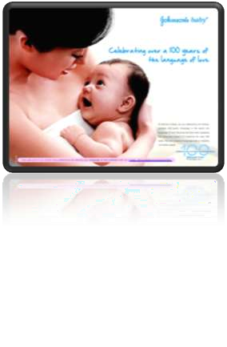
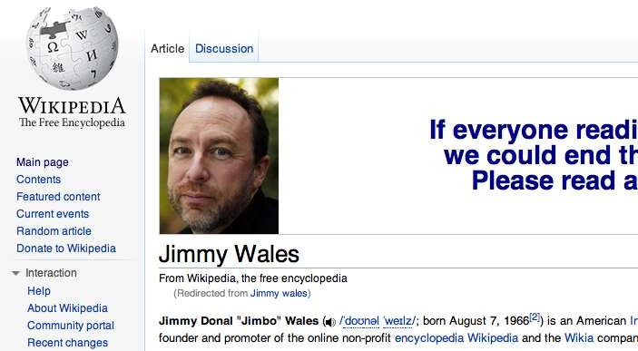

Personal Appeal

Slide 7
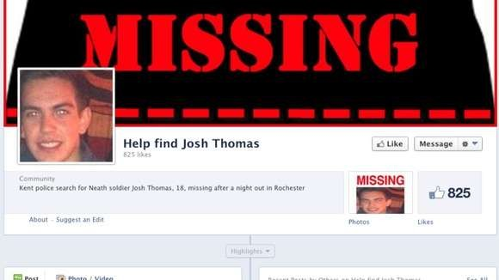
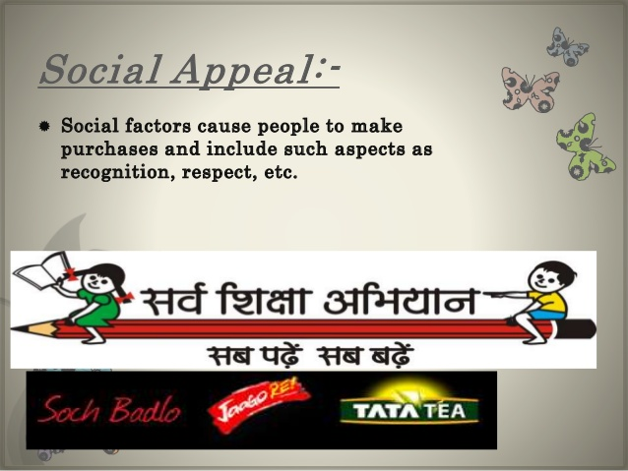
Social Appeal

Slide 8
Emotional Appeal
Fear Appeal
Fear is also an important factor that can have incredible influence on individuals. Fear is often used to good effect in advertising and marketing campaigns of beauty and health products including insurance. Advertising experts indicate that using moderate levels of fear in advertising can prove to be effective.
Humor Appeal
Humor is an element that is used in around 30% of the advertisements. Humor can be an excellent tool to catch the viewer’s attention and help in achieving instant recall which can work well for the sale of the product.
Humor can be used effectively when it is related to some benefit that the
customer can derive without which the joke might overpower the message.

Slide 9
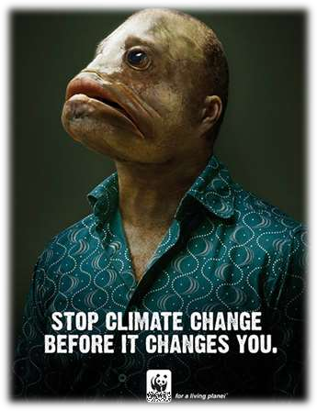
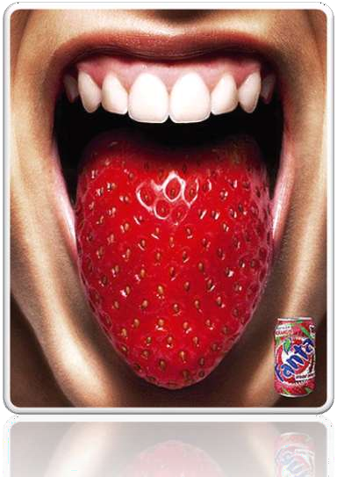
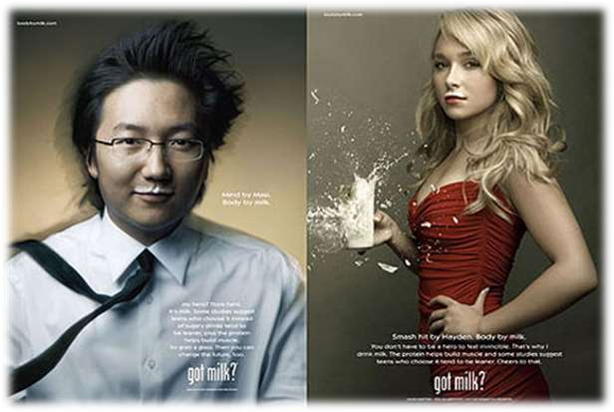
Humour Appeal
Fear Appeal

Slide 10
Advertising Appeal
Sex Appeal
Sex and nudity have always sold well.
Sexuality, sexual suggestiveness, over sexuality or sensuality raises curiosity of the audience and can result in strong feelings about the advertisement.
It can also result in the product appearing interesting.
Music Appeal
Music can be used as types of advertising appeals as it has a certain intrinsic value and can help in increasing the persuasiveness of the advertisement.
It can also help capture attention and increase customer recall.

Slide 11
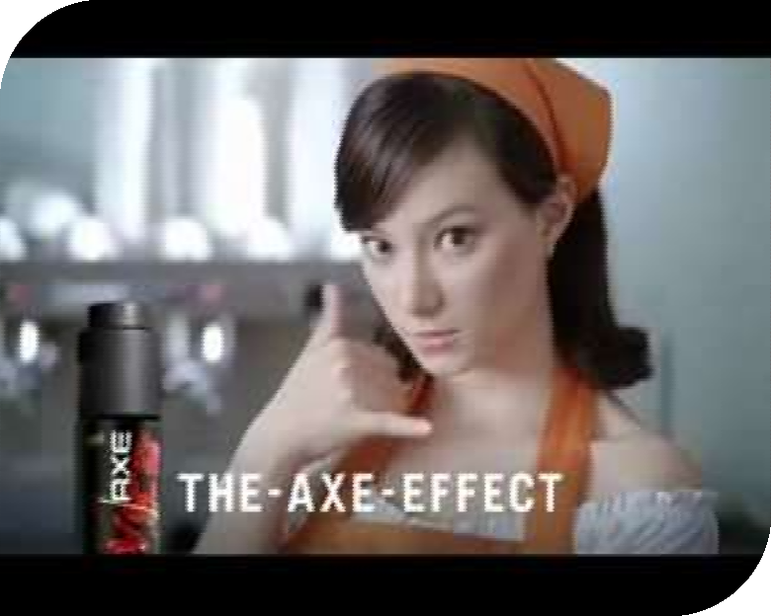
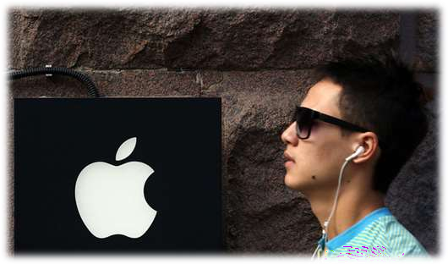
Music Appeal
Sex Appeal

Slide 12
Advertising Appeal
Scarcity Appeal
Scarcity appeals are based on limited supplies or limited time period for purchase of products and are often used while employing promotional tools including sweepstakes, contests etc.
Rational Appeal
Aims to focus on the individual’s functional, utilitarian or practical needs for particular products and services.
Emphasize the characteristics and features of the product and the service and how it would be beneficial to own or use the particular brand.

Slide 13
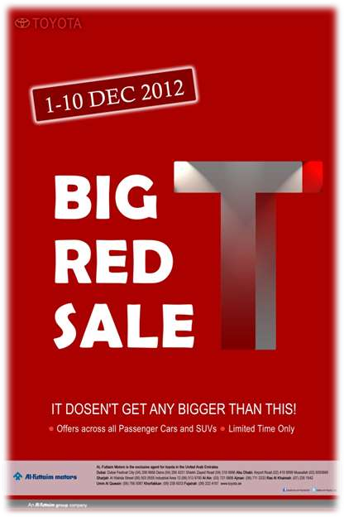

Rational Appeal
Scarcity Appeal

Slide 14
Advertising Appeal
Masculine Feminine Appeal
Used in cosmetic or beauty products.
This type of appeal aims at creating the impression of the perfect person..
Brand Appeal
Is directed towards people who are brand conscious and wish to choose particular products to make a brand statement.
Snob Appeal
Appeal is directed towards creating feeling of desire or envy for products that are termed top of the line or that have considerable qualities of luxury, elegance associated with them.
13

Slide 15
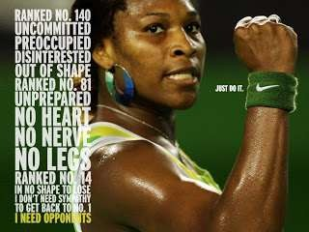
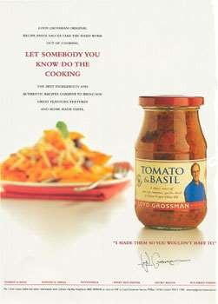
Brand Appeal
Masculine Feminine Appeal
14

Slide 16

Snob Appeal

Slide 17
Advertising Appeal
Adventure Appeal
Is directed towards giving the impression that purchasing a product will change the individual’s life radically and fill it with fun, adventure and action.
Less than Perfect Appeal
Advertisements often try to influence people to make certain purchases by pointing out their inadequacies or making them feel less perfect and more dissatisfied with their present condition.
These types of advertising appeals are used in cosmetic and
health industries.

Slide 18

Adventure Appeal

Slide 19
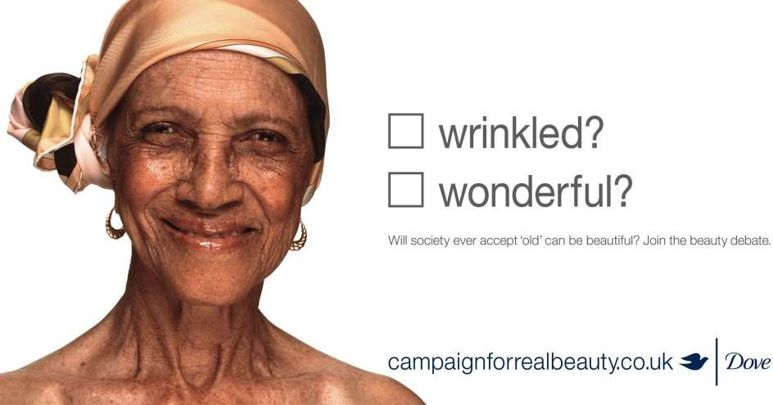
Less than Perfect Appeal

Slide 20
Advertising Appeal
Romance Appeal
These advertisements display the attraction between the sexes.
The appeal is used to signify that buying certain products will have a positive impact on the opposite sex and improve your romantic or love life.
Fragrances, automobiles and other products use these types of advertising appeals.
Sensitivity Appeal
These advertisements are used to drive at and influence the sensitivities of consumers.

Slide 21
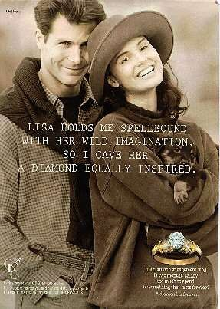
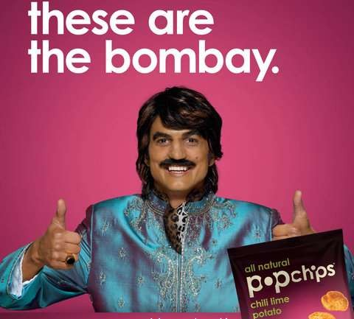
Sensitivity Appeal
Romance Appeal
20

Slide 22
Advertising Appeal
Youth Appeal
Advertisements that reflect youth giving aspects or ingredients of products use these types of appeals. Cosmetic products in particular make use of these appeals.
Endorsement
Celebrities and well known personalities often endorse certain products and their pitching can help drive the sales.
Play on Words
Advertisements also make effective use of catch phrases to convey the message. Such appeals help in brand recognition and recall and can be quite popular with the youth in particular.
21

Slide 23

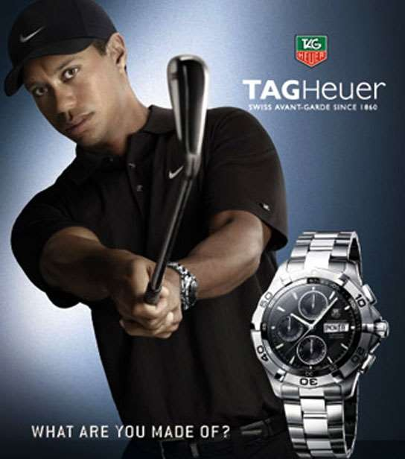
Endorsement
Youth Appeal
22

Slide 24
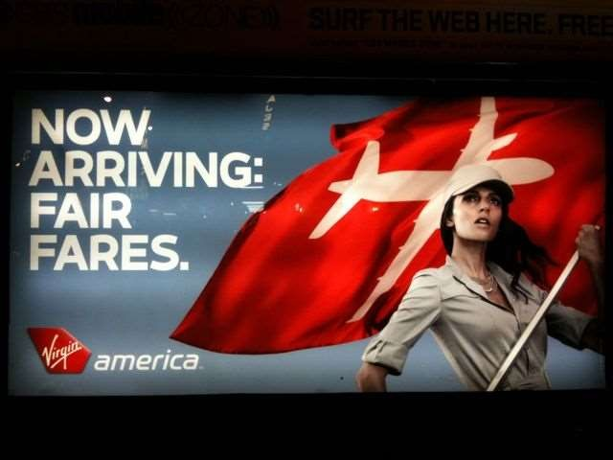
Play on Words
23

Slide 25
Advertising Appeal
Statistics
Advertisements also use statistics and figures to display aspects of the product and its popularity in particular.
Plain Appeal
These advertisements use every day aspects of life and appeal to ordinary people regarding the use of a product or service.
Bandwagon Appeal
This type of advertising appeal is meant to signify that since everybody is doing something you should be a part of the crowd as well.
It appeals towards the popularity aspect or coolness aspect of a person using a particular product or service
24

Slide 26
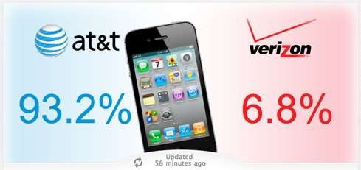
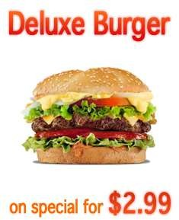
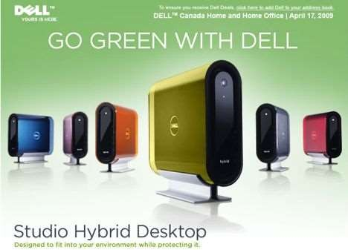
Statistics
Plain Appeal
Bandwagon Appeal
25

