Slide 1
UNIT - 3
Web graphics :
Graphic means any visual element represented by the computer. Web Graphics are those graphics that are used in a website. These graphics can be photos, videos, logos, banners, etc. Humans are more attracted to visual elements rather than textual elements. So, to make a website more appealing and user-friendly addition of web graphics is a necessity.
Types of Graphics on the Web :
2D Graphics
2D Graphics are commonly used animations on the websites. These are very simple looking and easy to use for the users. The 2D image can be animated only in two directions: horizontal and vertical. On those axes the objects and characters are still capable of moving parallelly, but they can only be moved by X and Y axes in your animation. So, you can not add depth to them.
Canvas: The Canvas API allows graphics to be drawn by using JavaScript and HTML <canvas> element. It is used in animation, gaming graphics, data visualization, photo editing, and real-time video processing.
SVG: SVG stands for Scalable Vector Graphics. It is an XML-based vector image format for defining two-dimensional graphics which supports interactivity and animation.

Slide 2
3D Graphics
3D Graphics are different from 2D graphics and the main difference is that 3D Graphics have Z-axis which means you can animate the object horizontally and vertically as well as forwrard and backward. By using 3D Graphics you can covert square to cube, circle to cylinder etc. which makes them look more realistic than the alternative.
WebGL: WebGL (Web Graphics Library) is a rasterization API for rendering 2D and 3D graphics in a web browser. WebGL uses hardware acceleration which enables developers the ability to build high-performance real-time rendering interactive graphics in the web browser.
Video Graphics
Video Graphics are those visual effects that have elements of motion to them. Video Graphics are really important in animated films, UI/UX Designs, infographics and many other visual media platforms. Video graphics are a way to communicate with the audience, which adds depth to your narrative.
Using HTML audio and video: The “audio” and “video” tags are inline elements that are used to embed sound files and video files into a web page.
WebRTC: WebRTC stands for Web Real-Time Communication. WebRTC API allows the secure access to the input peripherals such as microphones and webcams on a device to share or exchange the media-data, real-time data with a remote device in a peer-to-peer manner.

Slide 3
Elements of Web Graphics
There are many types of Web Graphics but let us understand only the most used Web Graphics.
Pictures: Pictures can convey information much faster and effectively than text as the average person responds far better to visual information compared to just plain text. Pictures are not only more effortless to recognize and process than words but also easier to recall. There are many image formats such as jpg/jpeg, png, etc.
Videos: Video can be part of the website UI or be used to convey additional information that can’t be conveyed using text or images. But videos can slow down the site and take much more time to load than any other graphic so it’s better to embed video from other platforms. Some video formats are mkv, mp4, etc.
Animations: We can use animations such as GIF in the website or code directly in the site using CSS, JSS or any other technology. Animation can be very helpful to boost the UI look and feel. Clever use of animation make the user experience must better and worth remembering. Micro interactions are commonly used animation in the websites.
SVG (Scalable Vector Graphics) : One of the most popular format used in the website to display icon or any scalable graphics. It is because the width and height of the graphic can be change to any size which is good for a responsive design. If we want to make our page responsive then raster images should be changes to SVG if possible.

Slide 4
Logo: A SVG or image used in the sites to represent brand identity. A logo if very important for the site because the user can forget the site name or URL but most of the time user will remember the logo. It better to create a logo that matches the site name or brand name.
How to use Web Graphics?
We must judiciously use graphics in our site and follow these steps:
Less File Size: The graphics used in the site must not have a huge file size as it can take time to load and can degrade the user experience. There are many users who does not have proper internet connection so, to make out site universal its better to make the overall website download size as less as possible.
Color: The color of the graphics should have good contrast and match with the brand colors and design. Good color choice is very important for a site to be successful and the graphics must look good for both light, dark theme or any theme provided by the site. The text color in the graphic can match the sites accent color like green in GFG.
Design: The graphic design must be user-friendly and if there is text in the graphic than it must be readable. The design of the graphic with respect to typography, font size, weight, background color all must give the same feels as the site. The design of the graphic must be cleverly and judiciously selected.

Slide 5
Layout: The graphic should fit well with the site layout and its size should also change with respect to different devices. Its better to use scalable graphic for responsive sites. Sometime pictures and videos size may not look good when width or height is increased or decreased beyond a limit so, its better to first decide the quality and resolution of the graphic.
Accessibility: We must also provide alternative text for images and maintain the site accessibility. The graphic must be interactable or understood but users using accessibility tools such as screen readers. We should have descriptive file names, consider proper color contrast and provide transcripts or captions for videos in least English language to further enhance accessibility.
JPG, PNG, GIF, SVG formats :
JPG/JPEG (Joint Photographic Experts Group) :
JPGs are the gold standard when it comes to uploading photos to the web.
These files are compressed, which allows for faster load times and smaller document sizes. However, the compression does reduce the quality of images, so there are some instances where a JPG might not cut it.
Save images as a JPG when they have many different colors and details and don’t need transparent backgrounds.
Best use: JPGs are ideal for uploading photography or a digital presentation.

Slide 6
PNG (Portable Network Graphics) :
PNGs are not terribly different from JPGs, but have one very important distinction — they can be saved with transparent backgrounds.
If you need to include a headshot, but don’t want the pesky white box background, PNG is the way to go. Similar to JPGs, PNGs are also compressed images, but they are considered “lossless” — meaning the compression doesn’t reduce the quality.
File sizes will be slightly larger, which is something to consider, but aren’t typically large enough to clog up your site when used in moderation.
Too many PNG files will inevitably slow down your website’s load time, which will negatively affect SEO and cause impatient users to bounce.
Best use: PNGs are ideal for smaller graphics and photos with transparent backgrounds.
GIF (Graphic Interchange Format) :
Whether you pronounce it “Jif” or “Gif,” a GIF is a file format you’re likely already familiar with.
GIFs are capable of being animated, and support the amusing animated loops we’ve become accustomed to encountering daily. Go ahead and hop on Giphy.com to explore random GIFS to your heart’s content.

Slide 7
GIFs use a more limited color palette than other photo formats, so you shouldn’t use this format for a static photo.
Best use: GIFs are ideal for animated loops.
SVG (Scalable Vector Graphic) :
SVG is a pretty unique file format. They allow for interactivity (think hover-over effects), and are infinitely scalable without ever losing their sharpness.
Look at this example of taking 100px wide version of Digital Ink’s logo in various file types and then scaling it up to 500px.
While the JPG and PNG are blurred terribly, the SVG is perfectly crisp.
SVG files are made up of a code called XML, which translates the visual elements into text. It may look like nonsense when you open it as a text document, but this allows seamless integration into HTML code.
Best use: SVGs are ideal for vector-based graphics, including your logo, any icons, and infographics.

Slide 8
Saving images for web :
When saving images for the web, the goal is usually to balance image quality and file size. Smaller file sizes are important for faster page loading times, especially in the context of websites. Here are some tips for saving images for the web:
File Format:
  Use the right file format. For photographs, JPEG is usually a good choice, as it supports high-quality compression for continuous-tone images. For images with transparency or sharp edges (like logos), consider using PNG.
  For simple graphics or icons, consider using SVG (Scalable Vector Graphics) for its ability to scale without loss of quality.
Compression:
  Adjust the compression level. When saving JPEGs, you can often reduce the quality slightly without a noticeable impact on the image but with a significant reduction in file size. Most image editing software allows you to adjust the compression level when saving as JPEG.
Image Dimensions:
Resize images to the dimensions they will be displayed. If your website only displays images at a maximum width of 800 pixels, there's no need to upload images that are 4000 pixels wide. Resize the images to the appropriate dimensions before saving.

Slide 9
Image Resolution:
  Reduce the resolution to 72 DPI (dots per inch). For web display, a resolution of 72 DPI is sufficient. Higher resolutions are not necessary and increase file size without improving the on-screen quality.
Image Cropping:
  Crop unnecessary parts of the image. Removing unnecessary elements reduces file size. Ensure that the important content remains intact after cropping.
Image Compression Tools:
  Use image compression tools. There are online tools and software applications that can help you compress images further without sacrificing too much quality. Examples include TinyPNG, ImageOptim, and JPEGoptim.
Minimize the Number of Colors:
  Use an appropriate color mode. If your image doesn't require a wide range of colors, consider converting it to the Indexed Color mode (GIF) or reducing the number of colors in the palette (PNG-8).

Slide 10
Image Sprites (for Icons):
If your website uses many small icons, consider using image sprites. Combining multiple small images into a single sprite sheet reduces the number of HTTP requests, improving loading times.
Cache Control:
  Implement proper caching strategies. Set up your web server to use cache headers to reduce the need for users to download the same images repeatedly.
Lazy Loading:
  Implement lazy loading for images. Load images only when they are about to come into the user's viewport. This can be especially helpful for images below the fold.
By following these tips, you can optimize your images for the web, ensuring a good balance between visual quality and faster page loading times.

Slide 11
Color design and theory :
Color design is a crucial aspect of web designing as it significantly influences the overall look and feel of a website. The effective use of color can enhance user experience, convey the brand identity, and impact user emotions. Here are some key principles and theories related to color design in web development:
Color Wheel:
  The color wheel is a fundamental tool for understanding color relationships. It consists of primary colors (red, blue, yellow), secondary colors (green, orange, purple), and tertiary colors (created by mixing a primary color with a secondary color).
  Complementary colors (opposite each other on the color wheel) create high contrast and vibrancy when used together.
Color Harmony:
Achieving harmony in color design is essential for a visually pleasing website. Common color harmonies include:
  Analogous: Colors that are next to each other on the color wheel.
  Triadic: Three colors evenly spaced around the color wheel.
  Split-Complementary: A base color and two colors adjacent to its complementary color.

Slide 12
Contrast:
  Contrast is crucial for readability and user experience. Use contrasting colors for text and background to ensure content is easily legible.
  High contrast can create a dynamic and visually appealing design, while low contrast may be suitable for subtle and sophisticated looks.
Color Psychology:
  Colors can evoke emotions and convey messages. For example, blue is often associated with calm and trust, while red can signify passion or urgency. Consider the psychological impact of colors based on your website's goals and target audience.
Branding:
  Consistent use of colors is vital for brand recognition. Establish a color palette that reflects the brand's identity and use it consistently across the website.
  The psychology of color can be employed to reinforce brand values and create a memorable user experience.

Slide 13
Accessibility:
  Ensure your color choices take into account accessibility standards. People with visual impairments may have difficulty distinguishing certain color combinations. Use sufficient contrast and provide alternative ways to convey information (such as text labels).
Color Trends:
  Stay aware of current design trends, but also consider the timeless nature of your website. Trends can provide inspiration, but it's essential to ensure your color choices align with your brand and target audience.
Tools:
  Use color tools to create and manage your color palette. Tools like Adobe Color Wheel, Colors, and Paletot can help you explore color combinations and ensure consistency.
Remember that the effectiveness of color design can vary based on cultural and personal associations, so it's essential to consider your target audience and the context in which your website will be used. Regular testing and feedback can help refine your color choices for optimal impact and user satisfaction.

Slide 14
Identify and apply the elements of design composition :
Design composition in web technologies involves arranging and organizing various elements on a webpage to create a visually appealing and functional layout. Here are key elements of design composition and how they can be applied in web development:
Layout:
  Application: Define a clear and well-organized structure for your webpage. Use grids and alignment to create a balanced layout.
  Web Technologies: HTML and CSS are fundamental for structuring and styling web content. Grid systems, flexbox, and CSS frameworks like Bootstrap can help achieve responsive and organized layouts.
Typography:
Application: Choose fonts that align with the website's tone and purpose. Use different font sizes and weights to create a hierarchy of text elements.
Web Technologies: CSS is used to style text, including font family, size, weight, and style. Web fonts (e.g., Google Fonts) can be integrated to enhance typographic choices.

Slide 15
Color:
Application: Use a consistent color scheme that aligns with the brand and evokes the desired emotions. Ensure proper contrast for readability.
Web Technologies: CSS is used to apply color to various elements. Color pickers, such as those provided by design tools or browsers, can aid in selecting and implementing color choices.
Whitespace (Negative Space):
Application: Allow for ample whitespace to enhance readability and reduce visual clutter. Use spacing to create a sense of balance and separation between elements.
Web Technologies: CSS margin and padding properties are employed to control the spacing around elements. Responsive design techniques ensure that whitespace adapts to different screen sizes.
Contrast and Unity:
  Application: Use contrast to highlight key elements and create visual interest. Ensure unity by maintaining a consistent design style.
  Web Technologies: CSS can control contrast through color choices, background images, and text styling. Consistent use of classes and styles helps achieve unity across different sections of a website.

Slide 16
Interactivity:
  Application: Integrate interactive elements such as buttons, links, and forms to engage users.
  Web Technologies: JavaScript is often used to enhance interactivity. Frameworks like React, Angular, or Vue.js enable the creation of dynamic and responsive user interfaces.
Responsive Design:
  Application: Ensure that the design adapts to different screen sizes and devices.
  Web Technologies: CSS media queries are essential for creating responsive designs. Frameworks like Bootstrap provide responsive utilities to simplify the process.
By understanding and applying these design composition principles in conjunction with appropriate web technologies, developers can create visually appealing, user-friendly, and effective web interfaces. Regular testing and iteration are key to refining the design and improving the overall user experience.

Slide 17
Contrast & balance :
Contrast and balance are two crucial principles in web design that contribute to the overall aesthetics and functionality of a website. Here's a closer look at each:
Contrast:
Definition:
Contrast refers to the visual difference between elements in a design. It involves using variations in color, size, shape, texture, or other visual properties to create a noticeable distinction between different elements.
Application:
Color Contrast: Use contrasting colors to make important elements stand out. For example, dark text on a light background or vice versa enhances readability.
Size Contrast: Vary the size of elements to create hierarchy. Larger elements tend to draw more attention.
Font Contrast: Use different font weights or styles for headers and body text to emphasize the hierarchy of information.

Slide 18
Importance:
Contrast enhances readability, draws attention to key elements, and adds visual interest to the design. It helps users quickly identify and navigate through content.
Web Technologies:
CSS is a powerful tool for implementing contrast. You can adjust color, font size, weight, and other visual properties to create the desired level of contrast.
Balance:
Definition:
Balance in design is the distribution of visual weight across different elements. It ensures that no single part of the design feels heavier or more dominant than another.
Application:
Symmetrical Balance: Elements on one side of the design mirror the other. It creates a formal and stable appearance.
Asymmetrical Balance: Visual weight is distributed unevenly but balanced by contrasting elements. It can create a dynamic and engaging layout.
Radial Balance: Elements radiate outward from a central point, creating a circular balance.

Slide 19
Importance:
Balance contributes to the overall harmony and stability of a design. It helps users navigate through the content without feeling overwhelmed or disoriented.
Web Technologies:
CSS layout techniques, such as flexbox and grid, are instrumental in achieving balance. They allow designers to control the positioning of elements on the page.
Tips for Using Contrast and Balance in Web Design:
Consistency:
  Maintain a consistent level of contrast and balance throughout the website to create a cohesive user experience.
Hierarchy:
  Use contrast and balance to establish a clear hierarchy of information. Important elements should stand out, while less important ones should recede.
Whitespace:
  Proper use of whitespace contributes to both contrast and balance. It helps separate and emphasize elements.

Slide 20
Testing:
  Regularly test your designs on different devices to ensure that the contrast and balance are maintained across various screen sizes.
Accessibility:
  Consider accessibility standards when implementing contrast to ensure that your content is readable for all users.
By skillfully applying contrast and balance, web designers can create visually appealing and user-friendly interfaces that effectively communicate information and engage users.
The rule of thirds :
The rule of thirds is a composition guideline that divides an image into a grid of thirds, both horizontally and vertically. The idea is to place the most important elements of the image along these lines and intersections.
It’s been said that this arrangement creates more opportunities for balance and interest in your design by breaking up what would be an otherwise static composition.

Slide 21
How to Use the Rule of Thirds in Web Design
The rule of thirds is a guideline, but it’s a good one. If you can create visual balance by following the rule of thirds, then do it!
Use the rule of thirds to create visual balance in your design.
The key to using the rule of thirds is knowing when to break it. Sometimes breaking this guideline will help create an interestingly asymmetrical design (for example, placing an image near two-thirds onto one side).
The Rule of Thirds is used to increase visual balance and helps the design look more natural.
The Rule of Thirds is a compositional rule used in photography and other visual arts. It’s meant to be applied when arranging the elements in your image. If you’ve ever used Photoshop, you may be familiar with the “crop tool” which allows you to crop an image into thirds horizontally and vertically. The Rule of Thirds is similar but it doesn’t involve cropping your images; rather, it involves placing important elements on one or more of the four gridlines created by dividing your image into nine equal sections (three rows and three columns).

Slide 22
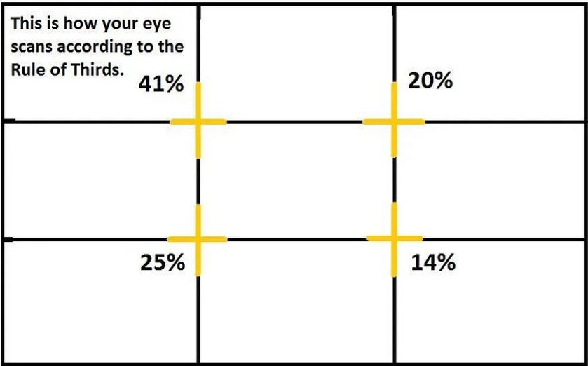
Why should you use the Rule of Thirds?
Well, it helps balance out an image by creating visual interest that draws attention to certain areas while directing viewers’ eyes around the page without actually directing their gaze at any one thing specifically. This can create interest without distracting from what matters most — whether that means increasing engagement or getting someone excited about something new they’re seeing for the first time! For example: Imagine how boring this would look if everything was centered across both axes..

Slide 23
Emphasis ,proximity, patterns, line , shape, unity, color and typography :
Let's delve into each of these design principles and elements in the context of web design:
1. Emphasis:
Definition: Emphasis is the principle of making certain elements stand out to draw attention. It helps guide users to the most important parts of a webpage.
Application in Web Design: Use color, size, contrast, and positioning to highlight key elements such as headings, buttons, or important content. Emphasis aids in creating a clear visual hierarchy.
2. Proximity:
Definition: Proximity is the principle of placing related elements close together to show their connection. It helps organize information and improve user understanding.
Application in Web Design: Group related content, navigation items, or buttons together. Proper proximity enhances the user experience by making it easier to identify and process information.
3. Patterns:
Definition: Patterns involve the repetition of visual elements. Consistent patterns create a sense of unity and can help establish a recognizable design style.

Slide 24
Application in Web Design: Use consistent layouts, color schemes, or graphic elements across the website. Patterns contribute to a cohesive and visually appealing design.
4. Line:
Definition: Lines guide the eye, create visual flow, and separate or connect elements. Lines can be straight, curved, horizontal, vertical, or diagonal.
Application in Web Design: Lines can be used in navigation menus, dividers, or to create flow between different sections. They contribute to the overall structure and aesthetics of a webpage.
5. Shape:
Definition: Shapes are two-dimensional elements defined by boundaries such as lines or color contrasts. They can be geometric or organic.
Application in Web Design: Shapes are used in buttons, icons, and various UI elements. Consistent shapes contribute to a unified design, and unique shapes can help establish brand identity.
6. Unity:
Definition: Unity refers to the coherence and consistency of a design. A unified design ensures that all elements work together harmoniously.
Application in Web Design: Maintain a consistent design style, color scheme, and typography throughout the website. Unity creates a seamless and professional user experience.

Slide 25
7. Color:
Definition: Color is a powerful design element that evokes emotions, communicates information, and enhances visual appeal.
Application in Web Design: Choose a color palette that aligns with the brand and the desired emotional tone. Use color to create contrast, establish hierarchy, and guide user attention.
8. Typography:
Definition: Typography involves the selection and arrangement of fonts, font sizes, spacing, and formatting to convey information effectively.
Application in Web Design: Choose readable fonts, establish a clear hierarchy with font sizes and weights, and use consistent typography across the website. Typography plays a crucial role in communication and brand representation.
In web design, these principles and elements work together to create visually appealing, functional, and user-friendly interfaces. A thoughtful application of these concepts contributes to a positive user experience and helps convey the intended message of the website.

Slide 26
Creating JPG, GIF, SVG & PNG images :
Creating images in different formats involves using various tools and techniques. Here's a brief guide on how to create images in the JPG, GIF, SVG, and PNG formats:
1. JPG (JPEG) Images:
Software Tools:
  Adobe Photoshop
  GIMP (GNU Image Manipulation Program)
  Online Tools (like Canva, Pixlr)
Steps:
  Open your chosen software tool.
  Create or import your image.
  Choose "Save As" or "Export" and select JPG as the file format.
  Adjust compression settings (if applicable) to balance file size and image quality.
  Save the image.

Slide 27
2. GIF Images:
Software Tools:
  Adobe Photoshop
  GIMP
  Online Tools (Giphy, Ezgif)
Steps:
  Create or import your image.
  Ensure the image has a limited color palette (GIFs support up to 256 colors).
  Choose "Save As" or "Export" and select GIF as the file format.
  Adjust settings like dithering and transparency if needed.
  Save the image.
3. SVG (Scalable Vector Graphics):
Software Tools:
  Adobe Illustrator
  Inkscape
  Text Editors (for hand-coding SVG)

Slide 28
Steps:
  Create or import your vector graphic.
  Choose "Save As" or "Export" and select SVG as the file format.
  Adjust settings such as viewBox and XML structure if needed.
  Save the image.
4. PNG Images:
Software Tools:
  Adobe Photoshop
  GIMP
  Online Tools (such as TinyPNG)
Steps:
  Open your chosen software tool.
  Create or import your image.
  Choose "Save As" or "Export" and select PNG as the file format.
  Adjust settings like transparency or color depth if needed.
  Save the image.

Slide 29
Tips:
Resolution: Consider the resolution of your images. Higher resolution is suitable for detailed graphics, while lower resolution may be acceptable for smaller file sizes or web graphics.
Compression: Be mindful of compression, especially for JPG images. Too much compression can degrade image quality.
Transparency: PNG and GIF support transparency, while JPG does not. SVG can also have transparent elements.
Vector vs. Raster: SVG is a vector format, while JPG, GIF, and PNG are raster formats. Vectors are resolution-independent and great for logos and graphics that need to scale without loss of quality.
Always be aware of licensing and copyright considerations when creating or using images. Additionally, test your images across various devices and browsers to ensure compatibility and optimal display.

Slide 30
Scanning and optimizing web images :
Scanning and optimizing web images are important steps in web development to ensure fast loading times, improved user experience, and optimal performance. Here are guidelines for scanning and optimizing web images:
Scanning Web Images:
Choose the Right Image Format:
  Different image formats serve different purposes. Choose the appropriate format based on the type of image:
JPEG (JPG): For photographs and images with gradients.
PNG: For images with transparency or crisp graphics.
GIF: For simple graphics, logos, and animations.
SVG: For vector graphics and logos.
Resolution:
Use an appropriate resolution for web images. High resolutions are not necessary for on-screen display and can increase file sizes unnecessarily.

Slide 31
Crop and Resize:
  Crop images to eliminate unnecessary parts and resize them to the dimensions required on the web. This reduces file size and improves loading times.
Compression:
  Apply compression to reduce file sizes without significant loss of quality. Many image editing tools provide options for compression. Be mindful of finding a balance between file size and image quality.
Optimizing Web Images:
Use Image Compression Tools:
  Utilize image compression tools to reduce the file size without compromising quality. Tools like ImageOptim, TinyPNG, or online services can automate this process.
Lazy Loading:
  Implement lazy loading for images, especially on long-scrolling pages. This defers the loading of images until they are about to come into the user's viewport, reducing initial page load time.

Slide 32
Responsive Images:
Use responsive images to cater to different device resolutions. Provide multiple sizes of the same image and use the ‘srcset’ attribute in the ‘<img>’ tag to enable browsers to choose the appropriate size based on the user's device.
Image Sprites:
  Consider using image sprites for small graphics and icons. Combining multiple small images into a single sprite reduces the number of server requests, enhancing performance.
Image Formats:
  Choose the appropriate image format based on the content. For example, use WebP for modern browsers that support it, as it often provides better compression than JPEG or PNG.
Enable Browser Caching:
  Configure server settings to enable browser caching for images. This allows users to download and store images locally, reducing load times for subsequent visits.
Content Delivery Network (CDN):
  Use a Content Delivery Network to serve images from servers geographically closer to the user, improving load times.

Slide 33
Optimize SVGs:
  If using SVGs, optimize the SVG code by removing unnecessary elements, attributes, and white spaces. You can use online tools or text editors to manually optimize SVG files.
Image Compression Libraries:
  For server-side optimization, consider using image compression libraries like ImageMagick or optipng to automatically compress images during the upload process.
Monitor Performance:
Regularly monitor your website's performance using tools like Google PageSpeed Insights or Lighthouse. These tools can provide insights and recommendations for further optimization.
By following these scanning and optimization techniques, you can ensure that your web images are appropriately sized, compressed, and delivered efficiently, contributing to a faster and more responsive web experience for users.

Slide 34
Creating a color palette :
Creating a color palette in web technology involves selecting a harmonious set of colors that complement each other and align with the overall design and branding goals of your website. Here are steps and considerations for creating a color palette:
1. Define the Purpose and Mood:
Understand the purpose of your website and the emotions you want to evoke. Different colors convey different meanings and emotions. For example:
  Blue: Trust, calmness
  Red: Energy, passion
  Green: Nature, growth
  Yellow: Optimism, warmth
2. Limit the Number of Colors:
Restrict your color palette to a manageable number of colors, typically between 3 to 5. This helps maintain consistency and avoids visual clutter.

Slide 35
3. Base Colors:
Choose one or two primary colors that will dominate your design. These colors often represent the main brand colors or set the overall tone for the website.
4. Accent Colors:
Select one or more accent colors that complement the base colors. Accent colors can be used for buttons, call-to-action elements, or to highlight important information.
5. Neutrals:
Include neutral colors like whites, grays, or muted tones. Neutrals can be used for backgrounds, text, and other supporting elements.
6. Consider Accessibility:
Ensure that your color palette is accessible to all users, including those with visual impairments. Use sufficient contrast between text and background colors.
7. Color Harmony:
Choose colors that work well together using principles of color harmony. Common harmonies include:
  Analogous: Colors next to each other on the color wheel.
  Complementary: Colors opposite each other on the color wheel.
  Triadic: Three colors evenly spaced around the color wheel.

Slide 36
8. Web Design Tools:
Utilize online tools or design software to create and experiment with color palettes. Tools like Adobe Color Wheel, Colors, and Paletot can help you explore and generate harmonious color combinations.
9. Test Across Devices:
Test your color palette across various devices and screen sizes to ensure consistent appearance. Colors may appear differently on different screens.
10. Branding Consistency:
Align your color palette with your brand identity. If your brand has existing colors, incorporate them into the website to maintain brand consistency.
11. Document Your Palette:
Document your chosen colors, including their hexadecimal or RGB values, for easy reference during the design and development process.
12. Iterate and Refine:
Don't hesitate to iterate and refine your color palette based on feedback usability testing, or evolving design requirements.

Slide 37
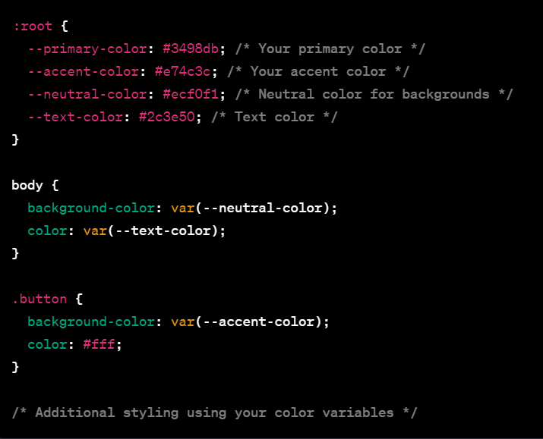
Example CSS for Applying Colors:

Slide 38
Typography of web :
Typography simply is a technique in user interface design to create a readable, appealing ,attractive and easy to eye text for users to read.
Typography plays a crucial role in web design, influencing the visual aesthetics and readability of a website. Here are key considerations and practices for typography in web technology:
1. Font Selection:
Choose readable and web-safe fonts that align with your brand and design goals. Common web-safe fonts include Arial, Helvetica, Georgia, and Times New Roman.
Consider using web font services like Google Fonts or Typekit to expand your font choices.
2. Font Size:
Use a readable font size for body text. The default font size for body text is often set to 16 pixels, but it can vary based on the design and content.
Use relative units like ‘em’ or ‘rem’ to ensure scalability and responsiveness.(EM is relative to the parent element's font size, so if you wish to scale the element's size based on its parent's size, use EM. REM is relative to the root (HTML) font size, so if you wish to scale the element's size based on the root size, no matter what the parent size is, use REM)
3. Hierarchy:
Establish a clear hierarchy of text elements, including headings (H1 to H6), subheadings, and body text. Larger font sizes should denote higher importance.
Use styling, such as bold or italics, to reinforce hierarchy.

Slide 39
4. Line Spacing (Leading):
Adjust line spacing to improve readability. A general guideline is to set the line height to 1.5 times the font size, but this can vary based on the typeface and design.
5. Letter Spacing (Tracking):
Modify letter spacing to enhance legibility. Avoid excessive letter spacing, especially in body text, to maintain readability.
6. Contrast:
Ensure sufficient contrast between text and background colors for readability. High contrast is especially important for body text.
7. Responsive Typography:
Implement responsive typography to adapt font sizes and layouts based on different screen sizes and devices. Use media queries in CSS to adjust styles accordingly.
8. Font Style:
Use different font weights (regular, bold) and styles (italic) to create emphasis and hierarchy.
Maintain consistency in font styles across the website for a cohesive look.

Slide 40
9. Serif vs. Sans Serif:
Choose between serif and sans-serif fonts based on the tone of your website. Serif fonts can convey a more traditional or formal tone, while sans-serif fonts often provide a modern and clean appearance.
10. Font Pairing:
Pair fonts that complement each other for headings and body text. Contrast in font styles can add visual interest while maintaining readability.
Tools like Google Fonts provide font pairings and suggestions.
11. Typography Scale:
Establish a consistent typography scale for your website. This involves defining a set of font sizes for different elements to maintain visual harmony.
12. Web Font Loading:
Optimize web font loading to prevent font-related performance issues. Techniques like asynchronous loading or utilizing the ‘font-display’ property can be employed.

Slide 41
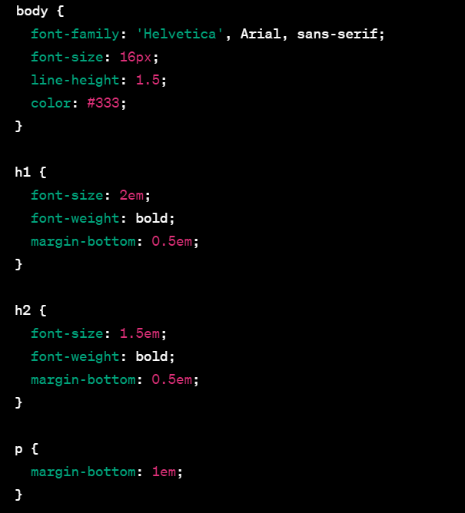
Example CSS for Typography Styles:

Slide 42
THANK - YOU

