Slide 1
Unit-3 Training &Development

Slide 2
Definition of Training
“Training is the act of increasing the knowledge and skills of an employee for doing a particular job” – Edwin B. Flippo

Slide 3
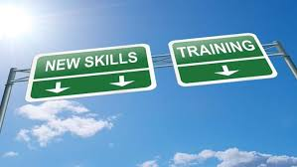
Training process
Identifying training needs analysis
Determining training goals and objectives
Designing
Implementation
Evaluation

Slide 4

Training Process
Identifying Training Needs Analysis
1) Organization Analysis
2) Task analysis
3) Individual analysis

Slide 5
Training Process
Determining training goals & Objectives
Designing
1) Trainees
2) Trainers
3) Methods
4) Locations
Implementation

Slide 6

Training process
Training Evaluation (Kirkpatrick's training Evaluation Model )
Reaction
Learning
Behavior
result

Slide 7

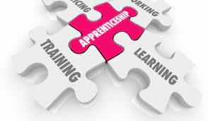
Training methods
On the Job Training
1) Job rotation
2) Apprenticeship
3) Internship
4) Coaching
5) Job instruction

Slide 8

training methods
Off-the-job training (
Learning by gaining Knowledge)
1)Case Study
2) Lectures
3) Simulation
4) Role Playing
5) Syndicates
6) Business Games

Slide 9

Training Evaluation
Training evaluation is a method that helps to analyze whether the initiatives and training programs are efficient and whether they are aligned with the objectives, vision, and goals of an organization. It is a process that discovers opportunities and training gaps while employee training.

Slide 10
Types of training evaluation
Formative evaluation – This type of training evaluation offers feedback to the developer and designer of the program so that they can know whether the course meets the requirements of its target audience.
Process evaluation– This type of training evaluation deals in information related to events occurred during training. It is about imparting and receiving feedback verbally.
Outcome evaluation – This type of training evaluation determines whether results were achieved after applying new skills and know-how.
Impact evaluation – This type of training evaluation deals with the impact of the training on the strategic goals of a company.

Slide 11
Case study
In Mahindra & Mahindra the training for the executive level is mainly conceptual level training called Ascent. It is a six day training imparted in two parts of three days each with some gap in between. The focus of Ascent is on the concepts of industrial intricate functions. Apart from this, there is a one day program me called MGTP which consists of technical training covering the need of manufacturing system, supplies module and certain question answer sessions. The training for staff level is called Stride. It is also a six day training program conducted in two parts of three days each focusing on the conceptual skills of the staff level. This is the main training program for the staff. The training program for the workers level mainly comprises of developmental and behavioral programs with stress on self maintenance, moral values and some modules on the work stress and hygiene, safety, etc. all the workers are supposed to undergo these programs . The feedback is in the form of individual talk with the HR personnel. They are asked to fill in a form, of individual talk with the HR personnel. They are asked to fill in the form, in the course of discussion, regarding the training. This is then evaluated. As such, there is no standard feedback system.

Slide 12
Questions
1. Analyze training at Mahindra & Mahindra. How can you improve the training effort further?
2. This case is an excellent example of “Efficient training Need Assessment.” Discuss

