Slide 1
BUISNESS RESEARCH METHODOLOGY
By- Ms. Amita Agrawal

Slide 2
What is Research?
The term research comprises of two words ‘re’ and ‘search’. ‘Re’ means again and ‘search’ means to find out.
A detailed and careful study of something to find out more information about it.
Research is a careful and detailed study into a specific problem, concern, or issue using the scientific method.
To begin researching something, you have to have a problem, concern, or issue that has turned into a question. These can come from observing the world, prior research, professional literature, or from peers. Research really begins with the right question, because your question must be answerable.

Slide 3
There is general agreement that research is :
1.Process of inquiry and investigation
2. Systematic and methodical
3. Increases Knowledge

Slide 4
What is Business Research
Business Research can be simply defined as a process of gather comprehensive data and information of all the areas of business and incorporating this information for sales and profit maximization.
It is a systematic management activity helping companies to determine which product will be most profitable for companies to produce.
Example:
Let say there’s an automobile company that is planning to launch a car that runs on CNG. In order to promote cleaner fuel, the company will be involved in developing different plans and strategies to identify the demand for the car they are intending to launch.

Slide 5
Importance of Business Research
It helps businesses gain better insights about their target customer’s preferences, buying patterns, pain points, as well as demographics.
Business Research also provides businesses with a detailed overview of their target markets, what’s in trend, as well as market demand.
By studying consumers’ buying patterns and preferences as well as market trends and demands with the help of business research, businesses can effectively and efficiently curate the best possible plans and strategies accordingly.
The importance of business research also lies in highlighting the areas where unnecessary costs can be minimized and those areas in a business which need more attention and can bring in more customers and hence boost profits.
Businesses can constantly innovate as per their customers’ preferences and interests and keep their attention towards the brand.
Business Research also plays the role of a catalyst as it helps business thrive in their markets by capturing all the available opportunities and also meeting the needs and preferences of their customers.

Slide 6
Characteristics of Research
1. Generalized:The researcher usually divides the identified population into smaller samples depending on the resource availability at the time of research being conducted. This sample is understood to be the appropriate representative of the identified population therefore the findings should also be applicable to and representative of the entire population.
Controlled: The concept of control implies that, in exploring causality in relation to two variables (factors), you set up your study in a way that minimizes the effects of other factors affecting the relationship. Some variables are classified as controlling factors and the other variables may be classified as possible effects of controlling factors. Laboratory experiments as in pure sciences like chemistry can be controlled but any study that involves societal issues cannot be controlled.
Rigorous : One must be careful in ensuring that the procedures followed to find answers to questions are relevant, appropriate and justified. Again, the degree of rigor varies markedly between the physical and social sciences and within the social sciences.

Slide 7
Empirical:The processes adopted should be tested for the accuracy and each step should be coherent in progression. This means that any conclusions drawn are based upon firm data gathered from information collected from real life experiences or observations.
Systematic: The procedure or process being developed to undertake a study should be carefully drafted to ensure that resources utilization is optimized. Chaotic or disorganized procedures would never yield expected outcomes. The steps should follow a logical sequence to get to the desired outcome.
Reliability:It is the extent to which an experiment, test, measuring procedure, research, research instrument, tool or procedure yields the same results on repeated trials.
Validity & verifiability: : It is the extent to which a concept, conclusion or measurement is well-founded and likely corresponds accurately to the real world. The word "valid" is derived from the Latin validus, meaning strong.

Slide 8
Methods of Research
Qualitative
Quantitative

Slide 9
What is the difference between Pure and Applied Research?
Pure vs Applied Research
Pure research is conducted without any specific goal. | Applied research is conducted with a specific goal in mind.
Aim
The main aim is to advance knowledge. | The main aim is to solve a specific and practical problem.
Nature
Pure research is exploratory in nature. | Applied research is descriptive in nature.
Theories and Principals
Pure research identifies new ideas, theories, principals and new ways of thinking. | Applied research is based on the theories, principals discovered through pure research.
Findings
Findings of pure research usually have a future use, not a current use. | Findings of applied research always have a current use.

Slide 10
Qualitative Research
Qualitative research is a method that collects data using conversational methods, usually open-ended questions. The responses collected are essentially non-numerical. This method helps a researcher understand what participants think and why they think in a particular way.
This method is not only about “what” people think but also “why” they think so.
For example, on successfully interviewing female customers, visiting the nearby stores and malls, and selecting them through random sampling, it was known that the store doesn’t have enough items for women and so there were fewer women visiting the store, which was understood only by personally interacting with them and understanding why they didn’t visit the store, because there were more male products than female ones.

Slide 11
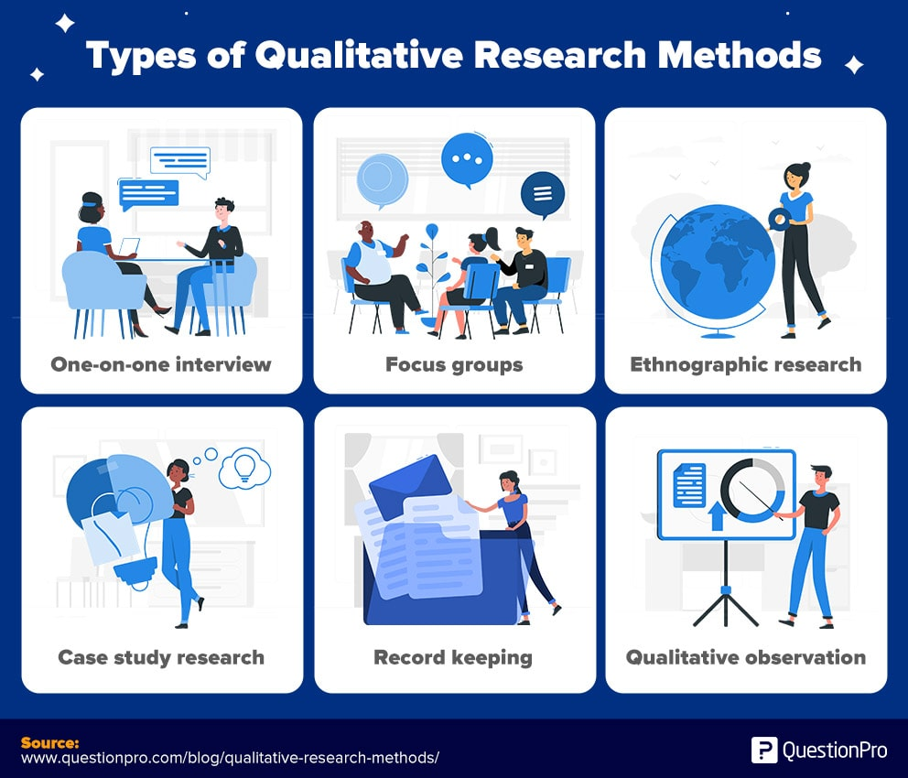

Slide 12
Quantitative Research
Quantitative methods deal with numbers and measurable forms. It uses a systematic way of investigating events or data. It answers questions to justify relationships with measurable variables to either explain, predict, or control a phenomenon.
Quantitative research collects information from existing and potential customers using sampling methods and sending out online surveys, online polls, questionnaires, etc., the results of which can be depicted in the form of numerical.
An example of quantitative research is the survey conducted to understand the amount of time a doctor takes to tend to a patient when the patient walks into the hospital. A patient satisfaction survey template can be administered to ask questions like how much time did a doctor takes to see a patient, how often does a patient walks into a hospital, and other such questions.

Slide 13
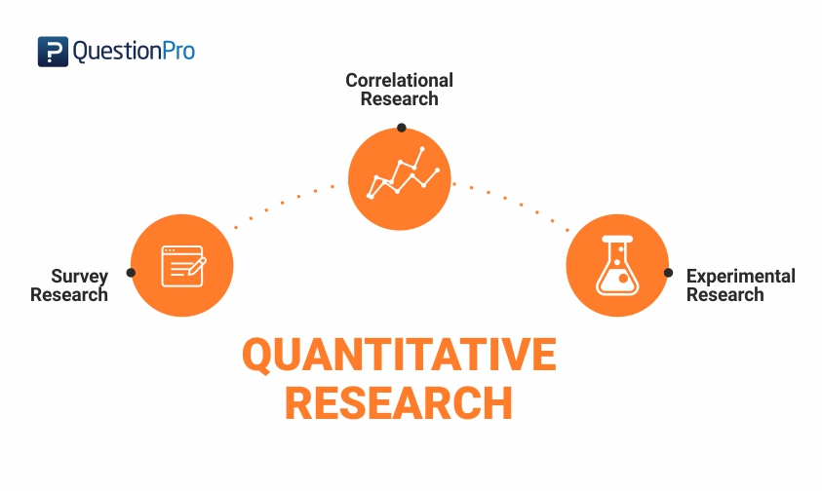
Type of Quantitative Research

Slide 14
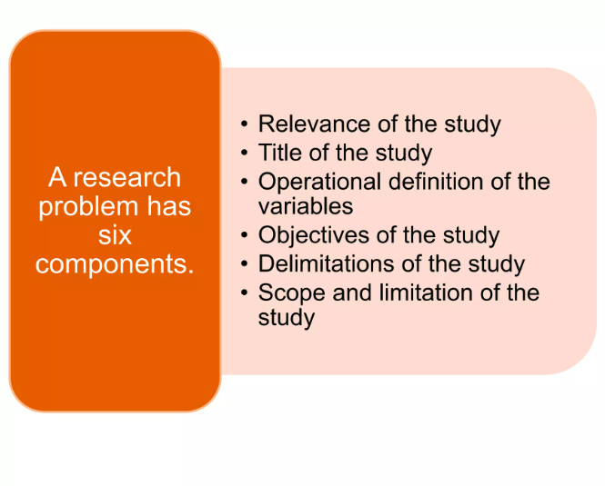

Slide 15
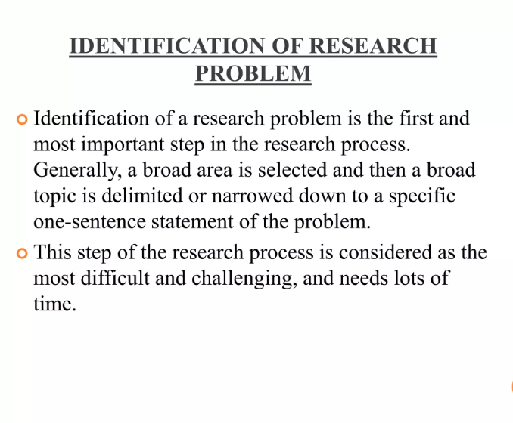

Slide 16
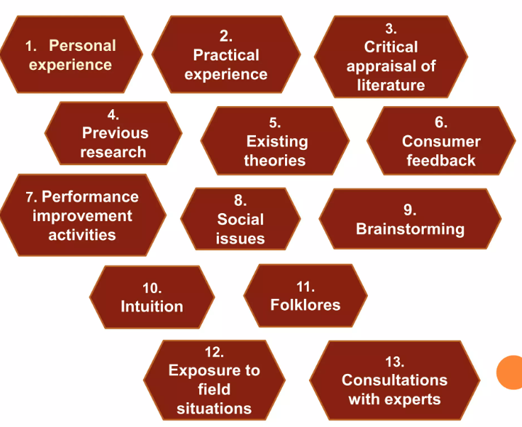

Slide 17
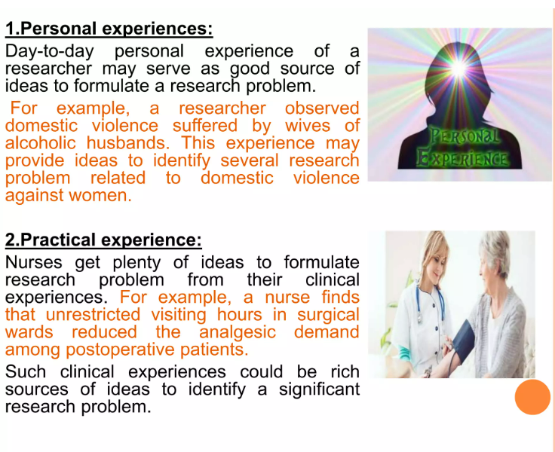

Slide 18
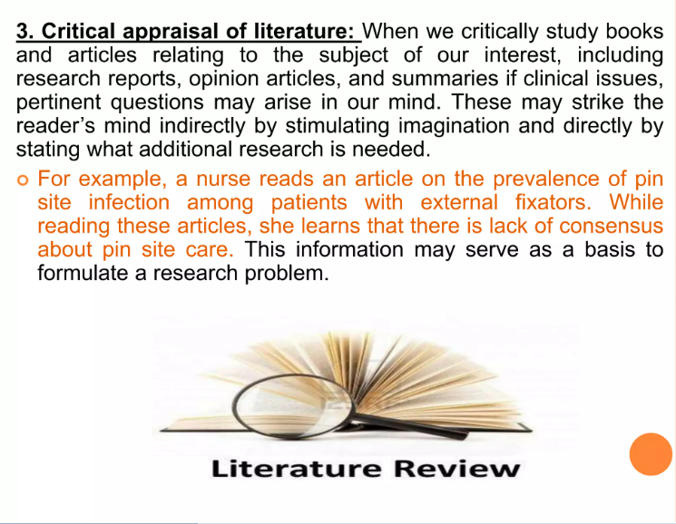

Slide 19
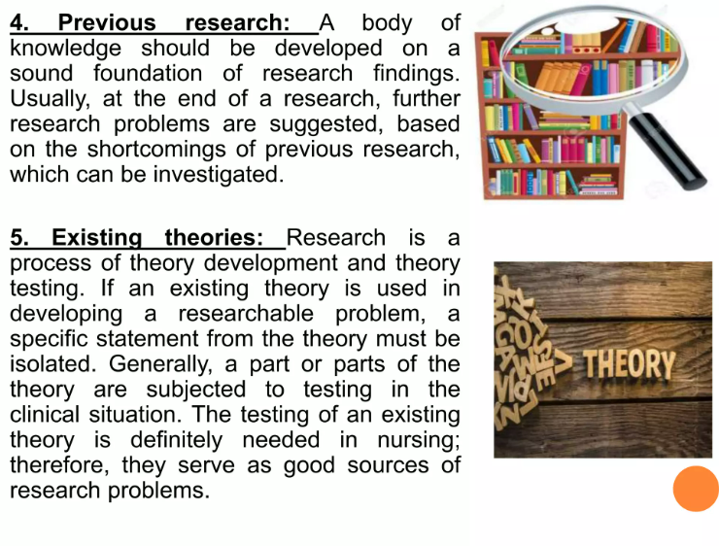

Slide 20
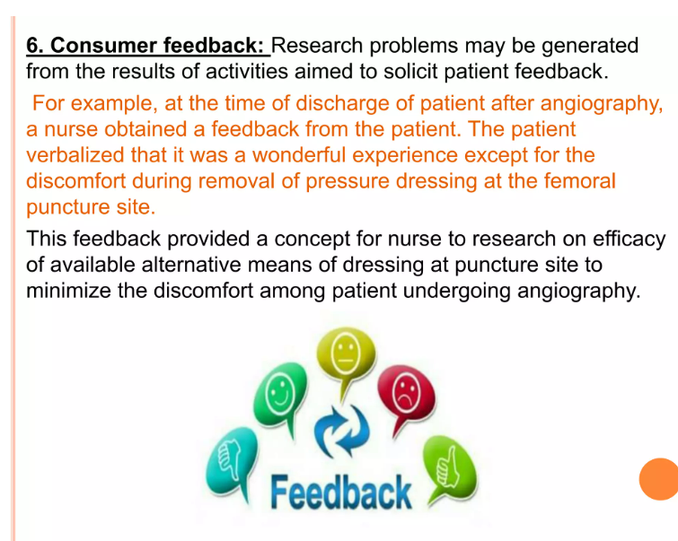

Slide 21
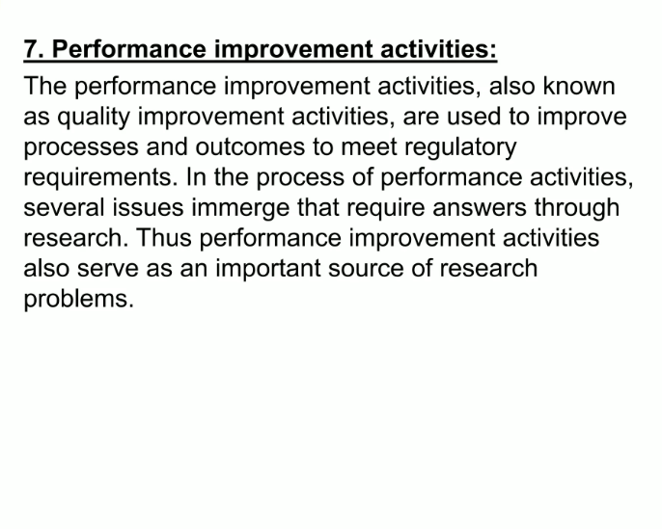

Slide 22
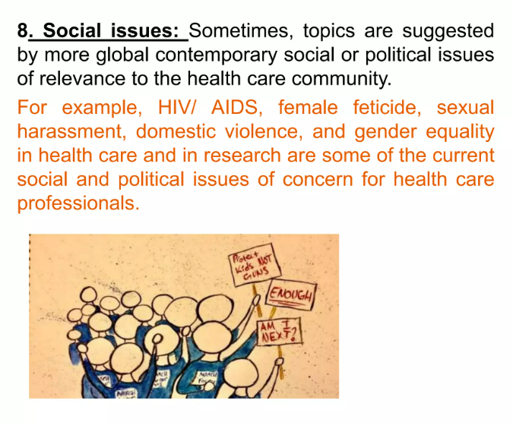

Slide 23
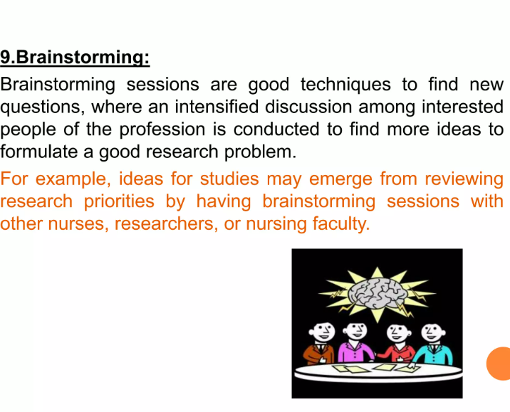

Slide 24
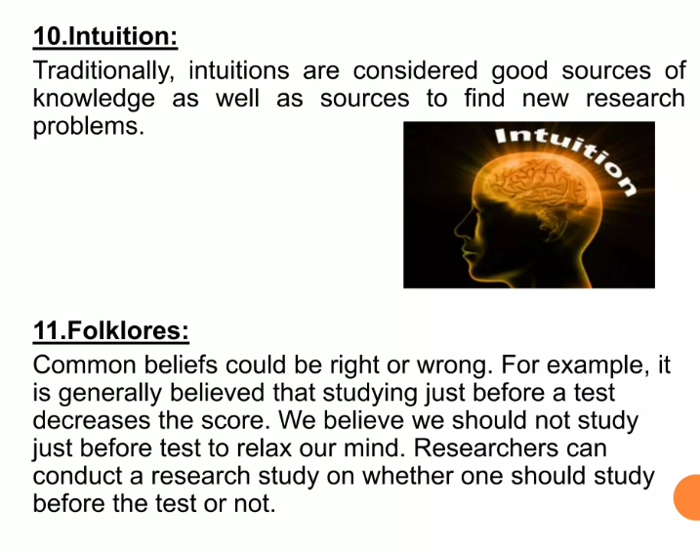

Slide 25
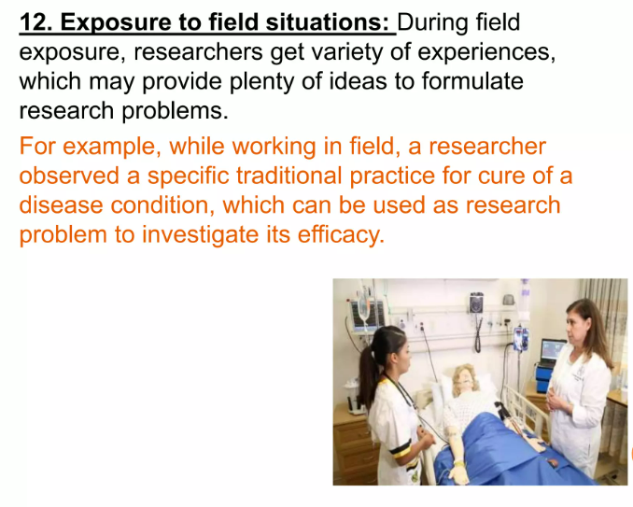

Slide 26
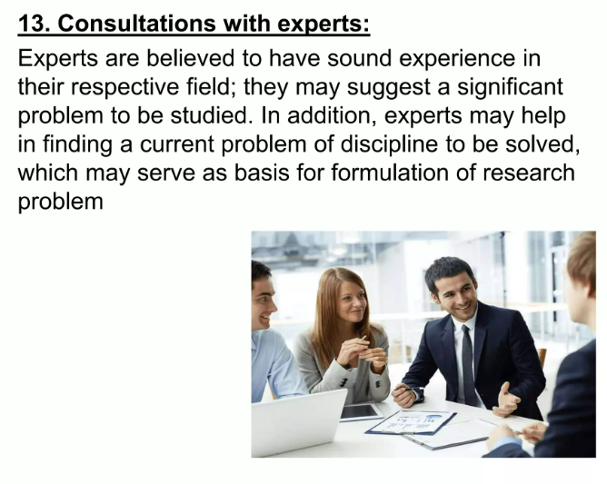

Slide 27
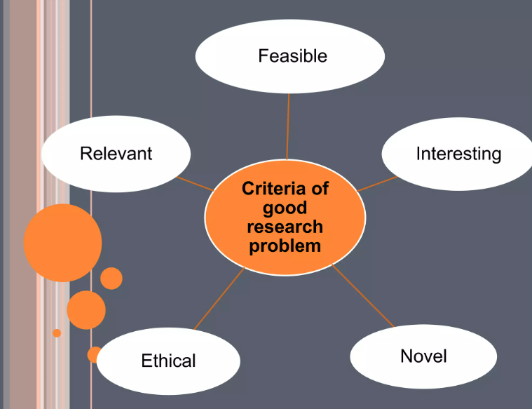

Slide 28
Research Process
formulating the research problem
extensive literature survey\
developing the hypothesis
preparing the research design
determining sample design
collecting the data
execution of the project
analysis of data
hypothesis testing
generalizations and interpretation, and
preparation of the report or presentation of the results,i.e., formal write-up of conclusions reached

Slide 29
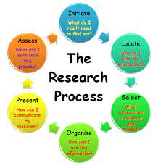

Slide 30
Formulating Research Problem
Identify a general area of interest
Learn more about the problem
Review the context of the information
Determine relationships between variables
Select and include important variables
Receive feedback and revise

