Slide 1
Problem & Challenges of Indian Economy

Slide 2
Problem
Challenges
Inflation
Poverty
Inefficient Agriculture
Population Growth
Corruption
Unemployment
Economic Growth
Income Inequality
Literacy Rate

Slide 3
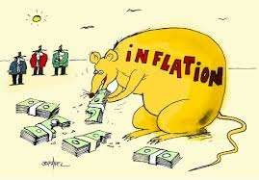
1. Inflation
Inflation is a situation wherein there are continuous increases in the price level of goods and services in an economy over a period of time.
Inflation is currently between 8-10%. This inflation has been a problem despite periods of economic slowdown.

Slide 4
Impact of Inflection
Business Community
Common People
Farmer
Investor

Slide 5
Causes of Inflation
Less productivity
Increases in wages
Increases in Taxes
Population Explosion

Slide 6
Population Growth
•
India ranks second after China in total population. Its population is growing 20% per decade, leading to problems that include food deficits, sanitation deterioration and pollution.
The food and nutrition deficit has created a 20% death rate due to malnutrition.
For example, 8% of India's population has no access to toilets, and 75% of surface water is contaminated by human waste.
Moreover, 60% of India's GDP is lost to health-related costs.
•
•

Slide 7
Impact of Population
Population Growth and Rate of saving and Investment
Investible Resources And Raising per capital Income
Population Growth and Marketed Surplus of Food grain
Unproductive Investment

Slide 8
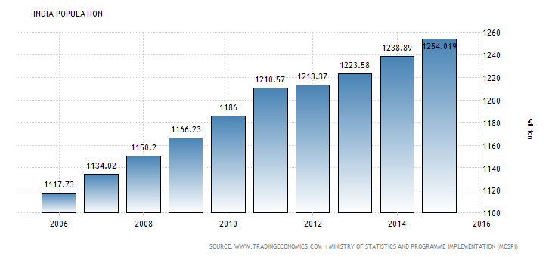
India Population

Slide 9
Corruption
Corruption in the Indian society has prevailed from time immemorial in one form or the other.
CBI has registered over 1,450 cases of alleged corruption during the years 2010, 2011 and 2012 (till March 31, 2012), it has registered 1,451 cases under the prevention of Corruption Act, 1988.

Slide 10
Impact of Corruption
Population Growth
Taxing System
Economic Difference in Public

Slide 11
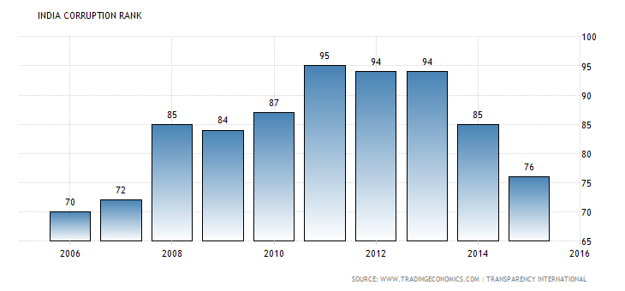
India corruption Rate

Slide 12
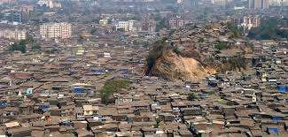
Poverty
“The biggest enemy of health in the developing world is poverty”
The poverty line is the minimum level of income deemed adequate in a given country.
The national poverty line using the Tendulkar methodology at the end of 2011-12 was estimated at Rs 816 per capita per month for rural area and Rs 1,000 per capita per month in urban areas for that year, according to the erstwhile Planning Commission, as IndiaSpend reported earlier. That is Rs 27 per day in rural areas and Rs 33 per day in urban areas.

Slide 13
Impact of Poverty
Health
Education
Economy
Society

Slide 14
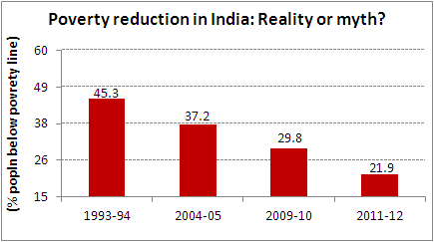
Poverty reduction

Slide 15
Unemployment
With increases in the number of unemployed persons , poverty expands.
It was assumed that the gains of the economic growth would percolate downward and the inequalities would decline and problem of poverty and unemployment would get solved automatically.

Slide 16
Impact of Unemployment
Increases in crime like theft, Violence, drug
Leads to Poverty and Inequality
Decrease in spending power
Decrease in Standard of living
Recession

Slide 17
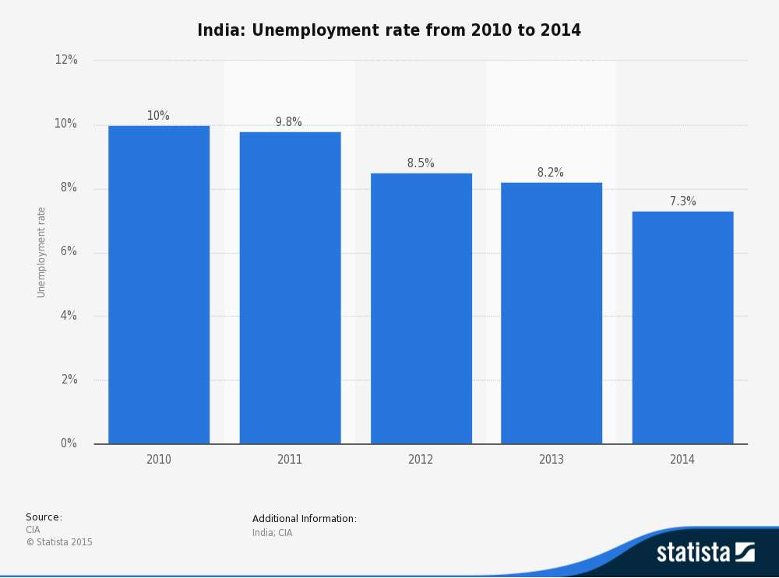
Unemployment Rate

Slide 18
Economic Growth
2013/14 has seen a slowdown in the rate of economic growth to 4-5%. Real GDP per capita growth is even lower.
This is a cause for concern as India needs a high growth rate to see rising living standards, lower unemployment and encouraging investment. India has fallen behind China, which is a comparable developing economy.

Slide 19
Impact of Economic Growth
Low living Standard
Poverty and Unemployment
Less infrastructural development

Slide 20
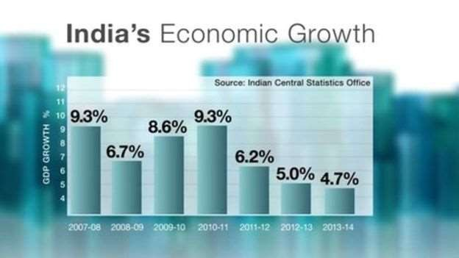
Economic Growth

Slide 21
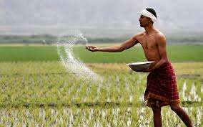
Inefficient agriculture
Agriculture produces 17.4% of economic output but, over 51% of the work force are employed in agriculture
This is the most inefficient sector of the economy and reform has proved slow.

Slide 22
Impact of Inefficient Agriculture
Source of Livelihood
National Income
Supplier of Food
Sustenance to Industry

Slide 23
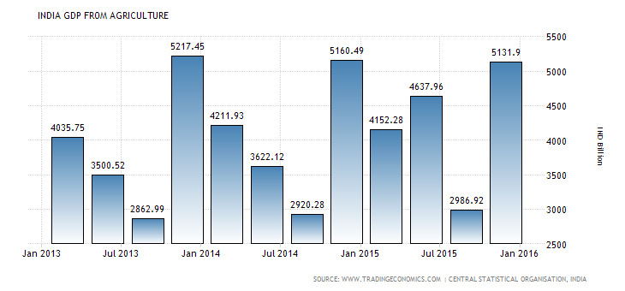
Agriculture

Slide 24
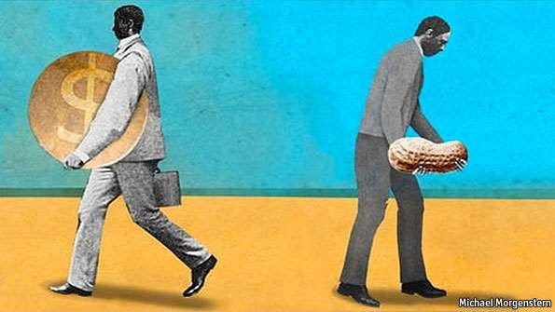
Income Inequality
It is hoped that economic growth would help drag the Indian poor above the poverty line.
More than 78 million homes do not have electricity. 33% (268million) of the population live on less than $1 per day. Furthermore with the spread of television in Indian villages the poor are increasingly aware of the disparity between rich and poor.

Slide 25
Impact of Income Inequality
Lack of educational opportunity
Gap between Rich And Poor
Increasing Unemployment
Family Influence

Slide 26
Literacy Rate
Although India has benefited from a high % of English speakers.
There is still high levels of illiteracy amongst the population. It is worse in rural areas and amongst women.
Over 50% of Indian women are illiterate This limits economic development and a more skilled workforce.

Slide 27
Impact of Literacy

Slide 28
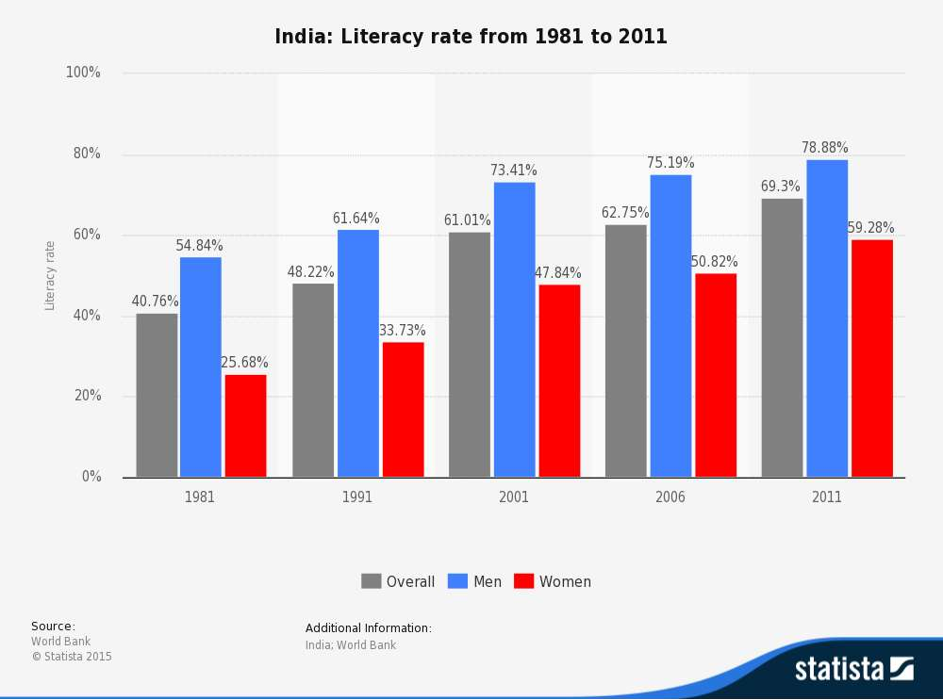
Literacy Rate

