Slide 1
INDUSTRIAL POLICY INDIA
Dr. Sangeeta Jain

Slide 2
INTRODUCTION
The quest for industrial development started soon after independence in 1947.
The Industrial Policy Resolution of 1948 defined the broad contours of the policy delineating the role of the State in industrial development both as an entrepreneur and authority.
This was followed by comprehensive enactment of Industries (Development & Regulation) Act, 1951 (referred as IDR Act) that provides for the necessary framework for implementing the Industrial Policy and enables the Union Government to direct investment into desired channels of industrial activity

Slide 4
Industrial Policy resolutions
Industrial policy resolution of 1948
Industrial policy resolution of 1956 Industrial policy resolution of 1973
Industrial policy resolution of 1977
Industrial policy resolution of 1980
NEW EONOMIC POLICY 1991

Slide 5
Industrial policy resolution of 1948
Important distinction was made-
Industries to be kept under :
-public sector,
-private sector and the
-joint sector.
Industrial Department and Regulation Act (IDR Act) was enacted in 1951.

Slide 6
Objective of IDR 1951
Empowering the Government to take necessary steps to regulate the pattern of industrial development through licensing.
This paved the way for the Industrial Policy Resolution of 1956, which was the first comprehensive statement on the strategy for industrial development in India.

Slide 7
Industrial Policy Resolution - 1956
Shaped by the Mahalanobis Model of growth, which suggested that emphasis on heavy industries would lead the economy towards a long term higher growth path.he Industrial Policy Resolution - 1956 classified industries into three categories
17 industries exclusively under the domain of the Government. These included, railways, air transport, arms and ammunition, iron and steel and atomic energy etc.
12 industries which were envisaged to be progressively State
owned but private sector was expected to supplement the efforts of the State.
The third category contained all the remaining industries and it was expected that private sector would initiate development of these industries but they would remain open for the State as well.

Slide 8
INDUSTRIAL POLICY RESOLUTION, 1973
It provided for a closer interaction between the agricultural and industrial sectors. Accorded the highest priority to the generation and transmission of power.
An exhaustive analysis of industrial products was made to identify products which are capable of being produced in the small scale sector.
The list of industries exclusively reserved for the small scale sector was expanded from 180 items to more than 500 items.
Within the small scale sector, a tiny sector was also defined with investment in machinery and equipment upto Rs.1 lakh and situated in towns with a population of less than 50,000 according to1971 census figures, and in villages.
Special legislation to protect cottage and household industries was also proposed to be introduced.

Slide 9
INDUSTRIAL POLICY RESOLUTION, 1977
The Government would promote the development of a system of linkages between nucleus large plants and the satellite ancillaries
To boost the development of small scale industries, the investment limit in the case of tiny units was enhanced to Rs.2 lakh, of a small scale units to Rs.20 lakh and of ancillaries to Rs.25lakh.
A scheme for building buffer stocks of essential raw materials for the Small Scale Industries was introduced for operation through the Small Industries Development Corporations in the States and the National Small Industries Corpaoration in the Centre.
Industrial processes and technologies aimed at optimum utilisation of energy or the exploitation of alternative sources of energy would be given special assistance, including finance on concessional terms.

Slide 10
INDUSTRIAL POLICY RESOLUTION 1980
Correction of regional imbalances;
Maximum production and achieving higher productivity; Higher employment generation;
Strengthening of the agricultural base through agro based industries;
Promotion of export-oriented industries;
Promotion of economic federalism through equitable
spread of investment and dispersal of returns;
Consumer protection against high prices and bad
quality.

Slide 11
New INDUSTRIAL POLICY 1991

Slide 12
The spread of industrialization to backward areas of the country will be actively promoted
through appropriate incentives, institutions and infrastructure investments.
Foreign investment and technology collaboration will be welcomed to obtain higher
technology, to increase exports and to expand the production base.
Abolish monopoly
Workers’ participation in management will be promoted

Slide 13
INDUSTRIAL POLICY 1991 ISSUES
Government recognizes the need for
social and economic justice, to end poverty and unemployment and to build a modern, democratic, socialist, prosperous and forward-looking India
India to grow as part of the world economy and not in isolation
Enhanced support to the small-scale sector so that it flourishes in an environment of economic efficiency and continuous technological up gradation
Emphasis on building our ability to pay for imports through our own foreign exchange earnings

Slide 14
INDUSTRIAL POLICY 1991 OBJECTIVES
In pursuit of the above objectives, Government have decided to take a series of initiatives in respect of the policies relating to the following areas:
Industrial Licensing.
Foreign Investment.
Foreign Technology Agreements.
Public Sector Policy.
MRTP Act.

Slide 15
INDUSTRIAL POLICY 1991
A. Industrial Licensing: Industrial licensing abolished for all projects except a short list of 18 industries related to security and strategic concerns, social reasons, hazardous chemicals etc. (Annex II)
Areas where security & strategic concerns predominate,
reserved for public sector. (Annex I)
In projects where imported capital goods are required, automatic clearance given.
In locations other than cities of more than 1 million population, no requirement of obtaining industrial approvals from Central Government.
Incentives & investments in infrastructural development, to promote dispersal to rural and backward areas.
Existing units enabled to produce any article without additional investment.

Slide 16
INDUSTRIAL POLICY 1991
B. Foreign Investment:
Approval upto 51 percent foreign equity in high priority industries.(Annex-III)
Imports governed by general policy applicable to other domestic units, payment of dividents monitored by RBI to ensure that outflows on account of dividents are balanced by export earnings.
Other foreign equity proposals, not covered above, need prior clearance.
A special Empowered Board- to negotiate with a number of large international firms & get FDIs approved.

Slide 17
INDUSTRIAL POLICY 1991
C. Foreign Technology Agreements:
Automatic permissions for foreign technology agreements in high priority industries (Annex-III) upto a lumpsum payment of Rs. 1 crore.
For industries other than those in Annex III, automatic permissions if no foreign exchange is required for payment
All other proposals need specific approval
No permission for foreign
technicians, foreign testing of indigenously developed technologies.

Slide 18
INDUSTRIAL POLICY 1991
D. Public Sector Policy:
Portfolio of public sector investments reviewed with a view to focus public sector on strategic, high tech & essential infrastructure.
Chronically sick public enterprises, referred to Board
of Industrial & Financial Reconstruction (BIFR).
A part of government’s shareholding in public sector offered to mutual funds, financial institutions, public & workers.
Boards of public sector companies- more professional
& powerful.
MOU system- managements would be granted greater autonomy & held accountable.

Slide 19
INDUSTRIAL POLICY 1991
E. MRTP Act: (Monopolistic Restrictive Trade Practices):
Removal of threshold limits of assets in respect of MRTP Companies & dominant undertakings.
Elimination of need of prior approval of Central Government for establishment, expanding, merger, amalgamation & takeover.
Emphasis on controlling & regulating monopolistic, restrictive & unfair trade practices.
Enabling the MRTP Commission to exercise punitive &
compensatory powers.

Slide 20
INDUSTRIAL POLICY, JULY 24, 1991
Government is pledged to launching a reinvigorated struggle for social and economic justice, to end poverty and unemployment and to build a modern, democratic, socialist, prosperous and forward-looking India.
Such a society can be built if India grows as part of the world economy and not in isolation
The spread of industrialisation to backward areas of the country will be actively promoted through appropriate incentives, institutions and infrastructure investments opportunity
4. Government will provide enhanced support to the small-scale sector so that it flourishes in an environment of economic efficiency and continuous technological upgradation. . .
30

Slide 21
Foreign investment and technology collaboration will be welcomed to obtain higher technology, to increase exports and to expand the production base.
Government will endeavour to abolish the monopoly of any sector or any individual enterprise in any field of manufacture, except on strategic or military considerations and open all manufacturing activity to competition.
The Government will ensure that the public sector plays its rightful role in the evolving socioeconomic scenario of the country. Government will ensure that the public sector is run on business lines as envisaged in the Industrial Policy Resolution of 1956 and would continue to innovate and lead in strategic areas of national importance.
Labour will be made an equal partner in progress and prosperity.

Slide 22
9.Government will fully protect the interests of labour, enhancetheir welfare and equip them in all respects to deal with the inevitability of technological change
The major objectives of the new industrial policy package will be to build on the gains already made, correct the distortions or weaknesses that may have crept in, maintain a sustained growth in productivity and gainful employment and attain international competitiveness
Need to preserve the environment and ensure the efficient use of available resources
In pursuit of the above objectives, Government have decided to take a series of initiatives in respect of the policies relating to the following areas:
Industrial Licensing
Foreign Investment
Foreign Technology Agreements
Public Sector Policy
MRTP Act(Monopolies and restrictive trade practices act)

Slide 23
Evaluation of the New Industrial Policy
Positives of the new policy are:
Delicensing of most industries will help entrepreneurs to quickly seize business opportunities.
Removal of controls under the MRTP Act will facilitate expansion and growth.
There will be greater inflow of foreign capital and technology due to easing of restrictions.
Burden on the public sector will be reduced and reforms relating to the public sector like transferring sick units to BIFR will help improve their performance. In case of women enterprenuers, not only ten percent of the plots in an industrial but also offering 5 percent additional subsidy subject to a maximum of Rs.5 lakh.
The policy environment is much more conducive for both domestic and foreign investment than in the past. However, a host of countries are now trying to woo foreign investment with a much more conducive economic environment than in India. Also, cultural factor do also tend to tilt the balance in favor of other nations.
Further, foreign investors still regard the policy and procedural system in India confusing. Rather many feel that policy and development environment in China is superior to India.
•
•
•
•
•
•
•

Slide 24
Evaluation of the New Industrial Policy
This Policy has been criticized on the following grounds:
It will lead to domination of MNC on the Indian Economy. Threfrom foreign competition due to cheaper imports and inability to meet the challenge from MNCs due to their weak economic strength vis-à-vis the MNCs. CII did raise the point that we have moved away from too much protectionism to too little protectionism.
Trade Unions oppose the policy due to fear of unemployment which may arise due to privatization.
Distortion in industrial pattern would occur due to slow pace of investment in few basic and strategic industries. Absence of a mechanism would slow down the development of backward
areas.
Government is silent about tackling the growing industrial₃₄ sickness. The Government has not announced a clear exit policy for sick units.

Slide 25
Second Generation Reforms
The 1991 reforms have considerably helped in improving the economic growth of the country. Yet much more needs to be done to reap the full benefits. There is a need for Second Generation Reforms:
A. Exploiting the Knowledge based Global Economy:
Revolutionizing the telecom sector to help to integrate India’s economy into the world economy.
Build institutes for higher education .
A system of intellectual property rights to reward innovations adequately.
Venture capital funds to finance risk projects of the knowledge based economy.
B. Growing Indian Transnational Corporations:
Indian firms to enjoy flexibility in entry and exit. Freedom to diversify and close down unsuccessful units.
Liberalize and move towards capital account convertibility.

Slide 26
Second Generation Reforms
C. High Growth of Agriculture:
State to ensure that adequate investments are made in irrigation, agricultural research,infrastructure and agricultural input.
D. Empowering the Poor:
Integrate and consolidate anti poverty measures. Set up a system for old age security.
E. Human Development
Primary education made compulsory.
Involve private sector to provide better primary education.
F. Clean Environment:
Arrest damage to environment
Promote clean and healthy environment.
G. Improvements to Governance:
Rationalize electricity prices
Bring in legal reforms that ensure inexpensive and speedy justice and at the same time facilitate economic growth.
•
•

Slide 27
Industrial policy related to large, small, micro, tiny industries
37

Slide 28
DEFINITIONS
INDUSTRY
Enterprises engaged in the
manufacture of
productions of goods: investment in plant and machinery
Enterprises engaged in providing or rendering of services: investment in equipment.
MICRO
Not exceeding Rs.25 Lakh
Between Rs. 25 lakh and Rs.5 core
Between Rs.5 crore and Rs.10 crore
Not exceeding Rs.10 lakh
Between Rs.10 lakh and Rs.2 crore.
Between Rs. 2 crore and Rs.5 crore.
SMALL
MEDIUM
38

Slide 29
The State-wise distribution of MSMEs show that more than 55% of these enterprises are in 6 States, namely, Uttar Pradesh, Maharashtra, Tamil Nadu, West Bengal, Andhra Pradesh and Karnataka. MSMEs in the country manufacture over 6,000 products. The MSME sector in India is highly heterogeneous in terms of the size of the enterprises, variety of products and services produced the levels of technology employed, etc.

Slide 30
MAJOR ISSUES RELATED TO MSME’S
Lack of availability of adequate and timely credit;
High cost of credit;
Limited access to equity capital;
Lack of access to global markets;
Low technology levels and lack of access to modern technology;
Lack of skilled manpower for manufacturing, services, marketing, etc.
Issues relating to taxation, both direct and indirect, and procedures thereof.
41

Slide 31
RECOMMENDATIONS
A three tier definition including:
(i) Tiny unit: upto Rs 10 lakh investment;
(ii)SSI unit: above Rs. 10 lakhs to Rs. 100 lakhs in plant and machinery;
(iii)Medium unit: Rs. 1 crore to Rs. 10 crores in plant and machinery.
Need for a single comprehensive law for SSI sector like Small Business Administration (SBA) Act of United States.
For infrastructure development, a corpus of Rs.2000 crore be set up so that adequate infrastructure facilities are available to the SSI sector.
FDI to be encouraged in SSIs for better technology transfer (within the permitted ceiling of equity participation by large scale units in the equity of SSI units).
A Technology Up-gradation & Modernisation Fund of Rs.5000 crore with an interest subsidy of five per cent.

Slide 32
To enhance the data base for the SSI sector,
conduct of fresh census for SSI sector,
collection of detailed data on clusters,
sample survey to be conducted annually,and
involvement of SSI associations in the census and other data collection activities.
Need for reduction of cost of credit for SSI sector.
Measures for strengthening resource support to SIDBI and to make available cheaper resources for on-lending at low interest rates to SSI sector.
Setting up of special venture capital type fund of Rs.500 crore to be named as Laghu Udyog Nirman Nidihi for equity support.
Standardisation of procedure and simplification of forms by banks.
Setting up of a Technology Bank for collection and dissemination of information about technology resources.
•
43

Slide 33
Policies and programmes for promoting SSI
Reservation policy;
Government’s price preference policy for marketing SSI products;
Technical assistance;
Financial assistance.
44

Slide 34
Financial institutes in India
Industrial finance corporation of India(IFCI)
Industrial credit and investment corporation of India(ICICI)
Industrial development bank of India(IDBI)
Small industries development bank of India(SIDBI)
Industrial investment bank of India.
National Bank of Agricultural and Rural Development of India(NABARD)
State industrial development corporations.
45

Slide 35
INDUSTRIAL POLICY 2010-2015
•
The Government has announced a new industrial policy for 2010-15, enhancing the investment limit of mega projects from Rs.100 to Rs.250crore for the purpose of offering benefits to them.
The policy provides a 25 percent VAT reimbursement for five years for large and medium enterprises, 50 percent for small enterprises and cent percent for micro units.
For micro and small industries the investment subsidy has been increased from Rs.15lakhs to Rs.20lakhs.
In case of women entrepreneurs, not only ten percent of the plots in an
industrial area but also offering 5 percent additional subsidy subject to a maximum of Rs.5lakhs.
Attract investments in the industry and service sector by developing

Slide 36
Maximize employment opportunities, Implement self-employment schemes effectively, and provides jobs to local people in the upcoming industrial units in the states.(Pradhan mantri employment generation programme launched by the government of India.)
Promote agro-based and food processing industry to make agriculture a most profitable proposition.
In order to ensure productive uses of land, multi-stored complexes for micro and small enterprises/industries will be constructed either through department’s corporations or through or private sector participation at potential sites.
Trade Related Intellectual Property Rights (TRIPR) under WORLD TRADE ORGANISATION will be widely publicized so that these could be used to generate more employment and trade opportunities.

Slide 37
आत्मनिर्भर भारत - असीमित अवसर ATMNIRBHAR BHART OPPORTUNITIES UNLIMTED
Dr. : SANGEETA JAIN
Prof. Govindram Seksaria Institute of Management and Research Indore
STRATEGIC REFORMS
and GROWTH INITIATIVES
Department of Economic Affairs, Ministry of Finance
05-05-2020

Slide 38
Atmanirbhar Bharat Abhiyan The new version of ‘Make in India’ Announced by Hon’ble Prime Minister on 12th May 2020
आत्मनिर्भर भारत आंदोलन or Self-Reliant India Movement
Five pillars of Atmanirbhar Bharat – Economy, Infrastructure, System, Vibrant Demography and Demand
Special economic and comprehensive package of Rs 20 lakh crores - equivalent to 10% of India’s GDP
It is time to become vocal for our local products
and make them global.

Slide 39
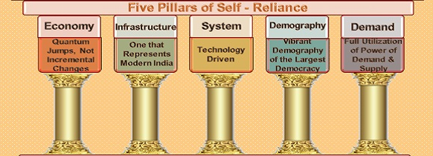

Slide 40
Economy
Quantum jumps, not incremental changes

Slide 41
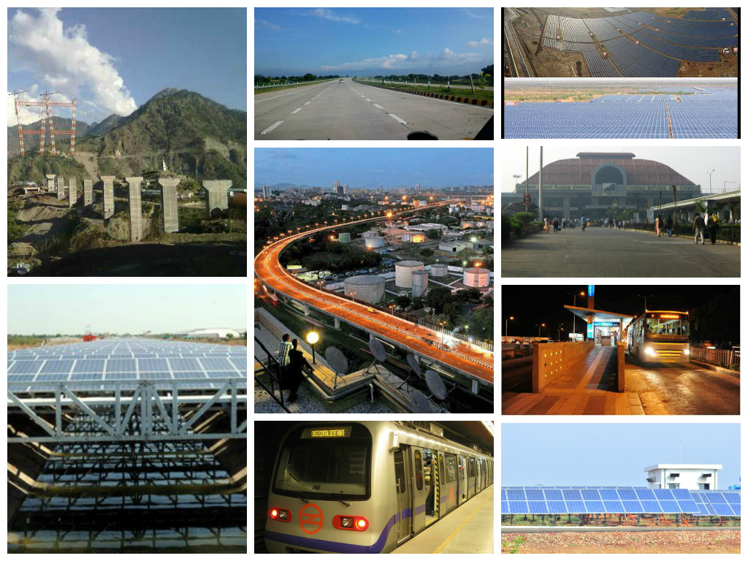
Infrastructure
Represents modern India

Slide 42
Systems
Technology-driven systems

Slide 43
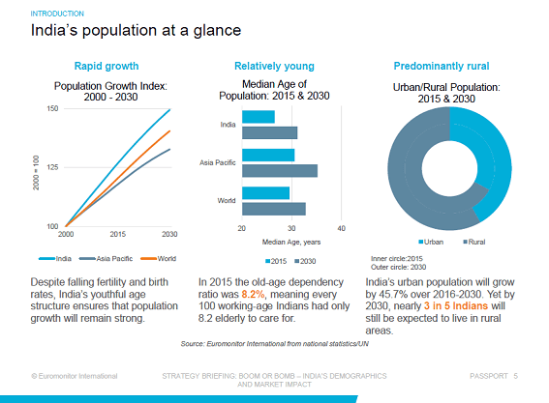
Demography
Vibrant Demography of the largest democracy

Slide 44
Demand
Full utilization of the power of demand & supply

Slide 45
Government Reforms &Enablers across Seven Sectors under atmanirbhar Bharat Abhiyaan.
Rs 40,000 crore increase in allocation for MGNREGS to provide employment boost
Health Reforms & Initiatives
Technology Driven Education with Equity post-COVID
Further enhancement of Ease of Doing Business through IBC related measures
Decriminalisation of Companies Act defaults
Ease of Doing Business for Corporates
Public Sector Enterprise Policy for a New, Self-reliant India
Increase borrowing limits of States from 3% to 5% for 2020-21 & promoting State level Reforms

Slide 46
40,000 crore increase in allocation for MGNREGS to provide employment boost
It will help generate nearly 300 crore person days in total addressing need for more work including returning migrant workers in Monsoon season as well.
Creation of larger number of durable and livelihood assets including water conservation
Assets will boost the rural economy through higher production.

Slide 47
Health Reforms & Initiatives
Public Expenditure on Health will be increased by investing in grass root health institutions and ramping up Health and Wellness Centres in rural and urban areas.
Setting up of Infectious Diseases Hospital Blocks in all districts and strengthening of lab network and surveillance by Integrated Public Health Labs in all districts & block level Labs & Public Health Unit to manage pandemics.
Further, National Institutional Platform for One health by ICMR will encourage research. And implementation of National Digital Health Blueprint under the National Digital Health Mission.

Slide 48
Technology Driven Education with Equity post-COVID
PM eVIDYA, a programme for multi-mode access to digital/online education to be launched immediately.
Manodarpan, an initiative for psycho-social support for students, teachers and families for mental health and emotional well-being to be launched immediately as well.
New National Curriculum and Pedagogical framework for school, early childhood and teachers will also be launched.
National Foundational Literacy and Numeracy Mission for ensuring that every child attains Learning levels and outcomes in grade 5 by 2025 will be launched by December 2020.

Slide 49
Further enhancement of Ease of Doing Business through IBC(Insolvency and Bankruptcy Code related measures
Minimum threshold to initiate insolvency proceedings has been raised to Rs. 1 crore (from Rs. 1 lakh, which largely insulates MSMEs).
Special insolvency resolution framework for MSMEs under Section 240A of the Code will be notified soon.
Suspension of fresh initiation of insolvency proceedings up to one year, depending upon the pandemic situation.
Empowering Central Government to exclude COVID 19 related debt from the definition of “default” under the Code for the purpose of triggering insolvency proceedings.

Slide 50
Decriminalization of Companies Act defaults
Decriminalisation of Companies Act violations involving minor technical and procedural defaults such as shortcomings in CSR reporting, inadequacies in Board report, filing defaults, delay in holding of AGM.
The Amendments will de-clog the criminal courts and NCLT.
7 compoundable offences altogether dropped and 5 to be dealt with under alternative framework.

Slide 51
Ease of Doing Business for Corporates
Direct listing of securities by Indian public companies in permissible foreign jurisdictions.
Private companies which list NCDs on stock exchanges not to be regarded as listed companies.
Including the provisions of Part IXA (Producer Companies) of Companies Act, 1956 in Companies Act, 2013.
Power to create additional/ specialized benches for NCLAT
Lower penalties for all defaults for Small Companies, One-person Companies, Producer Companies & Start Ups.

Slide 52
Public Sector Enterprise Policy for a New, Self-reliant India
List of strategic sectors requiring presence of PSEs in public interest will be notified
In strategic sectors, at least one enterprise will remain in the public sector but private sector will also be allowed
In other sectors, PSEs will be privatized (timing to be based on feasibility etc.)
To minimise wasteful administrative costs, number of enterprises in strategic sectors will ordinarily be only one to four; others will be privatised/ merged/ brought under holding companies

Slide 53
12 POTENTIAL sectors
Auto components
Textiles
Industrial machinery and furniture
Food processing
Organic farming
Iron, aluminum and copper
Agro – chemicals
Electronics
Leather and shoes
Pharmaceuticals
Mask Sanitizers
Ventilators
These have been identified to give more focus to become a global supplier.

Slide 54
Thank You

