Slide 1
Monetary policy & Fiscal policy :-
Crowding out effect
Macroeconomic policy
Fisca
Goals
Monetary policy

Slide 2
MACROECONOMIC POLICY
“
“
MONETARY POLICY
☺
Economic policy aimed at specific sectors :-
Industries
Markets
Demographics
FISCAL POLICY

Slide 3
Current Fiscal and Monetary Policy in India
What is fiscal policy?
It is government’s policy of expenditure and revenue.
What is monetary policy ?
It refers to the use of instruments under the control of Reserve Bank Of India to regulate the availability cost and use of credit.

Slide 4
FISCAL POLICY
Government
Government revenue & expenditure

Slide 5
Also known as :-
Budgetary policy
Income and expenditure policy Tax and expenditure policy

Slide 6
Tools of fiscal policy :-
FISCAL POLICY
 |  |  | Government Expenditure
 |  |  | Taxation

Slide 7
PUBLIC EXPENDITURE
Plan expenditure Non plan expenditure
Incurred by central government
On programmes and projects like
Roads, bridges , canals ,railways ,energy generation, irrigation and rural development, science and technology.
It includes both capital and revenue expenditure
Interest payments , subsidies, salaries to government employees , grants to states and union territories , pensions , defense, police, maintenance of law & order

Slide 8
Revenue of the Government
REVENUE RECEIPTS
TAX REVENUE
Direct taxes
Indirect taxes
NON TAX REVENUE
Profits from govt financial institutions
PSU
CAPITAL RECEIPTS
Payments of interests paid by state govts and local bodies on loans taken from govt.
Borrowings from various sources

Slide 9
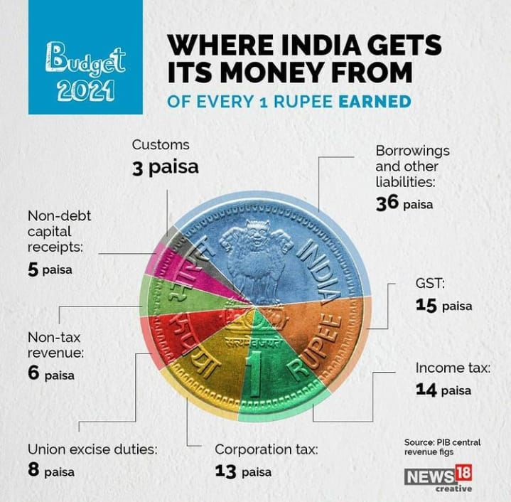
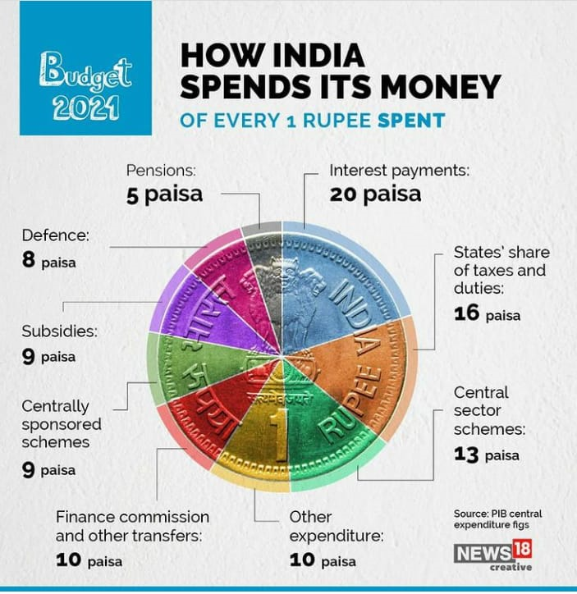

Slide 10
Non-debt creating capital receipts are those money receipts which are received by the government from the sale of old assets. These receipts are not treated as liabilities of the government. Examples of non-debt creating capital receipts are recovery of loans, proceeds from sale of public enterprises, etc.

Slide 11
Types of fiscal
policy
Expansionary fiscal policy
Fiscal consolidation
Government expenditure increases
Raising taxes or reducing government expenditure.
Taxes may remain unchanged or cut back on tax collections.
Budget deficit reduction
Stimulates output and expenditure.
Controls inflation

Slide 12
Crowding out effect :-
The crowding out effect is an economic theory arguing that rising public sector spending drives down or even eliminates private sector spending. A situation when due to expenditure fiscal policy, increases interest rates leads to a reduction in private investment spending such that it dampens the initial increases of total investment is called crowding out effect.
Expenditure
fiscal policy
Rise in
interest
Reduction private investment

Slide 13
Objectives of Fiscal policy in India
Resource mobilization and their efficient allocation.
To control inflation.
To reduce income inequalities through progressive taxation.
To facilitate balanced regional development.
Employment generation.
Capital formation and growth in National Income.
Allocation of resources to social and developmental objectives.
Reduction of balance of payments deficits

Slide 14
TOOLS OF FISCAL POLICY.
Public expenditure
Government borrowings
From RBI by selling bonds and securities to public
From international financial institutions
Income of the government (Revenue of the government)

Slide 15
Government borrowing
Borrowing from market by issuing bonds and selling it to public.
Borrowing from Reserve Bank India.
Borrowings from international finance institutions like World Bank and IMF.
Borrows by selling treasury bills through Reserve Bank of India
Raising funds from public such as national savings schemes , post office saving deposits provident fund collections etc.

Slide 16
BUDGET DEFICIT AND FISCAL DEFICIT
Budget deficit is the difference between total receipts and expenditure.
Total receipts = Revenue + Capital
Total expenditure = including borrowings and liabilities in revenue receipts
Fiscal deficit is budget deficit plus borrowings and other liabilities.
Fiscal deficit is more comprehensive measure to know the resource gap.
Fiscal deficit is estimated to be 3.2% of GDP in the budget 2017-2018.

Slide 17
Fiscal consolidation
Fiscal consolidation is reducing the fiscal deficit.
It can be done either by reducing public expenditure or by increasing public revenue.
It does not mean to increase the tax rates indiscriminately.
By increasing the tax base and controlling the parallel economy ,using progressive taxation methods public revenue can be increased .
Promote public expenditure towards investments in key sectors like infrastructure that will generate income to the government.

Slide 18
MONETARY POLICY
Central Bank\ RBI
Credit control\ Supply of money

Slide 19
Curative measures
Curative measures – Quantitative credit control measures
Monetary policy – Quantitative measures

Slide 20
Instruments of monetary policy :-
Bank Rate
Repo Rate and Reverse Repo Rate
Cash Reserve Ratio (CRR)
Open Market Operation (OMO)
Statutory Liquidity Ratio (SLR)
Marginal Standing Facility (MSF)

Slide 21
Types of monetary policy
Expansionary monetary policy
Contractionary monetary policy
Lowering interest rate
Raising interest Rate
Money supply
increases
Money supply decreases
To stimulate growth
To reduce inflation

Slide 22
Bank Rate:
Bank rate is the rate at which central bank discounts the bills of commercial banks. Undue expansion is prevented by increase in the bank rate – credit made dearer.
During depression bank rate is decreased – stimulates business activity – help recovery.
Repo Rate:
The rate at which commercial banks borrow from RBI
Boom: Repo rate is increased – borrowing becomes costlier.
Depression – Repo rate is reduced – borrowings from RBI becomes cheaper.
Reverse Repo Rate:
The rate at which RBI borrows money from banks.
Boom: Reverse repo rate is increased. Commercial banks transfer more funds to RBI, Reserves with banks reduced – loans become costlier
Depression: Reverse repo rate is decreased – funds remain with banks – credit becomes cheaper.

Slide 23
Open market operations
Open market operations - Deliberate direct sale and purchase of government securities and bills .
During depression – purchase of securities – cash reserves with commercial banks strengthens, credit expansion takes place.
During Boom – RBI sells securities – cash reserves with banks decrease – credit becomes dearer – investment options decrease.
Variable Reserve Ratio
Cash reserve ratio – Refers to that portion of total deposits which commercial bank has to keep with RBI in the form cash reserves.
Boom : CRR is increased
Depression : CRR is decreased

Slide 24
MARGINAL STANDING FACILITY
Marginal Standing Facility is a new Liquidity Adjustment Facility (LAF) window created by Reserve Bank of India in its credit policy of May 2011. MSF is the rate at which the banks are able to borrow overnight funds from RBI against the approved government securities.
Marginal standing facility (MSF), under which banks could borrow funds from RBI overnight, which is 1% above the liquidity adjustment facility-repo rate against pledging government securities. ... LAF is used to aid banks in adjusting the day to day mismatches in liquidity. LAF consists of repo and reverse repo operations.
The current Marginal Standing Facility (MSF) Rate is 4.25% As of today, i.e. on September 08, 2020, the Policy Rates which include Repo Rate stood at 4.00%, Reverse Repo Rate at 3.35%, Marginal Standing Facility (MSF) Rate at 4.25% and Bank Rate at 4.25%.
Statutory Liquidity Ratio: SLR is that portion of total deposits which the commercial bank is required to keep with itself in the form of liquid assts ie., cash, gold or government securities.
Boom : SLR is increased
Depression: SLR is decreased

Slide 25
Qualitative credit control measures
Fixation of margin requirements
Consumer credit regulation for speculation
Issue of directives ( appeals or warnings written or oral)
Rationing of credit- based on purpose wise
Moral suasion – asking for cooperation from commercial banks to monetary policy
Direct action – Charging penal rate of interest.

Slide 26
Qualitative credit control measures
Fixation of margin requirements
Consumer credit regulation for speculation
Issue of directives ( appeals or warnings written or oral)
Rationing of credit- based on purpose wise
Moral suasion – asking for cooperation from commercial banks to monetary policy
Direct action – Charging penal rate of interest.

Slide 27
Macro economic policy Goals:-
PRICE STABILITY
Price stability is achieved by avoiding or limiting fluctuations in price.
Output
It includes the total output of the economic growth and overall GDP of the economy.
Employment
This goal is commonly indicated By the employment of labor resources.
BALANCE OF PAYMENT STABILITY
The macroeconomic policy also includes the external sector. We have a balance of payment stability and exchange rate stability.
NATIONAL INCOME
The macro economy policy includes the national income of the economy. It means the aggregate income of the economy and GDP of the economy.

Slide 28
CONCLUSION
Monetary policy and fiscal policy are complementary to each other impact of any policy change will depend upon the interdependence between the fiscal and monetary policy.

